Slide 1
The Delta: Opening the Black Box
Michael Patrick George, Delta Watermaster
Presentation to California Water Association
Sacramento, May 19, 2016

Slide 2
Disclaimers
I am not speaking for the SWRCB or the DSC
I am not presenting State policy
I am expressing personal observations and opinions, except where specifically referenced to published materials

Slide 3
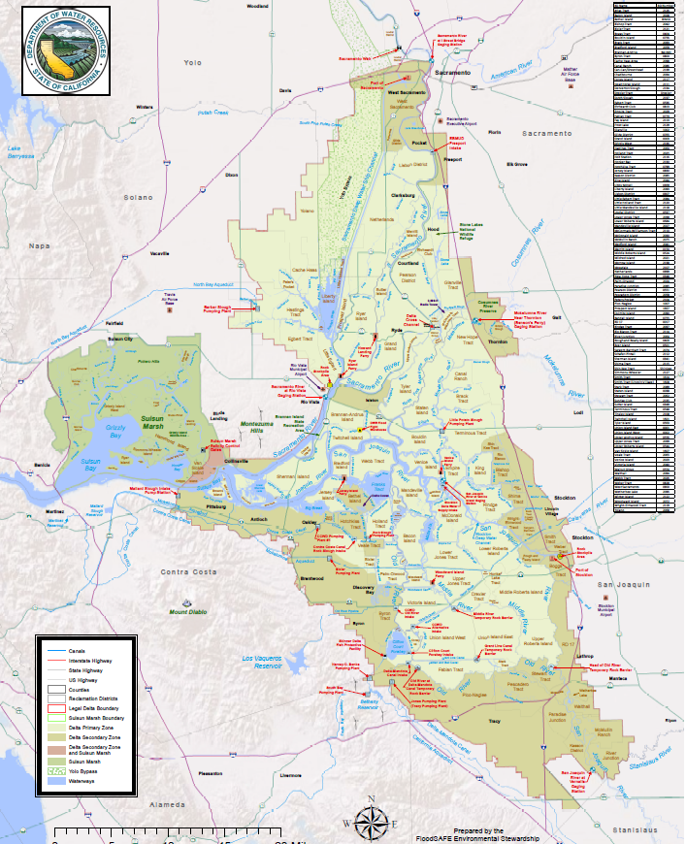
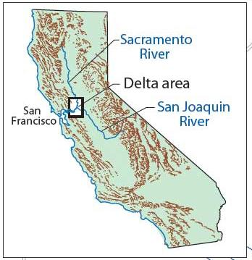

Slide 4
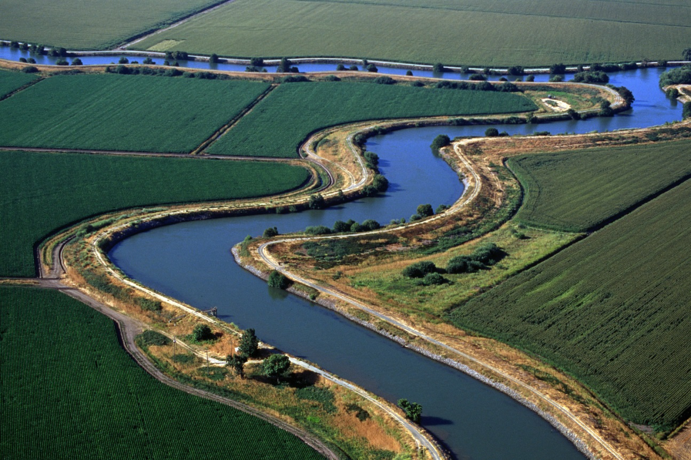
Delta Orientation
Today’s Delta has been shaped by public and private interests carrying out government policies
Transition from estuary and marsh to “reclaimed” land dedicated to agriculture
Water “development” made the Delta the “crossroads” of the State’s plumbing system

Slide 5
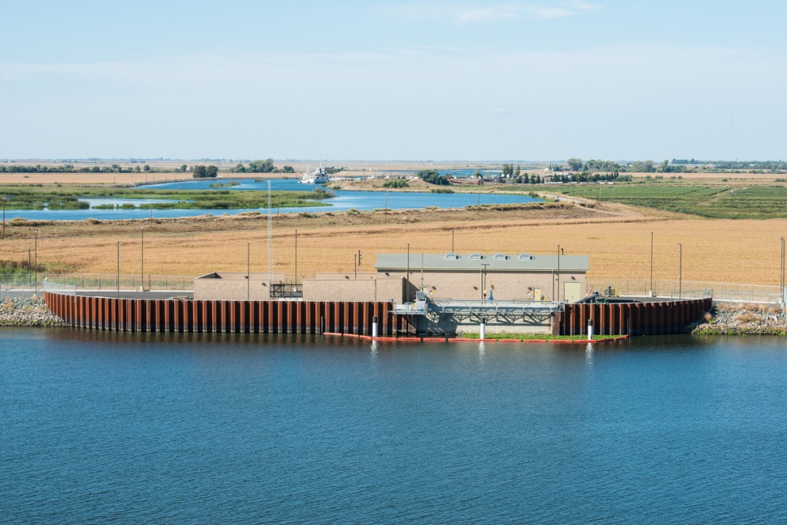
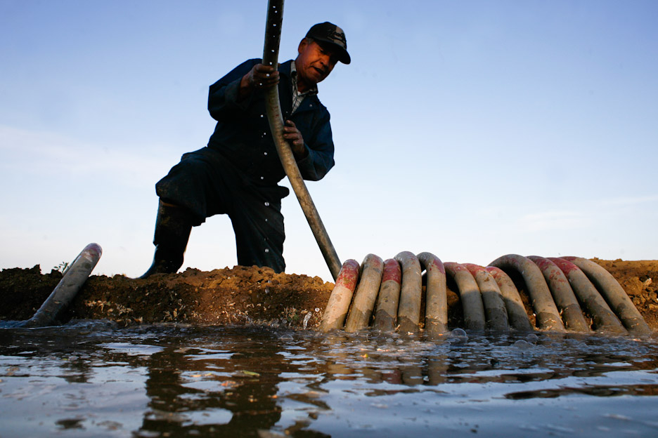
Water: “Over, Under, Around and Through” the Delta
1500 to 2,000 separate surface water diversion structures in the Delta
Pumps, siphons, weirs, gates

Slide 6
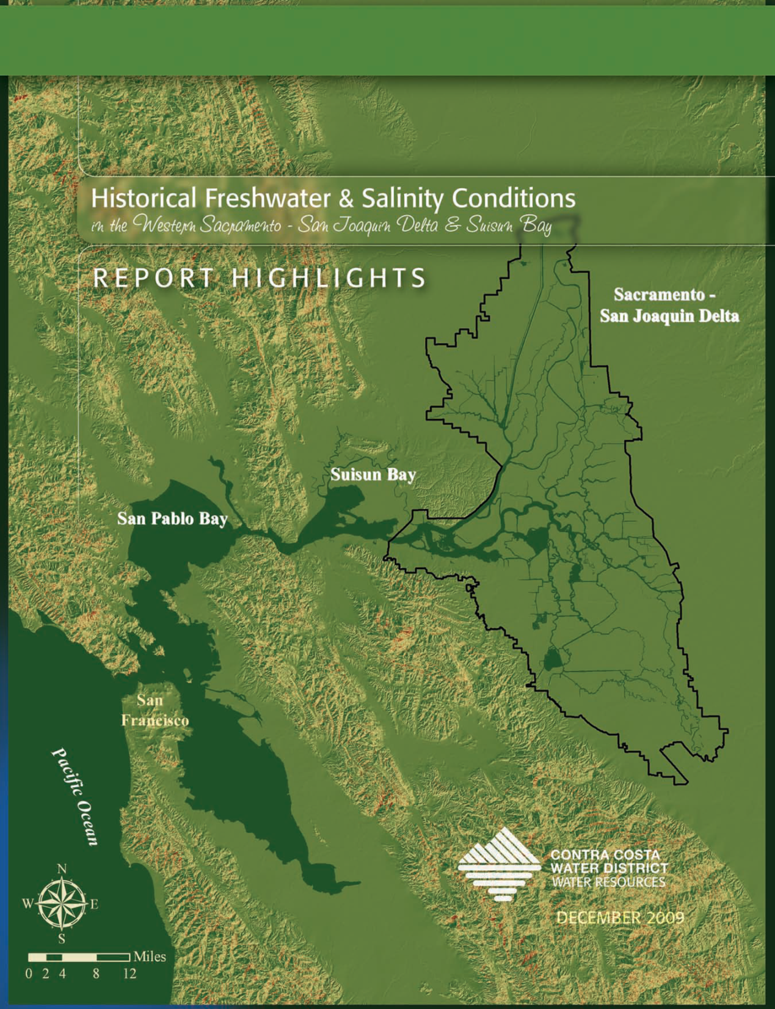
Upstream development
Irrigation from tributaries [Antioch]
Reduced flushing
Increased salt water intrusion [Contra Costa WD Study]

Slide 7
The Projects: CVP & SWP
Area of Origin protections
Project purposes
Upstream storage reservoirs
Pumping and conveyance facilities
Contractors pay for the facilities to get “available water” from junior water rights
Temporary misuse of the Delta for conveyance (1960)
Peripheral Canal: rejected by voters in 1982

Slide 8
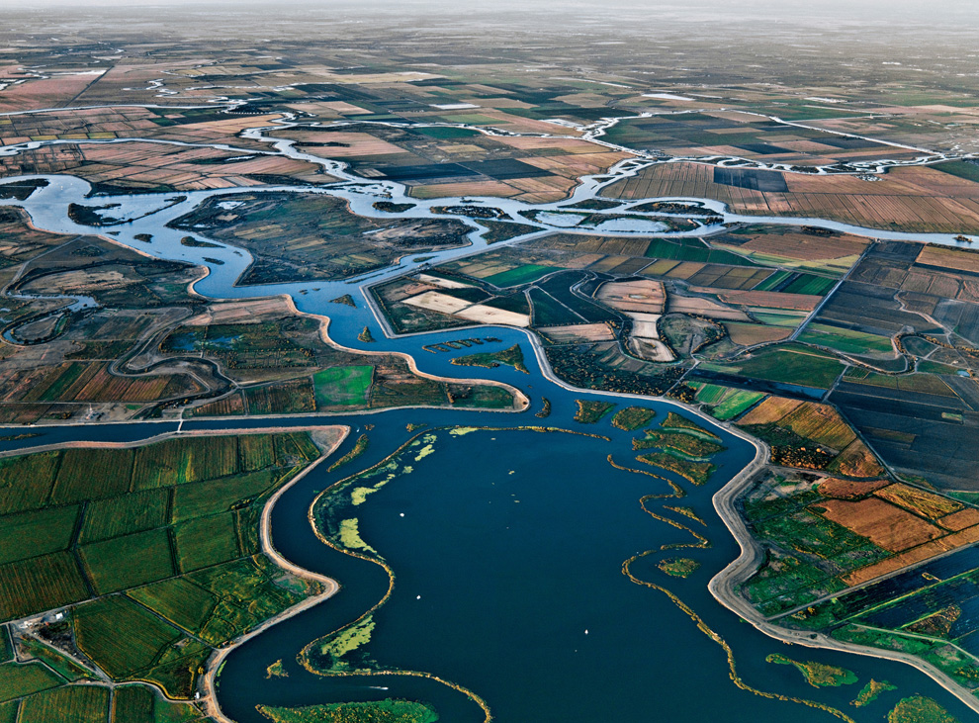
Stress on the Delta
Channelization
Dikes and subsidence
Tributary depletions
Project exports
Invasives
Pollution

Slide 9
Current Issues: Responses to Decline of the Delta
Who Cares?
Environmentalists
Bureaucrats and regulators
Farmers inside and outside of the Delta
Water users (from Redding to San Diego)
Those who like to eat, drink and breathe
The Delta drains 60% of California’s land mass

Slide 10
Unscrambling the Egg
CVPIA (1992), CalFed (1994) and the State Water Board’s Decision-1641 (2000): Imposing Conditions on Projects
Temporary but unsustainable expedient
Time, money and regulatory space to evaluate alternatives
Monitoring, litigating, and studying
Restoration versus reconciliation

Slide 11
Water Quality Control Plans: Balancing beneficial uses of water
Competing demands for limited supplies
Priorities, Riparians, Public Trust and Reasonable Use
Process, Phases and Timing
Fear and trembling among water rights claimants
The co-equal goals
“’Coequal goals’ means the two goals of providing a more reliable water supply for California and protecting, restoring, and enhancing the Delta ecosystem. The coequal goals shall be achieved in a manner that protects and enhances the unique cultural, recreational, natural resource, and agricultural values of the Delta as an evolving place.” (CA Water Code §85054)

Slide 12
Pending Regulatory Issues
Implementation of the Sustainable Groundwater Management Act
Delta Water Quality Control Plan update
Measurement of agricultural diversions
State Water Contractors’ complaint alleging unlawful diversion from the Delta
Petition for change in Projects’ water rights for WaterFix

