Slide 1
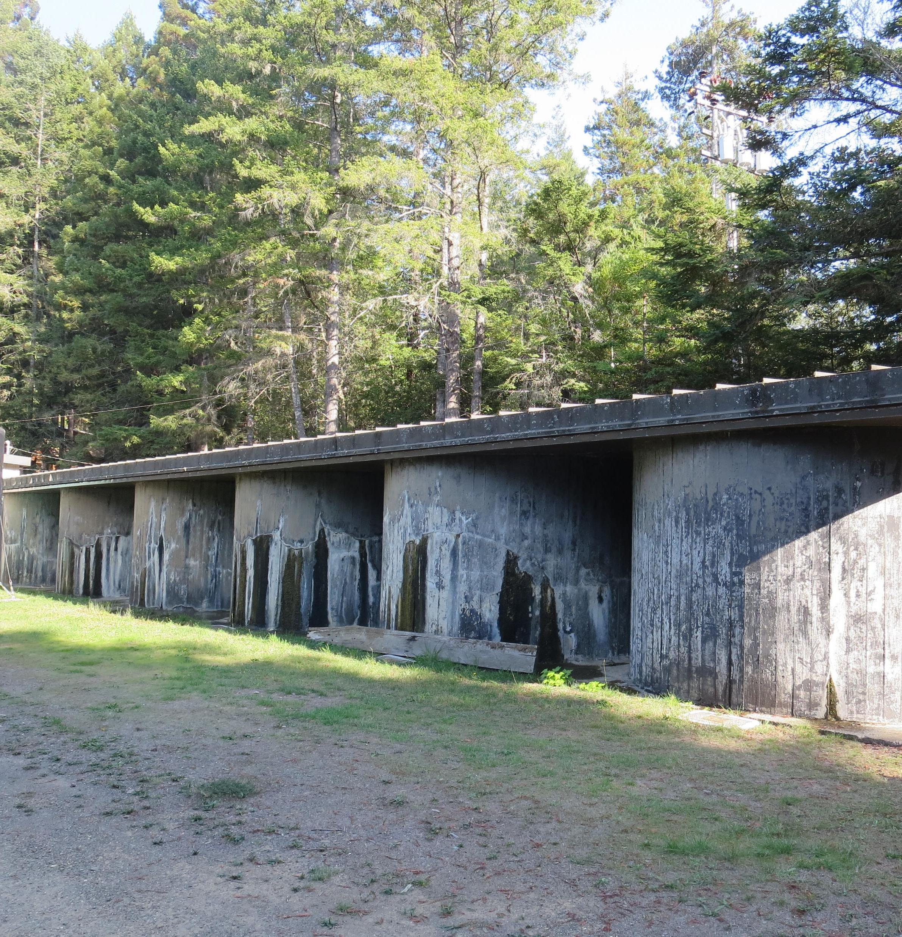
North Gualala
CA2310007
Tracer Study
November 15, 2018
Tracer Test: Slug-Dose Method
Reactor: Series of tanks connected at top and bottom
Filling Volume: 75,000 Gallons (10 x 7,500 Gal)
  Common filling header
Total Connected Volume: 149,000 Gallons
  (16 x 7,500 gal + 2 x 10,000 gal + 2 x 4,500 gal)
Baffles: None
Performed by:
Guy Schott, P.E.
CA Division of Drinking Water

Slide 2
Table of Content
Summary of Tracer Results
Reactor Design
Tracer Sample Location
Graph 1: Slug-Dose Curve
Purpose of a Tracer Test
Disinfection Exposure Time of Fluid in Vessel for Determining Ct₁₀
Ct₁₀ Value
Baffling Factor (BF)
Tracer Test Methods
Method of Analysis and Equipment

Slide 3
North Gualala Water Company
Tracer Test Results
Modified Slug-Dose Method
Test Date: 11/15/18
Baffling Factor (t₁₀/HRT): 0.11
Average Exit Flow: 112 gpm to t₁₀
Average Exit Flow Range: 53 - 292 gpm
Hydraulic Residence Time (HRT): Reactor volume/flow
HRT: 497 minutes to t₁₀
t₁₀: 55 minutes
Average Operating Volume of Tanks Filled from Top: 55,000 gallons (6.5 ft depth)
Tracer Added: Fluoride (215.6 grams, over 5 minutes)
Tracer Recovered at t₁₀: Fluoride (20.7 grams)
Tracer Recovered at 4 hours: Fluoride (134.6 grams)
Sample Frequency Outlet:
  0 – 10 min (5 min)
  10 – 70 min (3 min)
  70 – 240 min (5 min)

Slide 4
Clearwell Storage Tanks

Slide 5
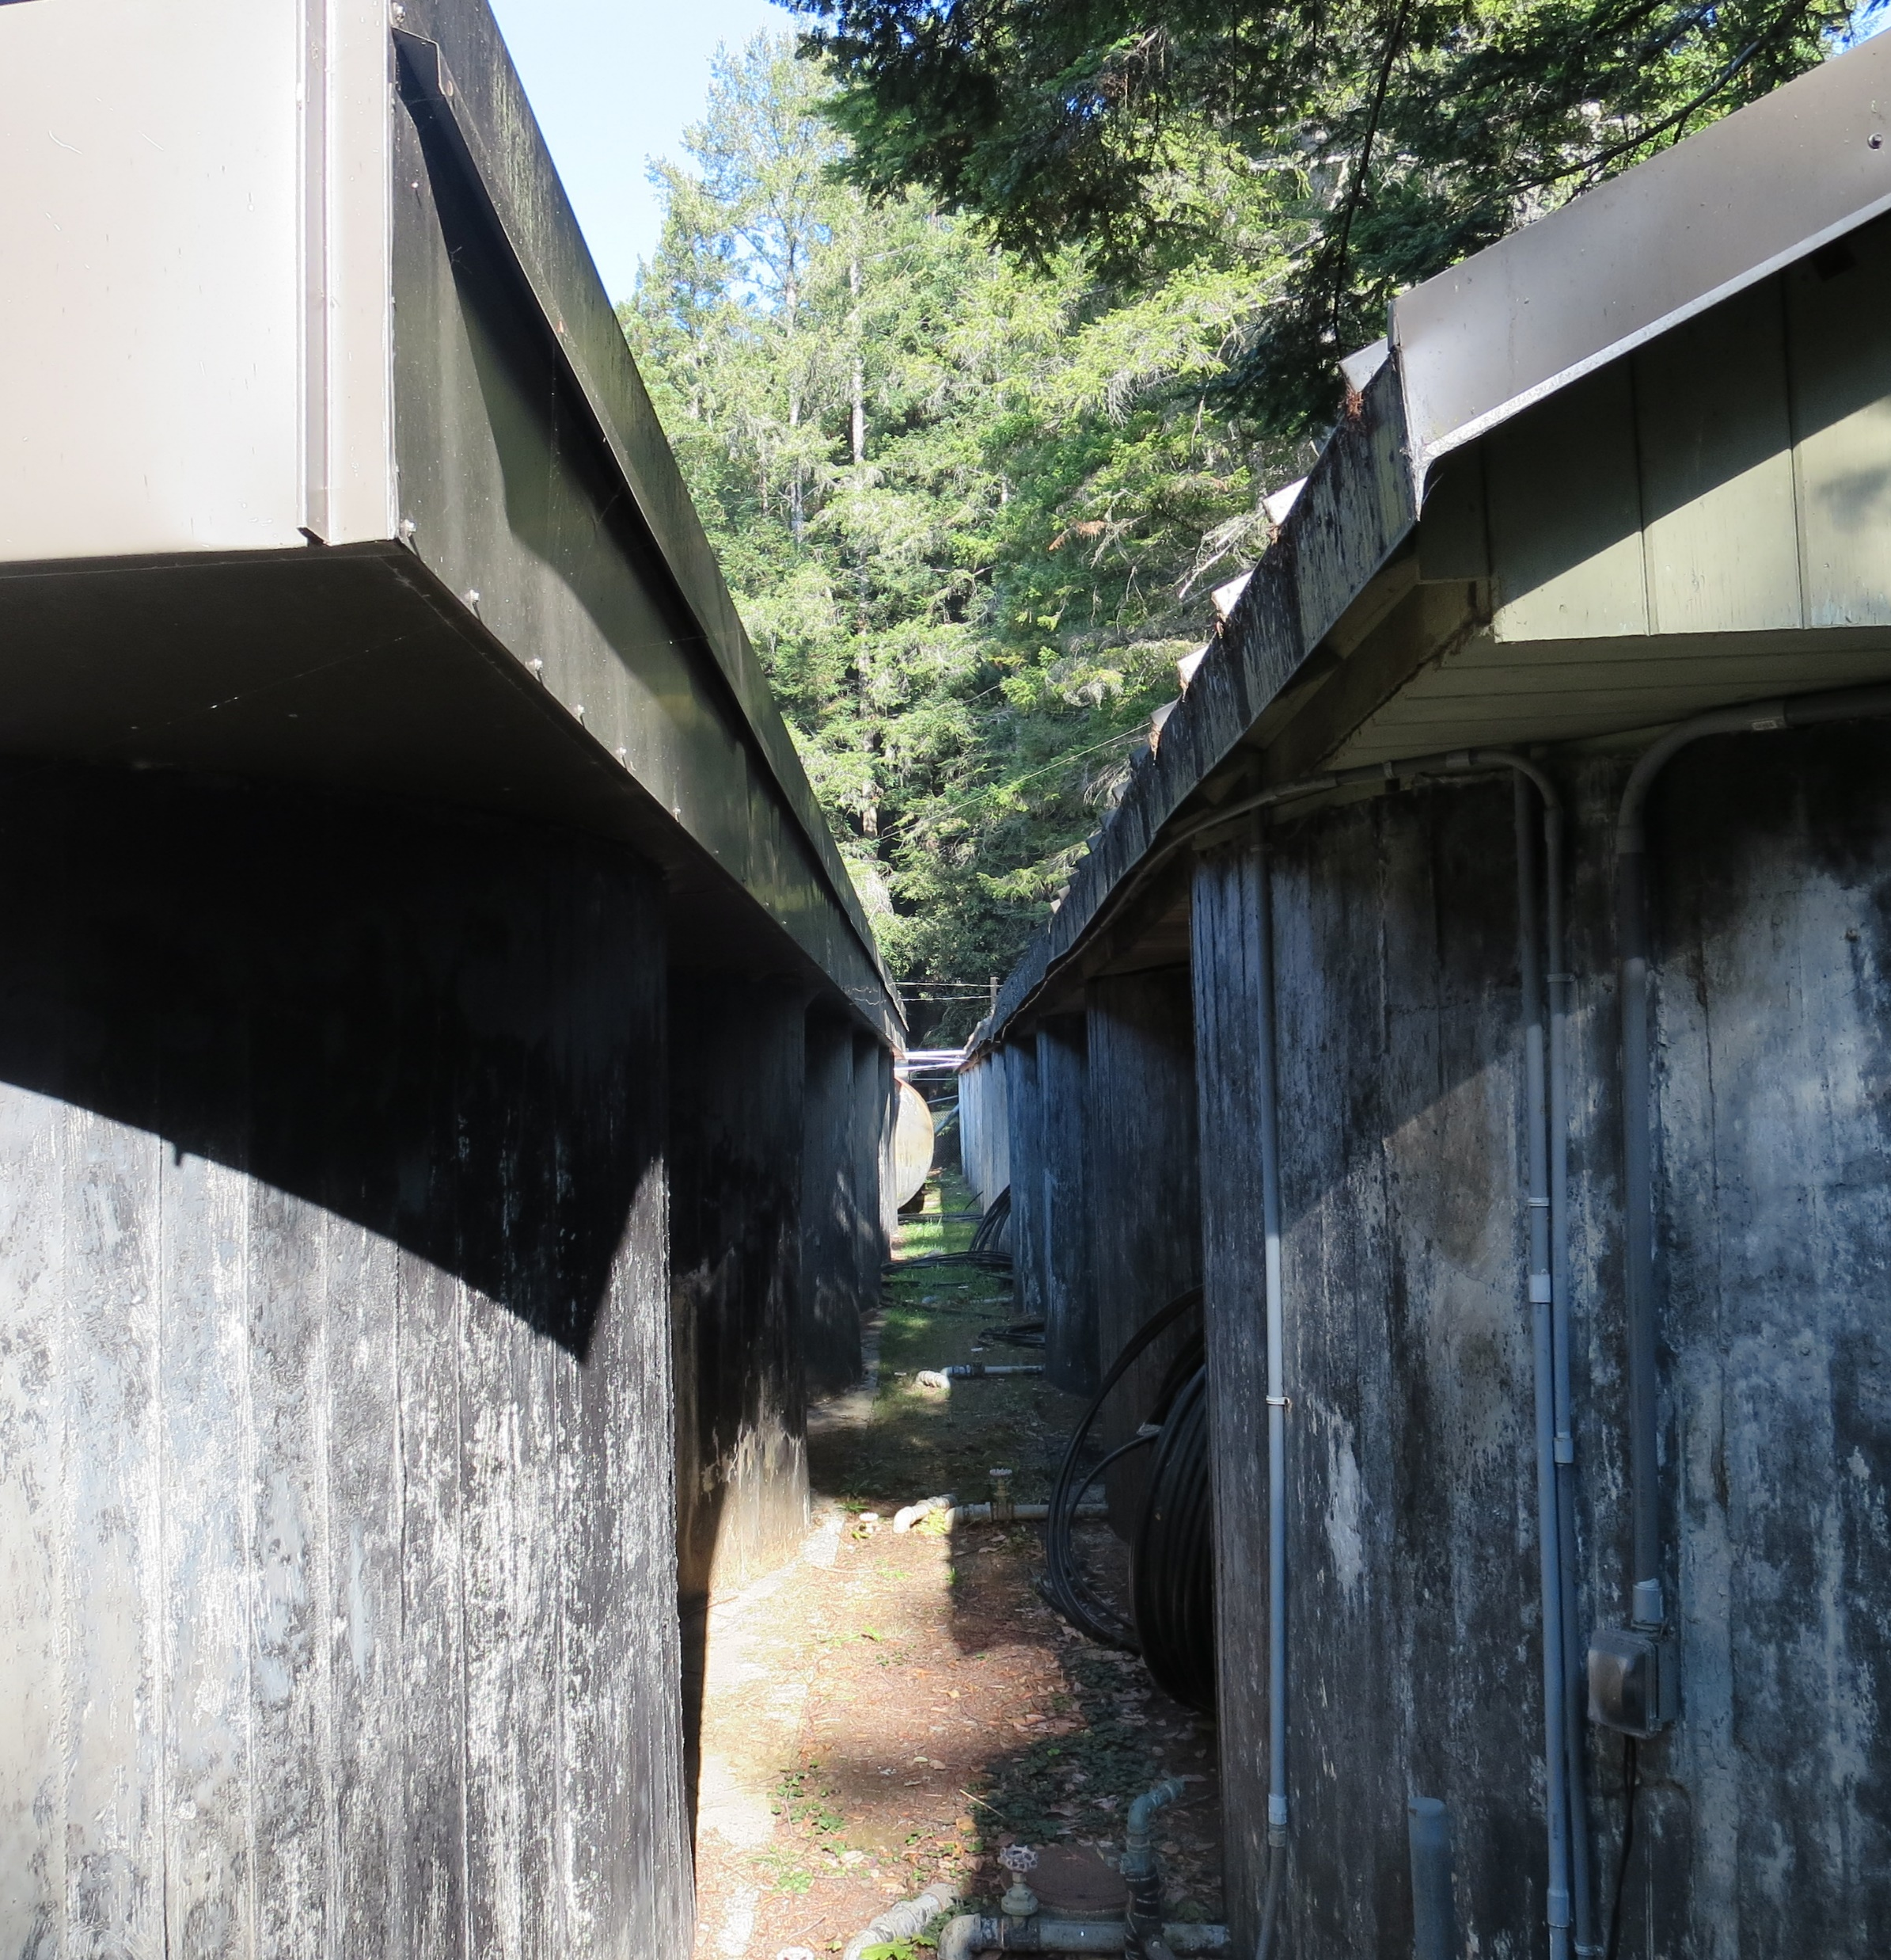
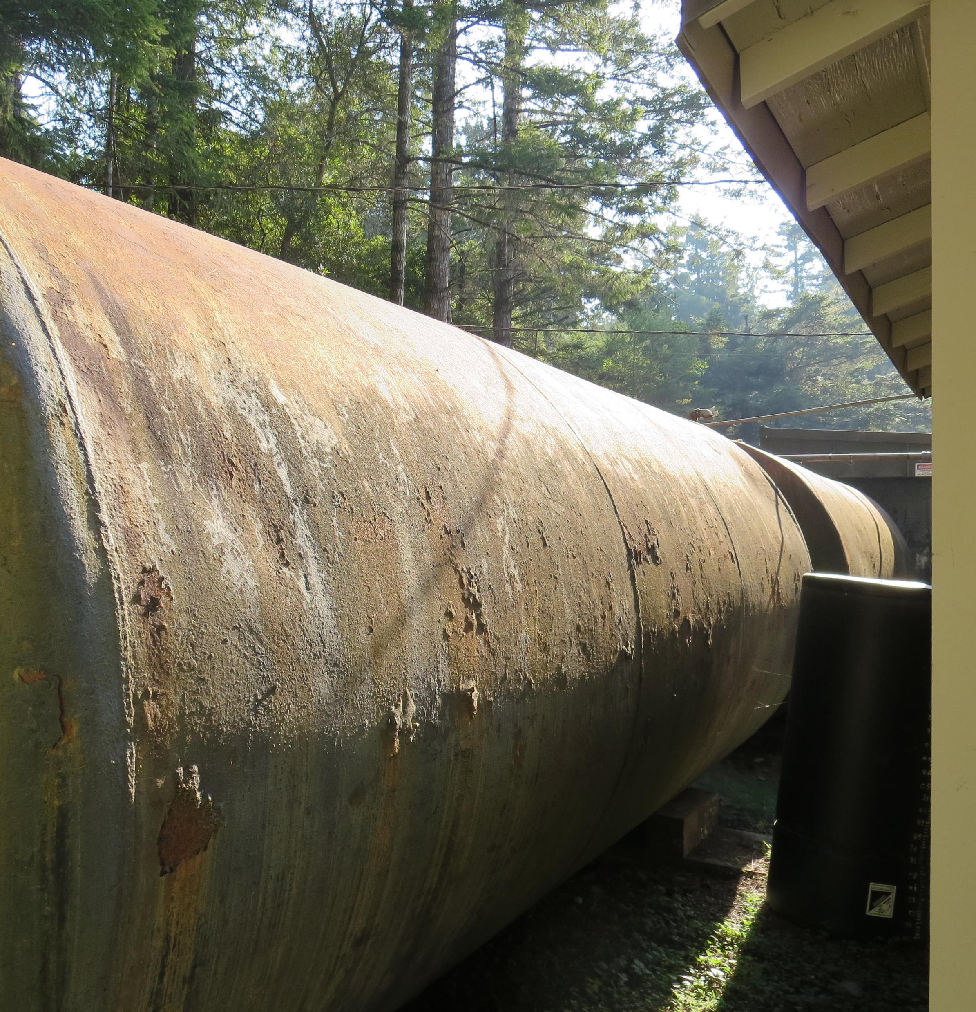
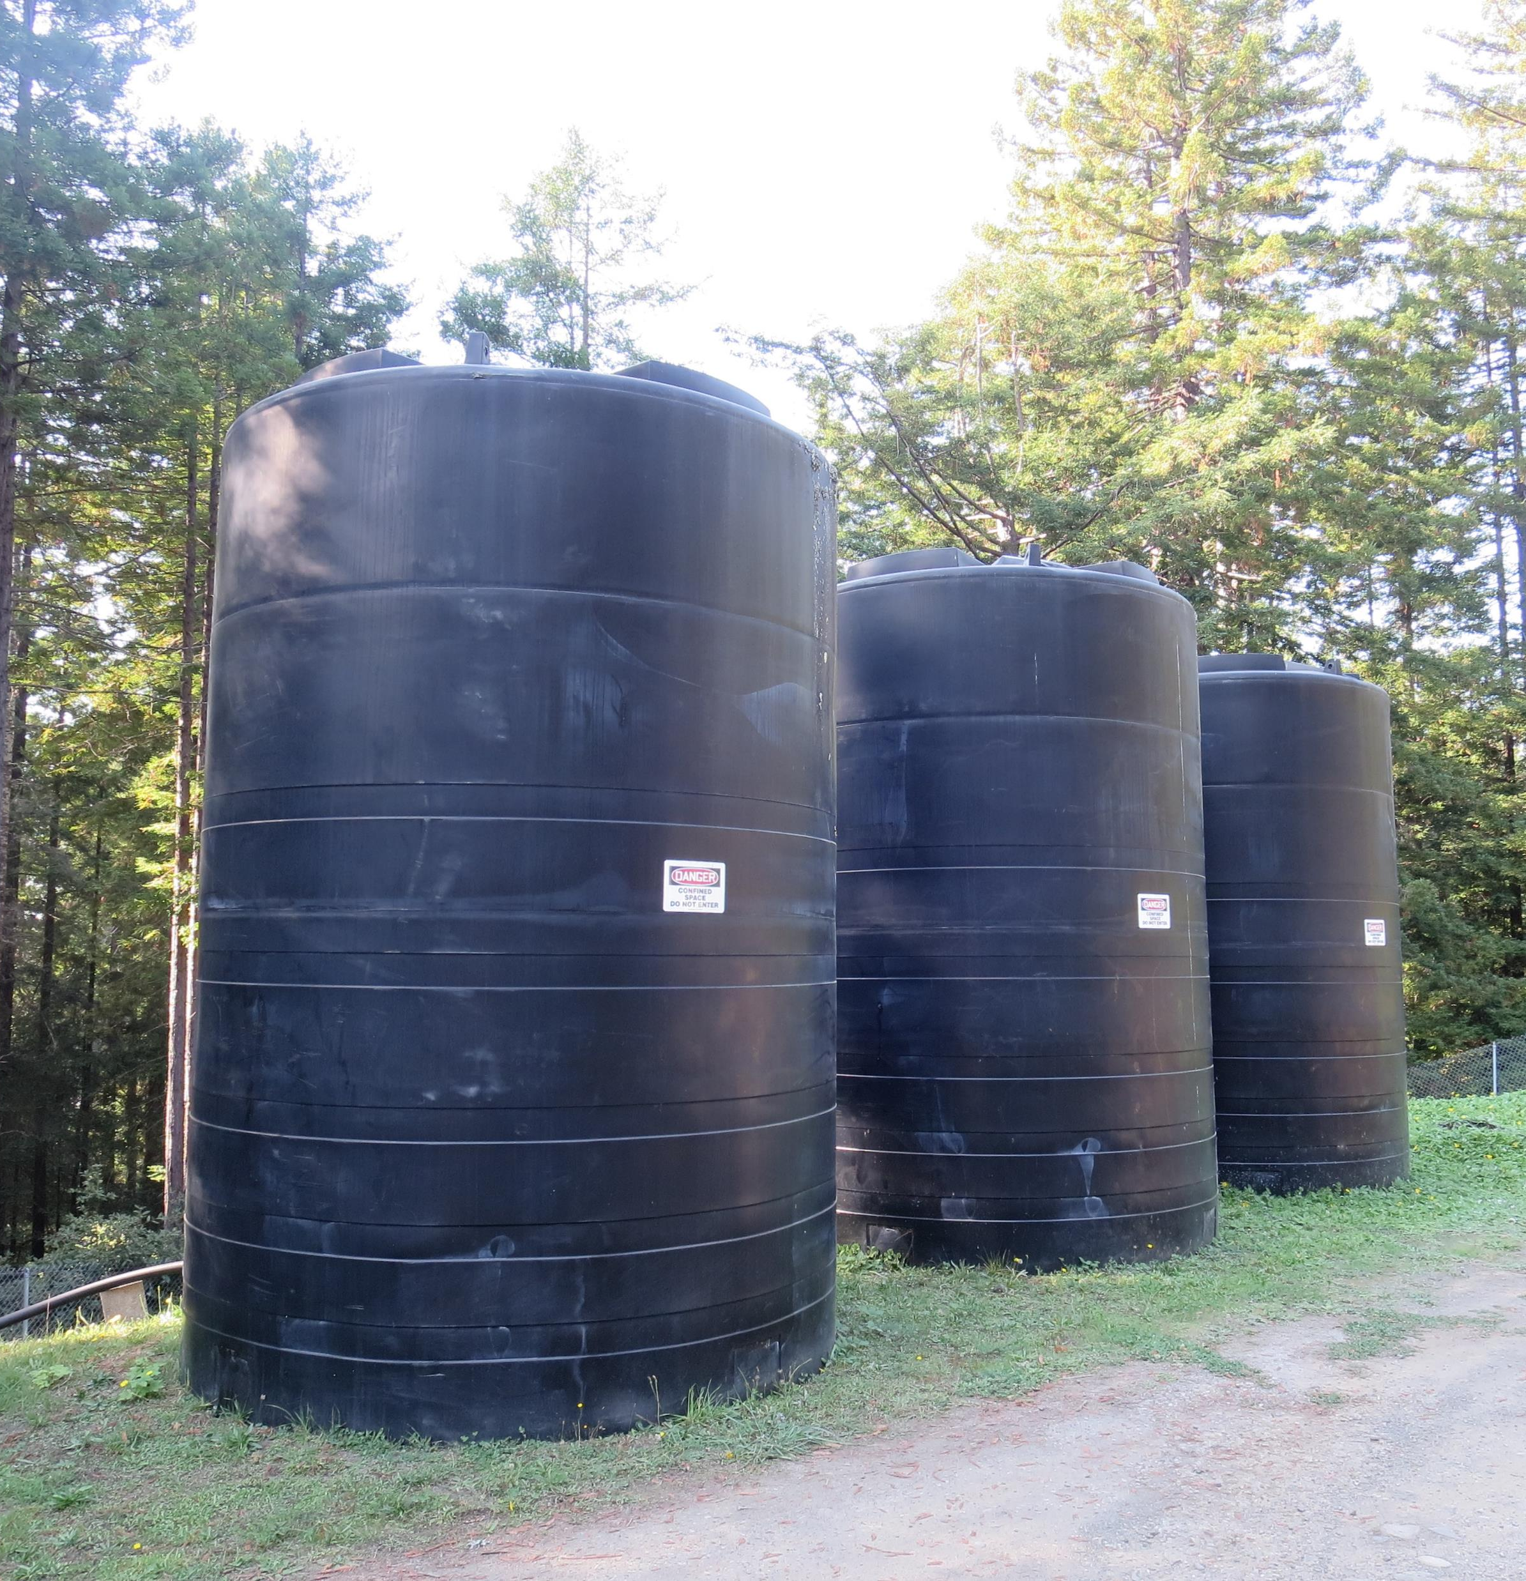
Clearwell/Storage Tanks Inner Connected

Slide 6
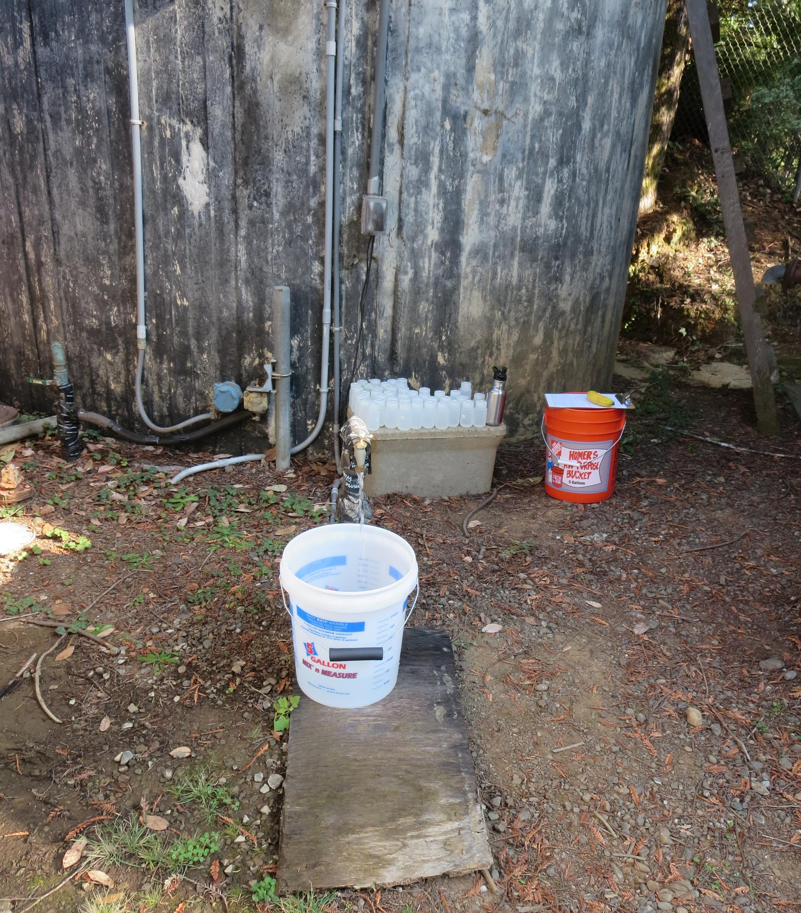
Tracer Sample Location

Slide 7
North Gualala CS – Slug-Dose Curve
t₁₀: 55 min
Baffling Factor = 0. 11
HRT: 497 min

Slide 8
North Gualala CS – Tank Exit Flow

Slide 9
Purpose a Tracer Study?
To determine the hydraulic efficiency or disinfectant exposure time of water through one or more reactors.
The addition of known quantities of a nonreactive chemical (tracer) is added in the form of a pulse (slug) or step-input.
The time of travel or disinfectant exposure time through the reactor is related to:
  Flow rate
  Reactor water volume
  Water Depth
  Reactor configuration

Slide 10
Disinfection Exposure Time of Fluid in Vessel for Determining Ct₁₀
“C” is the disinfectant residual (mg/L) at the point of inactivation compliance.
The disinfection exposure time of water used for Ct₁₀ calculation is the time (t₁₀) it takes for 10 percent of the water entering the reactor to exit the reactor.
To determine this, a marker (nonreactive tracer) is introduced into the water and is monitored leaving the reactor.
Example: 1.0 Kg of tracer is slug-dose; t₁₀ is that time when 0.1 Kg of tracer material (10%) has exit the reactor.

Slide 11
Ct₁₀ Value
- Log inactivation is based on the Delivered Dose, “Ct₁₀”
  “C” is the disinfectant residual (mg/L)
  “t₁₀” is the exposure or contact time (minutes)
  Multiply them:
C • t₁₀ = mg/L • min (delivered dose)
The calculated Ct₁₀ value is looked up in EPA Ct tables to determine the log inactivation based on specific monitoring parameters (pH, disinfectant residual and/or temperature).

Slide 12
Baffling Factor (BF)
Baffling factor or short-circuiting factor:
  Determined from tracer study or estimated
  BF = t₁₀/ HRT from tracer study
  HRT (hydraulic residence time) = reactor volume divided by reactor flow
Once the BF is determined, then it is applied to the operations of the reactor for determining the disinfectant exposure time.
Example:
  Clearwell(s) operating volume: 55,000 gallons
  Exit flow: 200 gpm
  BF: 0.11, from tracer study
  Calculated contact or disinfection exposure time:
    55,000 gal ÷ 200 gpm × 0.11 = 30 minutes = t₁₀

Slide 13
Test Methods
Slug-Dose or Pulse-Input Method
Adding the entire amount of tracer at the beginning of test. The reactor outlet tracer concentration is monitored for 3-4 HRT to determine mass recovery and the time (t₁₀) it takes for 10% of the tracer mass to exit the reactor.
Modified Slug-Dose or Pulse-Input Method
It is essentially the same as the Slug-Dose method. The different is the test is stop within 1 HRT due to the long duration to complete the test.
This test can be used if the tester is confident in the amount of tracer mass added and its analytical equipment.
This test was applied to North Gualala due to the HRT being over 8 hours. For full mass recovery, the test would have needed to go 3 x HRT (24 hours).

Slide 14
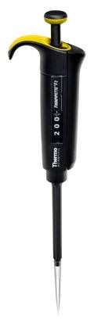
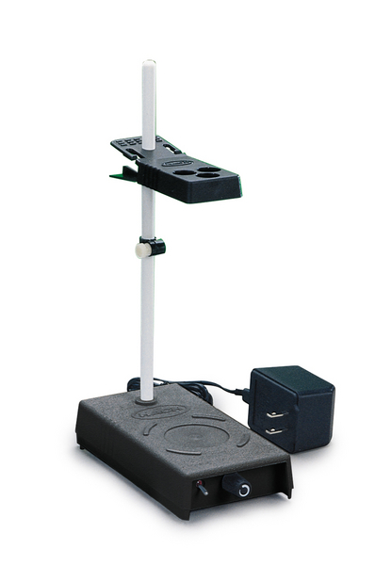
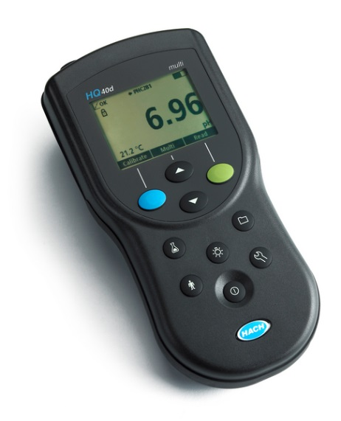
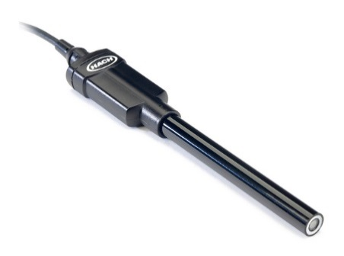
Method of Analysis and Equipment
Intellical™ ISEF121 Fluoride (F⁻) Ion Selective Electrode (ISE)
HQ40d Portable ISE Multi-Parameter Meter
Fluoride Ionic Strength Adjustor (ISA)
Fluoride Standards (0.2/2.0 & 0.5/ 5.0 mg/L)
50 mL graduated cylinder
Finnpipette F2 variable volume pipette, capacity 0.5 - 5 mL
Electrode stirrer stand
50 mL beakers
Stir Bar, Magnetic, Polygon

Slide 15

Contact
Guy Schott, P.E.
State Water Resources Control Board
Division of Drinking Water
Santa Rosa, CA
Guy.Schott@waterboards.ca.gov
707-576-2732

