Slide 1
Spray Aeration
Coalinga, CA
Harris Farms/Horse Barn
SN 100213
By
Guy Schott
April 2016

Slide 2
Flow: 181 gpm
HRT: 1,540 minutes
t₁₀/HRT: 0.08

Slide 3
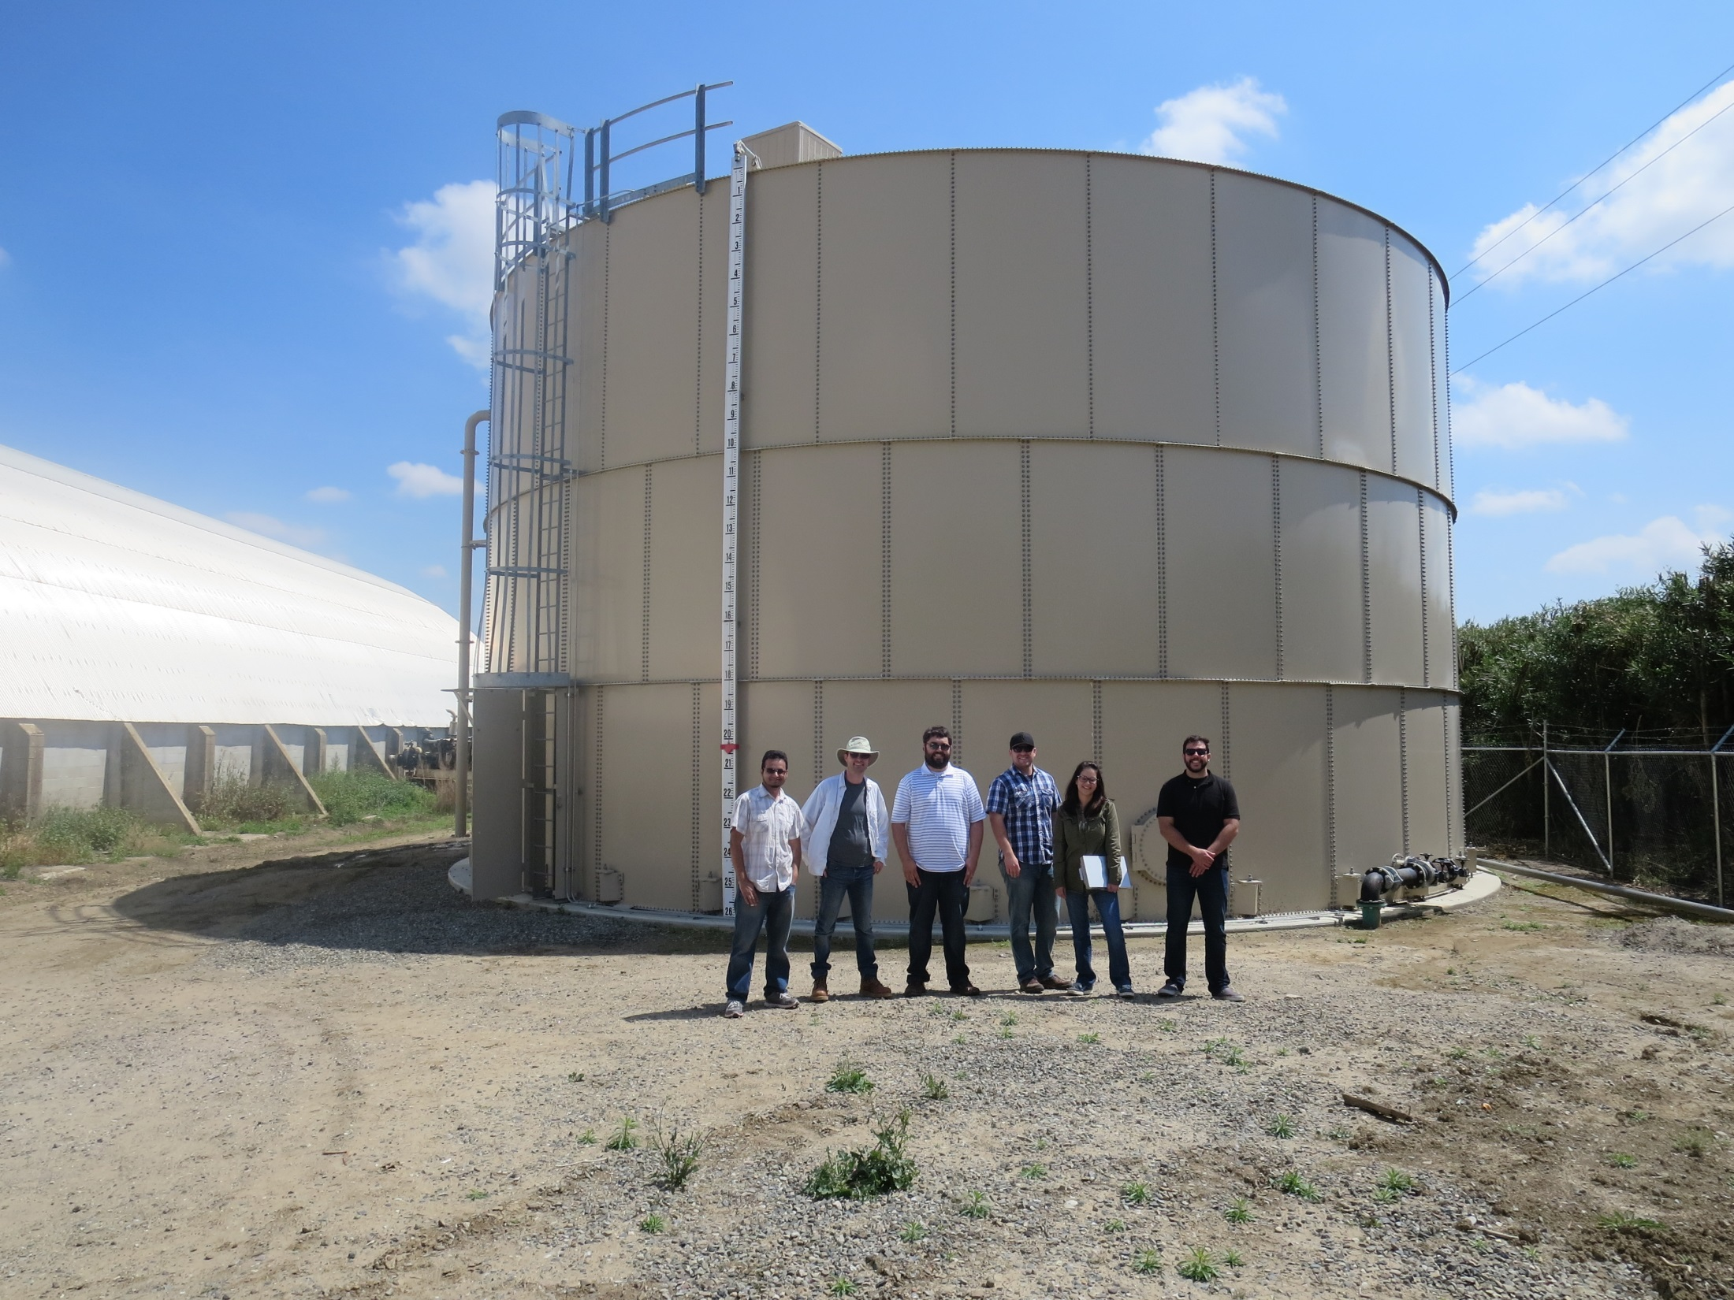

Slide 4
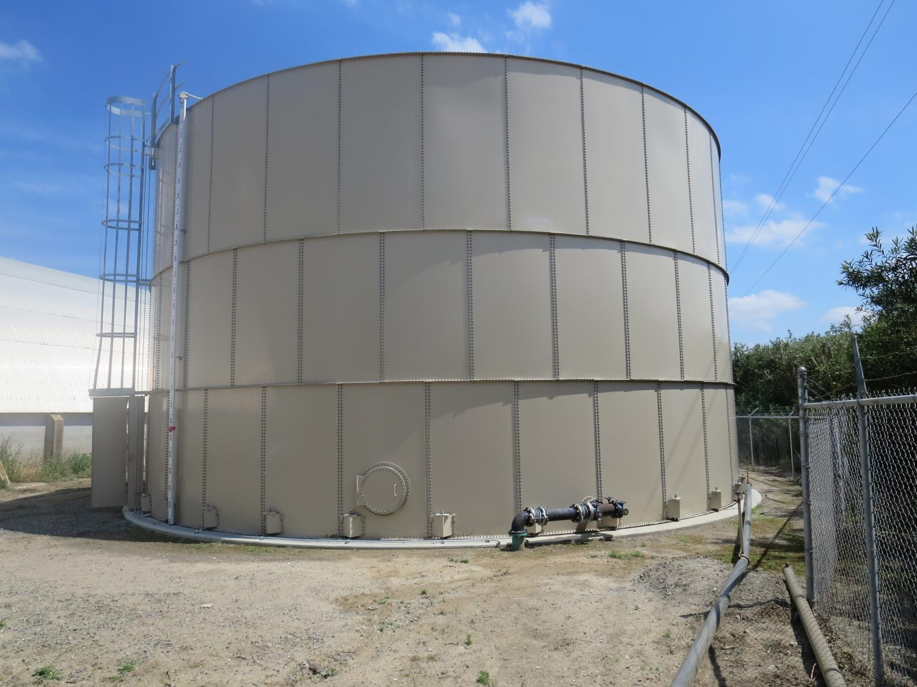
Clearwell
13,312 gal/ft
Inlet/outlet 180º
Top-to-bottom

Slide 5
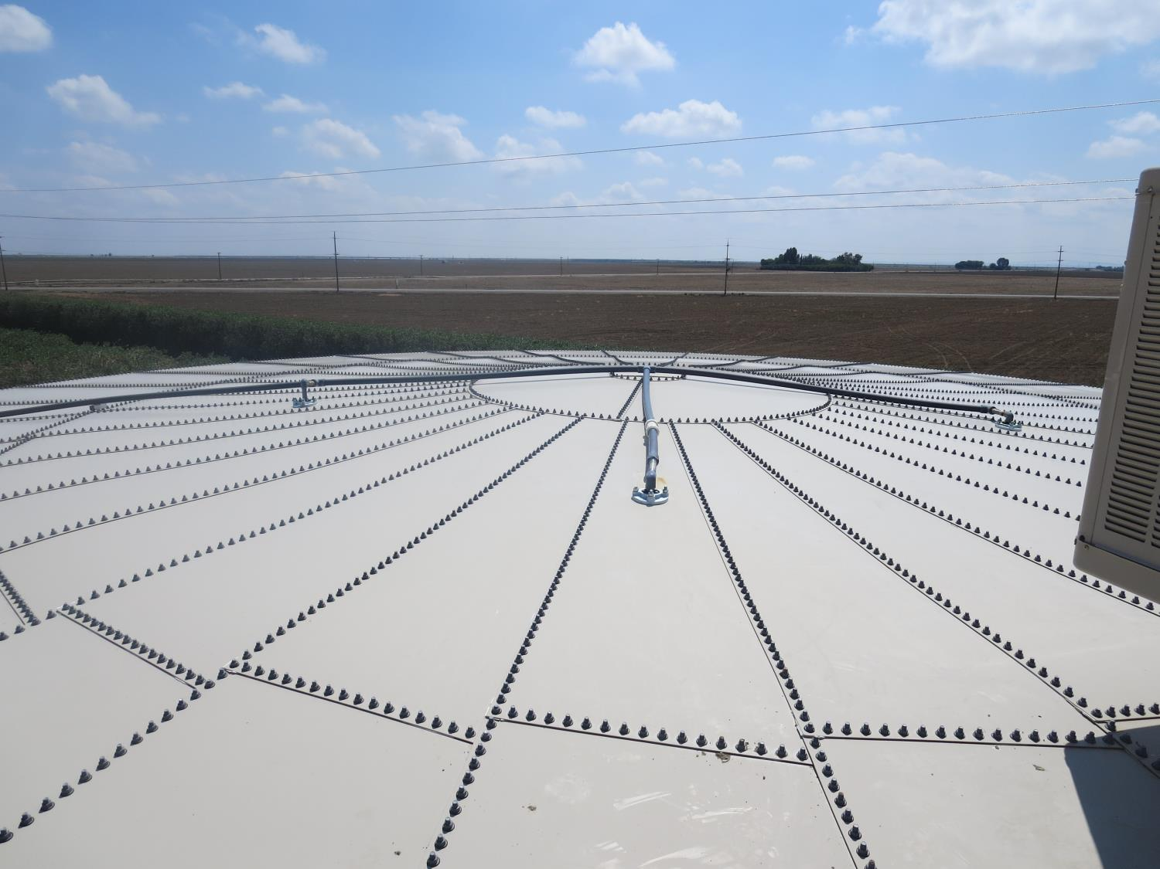
Spray Inlet Piping

Slide 6
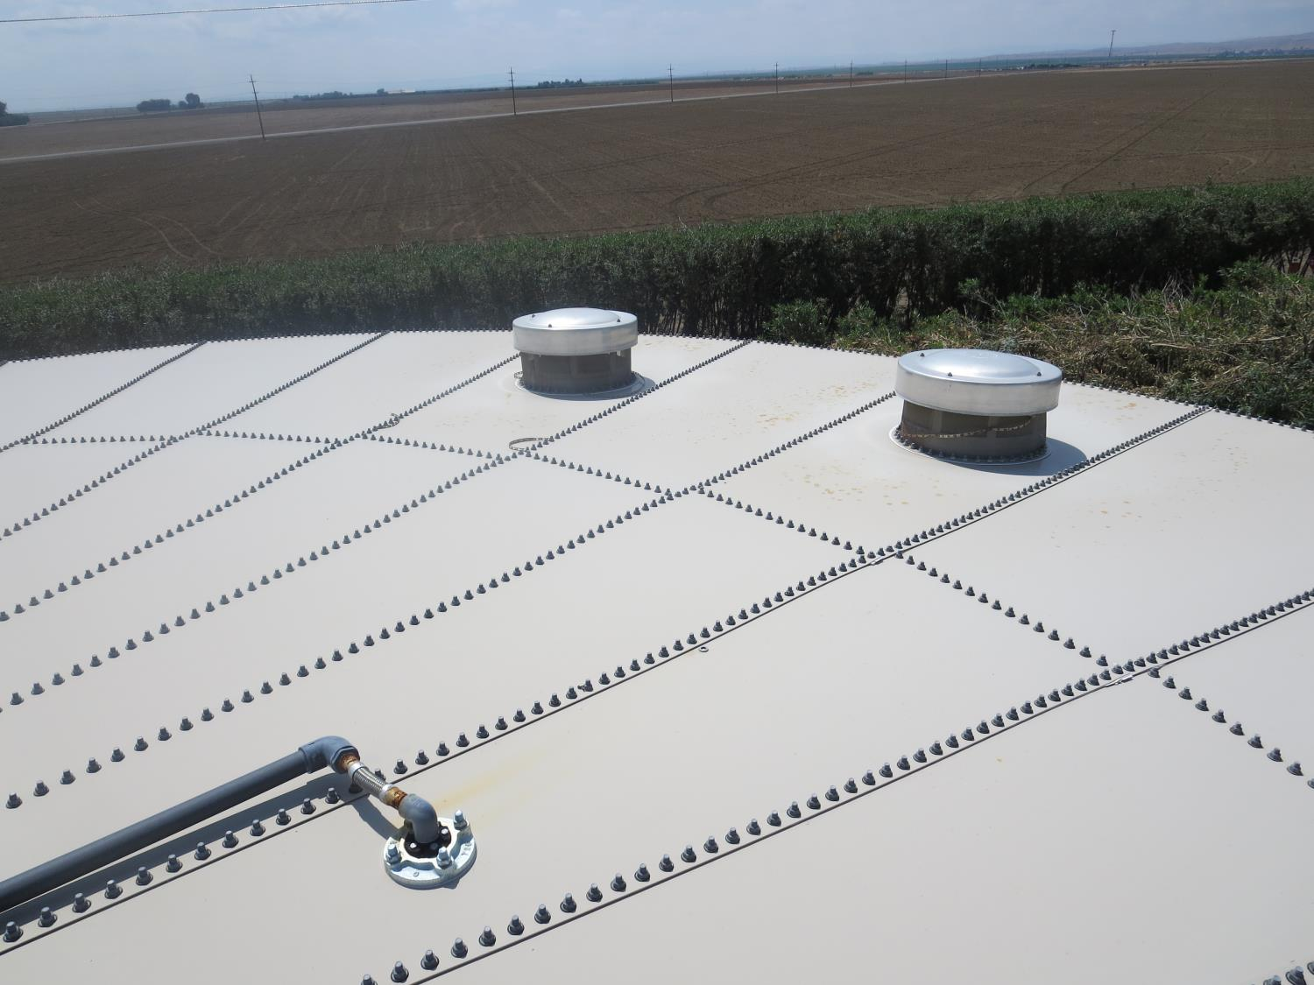

Slide 7
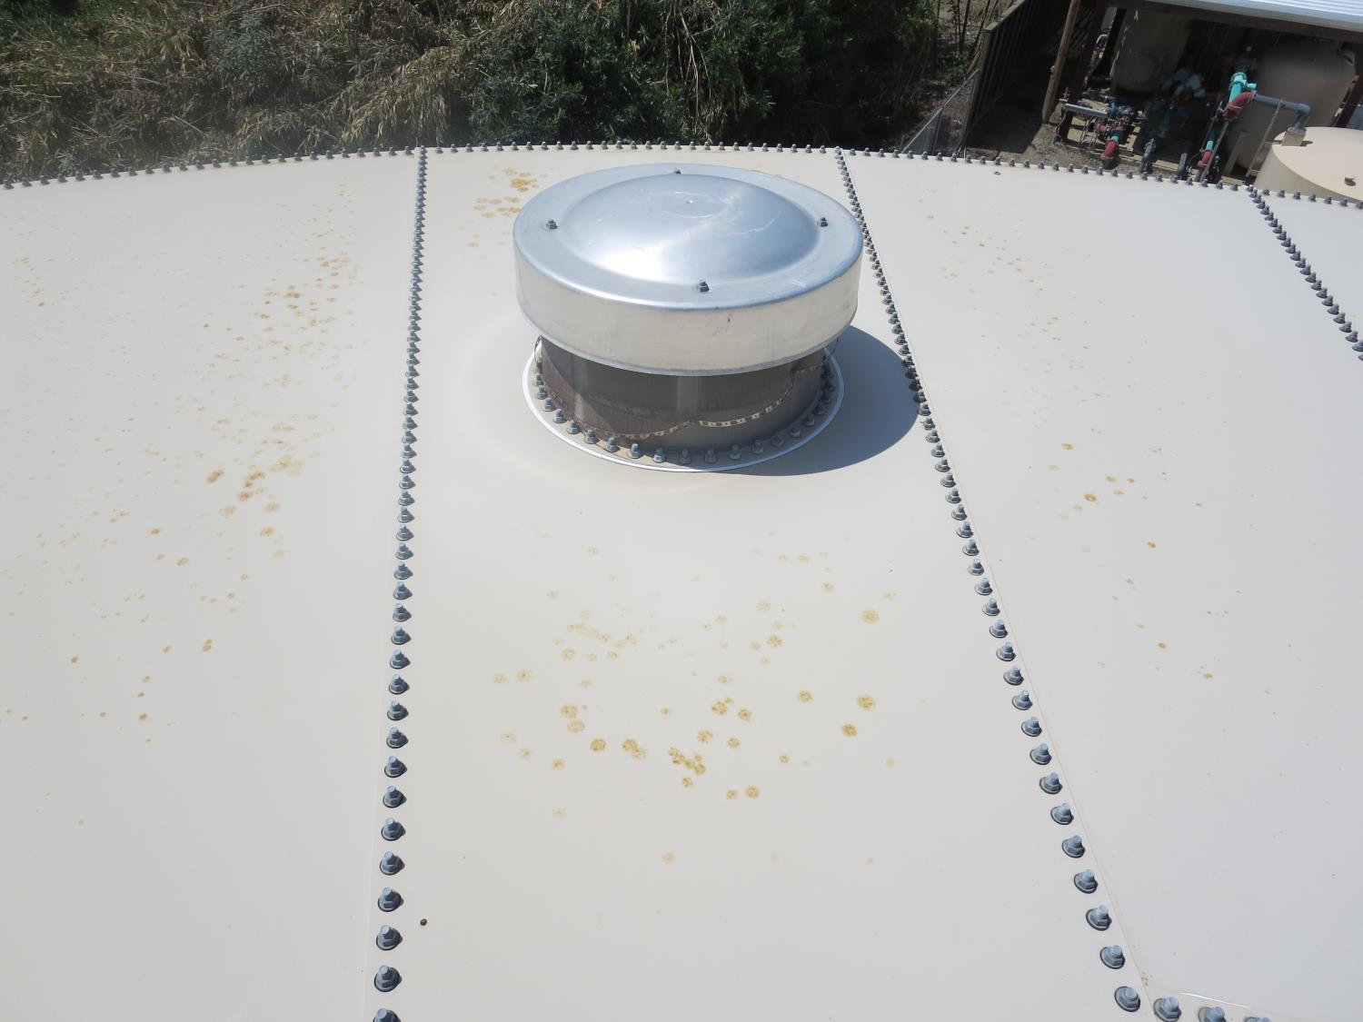

Slide 8
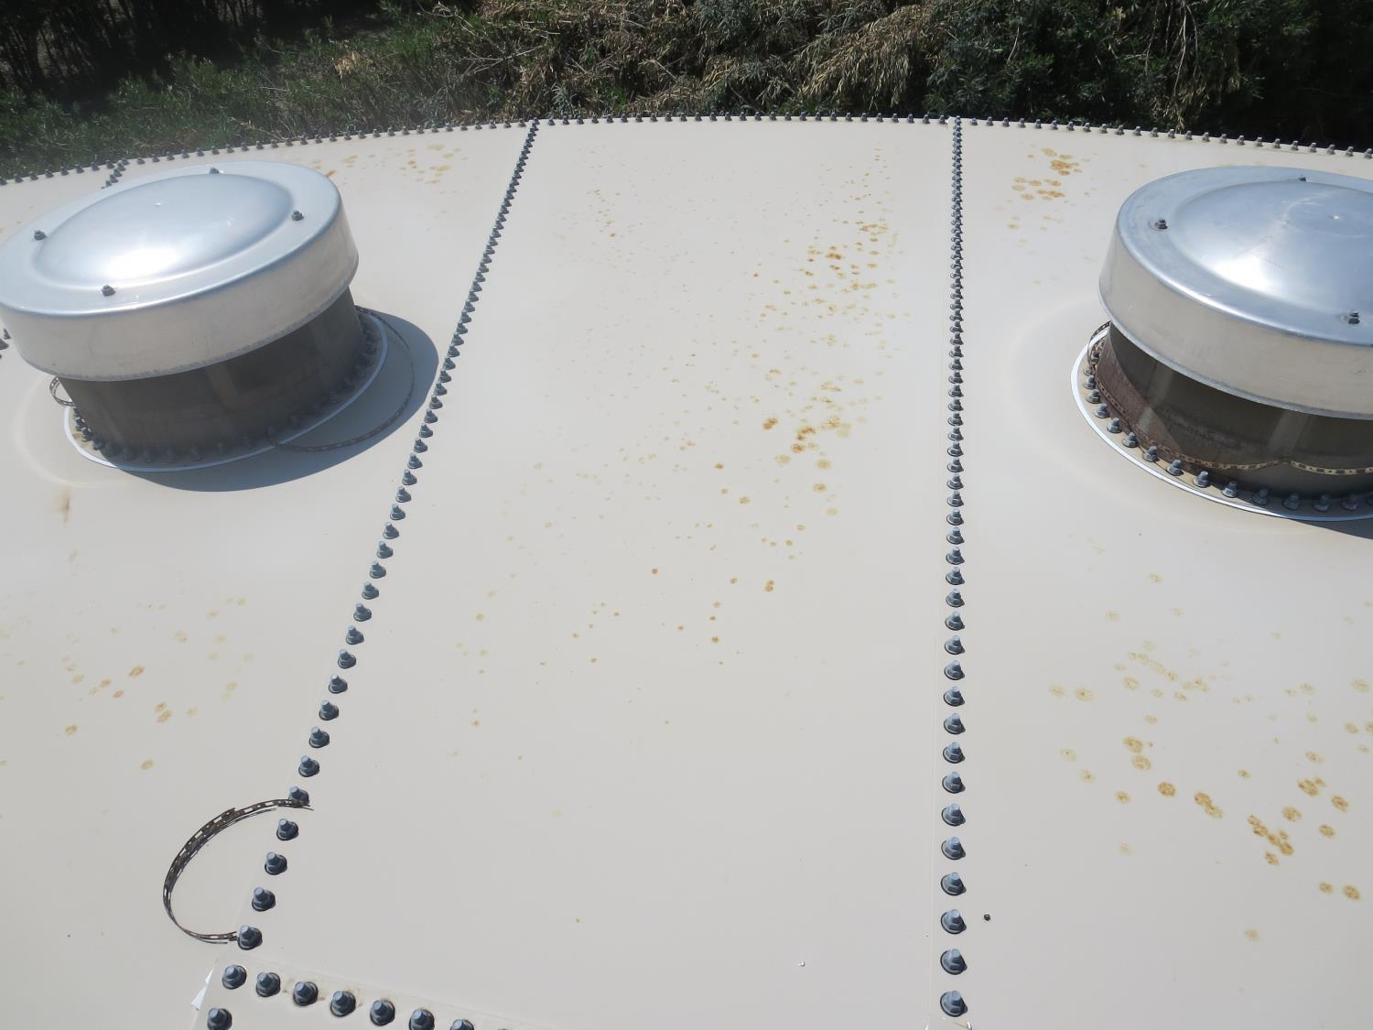

Slide 9
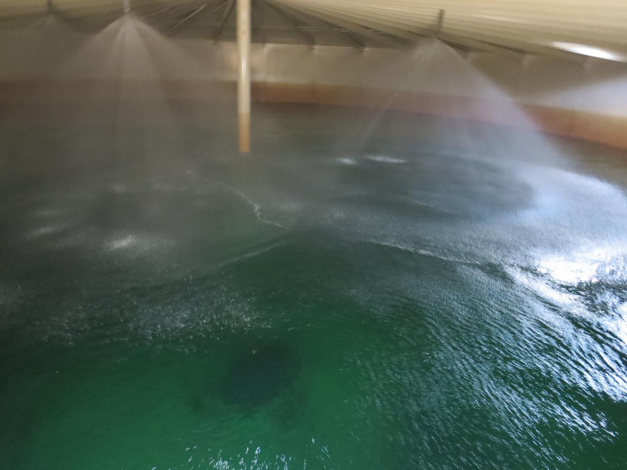

Slide 10
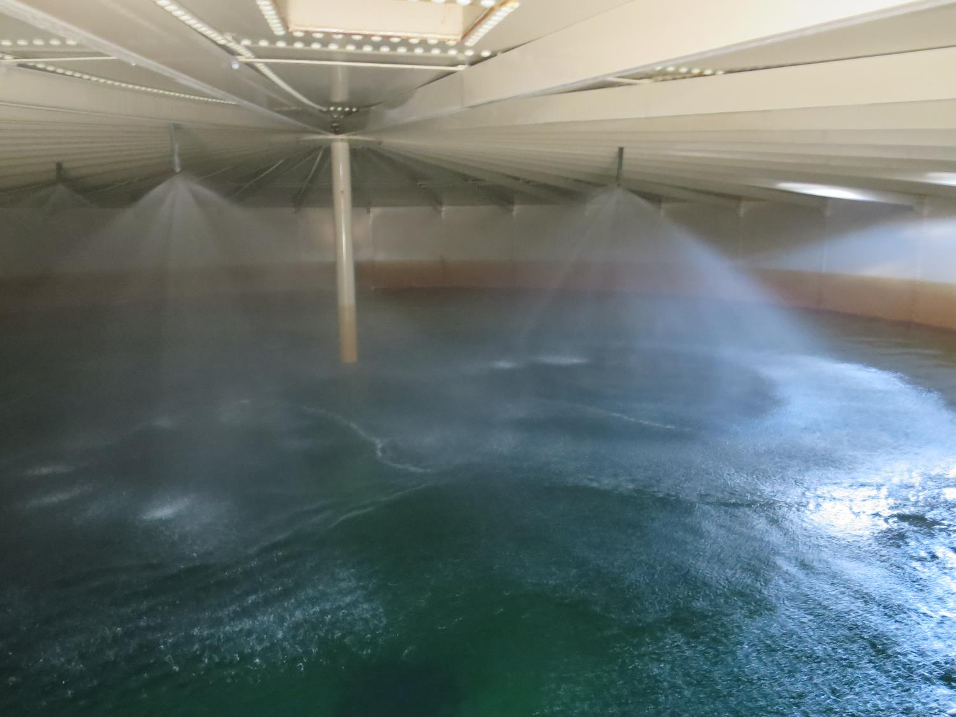

Slide 11
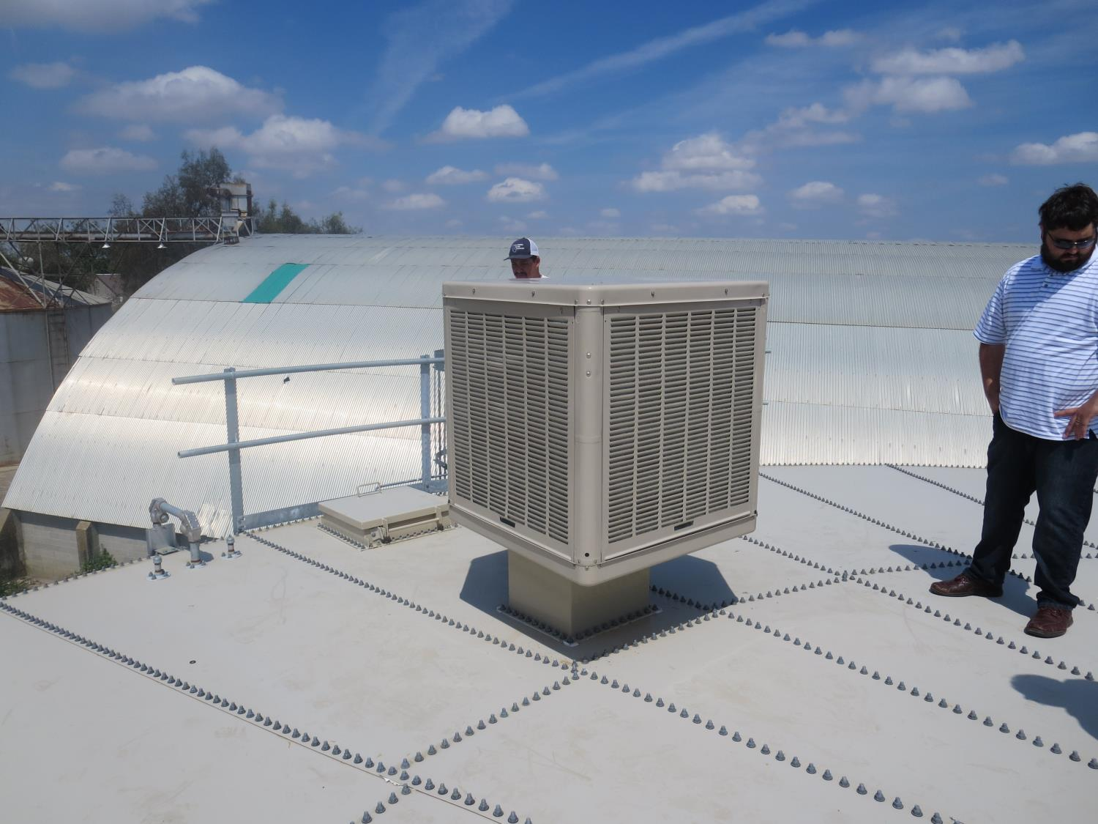
Blower

Slide 12
