Slide 1
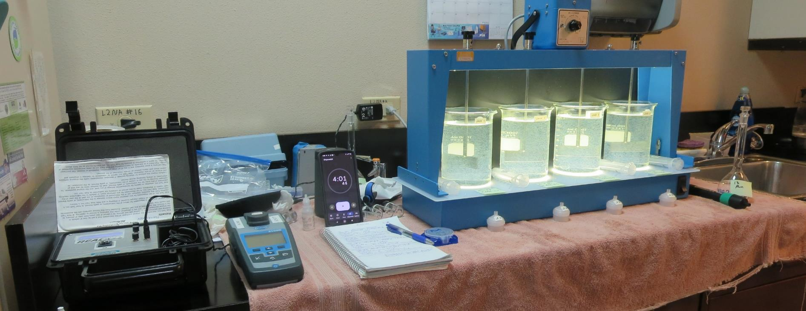
City of American Canyon CA2810005, Napa County, Jar Test
by Guy Schott, P.E. June 20, 2022

Slide 2
Source – North Bay Aqueduct

Slide 3
Conventional and Membrane Treatment Plants

Slide 4
City of American Canyon Source & Treated Water Characteristics, June 20, 2022
Source – North Bay Aqueduct
pH: 7.70 – 7.92
Alkalinity: 81 mg/L as CaCO₃
Turbidity: 9.06 NTU
UVT: 63.7%,
UVA: 0.195/cm
0.4 um Filtered
Turbidity: 0.42 NTU
UVT: 72.4%,
UVA: 0.139/cm
Plant Settled Water
1.0 NTU
Plant Filtrate Water
0.07 NTU
UVT: 92.3%,
UVA: 0.034/cm
Plant Filtrate Post Chlorine Water
0.08 NTU
UVT: 94.1%,
UVA: 0.026/cm

Slide 5
Applied Coagulants for Jar Testing (1)
7% Acid Alum
36.48% Alum
3.25% Al
6.2% Al₂O₃
7% H₂SO₄
SG = 1.30
NSF limit: 450 mg/L as Product
Chemtrade
10 mg/L as Alum = Reduction 6.99 mg/L as CaCO₃ with H₂SO₄
Nalclear 8170 Pulv
Polyacrylamide
NSF limit: 1 mg/L as Product

Slide 6
Applied Coagulants for Jar Testing (2)
Pro Pac 9800 (NTU Technologies)
50% Aluminum Chlorohydrate
50% Water
23.62% Al₂O₃
12.5% Al
83% Basicity
SG = 1.25-1.34
NSF limit: 250 mg/L as Product
10 mg/L as 9800 = Reduction 1.18 mg/L as CaCO₃
Pro Pac 9890 (NTU Technologies)
35-45% Aluminum Chlorohydrate
20% polyamine (50% water, 50% active polyamines)
35-45% Water
~18.9% Al₂O₃
~10.5% Al
83% Basicity
SG = 1.25-1.34
NSF limit: 50 mg/L as Product;
Product dose 10 mg/L = 1 mg/L polyamines active

Slide 7
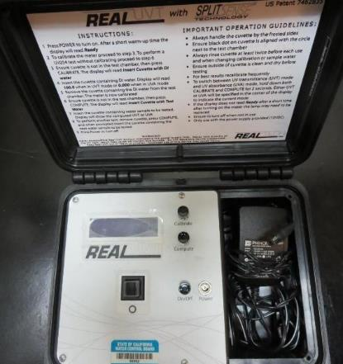
UVT/UVA, pathlength 10 mm
UV transmittance (UVT) is a measurement of the amount of ultraviolet light (254 nm) that passes through a water sample compared to the amount of light that passes through a pure water sample. The measurement is expressed as % UVT.
%UVT = 10^{(-UVA)} x 100%
UV absorbance (UVA) is calculated as a relative measure of the amount of light absorbed by a water sample compared with the amount of light absorbed by a pure water sample.
UVA = -log(%UVT/100)

Slide 8
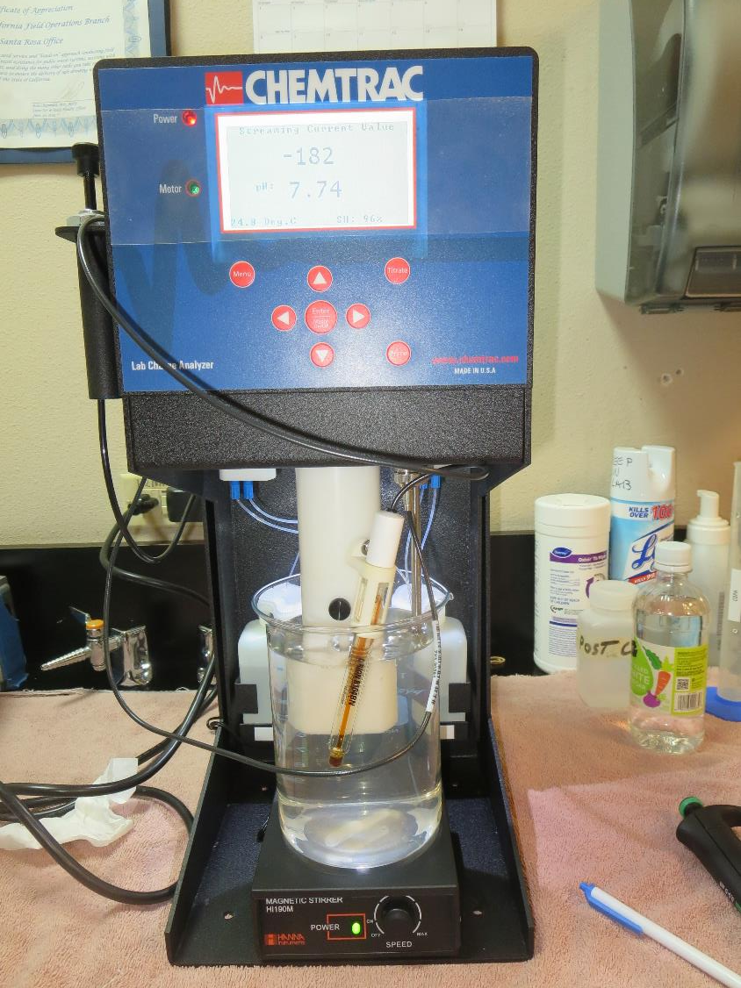
Laboratory Charge Analyzer
LCA: Used to determine coagulant demand of a source water entering the treatment plant.
Source pH: 7.74-7.90
LCA #1: 7% Acid Alum
pH adjusted to 6.6 w/acidic acid
Alum: 37 mg/L as Alum
H₂SO₄: 7.1 mg/L
LCA #2: 9800
No pH adjustment
44.0 mg/L as product

Slide 9
Coagulant Information
Unless stated otherwise, all coagulant doses are reported as Product (100% strength).
Aluminum Sulfate doses are reported as hydrated Al₂(SO₄)₃*14.3H₂0.
Preparation of coagulant stock solutions are generally 1.0 and/or 0.1 percent strength using 100 and/or 200 mL volumetric flasks.
Finnpipette F2 variable volume pipette, capacity 100-1000 micro liters is used for stock solution preparation and coagulant aid jar test dosing.
Finnpipette F2 variable volume pipette, capacity 0.5-5 mL is used for primary coagulant jar test dosing.

Slide 10
American Canyon: Source: North Bay Aqueduct Summary of Optimum Dose/Coagulants for Filtrate Jars
Jar# | Alum Al₂(SO₄)₃*14.3H₂0 mg/L | H₂SO₄ mg/L | 9800 mg/L | Alkalinity Reduction mg/L as CaCO₃ | Filtrate NTU | Filtrate %UVT | Filtrate UVA/cm | %UVA Reduction | Settle NTU 25 min
A | 0 | 0 | 75 | 8.87 | 0.04 | 92.5 | 0.033 | 76.3 | 0.57
B | 0 | 0 | 80 | 9.46 | 0.04 | 92.7 | 0.032 | 77.0 | 0.44
C | 80 | 15.4 | 0 | 55.9 | 0.04 | 92.1 | 0.035 | 74.8 | 1.10
D | 85 | 16.3 | 0 | 59.4 | 0.04 | 92.2 | 0.034 | 75.5 | 0.96

Slide 11
American Canyon; Jar Test 1 - 8 Results Flash Mix 200 RPM (20 sec); Floc Mix 30 RPM (5 min)
Jar# | Alum Al₂(SO₄)₃*14.3H₂0 mg/L | H₂SO₄ mg/L | Filtrate NTU | Filtrate %UVT | Filtrate UVA/cm | %UVA Reduction | Settle NTU 25 min
J1 | 35 | 6.7 | 0.10 | 87.9 | 0.055 | 60.4 | 3.66
J2 | 40 | 7.7 | 0.11 | 88.5 | 0.052 | 62.6 | 2.66
J3 | 45 | 8.6 | 0.18 | 89.1 | 0.049 | 64.7 | 2.46
J4 | 50 | 9.6 | 0.06 | 90.7 | 0.042 | 69.8 | 1.47
J5 | 55 | 10.6 | 0.07 | 90.8 | 0.041 | 70.5 | 1.84
J6 | 60 | 11.5 | 0.07 | 91.2 | 0.039 | 71.9 | 1.99
J7 | 65 | 12.5 | 0.05 | 91.7 | 0.037 | 73.4 | 1.79
J8 | 70 | 13.4 | 0.05 | 92.4 | 0.035 | 74.8 | 1.77

Slide 12
American Canyon; Jar Test 9 - 16 Results Flash Mix 200 RPM (20 sec); Floc Mix 30 RPM (5 min)
Jar# | Alum Al₂(SO₄)₃*14.3H₂0 mg/L | H₂SO₄ mg/L | 8170 mg/L | Filtrate NTU | Filtrate %UVT | Filtrate UVA/cm | %UVA Reduction | Settle NTU 25 min
J9 | 75 | 14.4 | 0 | 0.04 | 92.4 | 0.034 | 75.5 | 1.55
J10 | 80 | 15.4 | 0 | 0.08 | 92.7 | 0.032 | 77.0 | 1.74
J11 | 85 | 16.3 | 0 | 0.04 | 92.8 | 0.032 | 77.0 | 1.93
J12 | 90 | 17.3 | 0 | 0.04 | 92.8 | 0.032 | 77.0 | 2.12
J13 | 80 | 15.4 | 0 | 0.04 | 92.7 | 0.032 | 77.0 | 1.42
J14 | 80 | 15.4 | 0.2 | 0.04 | 92.6 | 0.033 | 76.3 | 1.64
J15 | 80 | 15.4 | 0.25 | 0.04 | 92.6 | 0.033 | 76.3 | 1.84
J16 | 80 | 15.4 | 0.3 | 0.05 | 92.5 | 0.033 | 76.3 | 1.68

Slide 13
American Canyon; Jar Test 17 - 20 Results Flash Mix 200 RPM (20 sec); Floc Mix 30 RPM (5 min)
Jar# | 9800 mg/L | 9890 mg/L | Filtrate NTU | Filtrate %UVT | Filtrate UVA/cm | %UVA Reduction | Settle NTU 25 min
J17 | 55 | 0 | 0.04 | 91.3 | 0.039 | 71.9 | 1.08
J18 | 60 | 0 | 0.04 | 91.5 | 0.038 | 72.7 | 1.32
J19 | 55 | 3 | 0.04 | 91.8 | 0.037 | 73.4 | 1.21
J20 | 60 | 3 | 0.04 | 91.9 | 0.036 | 74.1 | 1.25

Slide 14
American Canyon; Jar Test 21 - 24 Results Flash Mix 200 RPM (20 sec); Floc Mix 30 RPM (5 min)
Jar# | Alum Al₂(SO₄)₃*14.3H₂0 mg/L | H₂SO₄ mg/L | Filtrate NTU | Filtrate %UVT | Filtrate UVA/cm | %UVA Reduction | Settle NTU 25 min
J21 | 50 | 9.6 | 0.06 | 90.1 | 0.045 | 67.6 | 1.77
J22 | 60 | 11.5 | 0.05 | 90.9 | 0.041 | 70.5 | 1.66
J23 | 70 | 13.4 | 0.05 | 91.2 | 0.039 | 71.9 | 1.72
J24 | 80 | 15.4 | 0.05 | 92.3 | 0.034 | 75.5 | 1.17

Slide 15
American Canyon; Jar Test 25 - 32 Results Flash Mix 200 RPM (20 sec); Floc Mix 30 RPM (5 min)
Jar# | Alum Al₂(SO₄)₃*14.3H₂0 mg/L | H₂SO₄ mg/L | 9800 mg/L | Filtrate NTU | Filtrate %UVT | Filtrate UVA/cm | %UVA Reduction | Settle NTU 25 min
J25 | 0 | 0 | 60 | 0.05 | 91.5 | 0.038 | 72.7 | 0.41
J26 | 0 | 0 | 65 | 0.04 | 92.0 | 0.036 | 74.1 | 0.49
J27 | 0 | 0 | 70 | 0.04 | 92.3 | 0.034 | 75.5 | 0.45
J28 | 0 | 0 | 75 | 0.04 | 92.6 | 0.033 | 76.3 | 0.43
J29 | 0 | 0 | 75 | 0.04 | 92.5 | 0.033 | 76.3 | 0.57
J30 | 0 | 0 | 80 | 0.04 | 92.7 | 0.032 | 77.0 | 0.44
J31 | 80 | 15.4 | 0 | 0.04 | 92.1 | 0.035 | 74.8 | 1.10
J32 | 85 | 16.3 | 0 | 0.04 | 92.2 | 0.034 | 75.5 | 0.96

Slide 16
Jars 1-4 Test Flash Mix 20 Sec (200 RPM) Floc Mix 5 min (30 RPM) Applied Coagulant 7% Acid Alum

Slide 17
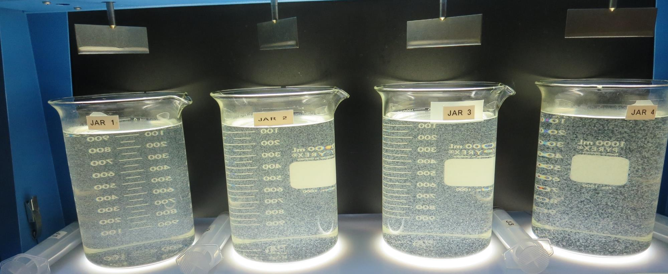
Jars 1-4: End of 5-minute flocculation (30 RPM) duration.
35 mg/L Alum
6.7 mg/L H₂SO₄
Filtrate: 0.10 NTU
UVT: 87.9%
UVA: 0.055/cm
UVA Reduction: 60.4%
Settled: 3.66 NTU
40 mg/L Alum
7.7 mg/L H₂SO₄
Filtrate: 0.11 NTU
UVT: 88.5%
UVA: 0.052/cm
UVA Reduction: 62.6%
Settled: 2.66 NTU
45 mg/L Alum
8.6 mg/L H₂SO₄
Filtrate: 0.18 NTU
UVT: 89.1%
UVA: 0.049/cm
UVA Reduction: 64.7%
Settled: 2.46 NTU
50 mg/L Alum
9.6 mg/L H₂SO₄
Filtrate: 0.06 NTU
UVT: 90.7%
UVA: 0.049/cm
UVA Reduction: 69.8%
Settled: 1.47NTU

Slide 18
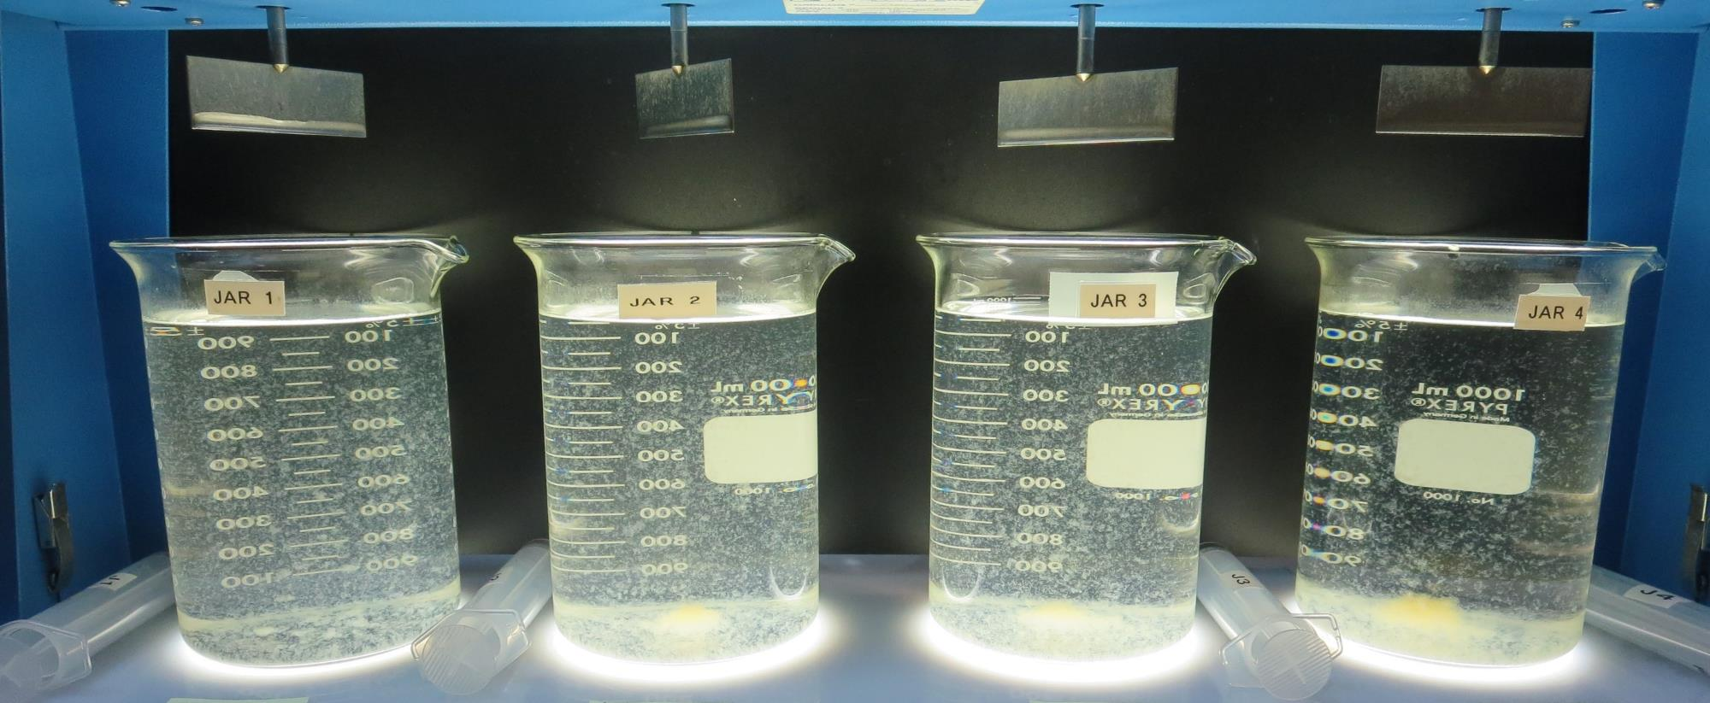
Jars 1-4: After 5 min of settling, 25 mL is syringed for filterability and %UVT/UVA.

Slide 19
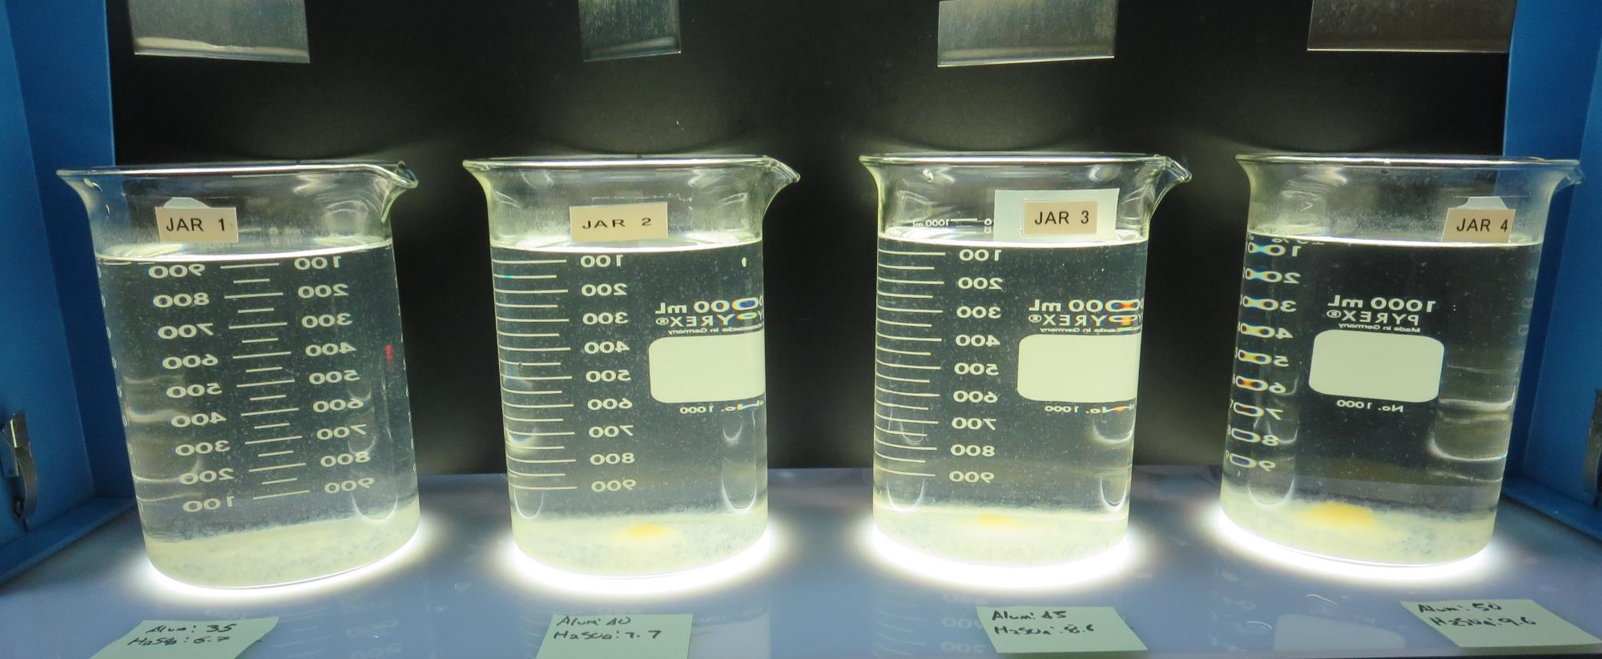
Jars 1-4: After 25-minutes of settling, settled water turbidity is taken.
35 mg/L Alum
6.7 mg/L H₂SO₄
Filtrate: 0.10 NTU
UVT: 87.9%
UVA: 0.055/cm
UVA Reduction: 60.4%
Settled: 3.66 NTU
40 mg/L Alum
7.7 mg/L H₂SO₄
Filtrate: 0.11 NTU
UVT: 88.5%
UVA: 0.052/cm
UVA Reduction: 62.6%
Settled: 2.66 NTU
45 mg/L Alum
8.6 mg/L H₂SO₄
Filtrate: 0.18 NTU
UVT: 89.1%
UVA: 0.049/cm
UVA Reduction: 64.7%
Settled: 2.46 NTU
50 mg/L Alum
9.6 mg/L H₂SO₄
Filtrate: 0.06 NTU
UVT: 90.7%
UVA: 0.049/cm
UVA Reduction: 69.8%
Settled: 1.47NTU

Slide 20
Jars 5-8 Test Flash Mix 20 Sec (200 RPM) Floc Mix 5 min (30 RPM) Applied Coagulant 7% Acid Alum

Slide 21
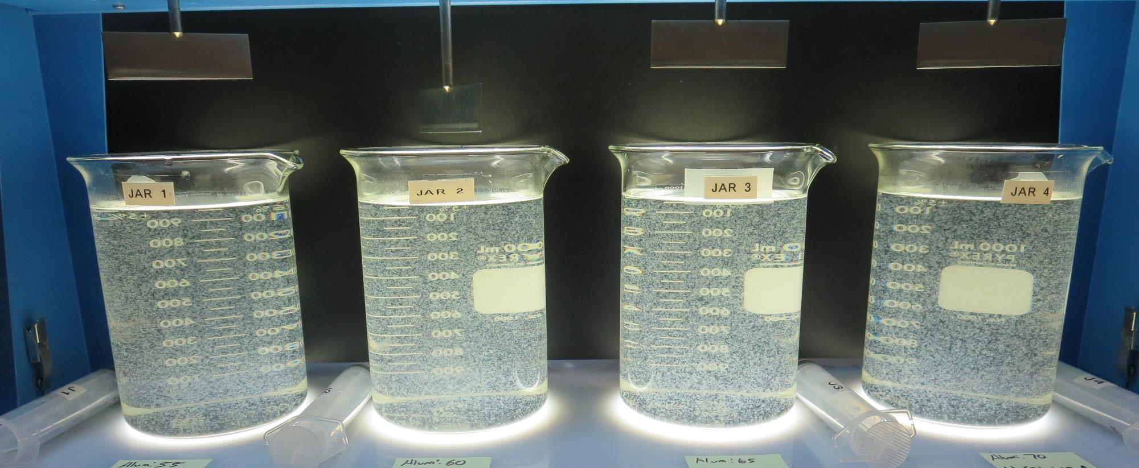
Jars 5-8: End of 5-minute flocculation (30 RPM) duration.
55 mg/L Alum
10.6 mg/L H₂SO₄
Filtrate: 0.07 NTU
UVT: 90.8%
UVA: 0.041/cm
UVA Reduction: 70.5%
Settled: 1.84 NTU
60 mg/L Alum
11.5 mg/L H₂SO₄
Filtrate: 0.07 NTU
UVT: 91.2%
UVA: 0.039/cm
UVA Reduction: 71.9%
Settled: 1.99 NTU
65 mg/L Alum
12.5 mg/L H₂SO₄
Filtrate: 0.05 NTU
UVT: 91.7%
UVA: 0.037/cm
UVA Reduction: 73.4%
Settled: 1.79 NTU
70 mg/L Alum
13.4 mg/L H₂SO₄
Filtrate: 0.05 NTU
UVT: 91.7%
UVA: 0.035/cm
UVA Reduction: 74.8%
Settled: 1.77 NTU

Slide 22
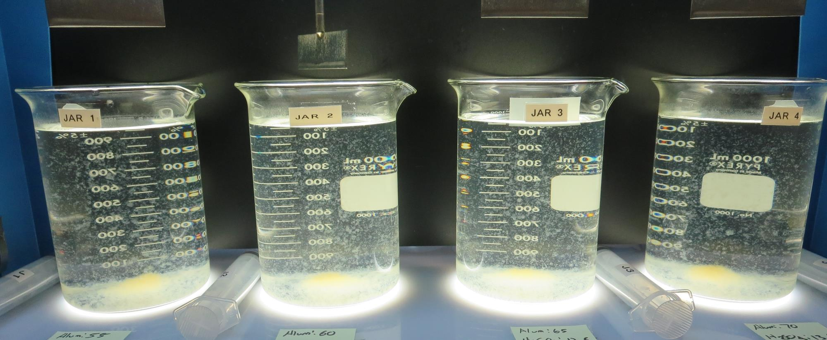
Jars 5-8: After 5 min of settling, 25 mL is syringed for filterability and %UVT/UVA.

Slide 23
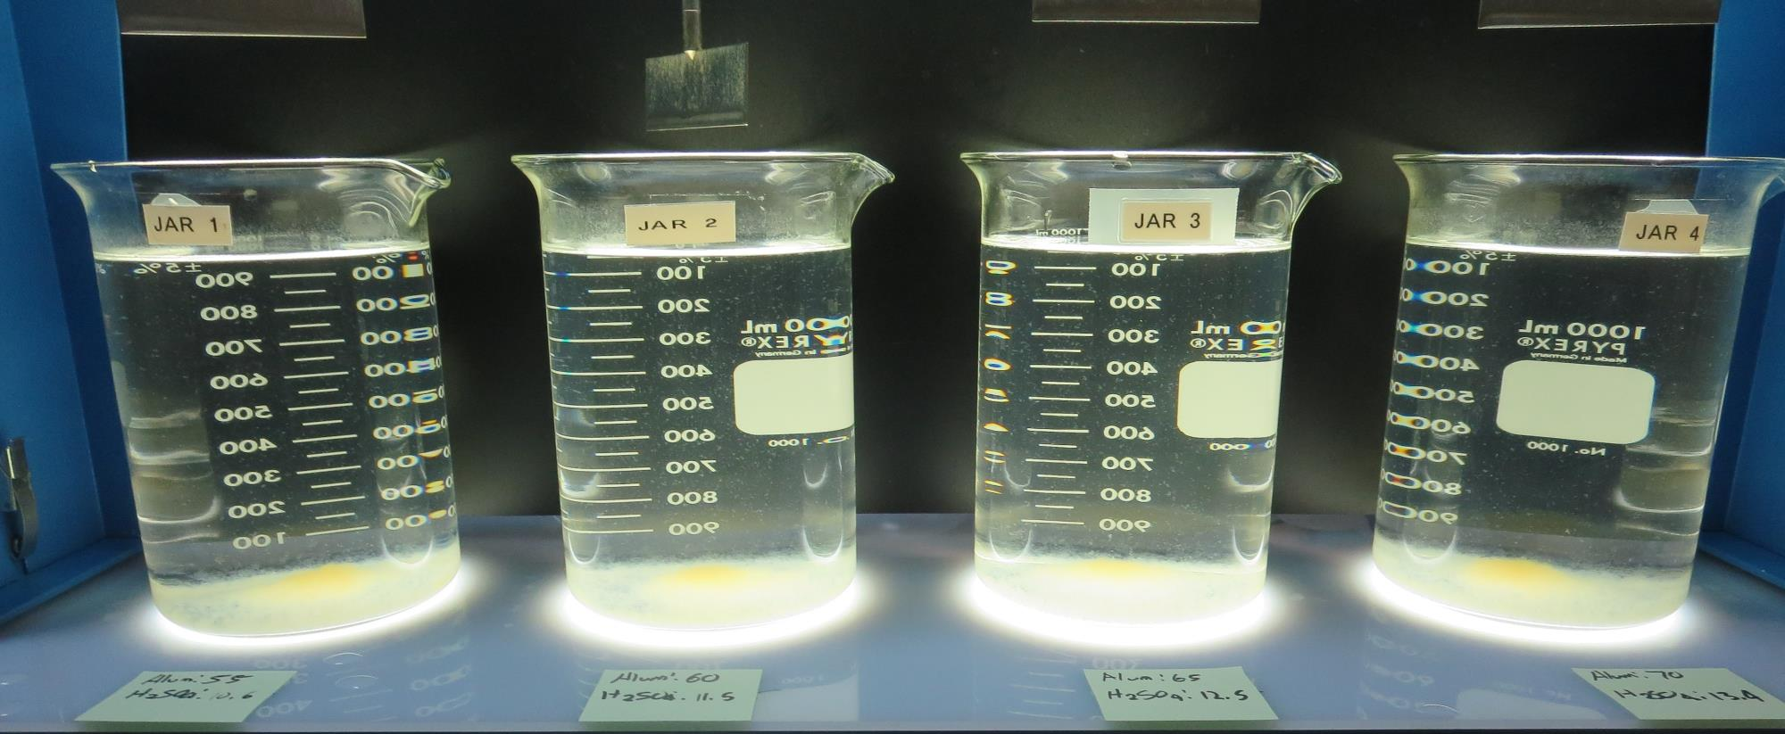
Jars 5-8: After 25-minutes of settling, settled water turbidity is taken.
55 mg/L Alum
10.6 mg/L H₂SO₄
Filtrate: 0.07 NTU
UVT: 90.8%
UVA: 0.041/cm
UVA Reduction: 70.5%
Settled: 1.84 NTU
60 mg/L Alum
11.5 mg/L H₂SO₄
Filtrate: 0.07 NTU
UVT: 91.2%
UVA: 0.039/cm
UVA Reduction: 71.9%
Settled: 1.99 NTU
65 mg/L Alum
12.5 mg/L H₂SO₄
Filtrate: 0.05 NTU
UVT: 91.7%
UVA: 0.037/cm
UVA Reduction: 73.4%
Settled: 1.79 NTU
70 mg/L Alum
13.4 mg/L H₂SO₄
Filtrate: 0.05 NTU
UVT: 91.7%
UVA: 0.035/cm
UVA Reduction: 74.8%
Settled: 1.77 NTU

Slide 24
Jars 9-12 Test Flash Mix 20 Sec (200 RPM) Floc Mix 5 min (30 RPM) Applied Coagulant 7% Acid Alum

Slide 25
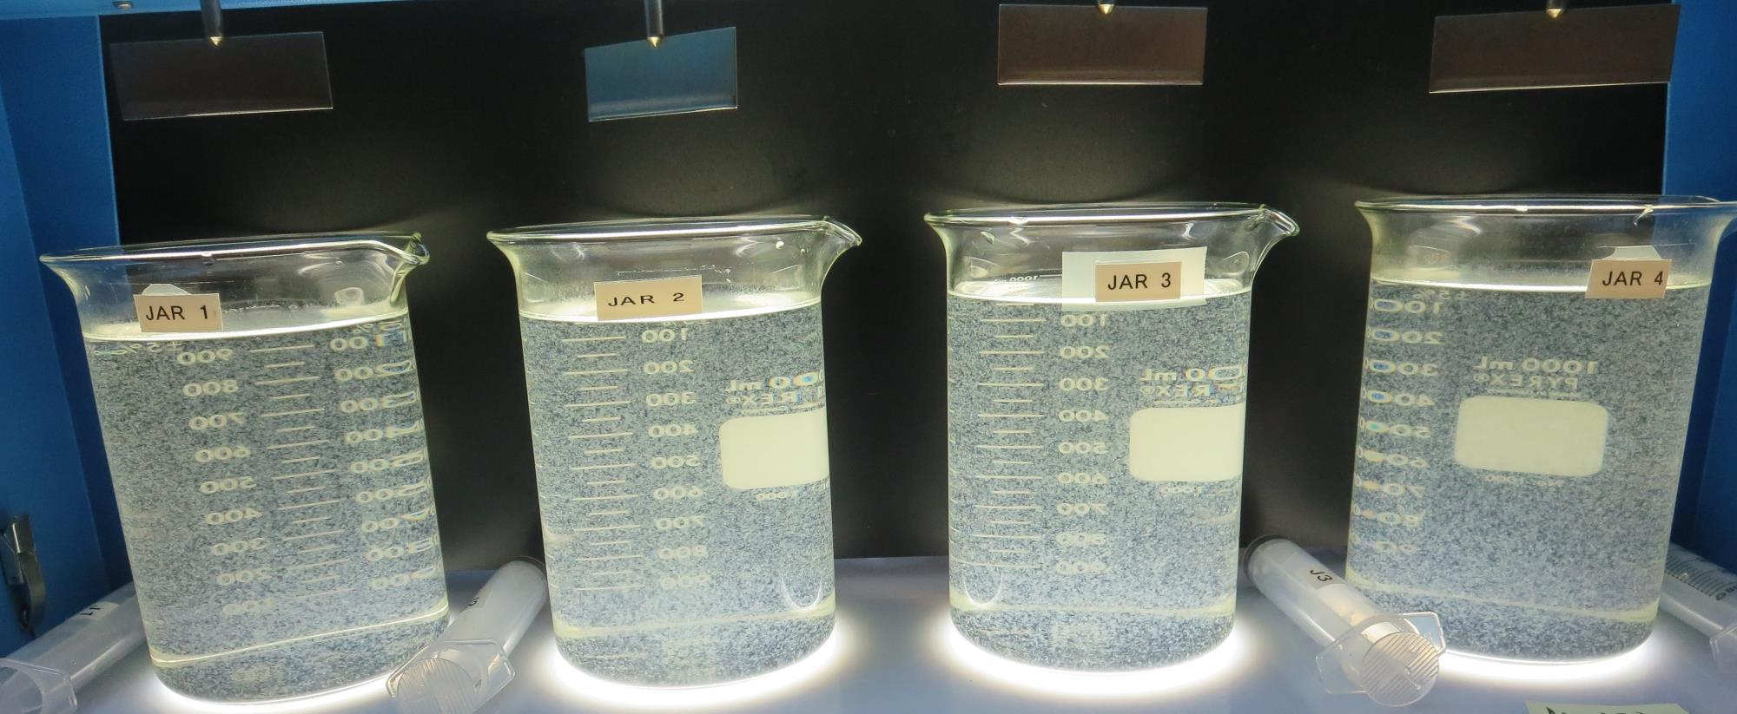
Jars 9-12: End of 5-minute flocculation (30 RPM) duration.
75 mg/L Alum
14.4 mg/L H₂SO₄
Filtrate: 0.04 NTU
UVT: 92.4%
UVA: 0.034/cm
UVA Reduction: 75.5%
Settled: 1.55 NTU
80 mg/L Alum
15.4 mg/L H₂SO₄
Filtrate: 0.08 NTU
UVT: 92.7%
UVA: 0.032/cm
UVA Reduction: 77.0%
Settled: 1.74 NTU
85 mg/L Alum
16.3 mg/L H₂SO₄
Filtrate: 0.04 NTU
UVT: 92.8%
UVA: 0.032/cm
UVA Reduction: 77.0%
Settled: 1.93 NTU
90 mg/L Alum
17.3 mg/L H₂SO₄
Filtrate: 0.04 NTU
UVT: 92.8%
UVA: 0.032/cm
UVA Reduction: 77.0%
Settled: 2.12 NTU

Slide 26
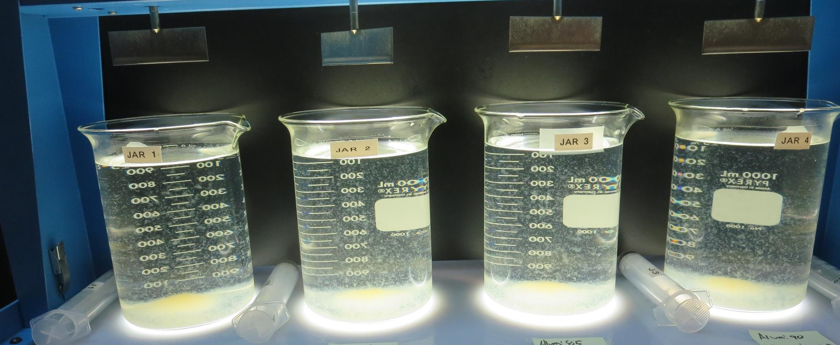
Jars 9-12: After 5 min of settling, 25 mL is syringed for filterability and %UVT/UVA.

Slide 27
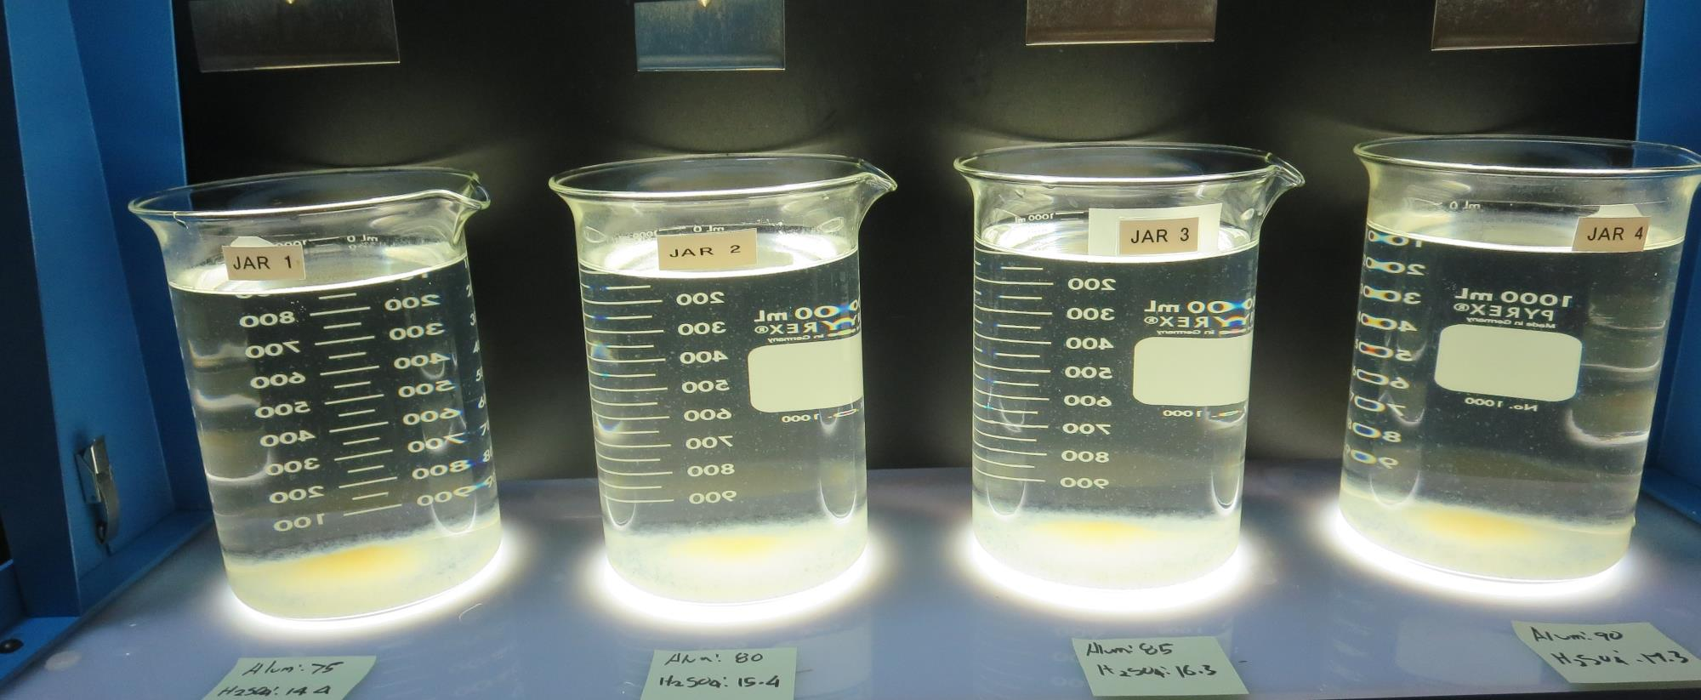
Jars 9-12: After 25-minutes of settling, settled water turbidity is taken.
75 mg/L Alum
14.4 mg/L H₂SO₄
Filtrate: 0.04 NTU
UVT: 92.4%
UVA: 0.034/cm
UVA Reduction: 75.5%
Settled: 1.55 NTU
80 mg/L Alum
15.4 mg/L H₂SO₄
Filtrate: 0.08 NTU
UVT: 92.7%
UVA: 0.032/cm
UVA Reduction: 77.0%
Settled: 1.74 NTU
85 mg/L Alum
16.3 mg/L H₂SO₄
Filtrate: 0.04 NTU
UVT: 92.8%
UVA: 0.032/cm
UVA Reduction: 77.0%
Settled: 1.93 NTU
90 mg/L Alum
17.3 mg/L H₂SO₄
Filtrate: 0.04 NTU
UVT: 92.8%
UVA: 0.032/cm
UVA Reduction: 77.0%
Settled: 2.12 NTU

Slide 28
Jars 13-16 Test Flash Mix 20 Sec (200 RPM) Floc Mix 5 min (30 RPM) Applied Coagulants 7% Acid Alum/8170

Slide 29
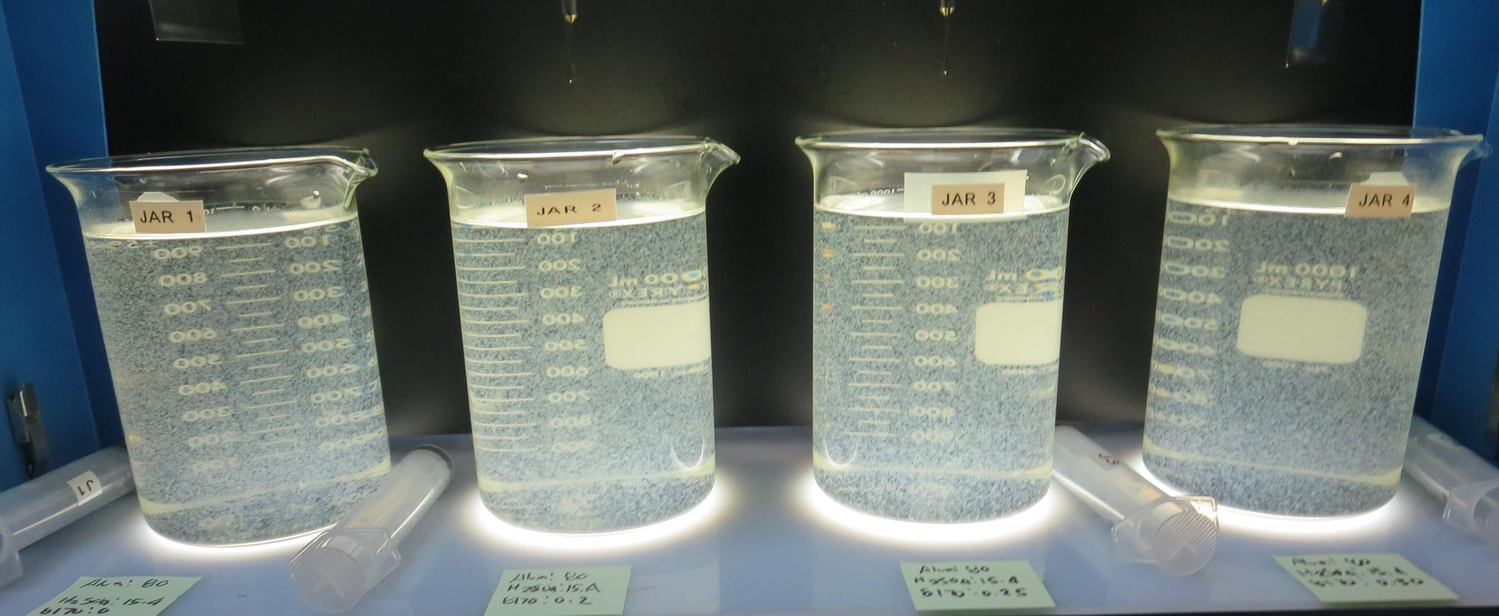
Jars 13-16: End of 5-minute flocculation (30 RPM) duration.
80 mg/L Alum
15.4 mg/L H₂SO₄
0 mg/L 8170
Filtrate: 0.04 NTU
UVT: 92.7%
UVA: 0.032/cm
UVA Reduction: 77.0%
Settled: 1.42 NTU
80 mg/L Alum
15.4 mg/L H₂SO₄
0.2 mg/L 8170
Filtrate: 0.04 NTU
UVT: 92.6%
UVA: 0.033/cm
UVA Reduction: 76.3%
Settled: 1.64 NTU
80 mg/L Alum
15.4 mg/L H₂SO₄
0.25 mg/L 8170
Filtrate: 0.04 NTU
UVT: 92.6%
UVA: 0.033/cm
UVA Reduction: 76.3%
Settled: 1.84 NTU
80 mg/L Alum
15.4 mg/L H₂SO₄
0.3 mg/L 8170
Filtrate: 0.05 NTU
UVT: 92.5%
UVA: 0.033/cm
UVA Reduction: 76.3%
Settled: 1.68 NTU

Slide 30
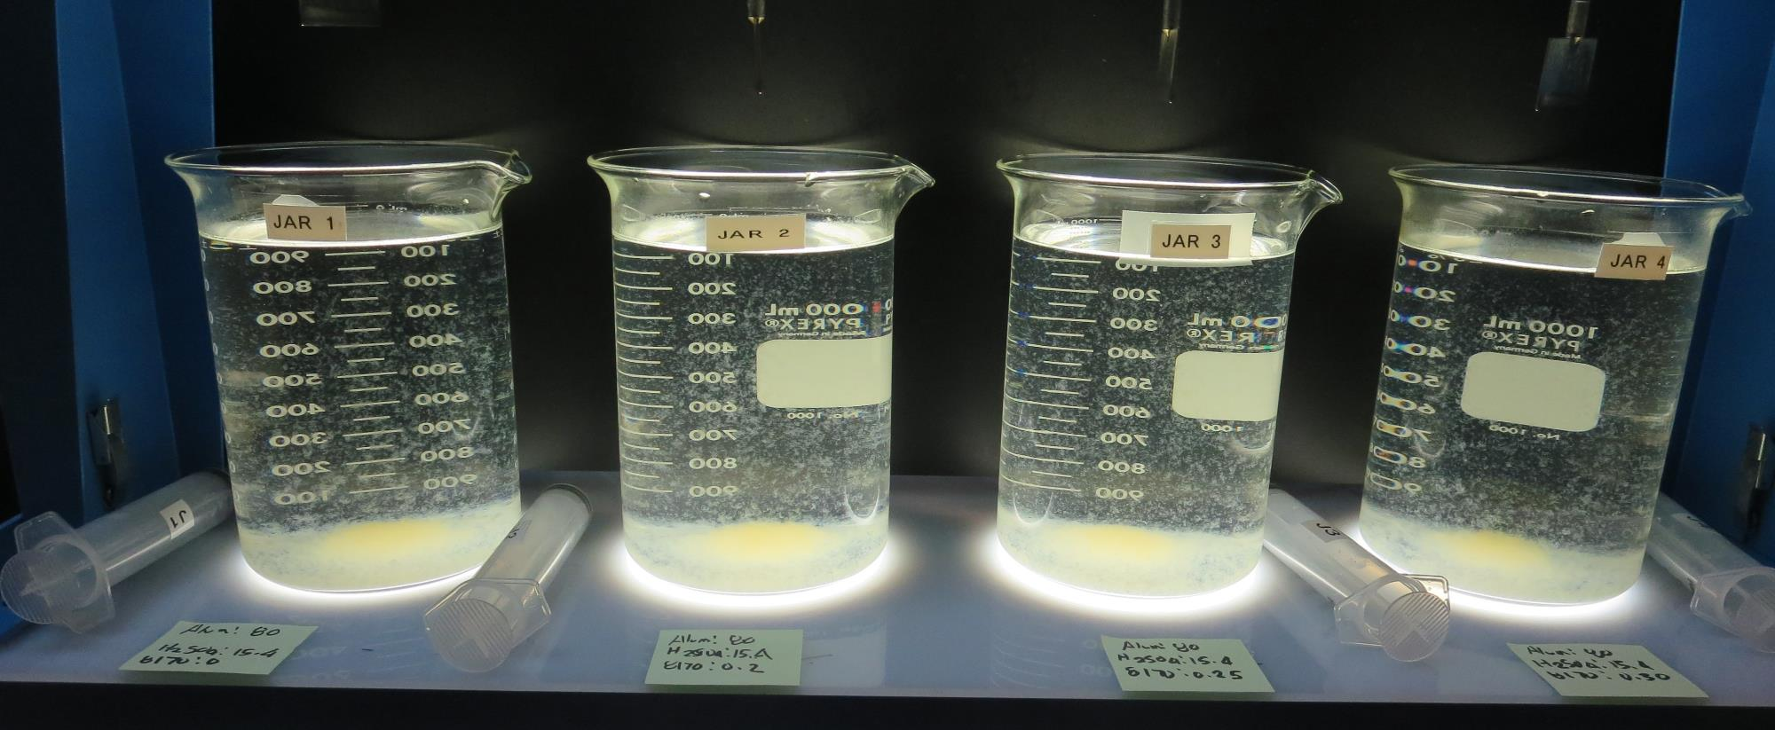
Jars 13-16: After 5 min of settling, 25 mL is syringed for filterability and %UVT/UVA.

Slide 31
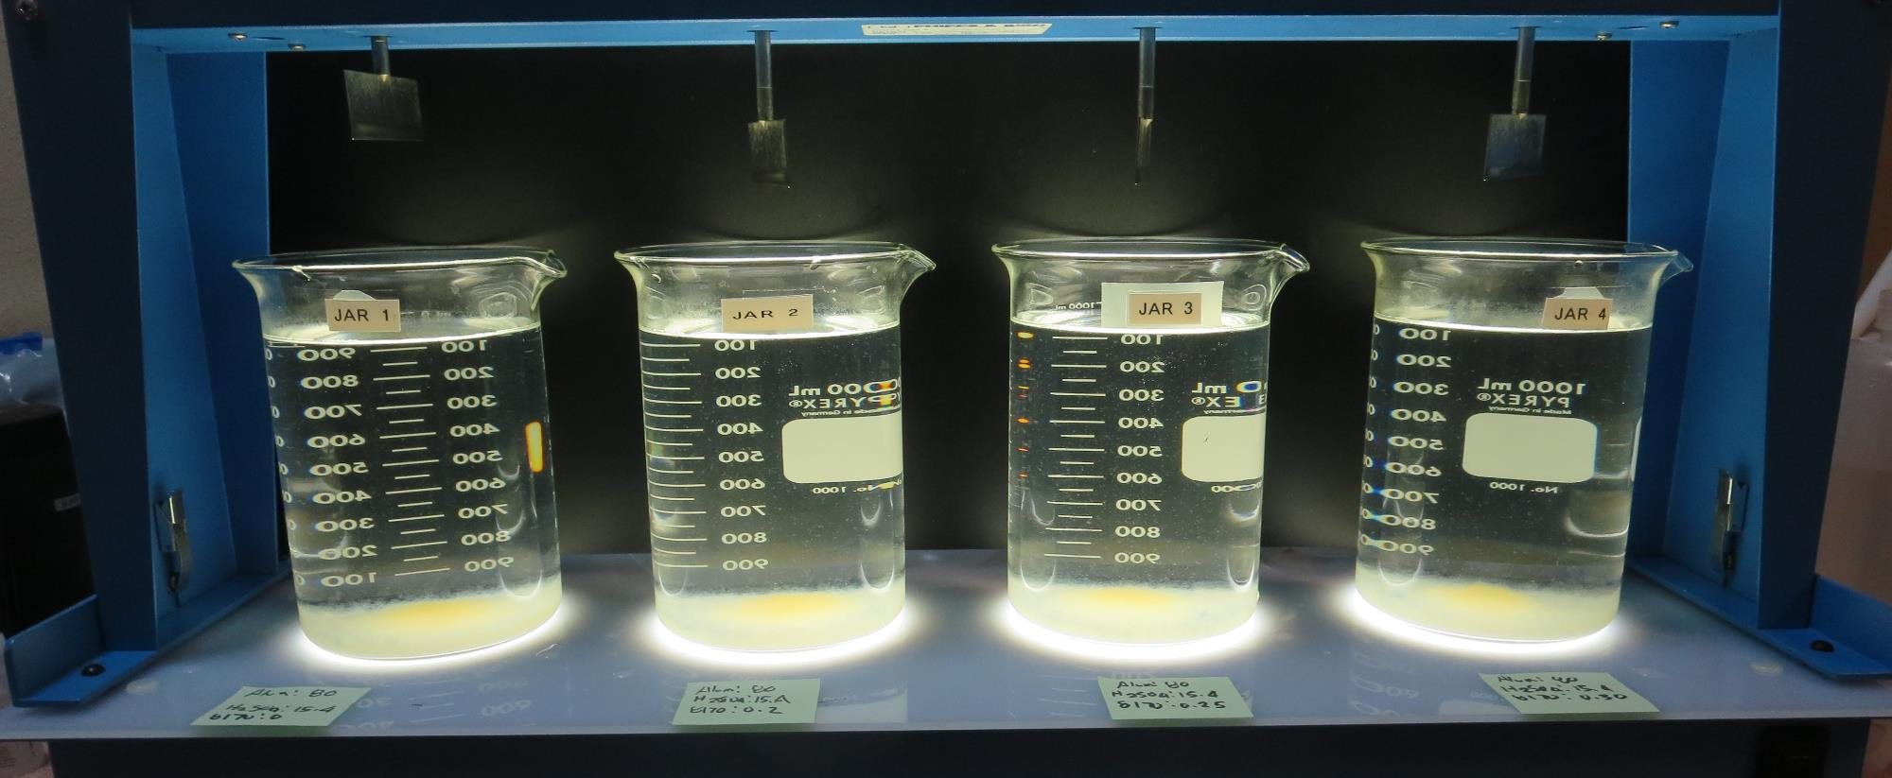
Jars 13-16: After 25-minutes of settling, settled water turbidity is taken.
80 mg/L Alum
15.4 mg/L H₂SO₄
0 mg/L 8170
Filtrate: 0.04 NTU
UVT: 92.7%
UVA: 0.032/cm
UVA Reduction: 77.0%
Settled: 1.42 NTU
80 mg/L Alum
15.4 mg/L H₂SO₄
0.2 mg/L 8170
Filtrate: 0.04 NTU
UVT: 92.6%
UVA: 0.033/cm
UVA Reduction: 76.3%
Settled: 1.64 NTU
80 mg/L Alum
15.4 mg/L H₂SO₄
0.25 mg/L 8170
Filtrate: 0.04 NTU
UVT: 92.6%
UVA: 0.033/cm
UVA Reduction: 76.3%
Settled: 1.84 NTU
80 mg/L Alum
15.4 mg/L H₂SO₄
0.3 mg/L 8170
Filtrate: 0.05 NTU
UVT: 92.5%
UVA: 0.033/cm
UVA Reduction: 76.3%
Settled: 1.68 NTU

Slide 32
Jars 17-20 Test Flash Mix 20 Sec (200 RPM) Floc Mix 5 min (30 RPM) Applied Coagulants 9800/9890

Slide 33
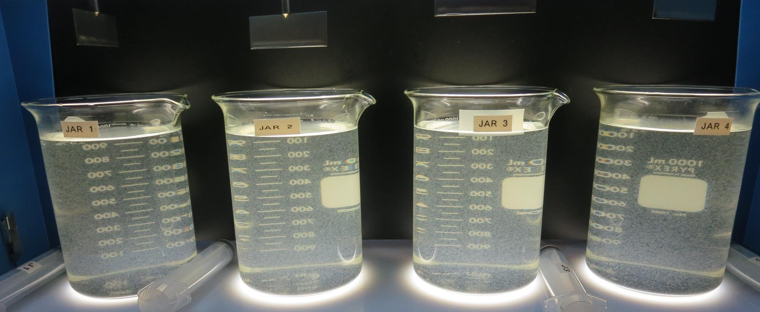
Jars 17-20: After 5 min of settling, 25 mL is syringed for filterability and %UVT/UVA.
55 mg/L 9800
0 mg/L 9890
Filtrate: 0.04 NTU
UVT: 91.3%
UVA: 0.039/cm
UVA Reduction: 71.9%
Settled: 1.08 NTU
60 mg/L 9800
0 mg/L 9890
Filtrate: 0.04 NTU
UVT: 91.5%
UVA: 0.038/cm
UVA Reduction: 72.7%
Settled: 1.32 NTU
55 mg/L 9800
3 mg/L 9890
Filtrate: 0.04 NTU
UVT: 91.8%
UVA: 0.037/cm
UVA Reduction: 73.4%
Settled: 1.21 NTU
60 mg/L 9800
3 mg/L 9890
Filtrate: 0.04 NTU
UVT: 91.9%
UVA: 0.036/cm
UVA Reduction: 74.1%
Settled: 1.25 NTU

Slide 34
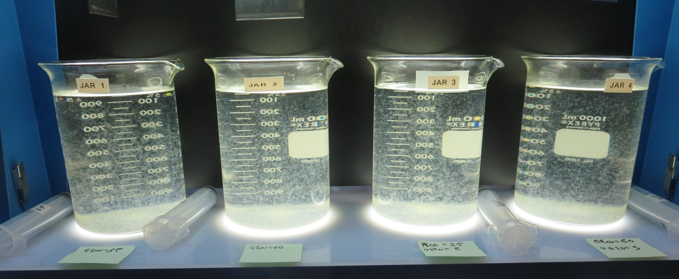
Jars 17-20: After 5 min of settling, 25 mL is syringed for filterability and %UVT/UVA.

Slide 35
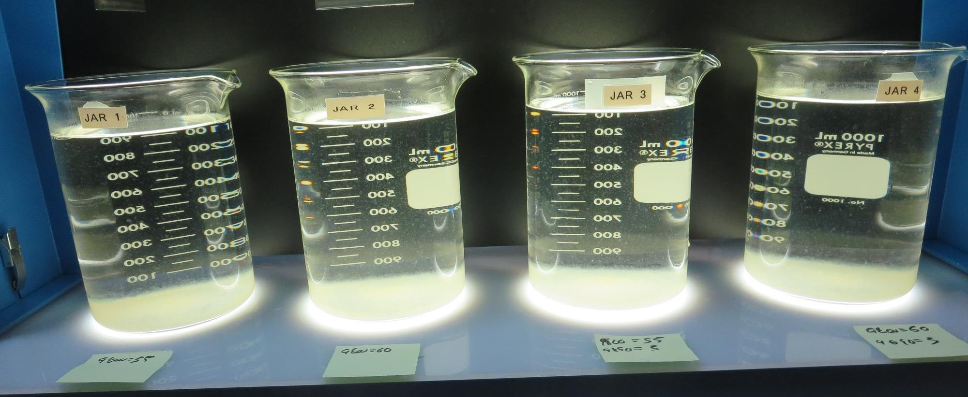
Jars 17-20: After 25-minutes of settling, settled water turbidity is taken.
55 mg/L 9800
0 mg/L 9890
Filtrate: 0.04 NTU
UVT: 91.3%
UVA: 0.039/cm
UVA Reduction: 71.9%
Settled: 1.08 NTU
60 mg/L 9800
0 mg/L 9890
Filtrate: 0.04 NTU
UVT: 91.5%
UVA: 0.038/cm
UVA Reduction: 72.7%
Settled: 1.32 NTU
55 mg/L 9800
3 mg/L 9890
Filtrate: 0.04 NTU
UVT: 91.8%
UVA: 0.037/cm
UVA Reduction: 73.4%
Settled: 1.21 NTU
60 mg/L 9800
3 mg/L 9890
Filtrate: 0.04 NTU
UVT: 91.9%
UVA: 0.036/cm
UVA Reduction: 74.1%
Settled: 1.25 NTU

Slide 36
Jars 21-24 Test Flash Mix 20 Sec (200 RPM) Floc Mix 5 min (30 RPM) Pictures not Available Applied Coagulant 7% Acid Alum

Slide 37
Jars 25-28 Test Flash Mix 20 Sec (200 RPM) Floc Mix 5 min (30 RPM) Applied Coagulant 9800

Slide 38
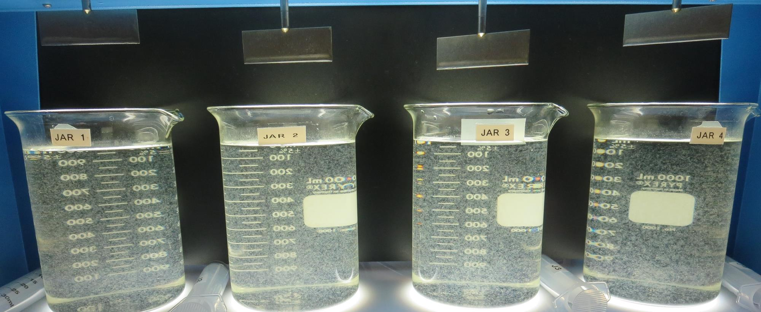
Jars 25-28: End of 5-minute flocculation (30 RPM) duration.
60 mg/L 9800
Filtrate: 0.05 NTU
UVT: 91.5%
UVA: 0.038/cm
UVA Reduction: 72.7%
Settled: 0.41 NTU
65 mg/L 9800
Filtrate: 0.04 NTU
UVT: 92.0%
UVA: 0.036/cm
UVA Reduction: 74.1%
Settled: 0.49 NTU
70 mg/L 9800
Filtrate: 0.04 NTU
UVT: 92.3%
UVA: 0.034/cm
UVA Reduction: 75.5%
Settled: 0.45 NTU
75 mg/L 9800
Filtrate: 0.04 NTU
UVT: 92.6%
UVA: 0.033/cm
UVA Reduction: 76.3%
Settled: 0.45 NTU

Slide 39
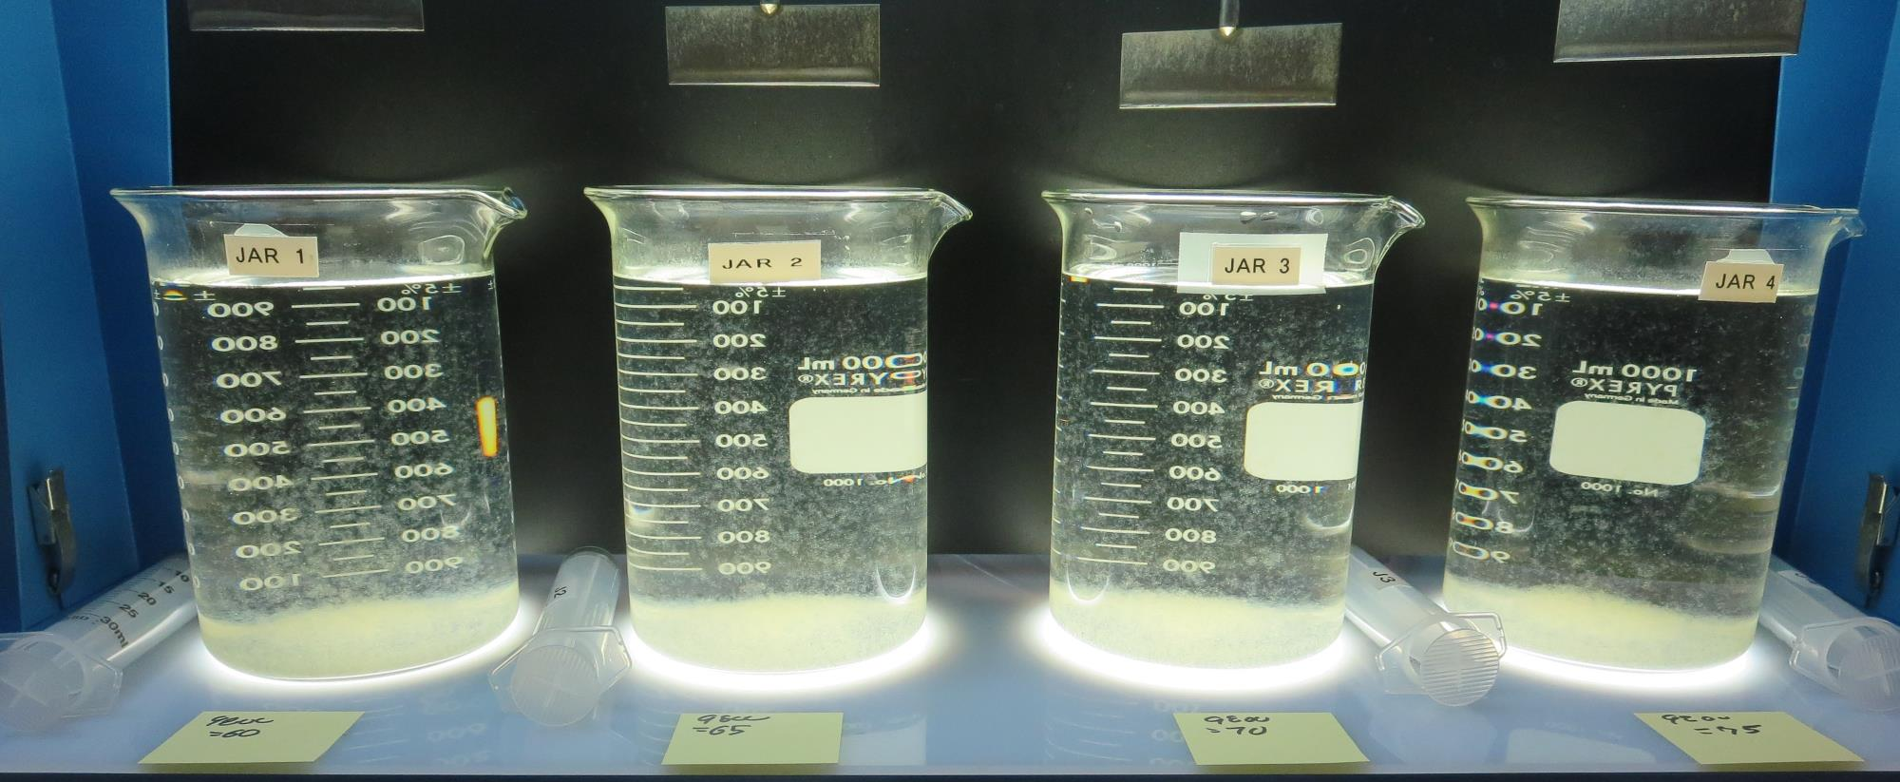
Jars 25-28: After 5 min of settling, 25 mL is syringed for filterability and %UVT/UVA.

Slide 40
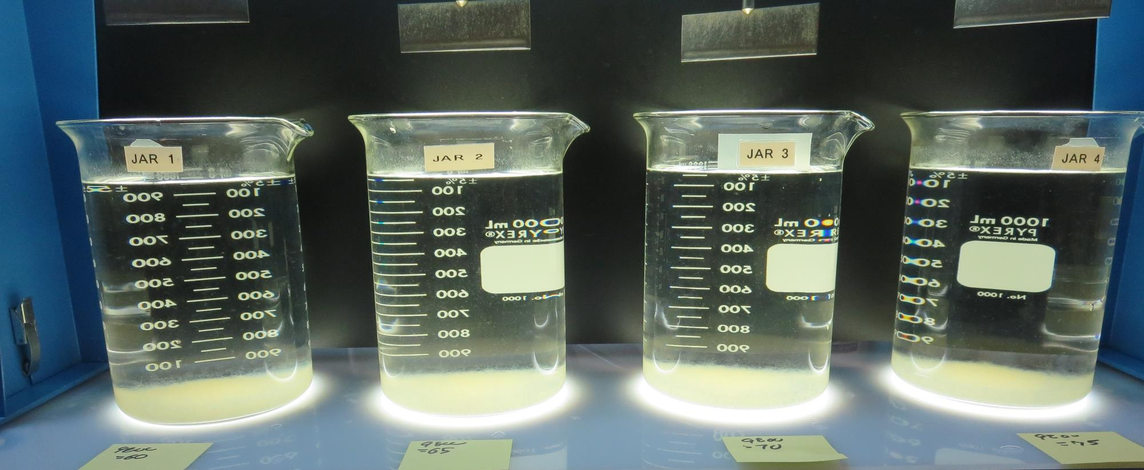
Jars 25-28: After 25-minutes of settling, settled water turbidity is taken.
60 mg/L 9800
Filtrate: 0.05 NTU
UVT: 91.5%
UVA: 0.038/cm
UVA Reduction: 72.7%
Settled: 0.41 NTU
65 mg/L 9800
Filtrate: 0.04 NTU
UVT: 92.0%
UVA: 0.036/cm
UVA Reduction: 74.1%
Settled: 0.49 NTU
70 mg/L 9800
Filtrate: 0.04 NTU
UVT: 92.3%
UVA: 0.034/cm
UVA Reduction: 75.5%
Settled: 0.45 NTU
75 mg/L 9800
Filtrate: 0.04 NTU
UVT: 92.6%
UVA: 0.033/cm
UVA Reduction: 76.3%
Settled: 0.45 NTU

Slide 41
Jars 29-32 Test Flash Mix 20 Sec (200 RPM) Floc Mix 5 min (30 RPM) Applied Coagulants 7% Acid Alum/9800

Slide 42
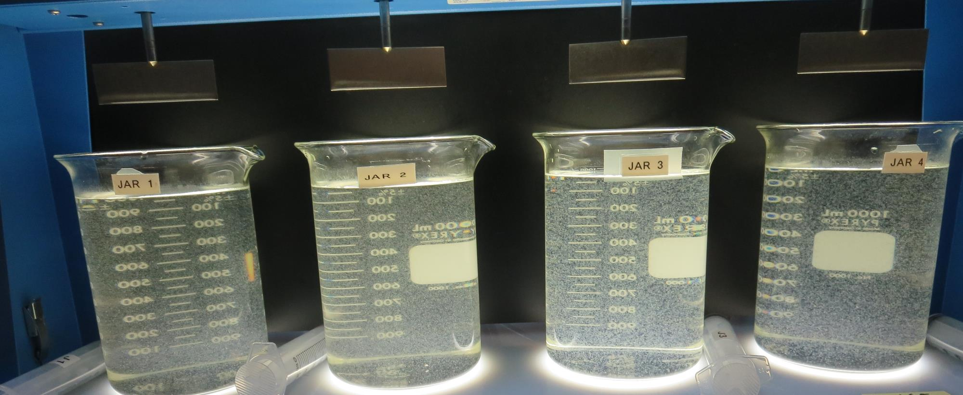
Jars 29-32: After 5 min of settling, 25 mL is syringed for filterability and %UVT/UVA.
75 mg/L 9800
Filtrate: 0.04 NTU
UVT: 92.5%
UVA: 0.033/cm
UVA Reduction: 76.3%
Settled: 0.57 NTU
80 mg/L 9800
Filtrate: 0.04 NTU
UVT: 92.7%
UVA: 0.032/cm
UVA Reduction: 77.0%
Settled: 0.44 NTU
80 mg/L Alum
15.4 mg/L H₂SO₄
Filtrate: 0.04 NTU
UVT: 92.1%
UVA: 0.035/cm
UVA Reduction: 74.8%
Settled: 1.60 NTU
85 mg/L Alum
16.3 mg/L H₂SO₄
Filtrate: 0.04 NTU
UVT: 92.2%
UVA: 0.034/cm
UVA Reduction: 75.5%
Settled: 0.96 NTU

Slide 43
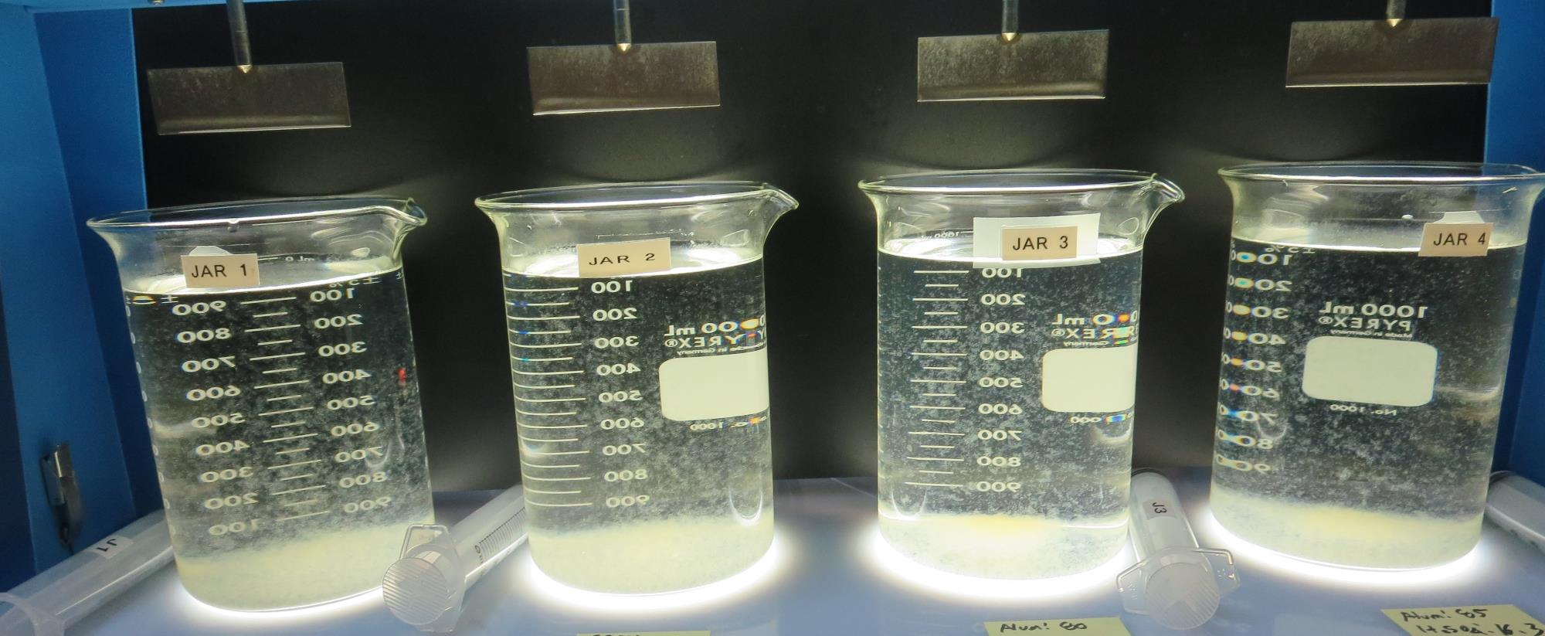
Jars 29-32: After 5 min of settling, 25 mL is syringed for filterability and %UVT/UVA.

Slide 44
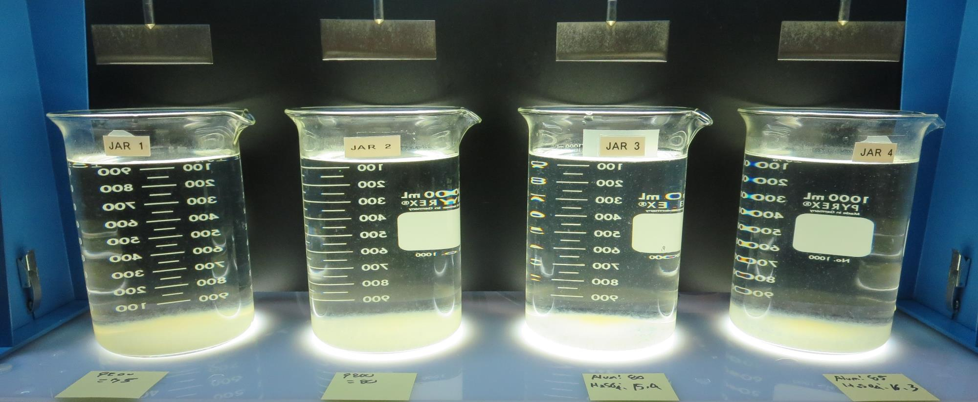
Jars 29-32: After 25-minutes of settling, settled water turbidity is taken.
75 mg/L 9800
Filtrate: 0.04 NTU
UVT: 92.5%
UVA: 0.033/cm
UVA Reduction: 76.3%
Settled: 0.57 NTU
80 mg/L 9800
Filtrate: 0.04 NTU
UVT: 92.7%
UVA: 0.032/cm
UVA Reduction: 77.0%
Settled: 0.44 NTU
80 mg/L Alum
15.4 mg/L H₂SO₄
Filtrate: 0.04 NTU
UVT: 92.1%
UVA: 0.035/cm
UVA Reduction: 74.8%
Settled: 1.60 NTU
85 mg/L Alum
16.3 mg/L H₂SO₄
Filtrate: 0.04 NTU
UVT: 92.2%
UVA: 0.034/cm
UVA Reduction: 75.5%
Settled: 0.96 NTU

Slide 45
Jar Testing for 1-Liter Jars: Procedures for Most Treatment Plants
Fill jars with source water prior to coagulant injection and set paddle speed at 30 rpm
Add chemicals (i.e., NaOCl, primary coagulant, coagulant aid) to each jar
Flash mix for 15-30 seconds (200 rpm)
Slow mix for 5 minutes (20-30 rpm)
Settled for 5 minutes. Syringe 25 mL from each jar taken 1-inch below surface (25 mL/12 sec rate)
Filtered through 1.2 um isopore membrane into cuvette drip rate, 15 mL/(50-90 sec)
Measure filtrate turbidity, chlorine residual and %UVT/UVA
Measure settled water turbidity after 25 minutes of total setting
Record all data

Slide 46
Jar Test Filterability Test Equipment
Turbidity Instrument
Syringe w/Luer-Lock Tip, 30 cc
(part#: 2225800, by Hach)
Swinnex Filter Holder, 25 mm (part#: SX0002500)
Isopore Membrane Filter, 1.2 um absolute
pore size,
Φ= 25 mm , thickness: 24 um,
hydrophilic polycarbonate membrane
(part #: RTTP02500)
Go to Sigma-Aldrich for laboratory supplies http://www.sigmaaldrich.com/united-states.html

Slide 47
Isopore Membrane Information
Categories | Information
trade name | Isopore
filter color | White
chemistry | Polycarbonate (PC)
water flow rate | Avg. 175 mL/min x cm² (typical results @ 10 psi)
media | Isopore®
wettability | Hydrophilic
porosity | 14.7%
pore size | 1.2 µm
bubble point at 23 °C | 1.0 bar, air with water
thickness | 24 µm
filter diameter (ø) | 25 mm
material size | polycarbonate, Hydrophilic, 1.2 µm, 25 mm, white, plain, 100

Slide 48
Isopore Membrane Background Information
The Isopore membrane is a polycarbonate, track-etched screen filter recommended for all analyses in which the sample is viewed on the surface of the membrane. The Isopore membrane is composed of polycarbonate film, which has a smooth, glass-like surface for clearer sample observation. The unique manufacturing process of the membrane ensures a precise pore diameter and a consistent pore size for accurate separation of samples by size. Matched-weight filters are not usually required because of low, constant tar and ash weights. Features & Benefits: Membrane structure retains particles on the surface, simplifying counting and analysis

Slide 49
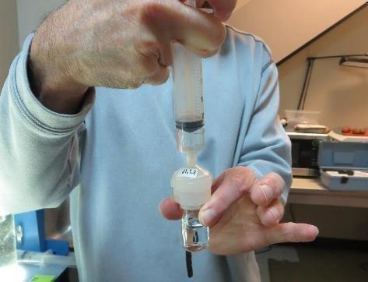
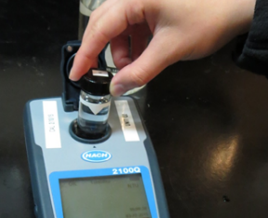
Jar Test - Filterability Test
Syringe ~ 25 mL from jar (after 5-minutes of settling)
Filter-to-waste 3-5 mL
Filter directly into clean cuvette
Measure turbidity
Note: Take several readings before recording final NTU results. Micro bubbles can adhere to glass causing false NTU readings. To remove bubbles, tilt cuvette up to 90 degrees.

Slide 50
Contact
Guy Schott, P.E.
State Water Resources Control Board
Division of Drinking Water
Santa Rosa, CA
Go to Stock Solution/Dose calculations/Jar Test Results for tools to download
www.waterboards.ca.gov/drinking_water/programs/districts/mendocino_district.html
Email: Guy Schott - Guy.Schott@waterboards.ca.gov
Office Number: 707-576-2732

