Slide 1
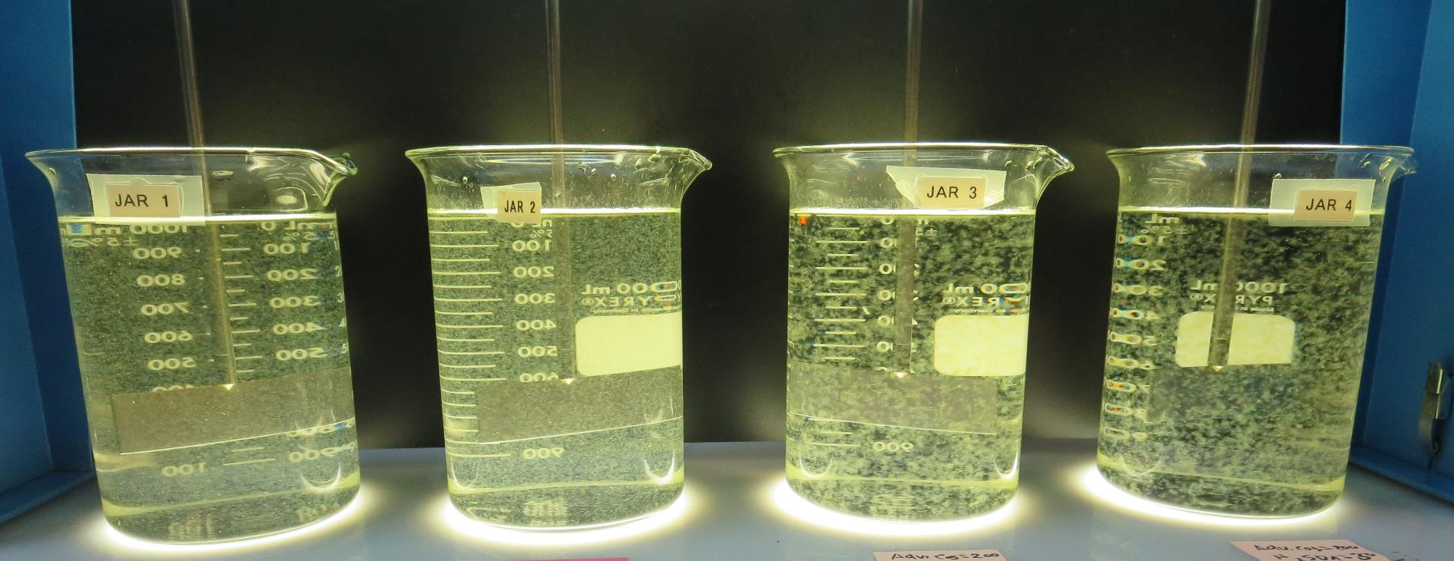
Lucerne Water Co., CA Water Service CA1710005 Lake County Jar Test
by Guy Schott, P.E.
September 4, 2020

Slide 2
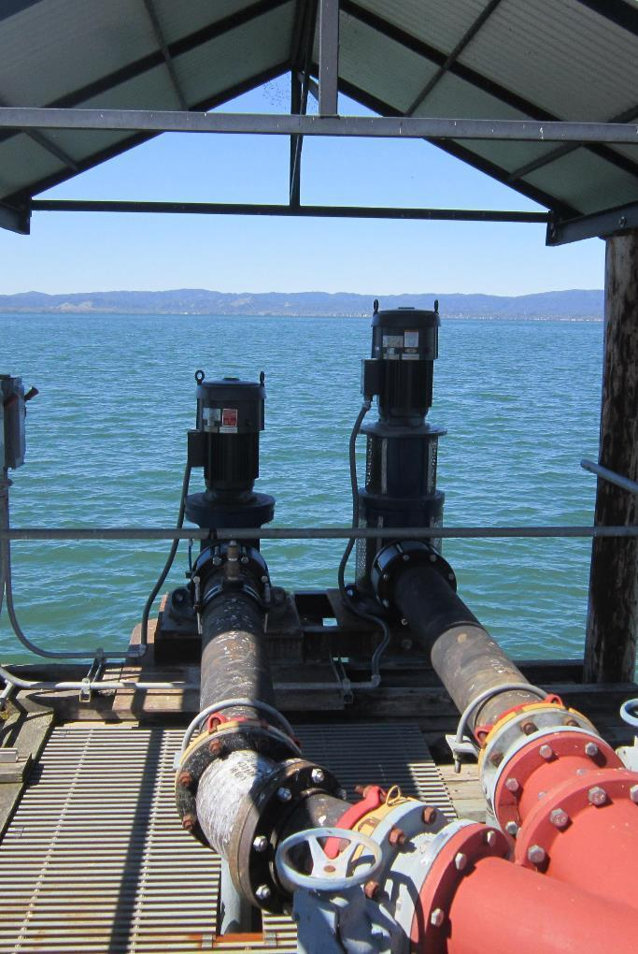
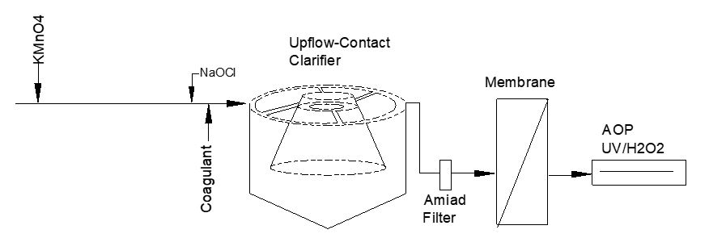
Lucerne Water Co. Source Water: Clear Lake Conventional Treatment

Slide 3
Lucerne Water Co. Characteristics Sept 4, 2020
Source
Turbidity: 7.55 NTU
pH: 8.92
UVT: 78.7%,
UVA: 0.104/cm
0.4 um Filtered
Turbidity: 0.45 NTU
UVT: 83.2%,
UVA: 0.079/cm
Coagulant Dose:
9800: 55 mg/L
Post Membrane, Pre-Chlorine:
0.07 NTU
UVT: 90.3%,
UVA: 0.044/cm
UVA Reduction: 44.3%

Slide 4
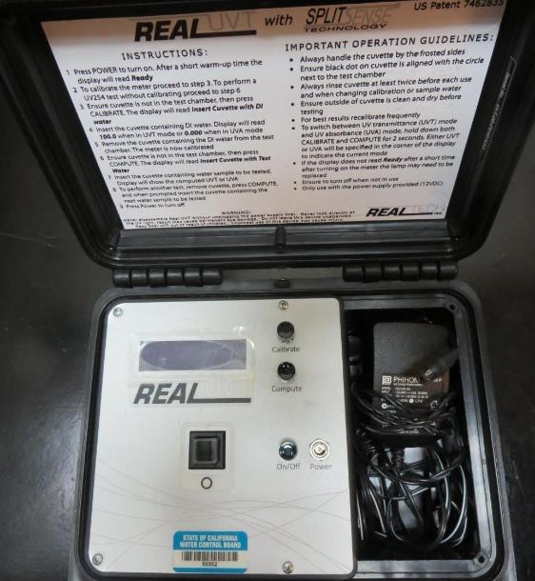
UVT/UVA, pathlength 10 mm
UV transmittance (UVT) is a measurement of the amount of ultraviolet light (commonly at 254 nm due to its germicidal effect) that passes through a water sample compared to the amount of light that passes through a pure water sample. The measurement is expressed as a percentage, % UVT.
%UVT = 10^{(-UVA)} x 100%
UV absorbance (UVA) is calculated as a relative measure of the amount of light absorbed by a water sample compared with the amount of light absorbed by a pure water sample.
UVA = -log(%UVT/100)

Slide 5
Applied Coagulants for Jar Testing
Pro Pac 9800 (NTU Technologies)
50% Aluminum Chlorohydrate (ACH)
50% Water
SG = 1.34
Pro Pac 9810 (NTU Technologies)
45-50% Aluminum Chlorohydrate (ACH)
35-45% Water
5% Proprietary
SG = 1.25 – 1.34
BWS, Inc.
Advanced Coagulant
AdvFloc-CTC-00011
12.55% Al₂O₃
64.9% Basicity
SG = 1.299
Gregory F. Nieckarz, Ph.D.
Principal Consultant
SWS Consulting, LLC.
+1.541.953.5112
gregn.swsc@gmail.com

Slide 6
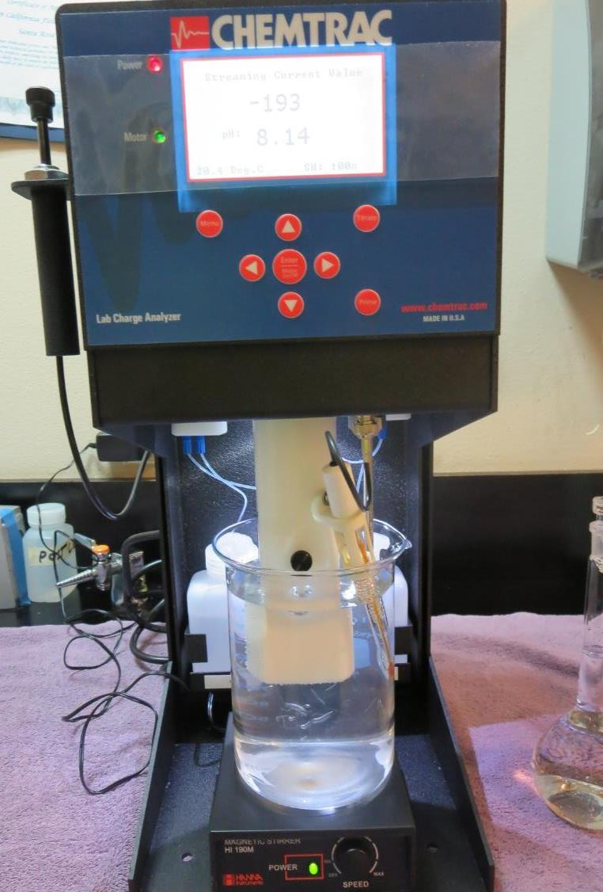
Laboratory Charge Analyzer
LCA: Used to determine coagulant demand of a source water entering the treatment plant.
Source pH: 8.91
LCA #1:
9800: 38 mg/L as product
pH adjusted to 7.50 with acetic acid
LCA #2:
Advanced Coagulant: 140 mg/L
pH adjusted to 7.40 with acetic acid

Slide 7
Coagulant Information
Unless stated otherwise, all coagulant doses are reported as Product (100% strength).
Preparation of coagulant stock solutions are generally 1.0 and/or 0.1 percent strength using 100 and/or 200 mL volumetric flasks.
Finnpipette F2 variable volume pipette, capacity 100-1000 micro liters is used for stock solution preparation and coagulant aid jar test dosing.
Finnpipette F2 variable volume pipette, capacity 0.5-5 mL is used for primary coagulant jar test dosing.

Slide 8
Source Water pH and Alkalinity Changes
Constituents | pH (measured) | Alkalinity as CaCO₃, mg/L
Source pH | 8.92 - 9.0 | 158
H₂SO₄ = 20 mg/L | 7.8 | 138 (calc)
H₂SO₄ = 30 mg/L | 7.4 | 127 (calc)
9800 = 40 mg/L | 8.73 | 153 (calc)
9800 = 60 mg/L | 8.62 | 151 (calc)
9800 = 140 mg/L | 8.06 | 140 (141, calc)
Adv Coag. = 150 mg/L | 7.67 | 139 (calc)
Adv Coag. = 200 mg/L | 7.41 | 129 (132, calc)

Slide 9
Lucerne Water Co., Jar Test 1 - 8 Results Flash Mix 200 RPM (30 sec); Floc Mix 30 RPM (5 min)
Jar# | 9800 mg/L | 9890 mg/L | Adv. Coag. mg/L | Filtrate NTU | Filtrate %UVT | Filtrate UVA/cm | %UVA Reduction | Settle NTU 25 min
J1 | 38 | 0 | 0 | 0.14 | 89.0 | 0.050 | 36.7 | 0.53
J2 | 42 | 0 | 0 | 0.14 | 89.0 | 0.050 | 36.7 | 0.54
J3 | 55 | 0 | 0 | 0.13 | 89.5 | 0.047 | 40.5 | 0.40
J4 | 0 | 0 | 140 | 0.13 | 88.4 | 0.053 | 32.9 | 0.56
J5 | 38 | 3.8 | 0 | 0.10 | 89.1 | 0.049 | 38.0 | 0.50
J6 | 42 | 4.2 | 0 | 0.14 | 88.8 | 0.051 | 35.4 | 0.68
J7 | 55 | 5.5 | 0 | 0.12 | 89.2 | 0.049 | 38.0 | 0.38
J8 | 0 | 0 | 180 | 0.14 | 88.6 | 0.052 | 34.2 | 0.57

Slide 10
Lucerne Water Co., Jar Test 9 - 12 Results Flash Mix 200 RPM for 30 Seconds
Jar# | 30 RPM Floc Mix min | 9810 mg/L | Filtrate NTU | Filtrate %UVT | Filtrate UVA/cm | %UVA Reduction | Settle NTU 25 min
J9 | 5 | 38 | 0.17 | 89.5 | 0.048 | 39.2 | 0.64
J10 | 5 | 40 | 0.15 | 88.8 | 0.051 | 35.4 | 0.74
J11 | 5 | 42 | 0.15 | 89.1 | 0.050 | 36.7 | 0.54
J12 | 5 | 44 | 0.15 | 89.2 | 0.049 | 38.0 | 0.59

Slide 11
Lucerne Water Co., Jar Test 13 - 20 Results Flash Mix 200 RPM (30 sec); Floc Mix 30 RPM (5 min)
Jar # | H₂SO₄ mg/L | 9800 mg/L | Filtrate NTU | Filtrate %UVT | Filtrate UVA/cm | %UVA Reduction | Settle NTU 25 min
J13 | 0 | 40 | 0.14 | 89.5 | 0.048 | 39.2 | 0.52
J14 | 20 | 40 | 0.12 | 90.4 | 0.043 | 45.6 | 0.38
J15 | 0 | 60 | 0.13 | 89.7 | 0.047 | 40.5 | 0.40
J16 | 20 | 60 | 0.09 | 91.4 | 0.039 | 50.6 | 0.31
J17 | 0 | 40 | 0.14 | 89.5 | 0.047 | 40.5 | 0.40
J18 | 30 | 40 | 0.12 | 91.1 | 0.040 | 49.4 | 0.47
J19 | 0 | 60 | 0.11 | 90.1 | 0.045 | 43.0 | 0.40
J20 | 30 | 60 | 0.08 | 92.0 | 0.036 | 54.4 | 0.38

Slide 12
Lucerne Water Co., Jar Test 21 - 28 Results Flash Mix 200 RPM (30 sec); Floc Mix 30 RPM (5 min)
Jar # | H₂SO₄ mg/L | 9800 mg/L | Filtrate NTU | Filtrate %UVT | Filtrate UVA/cm | %UVA Reduction | Settle NTU 25 min
J21 | 0 | 150 | 0.15 | 89.8 | 0.046 | 41.8 | 0.93
J22 | 20 | 150 | 0.14 | 91.6 | 0.038 | 51.9 | 0.41
J23 | 0 | 200 | 0.11 | 91.1 | 0.040 | 49.4 | 0.55
J24 | 20 | 200 | 0.09 | 92.5 | 0.033 | 58.2 | 0.17
J25 | 0 | 150 | 0.14 | 90.1 | 0.045 | 43.0 | 0.73
J26 | 30 | 150 | 0.12 | 92.1 | 0.035 | 55.7 | 0.50
J27 | 0 | 200 | 0.13 | 90.8 | 0.041 | 48.1 | 0.50
J28 | 30 | 200 | 0.08 | 92.7 | 0.032 | 59.5 | 0.22

Slide 13
Lucerne Water Co., Jar Test 29 - 32 Results Flash Mix 200 RPM (30 sec); Floc Mix 30 RPM (5 min)
Jar# | H₂SO₄ mg/L | 9800 mg/L | Adv. Coag. mg/L | Filtrate NTU | Filtrate %UVT | Filtrate UVA/cm | %UVA Reduction | Settle NTU 25 min
J29 | 20 | 60 | 0 | 0.08 | 91.7 | 0.037 | 53.2 | 0.31
J30 | 30 | 60 | 0 | 0.10 | 91.7 | 0.037 | 53.2 | 0.37
J31 | 20 | 0 | 200 | 0.10 | 92.6 | 0.033 | 58.2 | 0.32
J32 | 30 | 0 | 200 | 0.08 | 93.1 | 0.031 | 60.8 | 0.17

Slide 14
Jars 1-4 Test Flash Mix 30 Sec (200 RPM) Floc Mix 5 min (30 RPM) Applied Coagulants 9800/Adv. Coag.

Slide 15
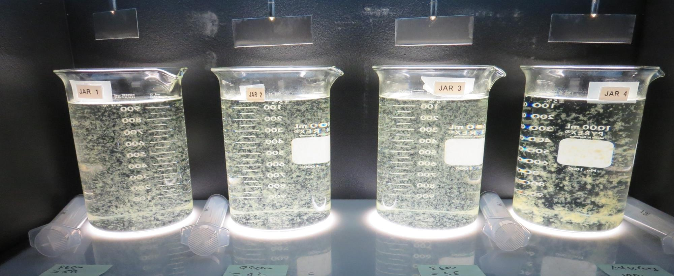
Jars 1-4: End of 5-minute flocculation (30 RPM) duration.
38 mg/L 9800
Filtrate 0.14 NTU
UVT: 89.0%
UVA: 0.050/cm
UVA Reduction 36.7%
Settled: 0.53 NTU
42 mg/L 9800
Filtrate 0.14 NTU
UVT: 89.0%
UVA: 0.050/cm
UVA Reduction 36.7%
Settled: 0.54 NTU
55 mg/L 9800
Filtrate 0.13 NTU
UVT: 89.5%
UVA: 0.047/cm
UVA Reduction 40.5%
Settled: 0.40 NTU
140 mg/L Adv. Coag.
Filtrate 0.13 NTU
UVT: 88.4%
UVA: 0.053/cm
UVA Reduction 32.9%
Settled: 0.56 NTU

Slide 16
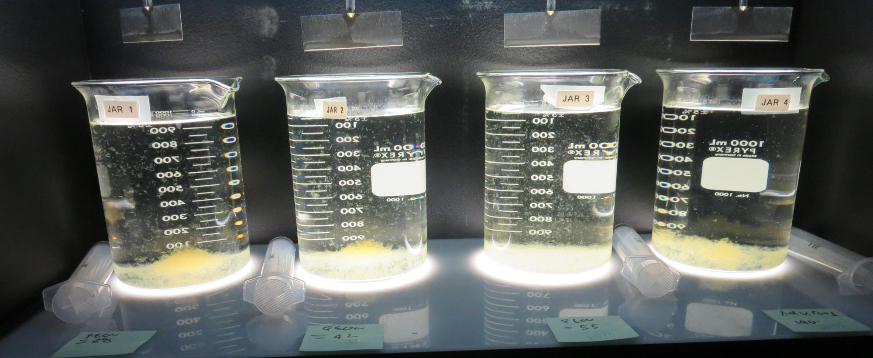
Jars 1-4: After 5 min of settling, 25 mL is syringed for filterability and %UVT/UVA.

Slide 17
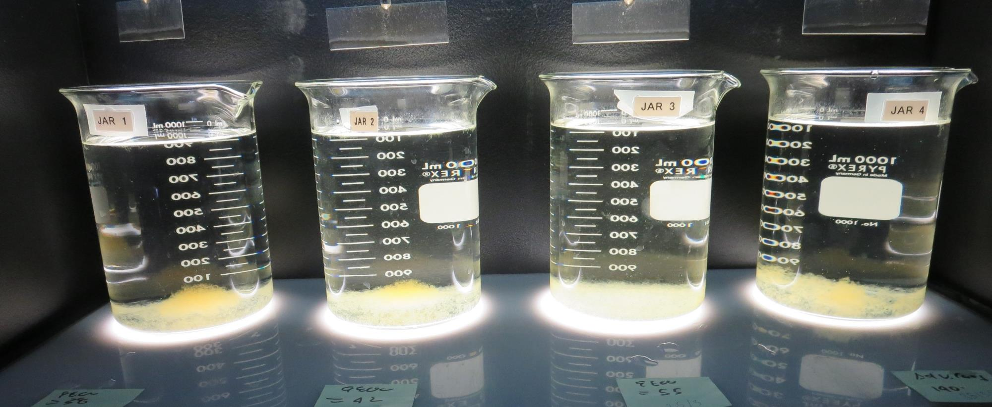
Jars 1-4: After 25-minutes of settling, settled water turbidity is taken.
38 mg/L 9800
Filtrate 0.14 NTU
UVT: 89.0%
UVA: 0.050/cm
UVA Reduction 36.7%
Settled: 0.53 NTU
42 mg/L 9800
Filtrate 0.14 NTU
UVT: 89.0%
UVA: 0.050/cm
UVA Reduction 36.7%
Settled: 0.54 NTU
55 mg/L 9800
Filtrate 0.13 NTU
UVT: 89.5%
UVA: 0.047/cm
UVA Reduction 40.5%
Settled: 0.40 NTU
140 mg/L Adv. Coag.
Filtrate 0.13 NTU
UVT: 88.4%
UVA: 0.053/cm
UVA Reduction 32.9%
Settled: 0.56 NTU

Slide 18
Jars 5-8 Test Flash Mix 30 Sec (200 RPM) Floc Mix 5 min (30 RPM) Applied Coagulants 9800/Adv. Coag.

Slide 19
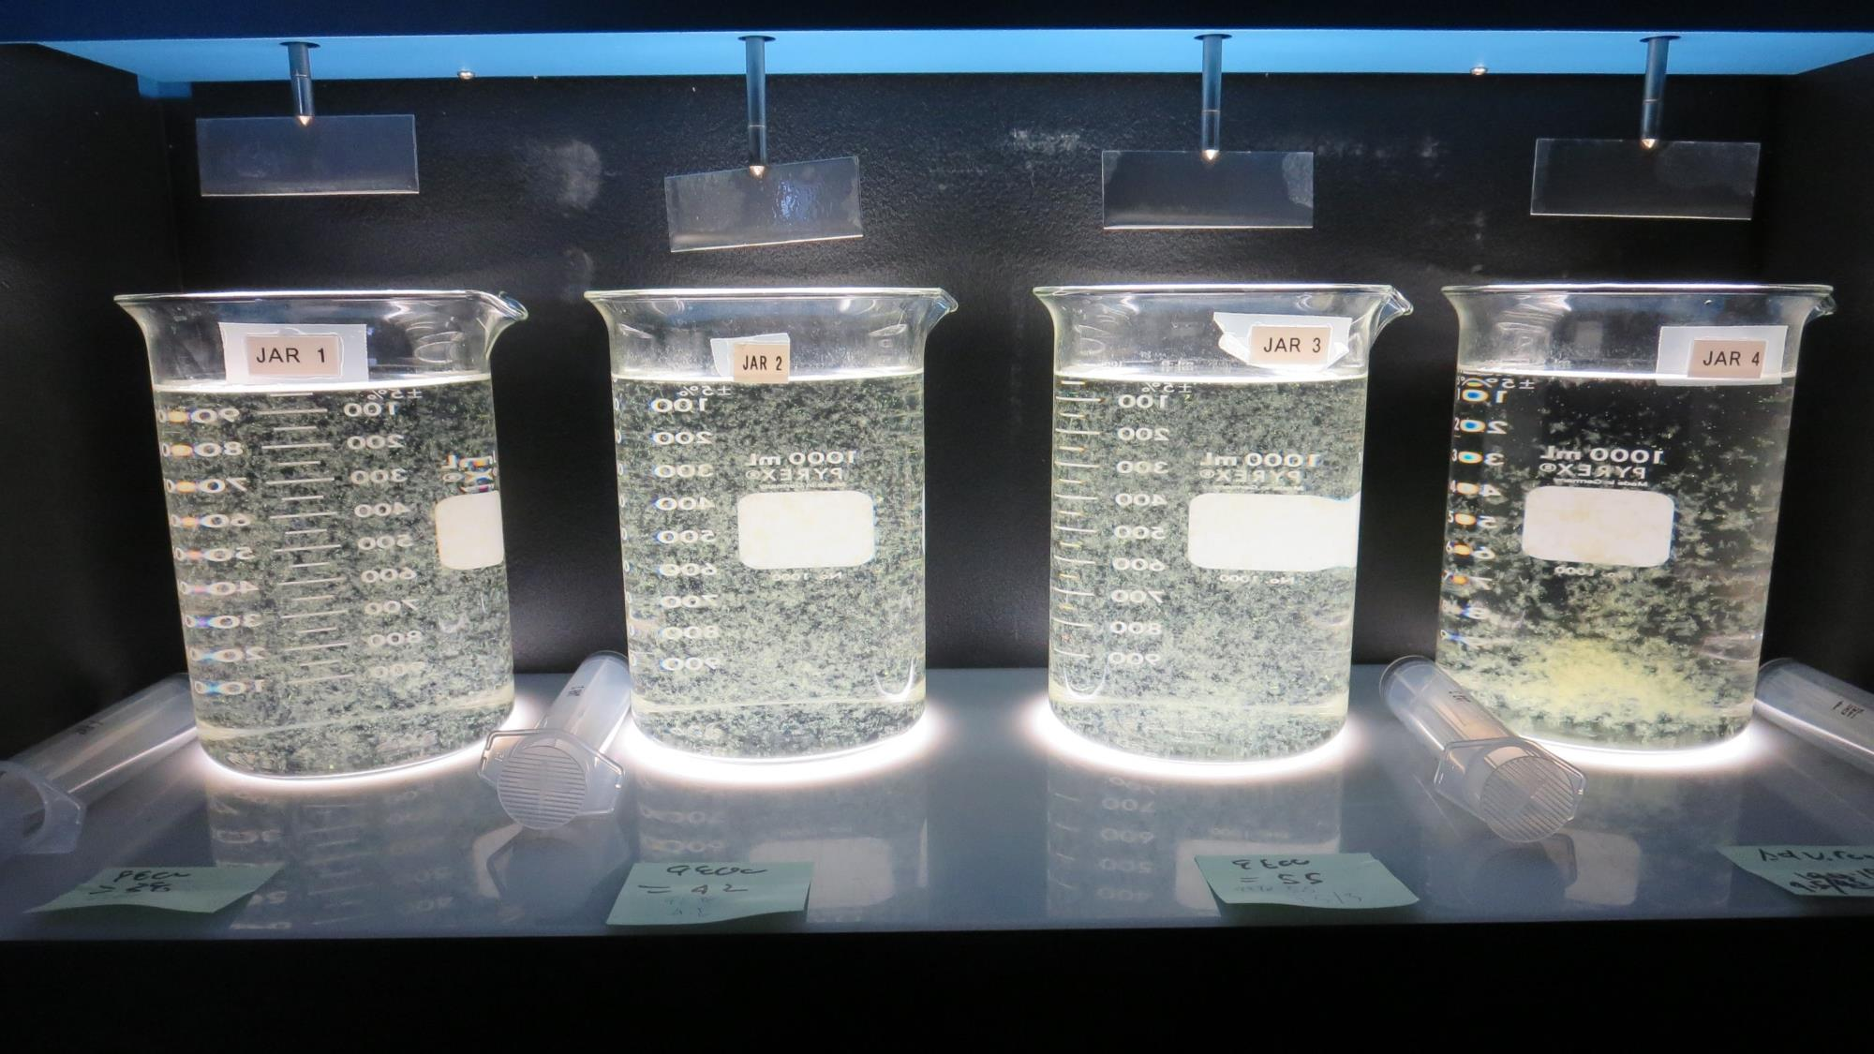
Jars 5-8: End of 5-minute flocculation (30 RPM) duration.
38 mg/L 9800
3.8 mg/L 9890
Filtrate 0.10 NTU
UVT: 89.1%
UVA: 0.049/cm
UVA Reduction 38%
Settled: 0.50 NTU
42 mg/L 9800
4.2 mg/L 9890
Filtrate 0.14 NTU
UVT: 88.8%
UVA: 0.051/cm
UVA Reduction 35.4%
Settled: 0.68 NTU
55 mg/L 9800
5.5 mg/L 9890
Filtrate 0.12 NTU
UVT: 89.2%
UVA: 0.049/cm
UVA Reduction 38%
Settled: 0.38 NTU
180 mg/L Adv. Coag.
Filtrate 0.14 NTU
UVT: 88.6%
UVA: 0.052/cm
UVA Reduction 34.2%
Settled: 0.57 NTU

Slide 20
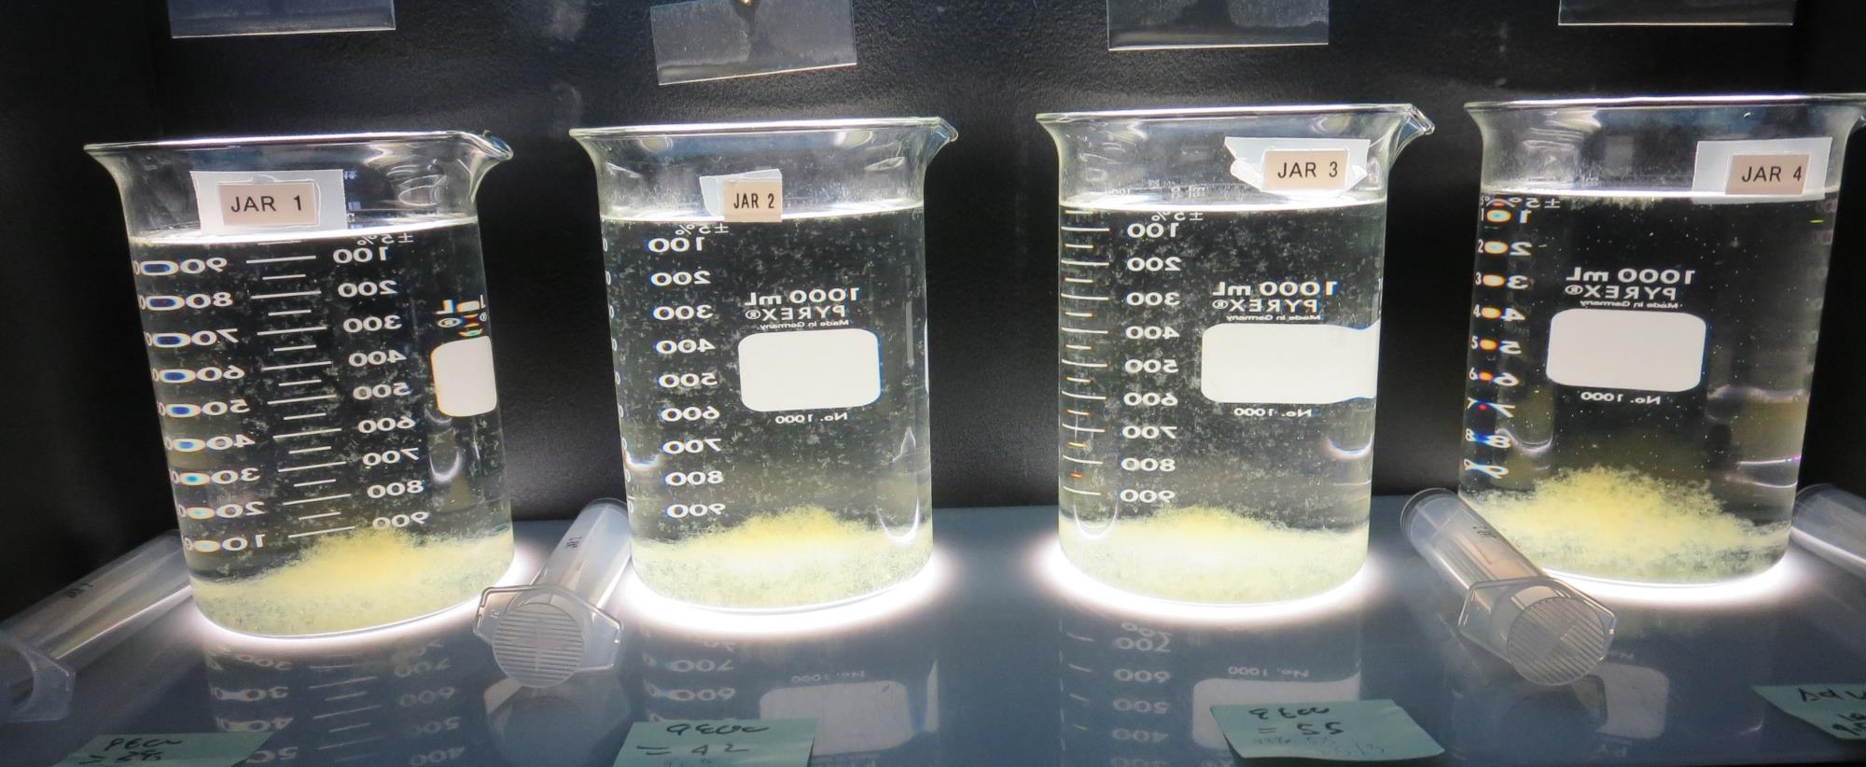
Jars 5-8: After 5 min of settling, 25 mL is syringed for filterability and %UVT/UVA.

Slide 21
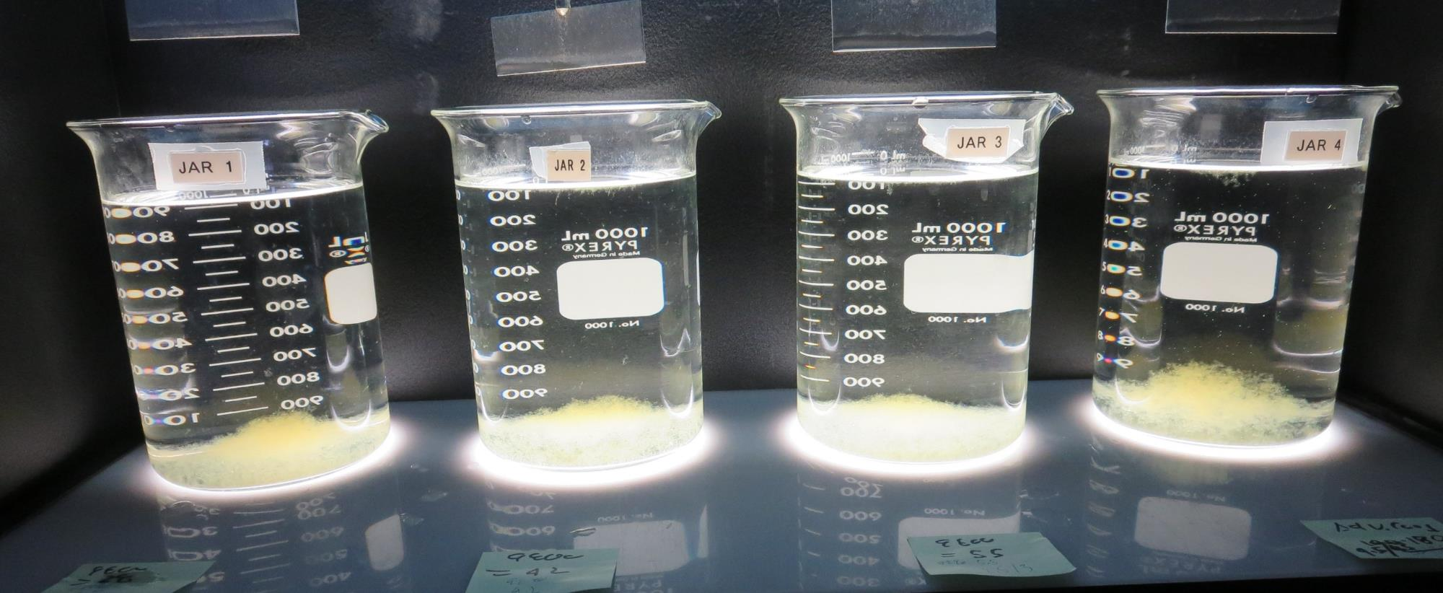
Jars 5-8: After 25-minutes of settling, settled water turbidity is taken.
38 mg/L 9800
3.8 mg/L 9890
Filtrate 0.10 NTU
UVT: 89.1%
UVA: 0.049/cm
UVA Reduction 38%
Settled: 0.50 NTU
42 mg/L 9800
4.2 mg/L 9890
Filtrate 0.14 NTU
UVT: 88.8%
UVA: 0.051/cm
UVA Reduction 35.4%
Settled: 0.68 NTU
55 mg/L 9800
5.5 mg/L 9890
Filtrate 0.12 NTU
UVT: 89.2%
UVA: 0.049/cm
UVA Reduction 38%
Settled: 0.38 NTU
180 mg/L Adv. Coag.
Filtrate 0.14 NTU
UVT: 88.6%
UVA: 0.052/cm
UVA Reduction 34.2%
Settled: 0.57 NTU

Slide 22
Jars 9-12 Test Flash Mix 30 Sec (200 RPM) Floc Mix 5 min (30 RPM) Applied Coagulant 9810

Slide 23
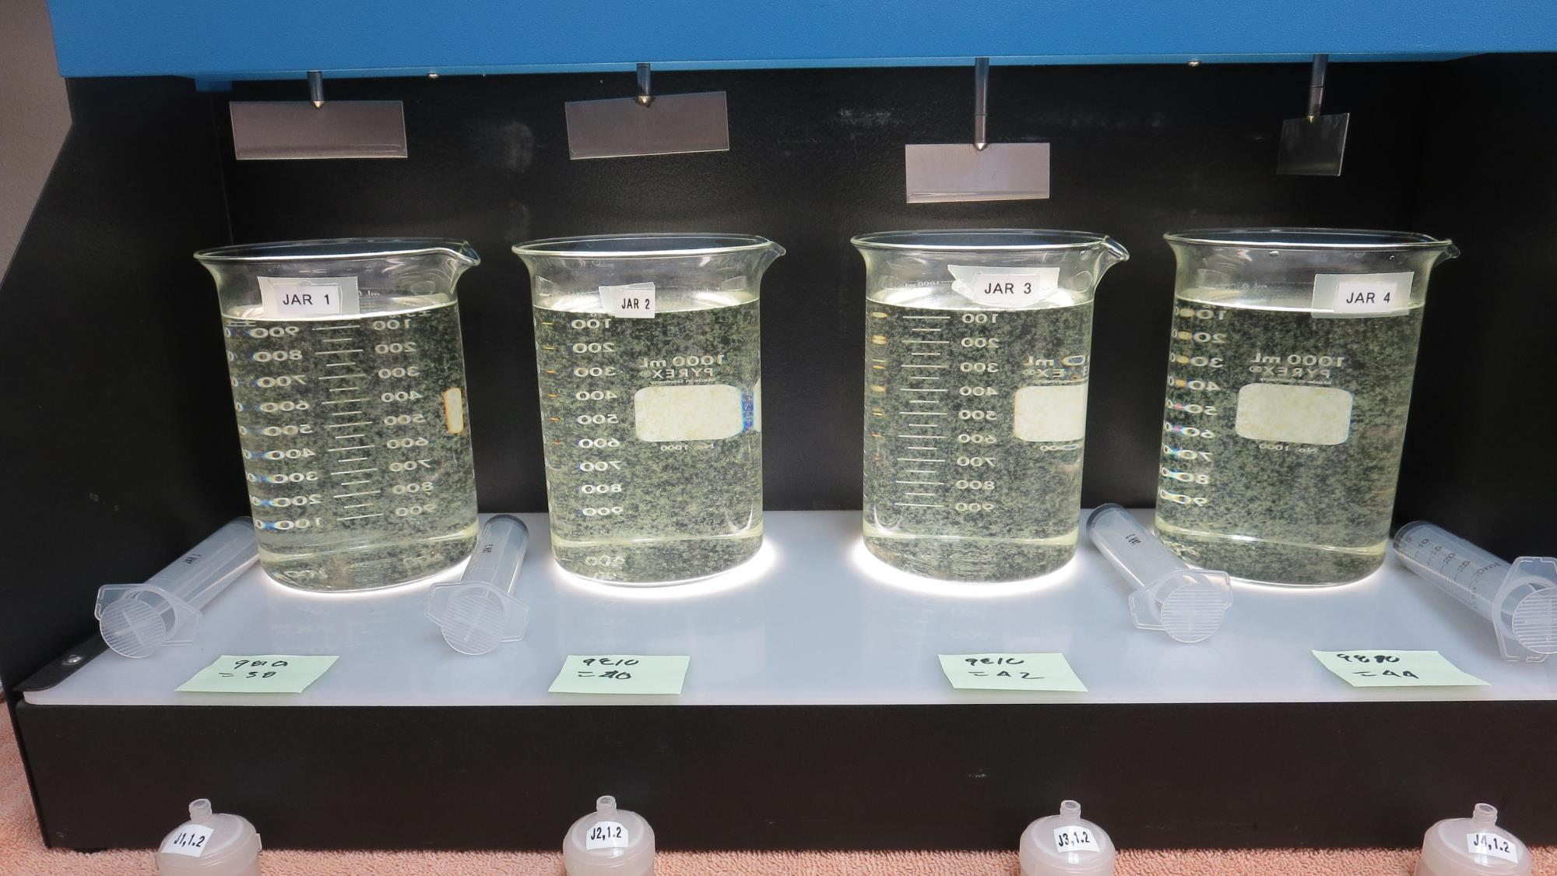
Jars 9-12: End of 5-minute flocculation (30 RPM) duration.
38 mg/L 9810
Filtrate 0.17 NTU
UVT: 89.5%
UVA: 0.048/cm
UVA Reduction 39.2%
Settled: 0.64 NTU
40 mg/L 9810
Filtrate 0.15 NTU
UVT: 88.8%
UVA: 0.051/cm
UVA Reduction 35.4%
Settled: 0.74 NTU
42 mg/L 9810
Filtrate 0.15 NTU
UVT: 89.1%
UVA: 0.050/cm
UVA Reduction 36.7%
Settled: 0.54 NTU
44 mg/L 9810
Filtrate 0.15 NTU
UVT: 89.2%
UVA: 0.049/cm
UVA Reduction 38%
Settled: 0.59 NTU

Slide 24
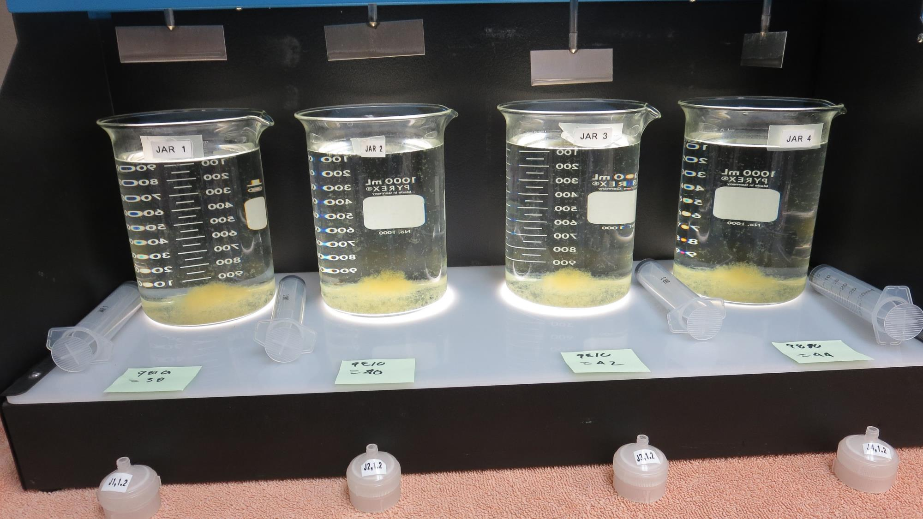
Jars 9-12: After 5 min of settling, 25 mL is syringed for filterability and %UVT/UVA.

Slide 25
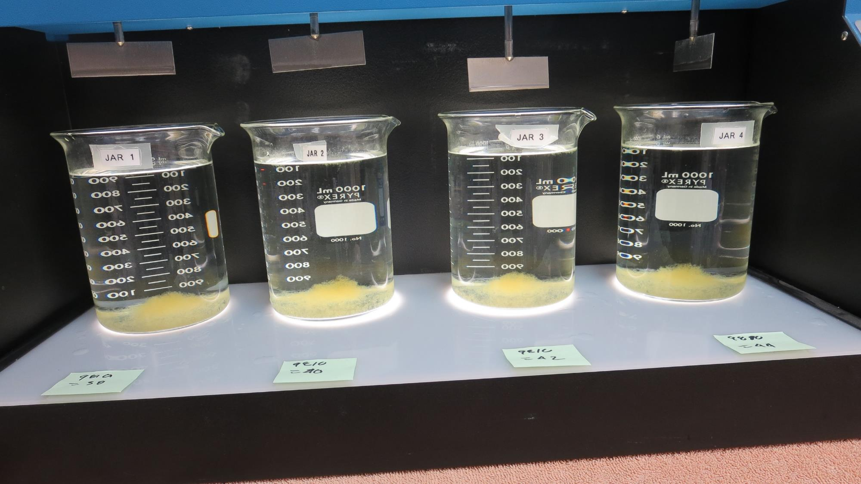
Jars 9-12: After 25-minutes of settling, settled water turbidity is taken.
38 mg/L 9810
Filtrate 0.17 NTU
UVT: 89.5%
UVA: 0.048/cm
UVA Reduction 39.2%
Settled: 0.64 NTU
40 mg/L 9810
Filtrate 0.15 NTU
UVT: 88.8%
UVA: 0.051/cm
UVA Reduction 35.4%
Settled: 0.74 NTU
42 mg/L 9810
Filtrate 0.15 NTU
UVT: 89.1%
UVA: 0.050/cm
UVA Reduction 36.7%
Settled: 0.54 NTU
44 mg/L 9810
Filtrate 0.15 NTU
UVT: 89.2%
UVA: 0.049/cm
UVA Reduction 38%
Settled: 0.59 NTU

Slide 26
Jars 13-16 Test Flash Mix 30 Sec (200 RPM) Floc Mix 5 min (30 RPM) Applied Acid (H₂SO₄) + Applied Coagulant 9800

Slide 27
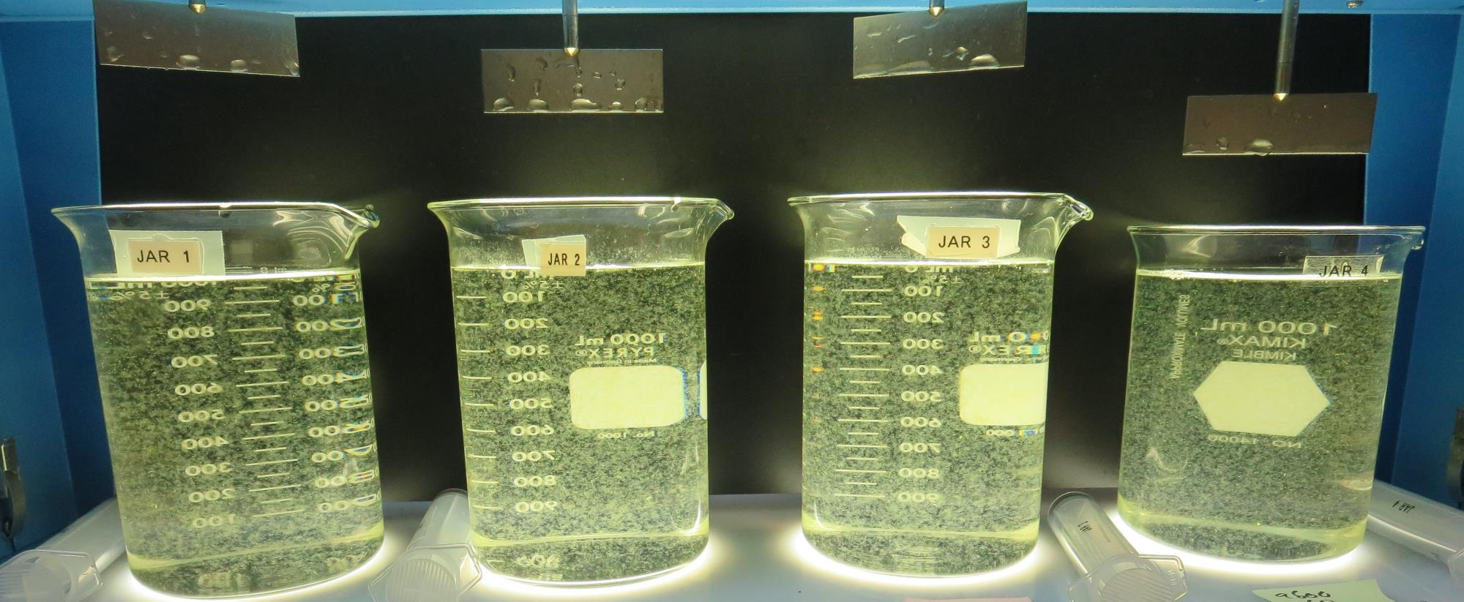
Jars 13-16: End of 5-minute flocculation (30 RPM) duration.
0 mg/L H₂SO₄
40 mg/L 9800
Filtrate 0.14 NTU
UVT: 89.5%
UVA: 0.048/cm
UVA Reduction 39.2%
Settled: 0.52 NTU
20 mg/L H₂SO₄
40 mg/L 9800
Filtrate 0.12 NTU
UVT: 90.4%
UVA: 0.043/cm
UVA Reduction 45.6%
Settled: 0.38 NTU
0 mg/L H₂SO₄
60 mg/L 9800
Filtrate 0.13 NTU
UVT: 89.7%
UVA: 0.047/cm
UVA Reduction 40.5%
Settled: 0.40 NTU
20 mg/L H₂SO₄
60 mg/L 9800
Filtrate 0.09 NTU
UVT: 91.4%
UVA: 0.039/cm
UVA Reduction 50.6%
Settled: 0.31 NTU

Slide 28
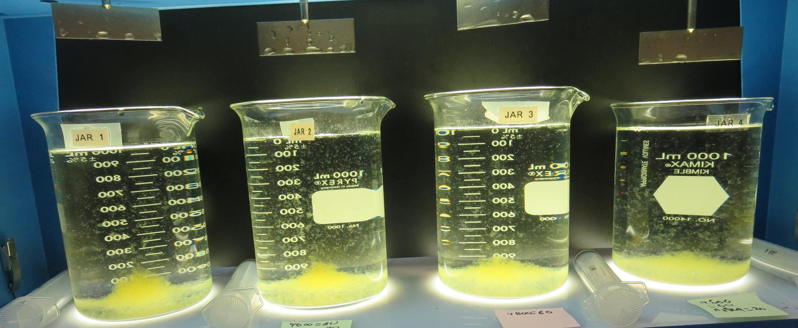
Jars 13-16: After 5 min of settling, 25 mL is syringed for filterability and %UVT/UVA.

Slide 29
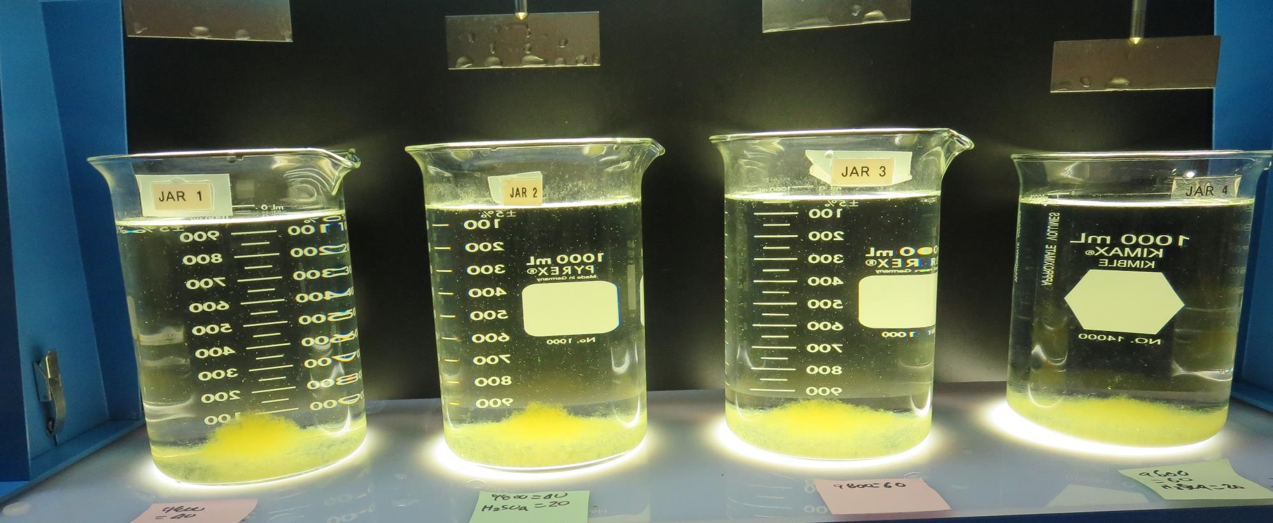
Jars 13-16: After 25-minutes of settling, settled water turbidity is taken.
0 mg/L H₂SO₄
40 mg/L 9800
Filtrate 0.14 NTU
UVT: 89.5%
UVA: 0.048/cm
UVA Reduction 39.2%
Settled: 0.52 NTU
20 mg/L H₂SO₄
40 mg/L 9800
Filtrate 0.12 NTU
UVT: 90.4%
UVA: 0.043/cm
UVA Reduction 45.6%
Settled: 0.38 NTU
0 mg/L H₂SO₄
60 mg/L 9800
Filtrate 0.13 NTU
UVT: 89.7%
UVA: 0.047/cm
UVA Reduction 40.5%
Settled: 0.40 NTU
20 mg/L H₂SO₄
60 mg/L 9800
Filtrate 0.09 NTU
UVT: 91.4%
UVA: 0.039/cm
UVA Reduction 50.6%
Settled: 0.31 NTU

Slide 30
Jars 17-20 Test Flash Mix 30 Sec (200 RPM) Floc Mix 5 min (30 RPM) Applied Acid (H₂SO₄) + Applied Coagulant 9800

Slide 31
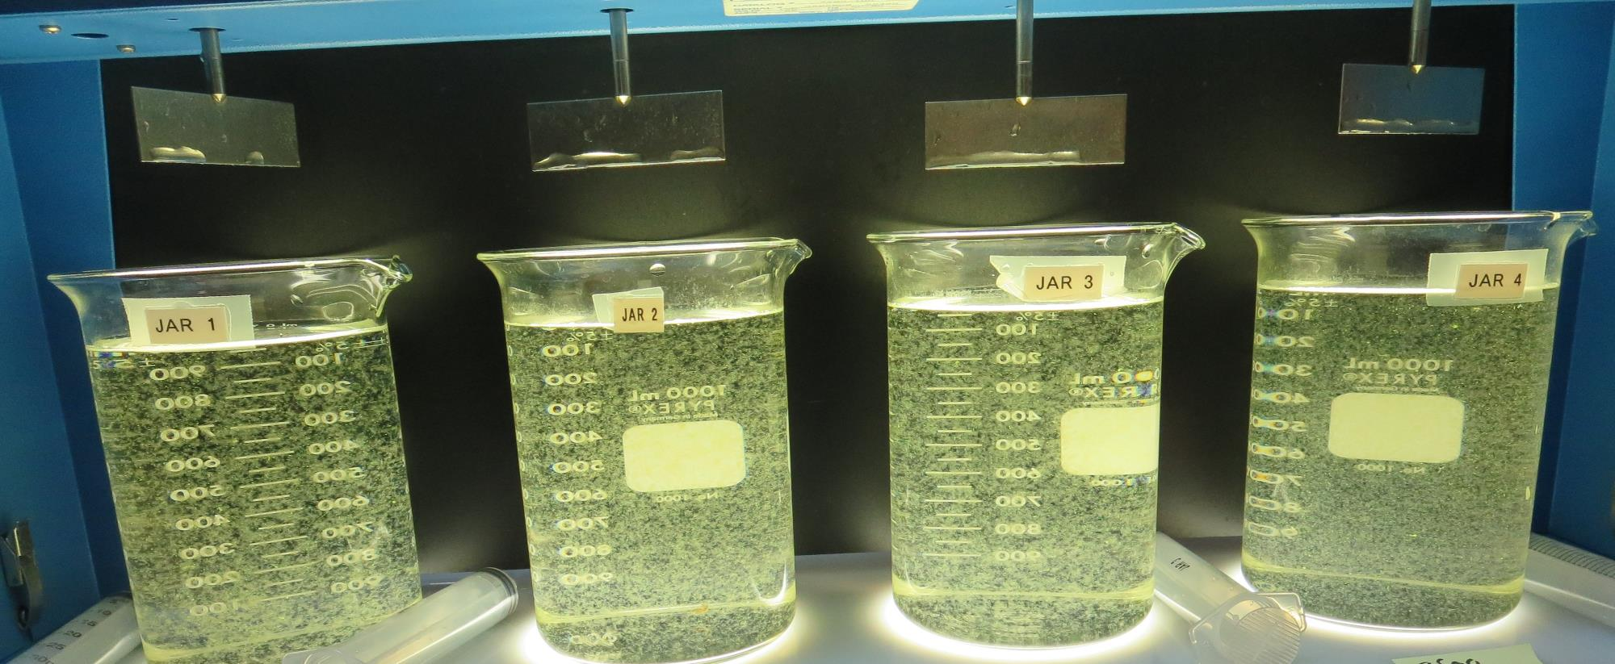
Jars 17-20: End of 5-minute flocculation (30 RPM) duration.
0 mg/L H₂SO₄
40 mg/L 9800
Filtrate 0.14 NTU
UVT: 89.5%
UVA: 0.047/cm
UVA Reduction 40.5%
Settled: 0.40 NTU
30 mg/L H₂SO₄
40 mg/L 9800
Filtrate 0.12 NTU
UVT: 91.1%
UVA: 0.040/cm
UVA Reduction 49.4%
Settled: 0.47 NTU
0 mg/L H₂SO₄
60 mg/L 9800
Filtrate 0.11 NTU
UVT: 90.1%
UVA: 0.045/cm
UVA Reduction 43%
Settled: 0.40 NTU
30 mg/L H₂SO₄
60 mg/L 9800
Filtrate 0.08 NTU
UVT: 92.0%
UVA: 0.036/cm
UVA Reduction 54.4%
Settled: 0.38 NTU

Slide 32
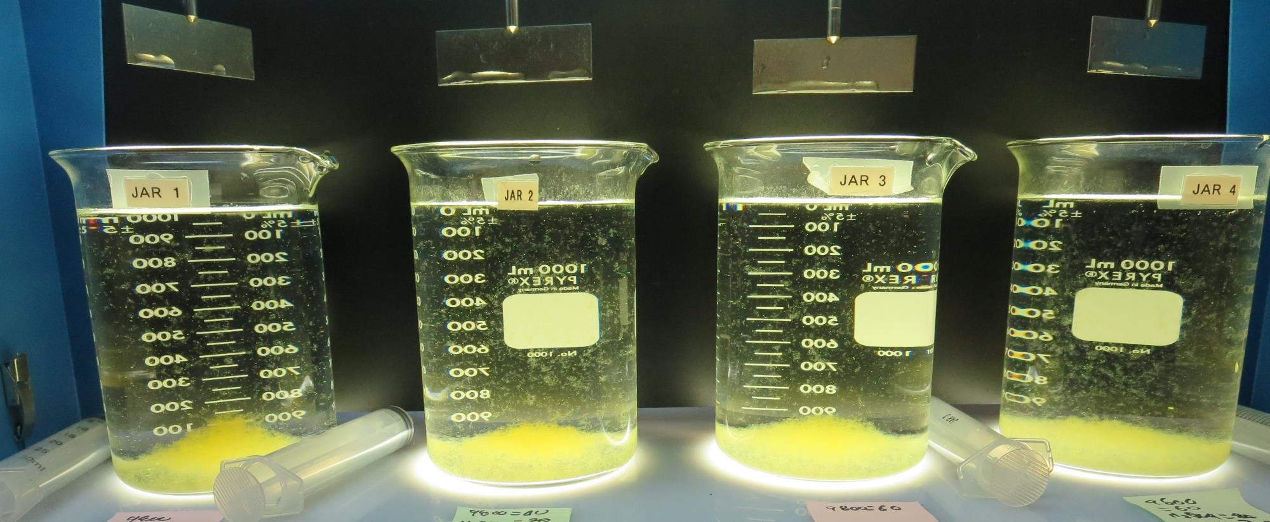
Jars 17-20: After 5 min of settling, 25 mL is syringed for filterability and %UVT/UVA.

Slide 33
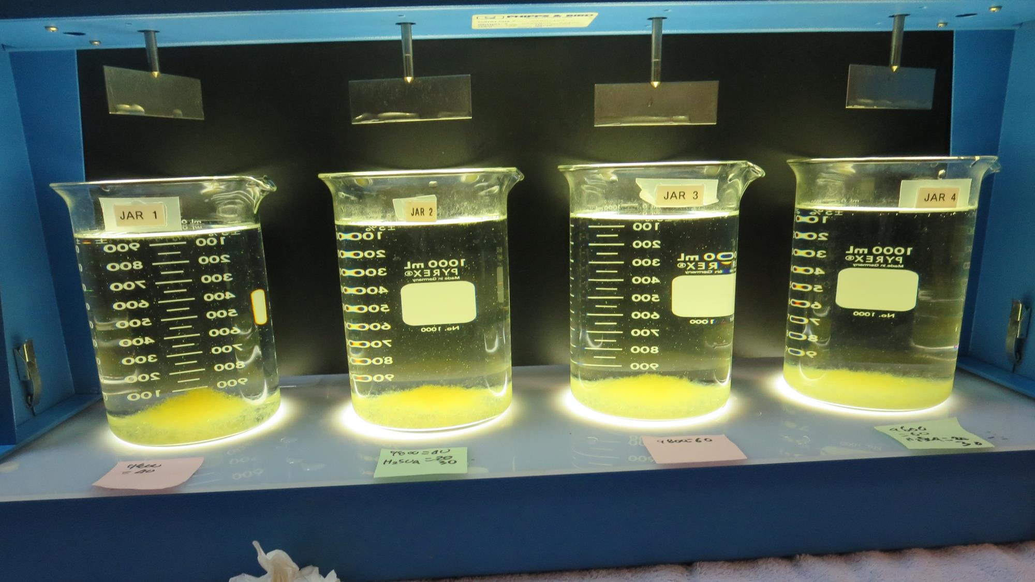
Jars 17-20: After 25-minutes of settling, settled water turbidity is taken.
0 mg/L H₂SO₄
40 mg/L 9800
Filtrate 0.14 NTU
UVT: 89.5%
UVA: 0.047/cm
UVA Reduction 40.5%
Settled: 0.40 NTU
30 mg/L H₂SO₄
40 mg/L 9800
Filtrate 0.12 NTU
UVT: 91.1%
UVA: 0.040/cm
UVA Reduction 49.4%
Settled: 0.47 NTU
0 mg/L H₂SO₄
60 mg/L 9800
Filtrate 0.11 NTU
UVT: 90.1%
UVA: 0.045/cm
UVA Reduction 43%
Settled: 0.40 NTU
30 mg/L H₂SO₄
60 mg/L 9800
Filtrate 0.08 NTU
UVT: 92.0%
UVA: 0.036/cm
UVA Reduction 54.4%
Settled: 0.38 NTU

Slide 34
Jars 21-24 Test Flash Mix 30 Sec (200 RPM) Floc Mix 5 min (30 RPM) Applied Acid (H₂SO₄) + Applied Coagulant Advanced Coagulant

Slide 35
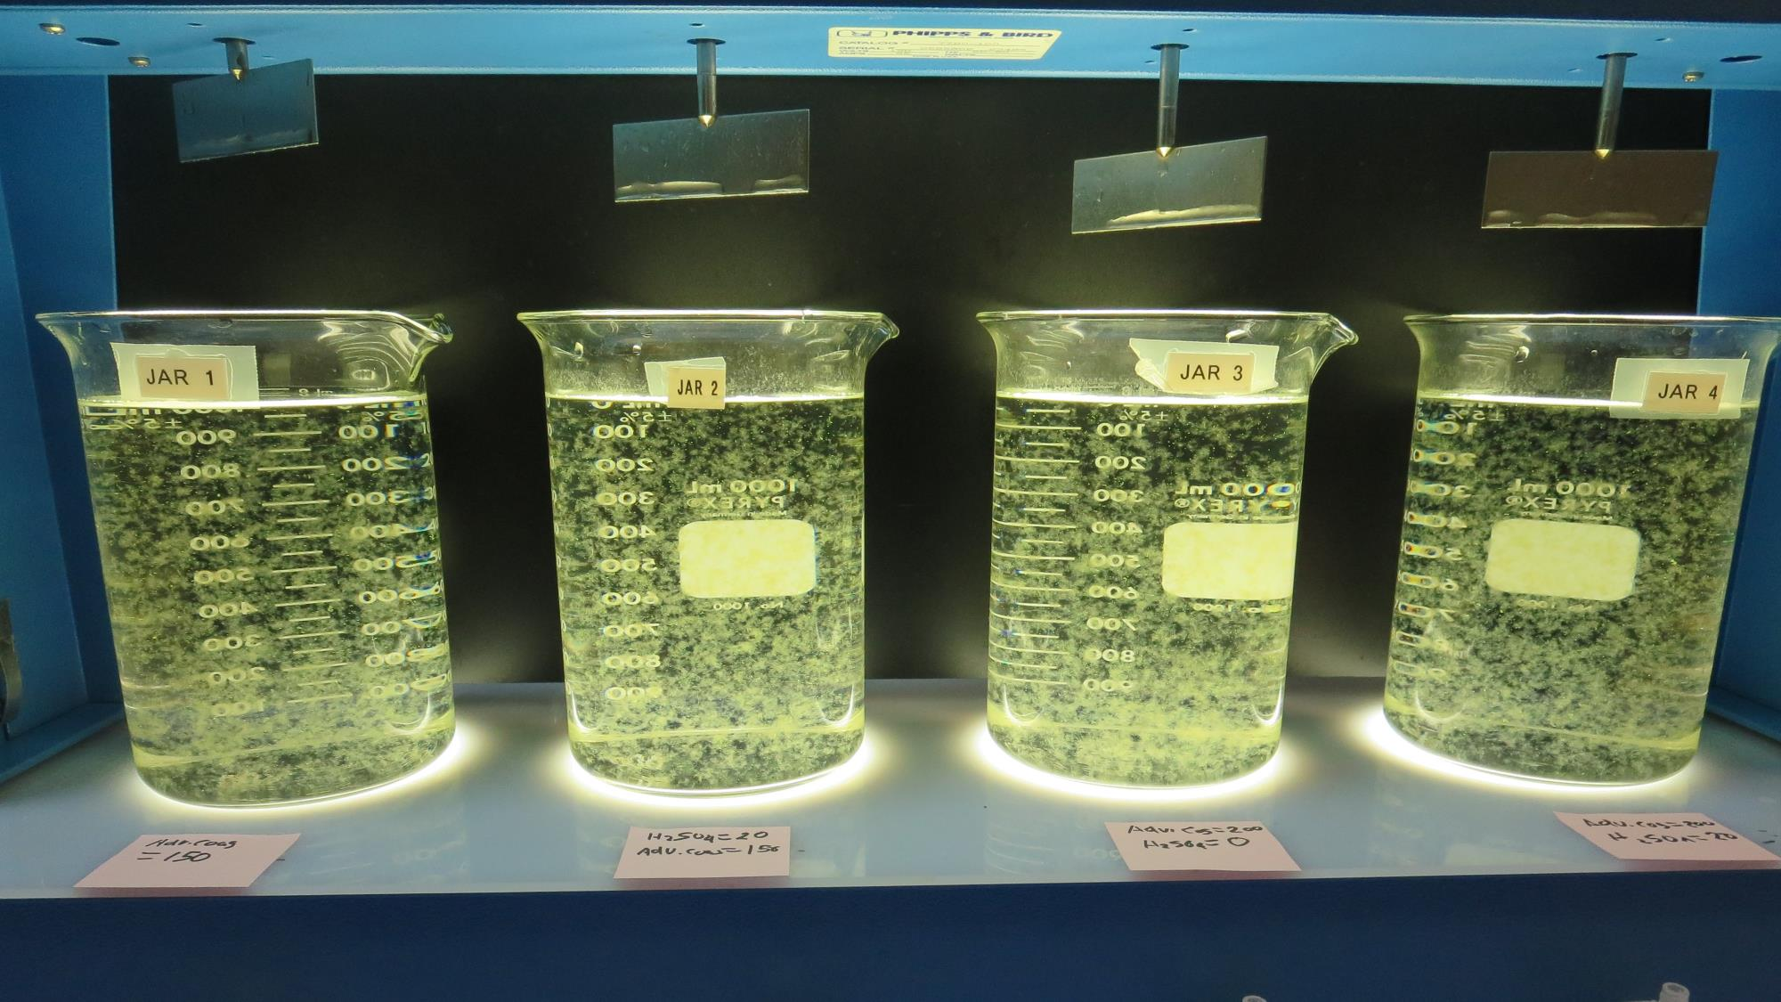
Jars 21-24: End of 5-minute flocculation (30 RPM) duration.
0 mg/L H₂SO₄
150 mg/L Adv Coag.
Filtrate 0.15 NTU
UVT: 89.8%
UVA: 0.046/cm
UVA Reduction 41.8%
Settled: 0.93 NTU
20 mg/L H₂SO₄
150 mg/L Adv Coag.
Filtrate 0.14 NTU
UVT: 91.6%
UVA: 0.038/cm
UVA Reduction 51.9%
Settled: 0.41 NTU
0 mg/L H₂SO₄
200 mg/L Adv Coag.
Filtrate 0.11 NTU
UVT: 91.1%
UVA: 0.040/cm
UVA Reduction 49.4%
Settled: 0.55 NTU
20 mg/L H₂SO₄
200 mg/L Adv Coag.
Filtrate 0.09 NTU
UVT: 92.5%
UVA: 0.033/cm
UVA Reduction 58.2%
Settled: 0.17 NTU

Slide 36
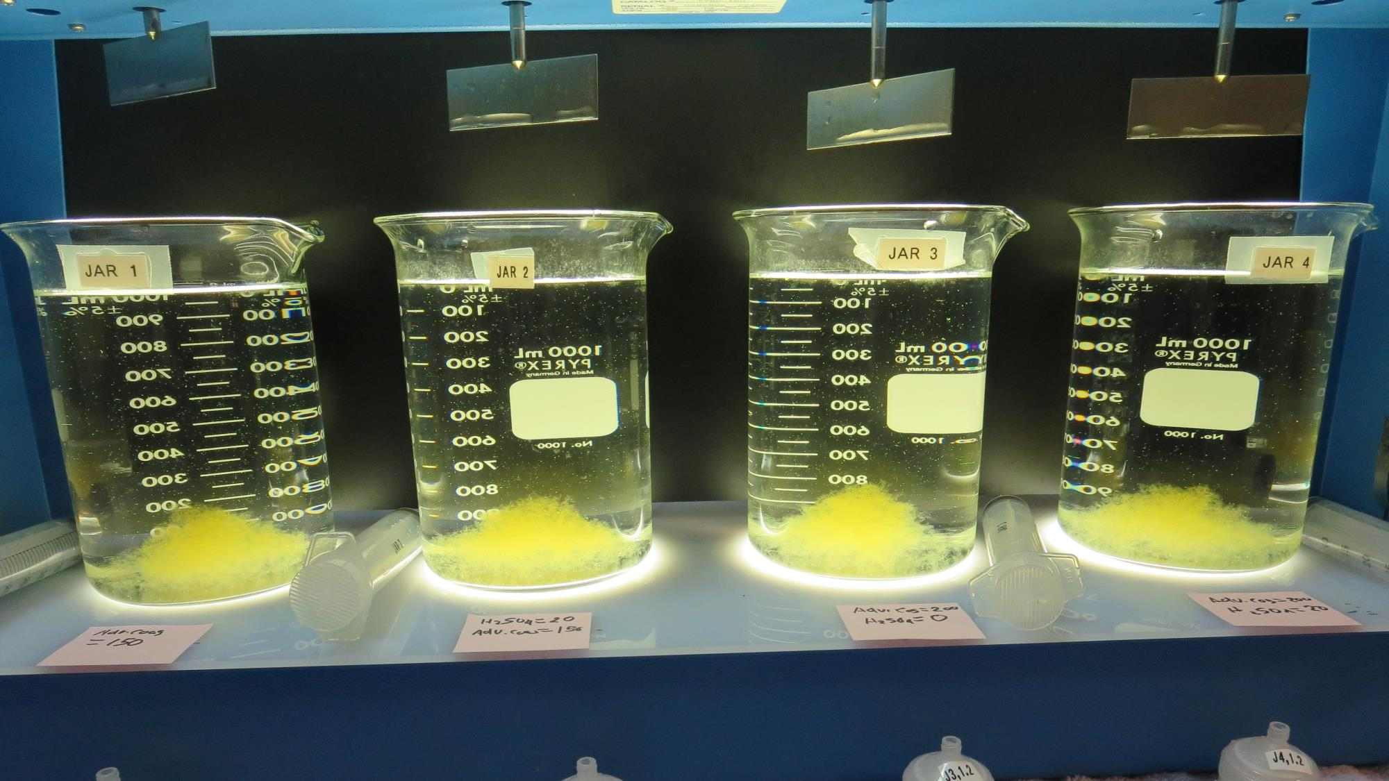
Jars 21-24: After 5 min of settling, 25 mL is syringed for filterability and %UVT/UVA.

Slide 37
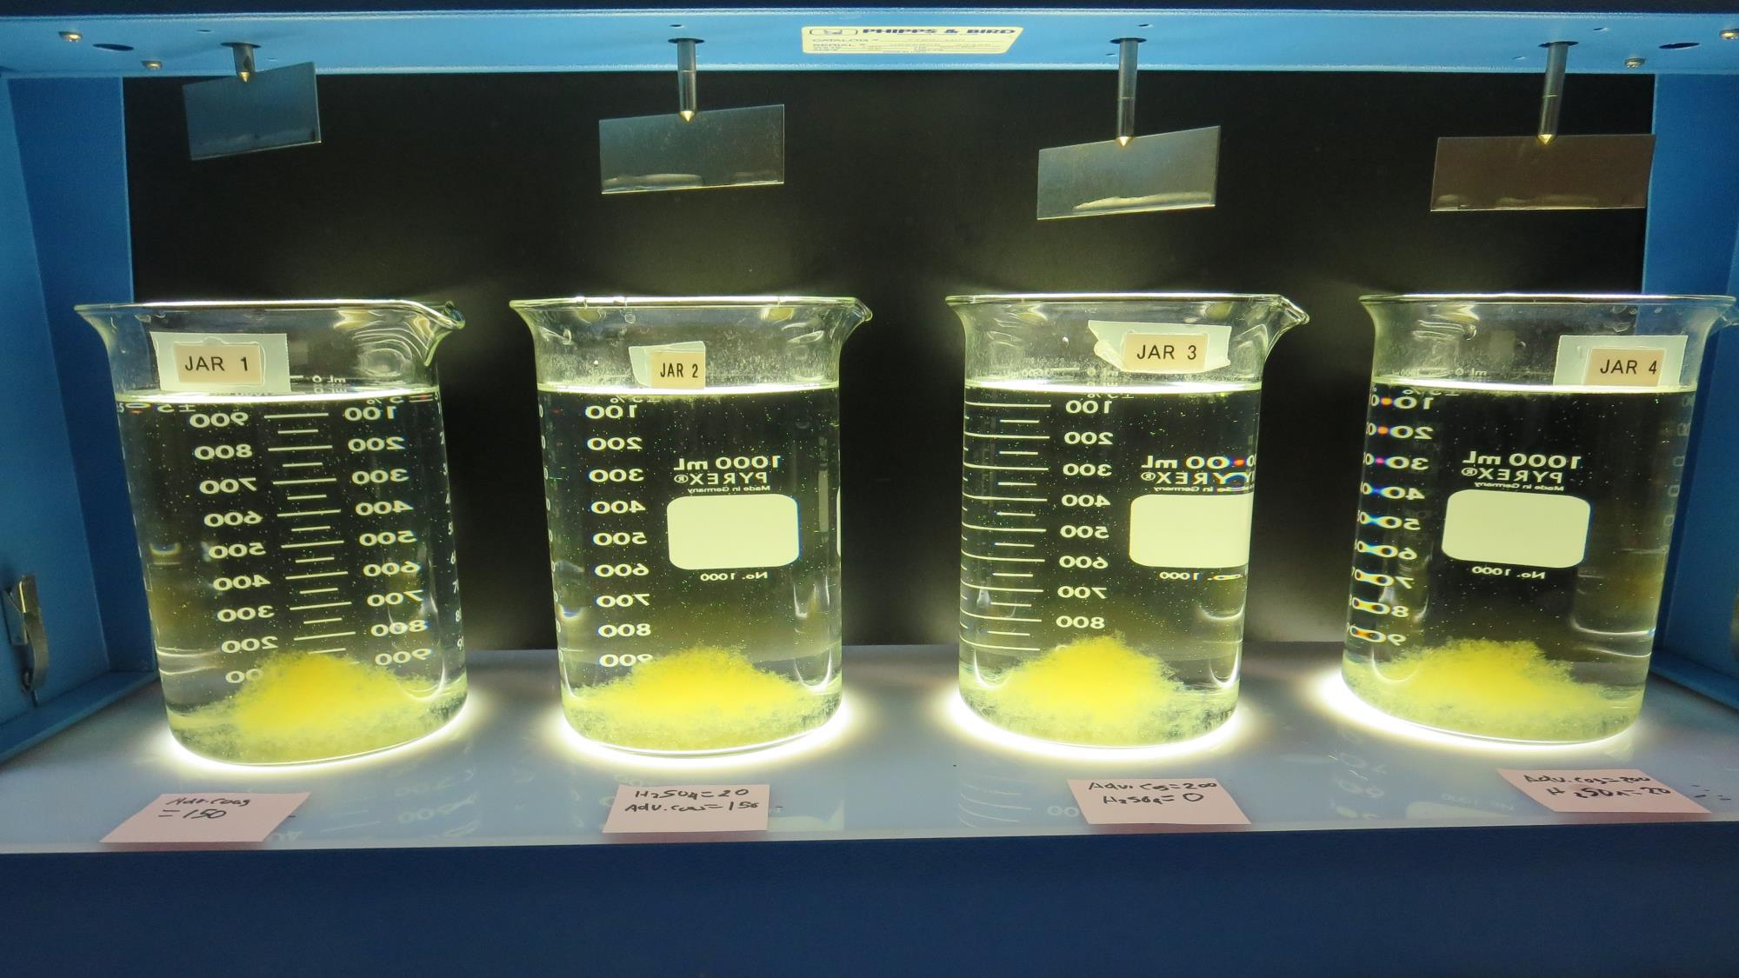
Jars 21-24: After 25-minutes of settling, settled water turbidity is taken.
0 mg/L H₂SO₄
150 mg/L Adv Coag.
Filtrate 0.15 NTU
UVT: 89.8%
UVA: 0.046/cm
UVA Reduction 41.8%
Settled: 0.93 NTU
20 mg/L H₂SO₄
150 mg/L Adv Coag.
Filtrate 0.14 NTU
UVT: 91.6%
UVA: 0.038/cm
UVA Reduction 51.9%
Settled: 0.41 NTU
0 mg/L H₂SO₄
200 mg/L Adv Coag.
Filtrate 0.11 NTU
UVT: 91.1%
UVA: 0.040/cm
UVA Reduction 49.4%
Settled: 0.55 NTU
20 mg/L H₂SO₄
200 mg/L Adv Coag.
Filtrate 0.09 NTU
UVT: 92.5%
UVA: 0.033/cm
UVA Reduction 58.2%
Settled: 0.17 NTU

Slide 38
Jars 25-28 Test Flash Mix 30 Sec (200 RPM) Floc Mix 5 min (30 RPM) Applied Acid (H₂SO₄) + Applied Coagulant Advanced Coagulant

Slide 39
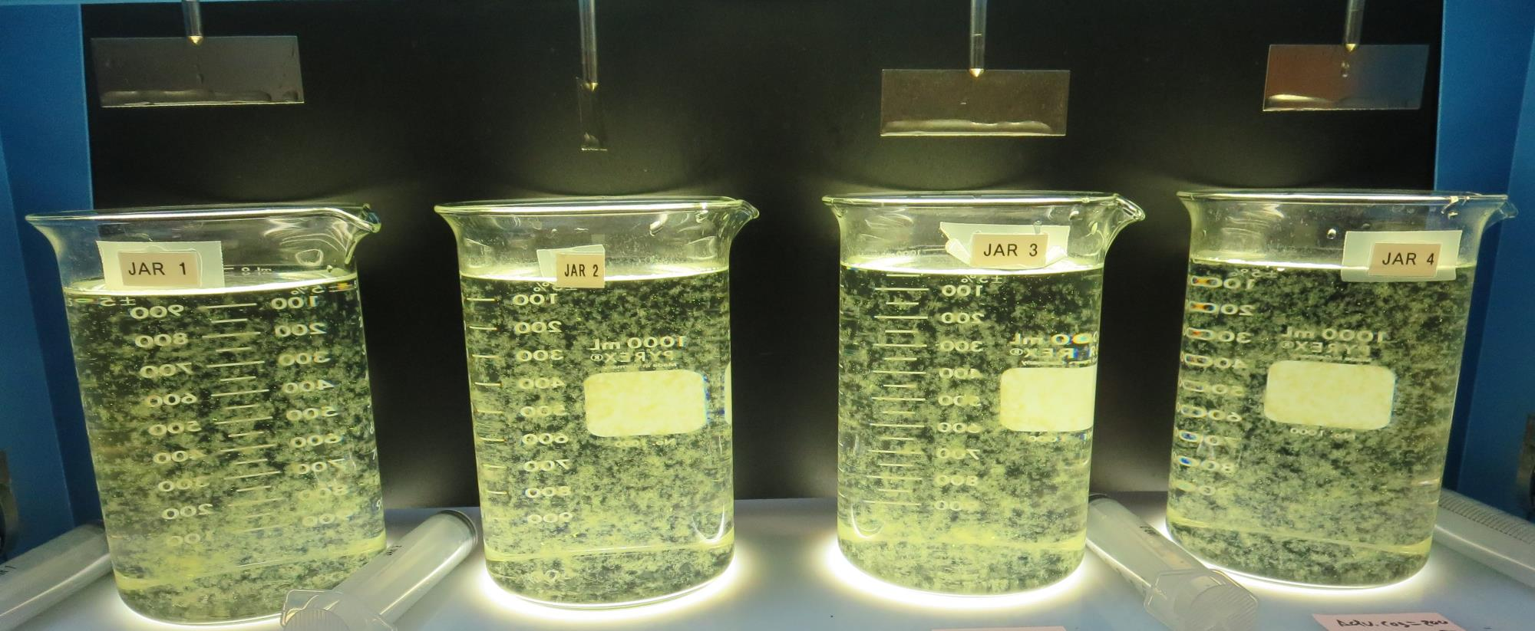
Jars 25-28: End of 5-minute flocculation (30 RPM) duration.
0 mg/L H₂SO₄
150 mg/L Adv Coag.
Filtrate 0.14 NTU
UVT: 90.1%
UVA: 0.045/cm
UVA Reduction 43%
Settled: 0.73 NTU
30 mg/L H₂SO₄
150 mg/L Adv Coag.
Filtrate 0.12 NTU
UVT: 92.1%
UVA: 0.035/cm
UVA Reduction 55.7%
Settled: 0.50 NTU
0 mg/L H₂SO₄
200 mg/L Adv Coag.
Filtrate 0.13 NTU
UVT: 90.8%
UVA: 0.040/cm
UVA Reduction 48.1%
Settled: 0.50 NTU
30 mg/L H₂SO₄
200 mg/L Adv Coag.
Filtrate 0.08 NTU
UVT: 92.7%
UVA: 0.032/cm
UVA Reduction 59.5%
Settled: 0.22 NTU

Slide 40
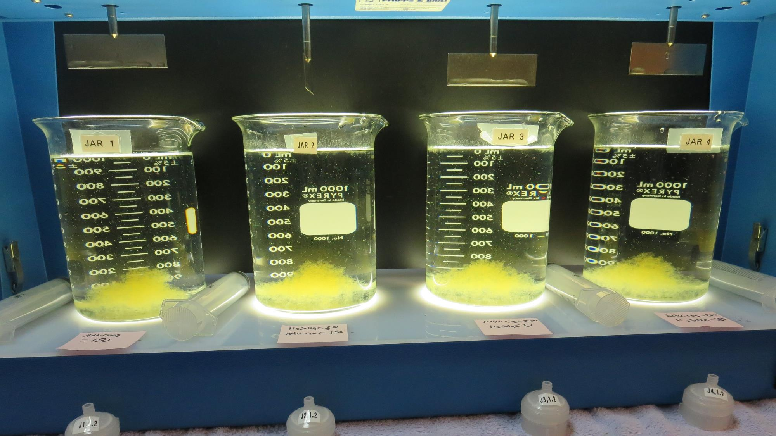
Jars 25-28: After 5 min of settling, 25 mL is syringed for filterability and %UVT/UVA.

Slide 41
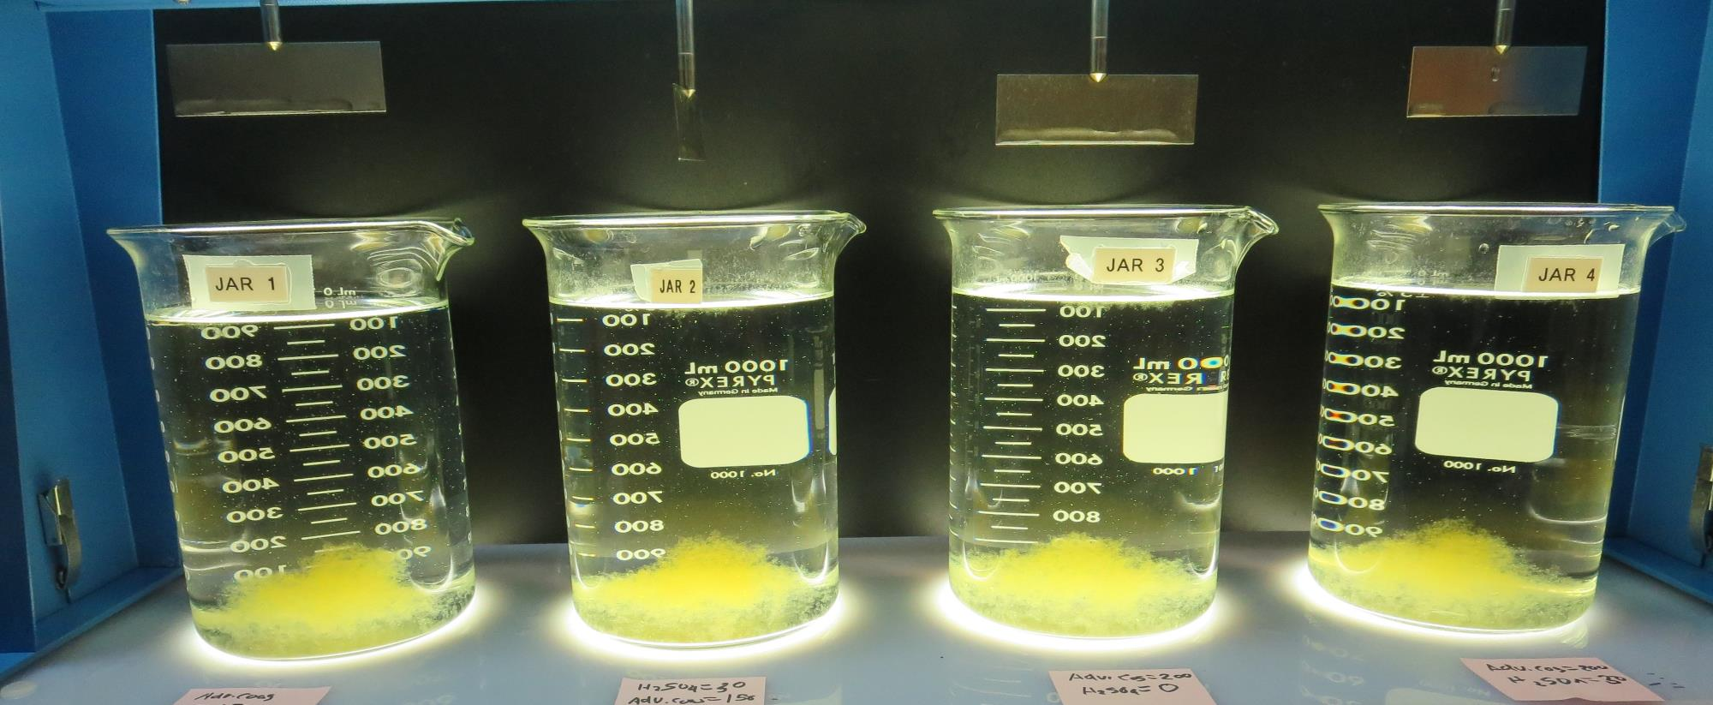
Jars 25-28: After 25-minutes of settling, settled water turbidity is taken.
0 mg/L H₂SO₄
150 mg/L Adv Coag.
Filtrate 0.14 NTU
UVT: 90.1%
UVA: 0.045/cm
UVA Reduction 43%
Settled: 0.73 NTU
30 mg/L H₂SO₄
150 mg/L Adv Coag.
Filtrate 0.12 NTU
UVT: 92.1%
UVA: 0.035/cm
UVA Reduction 55.7%
Settled: 0.50 NTU
0 mg/L H₂SO₄
200 mg/L Adv Coag.
Filtrate 0.13 NTU
UVT: 90.8%
UVA: 0.040/cm
UVA Reduction 48.1%
Settled: 0.50 NTU
30 mg/L H₂SO₄
200 mg/L Adv Coag.
Filtrate 0.08 NTU
UVT: 92.7%
UVA: 0.032/cm
UVA Reduction 59.5%
Settled: 0.22 NTU

Slide 42
Jars 29-32 Test Flash Mix 30 Sec (200 RPM) Floc Mix 5 min (30 RPM) Applied Acid (H₂SO₄) + Applied Coagulants 9800/Advanced Coagulant

Slide 43
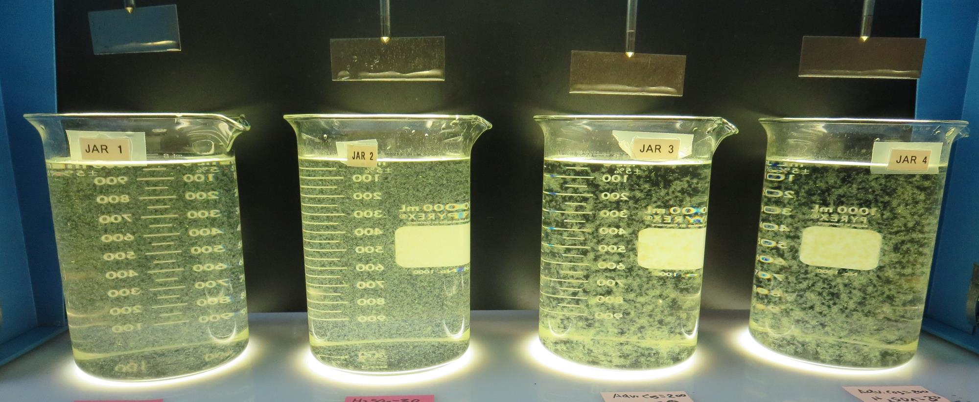
Jars 29-32: End of 5-minute flocculation (30 RPM) duration.
20 mg/L H₂SO₄
60 mg/L 9800
Filtrate 0.08 NTU
UVT: 91.7%
UVA: 0.037/cm
UVA Reduction 53.2%
Settled: 0.31 NTU
30 mg/L H₂SO₄
60 mg/L 9800
Filtrate 0.10 NTU
UVT: 91.7%
UVA: 0.037/cm
UVA Reduction 53.2%
Settled: 0.37 NTU
20 mg/L H₂SO₄
200 mg/L Adv Coag.
Filtrate 0.10 NTU
UVT: 92.6%
UVA: 0.033/cm
UVA Reduction 58.2%
Settled: 0.32 NTU
30 mg/L H₂SO₄
200 mg/L Adv Coag.
Filtrate 0.08 NTU
UVT: 93.1%
UVA: 0.031/cm
UVA Reduction 60.8%
Settled: 0.17 NTU

Slide 44
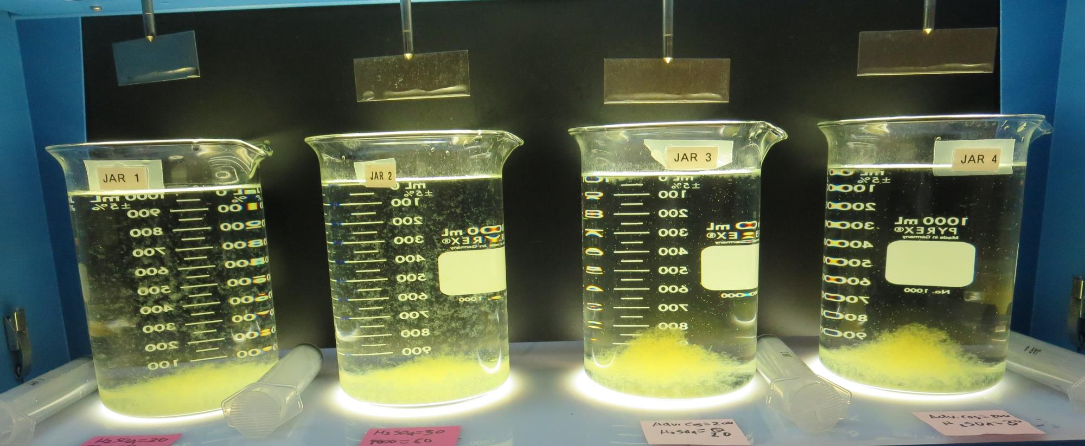
Jars 29-32: After 5 min of settling, 25 mL is syringed for filterability and %UVT/UVA.

Slide 45
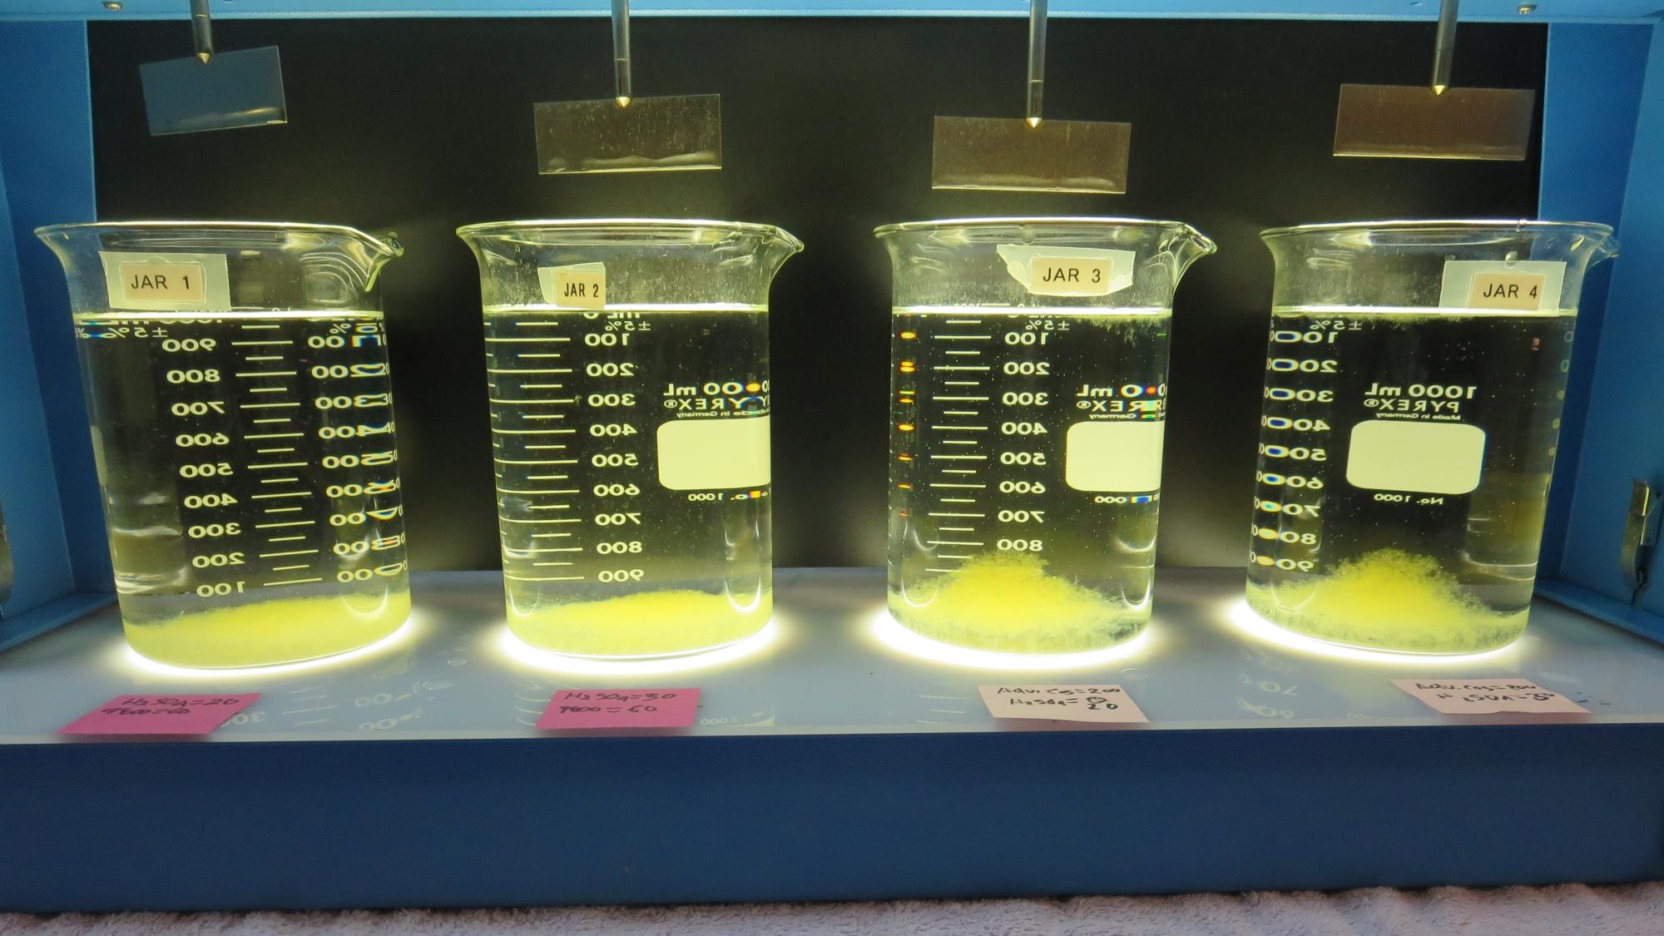
Jars 29-32: After 25-minutes of settling, settled water turbidity is taken.
20 mg/L H₂SO₄
60 mg/L 9800
Filtrate 0.08 NTU
UVT: 91.7%
UVA: 0.037/cm
UVA Reduction 53.2%
Settled: 0.31 NTU
30 mg/L H₂SO₄
60 mg/L 9800
Filtrate 0.10 NTU
UVT: 91.7%
UVA: 0.037/cm
UVA Reduction 53.2%
Settled: 0.37 NTU
20 mg/L H₂SO₄
200 mg/L Adv Coag.
Filtrate 0.10 NTU
UVT: 92.6%
UVA: 0.033/cm
UVA Reduction 58.2%
Settled: 0.32 NTU
30 mg/L H₂SO₄
200 mg/L Adv Coag.
Filtrate 0.08 NTU
UVT: 93.1%
UVA: 0.031/cm
UVA Reduction 60.8%
Settled: 0.17 NTU

Slide 46
Jar Testing for 1-Liter Jars: Procedures for Most Treatment Plants
Fill jars with source water prior to coagulant injection and set paddle speed at 30 rpm
Add chemicals (i.e., NaOCl, primary coagulant, coagulant aid) to each jar
Flash mix for 15-60 seconds (200 rpm)
Slow mix for 5 minutes (20-30 rpm)
Settled for 5 minutes. Syringe 25 mL from each jar taken 1-inch below surface (25 mL/12 sec rate)
Filtered through 1.2 um isopore membrane into cuvette drip rate, 15 mL/(50-90 sec)
Measure filtrate turbidity, chlorine residual and %UVT/UVA
Measure settled water turbidity after 25 minutes of total setting
Record all data

Slide 47
Jar Test Filterability Test Equipment
Turbidity Instrument
Syringe w/Luer-Lock Tip, 30 cc
(part#: 2225800, by Hach)
Swinnex Filter Holder, 25 mm (part#: SX0002500)
Isopore Membrane Filter, 1.2 um absolute
pore size,
Φ= 25 mm , thickness: 24 um,
hydrophilic polycarbonate membrane
(part #: RTTP02500)
Go to Sigma-Aldrich for laboratory supplies http://www.sigmaaldrich.com/united-states.html

Slide 48
Isopore Membrane Information
Categories | Information
trade name | Isopore
filter color | White
chemistry | Polycarbonate (PC)
water flow rate | Avg. 175 mL/min x cm² (typical results @ 10 psi)
media | Isopore®
wettability | Hydrophilic
porosity | 14.7%
pore size | 1.2 µm
bubble point at 23 °C | 1.0 bar, air with water
thickness | 24 µm
filter diameter (ø) | 25 mm
material size | polycarbonate, Hydrophilic, 1.2 µm, 25 mm, white, plain, 100

Slide 49
Isopore Membrane Background Information
The Isopore membrane is a polycarbonate, track-etched screen filter recommended for all analyses in which the sample is viewed on the surface of the membrane. The Isopore membrane is composed of polycarbonate film, which has a smooth, glass-like surface for clearer sample observation. The unique manufacturing process of the membrane ensures a precise pore diameter and a consistent pore size for accurate separation of samples by size. Matched-weight filters are not usually required because of low, constant tar and ash weights. Features & Benefits: Membrane structure retains particles on the surface, simplifying counting and analysis

Slide 50
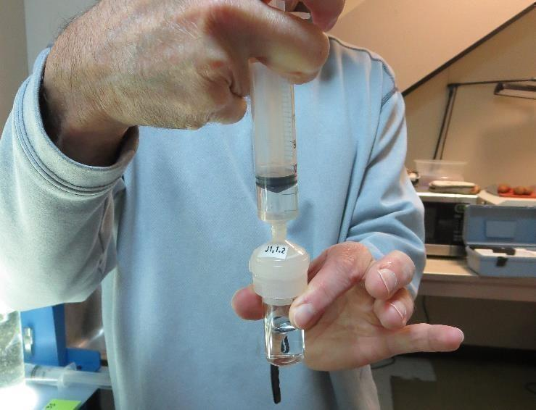
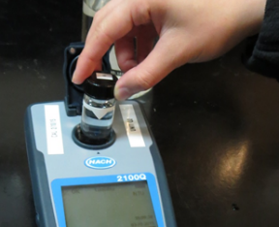
Jar Test - Filterability Test
Syringe ~ 25 mL from jar (after 5-minutes of settling)
Filter-to-waste 3-5 mL
Filter directly into clean cuvette
Measure turbidity
Note: Take several readings before recording final NTU results. Micro bubbles can adhere to glass causing false NTU readings. To remove bubbles, tilt cuvette up to 90 degrees.

Slide 51
Contact
Guy Schott, P.E.
State Water Resources Control Board
Division of Drinking Water
Santa Rosa, CA
Go to Stock Solution/Dose calculations/Jar Test Results for tools to download
www.waterboards.ca.gov/drinking_water/programs/districts/mendocino_district.html
Email: Guy Schott - Guy.Schott@waterboards.ca.gov
Office Number: 707-576-2732

