Slide 1
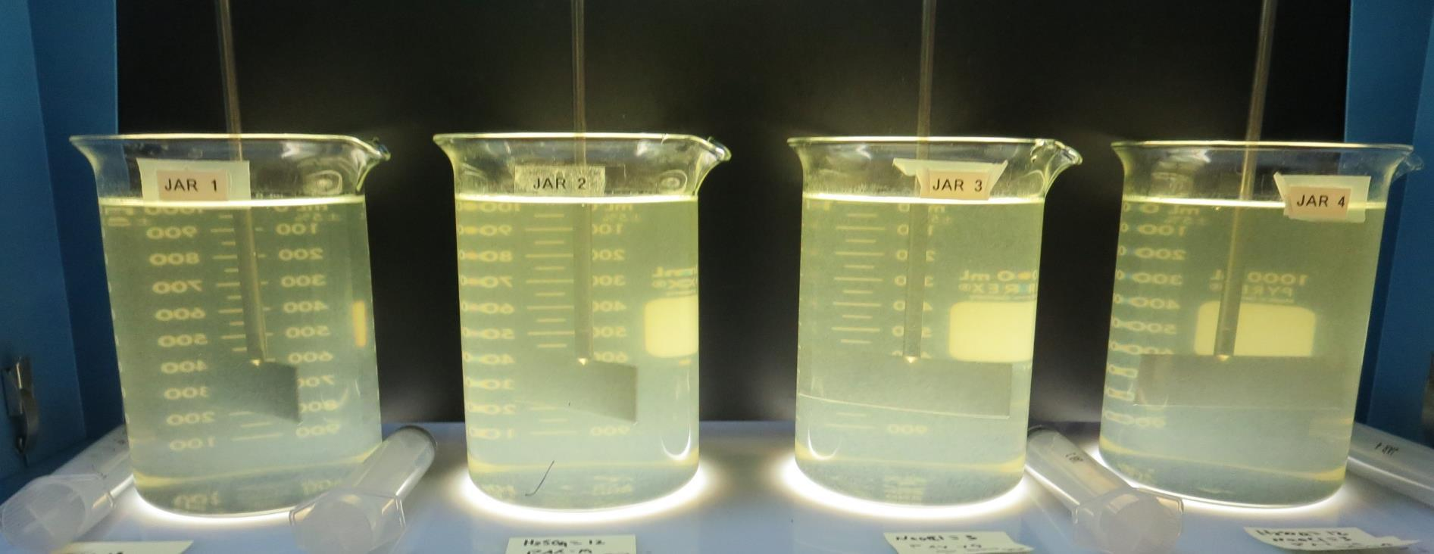
CWS – North Garden CA1510055 Kern County Jar Test
by Guy Schott, P.E.
November 22, 2020

Slide 2
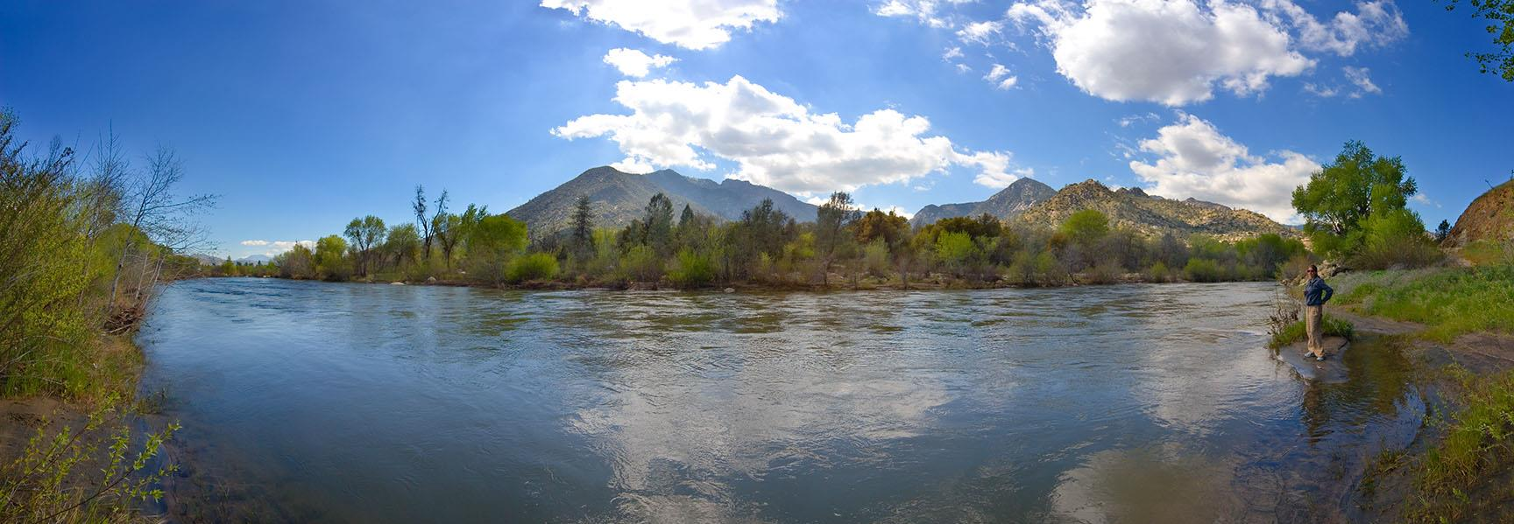
CWS – North Garden Source Water: Kern Canal Conventional Treatment (pre-KMnO4, coagulant injection, plate settling & membrane filtration)

Slide 3
CWS – North Garden Characteristics Nov. 22, 2020
Source
Alkalinity: 78-80 mg/L CaCO₃
pH: 8.86 – 8.97
Turbidity: 12.2 NTU
UVT: 64.2%,
UVA: 0.192/cm
0.4 um Filtered
Turbidity: 0.78 NTU
UVT: 87.4%,
UVA: 0.058/cm

Slide 4
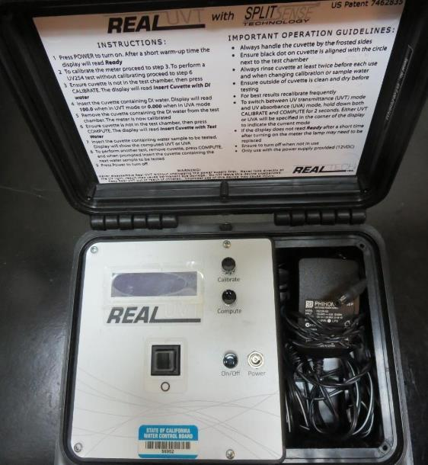
UVT/UVA, pathlength 10 mm
UV transmittance (UVT) is a measurement of the amount of ultraviolet light (commonly at 254 nm due to its germicidal effect) that passes through a water sample compared to the amount of light that passes through a pure water sample. The measurement is expressed as a percentage, % UVT.
%UVT = 10^{(-UVA)} x 100%
UV absorbance (UVA) is calculated as a relative measure of the amount of light absorbed by a water sample compared with the amount of light absorbed by a pure water sample.
UVA = -log(%UVT/100)

Slide 5
Applied Coagulants for Jar Testing
PAX – XL19
50% Aluminum Chlorohydrate (ACH)
23.22% Al₂O₃
50% Water
SG = 1.332
poly-Amine
Average bulk viscosity: 750cps
Average bulk specific gravity: 1.15 (~9.6lb./gal.
Bulk average solution concentration: 50%
NSF limit: 10 mg/L (product)
BWS, Inc.
Advanced Coagulant
AdvFloc-CTC-00011
12.55% Al₂O₃
64.9% Basicity
SG = 1.299
Gregory F. Nieckarz, Ph.D.
Principal Consultant
SWS Consulting, LLC.
+1.541.953.5112
gregn.swsc@gmail.com

Slide 6
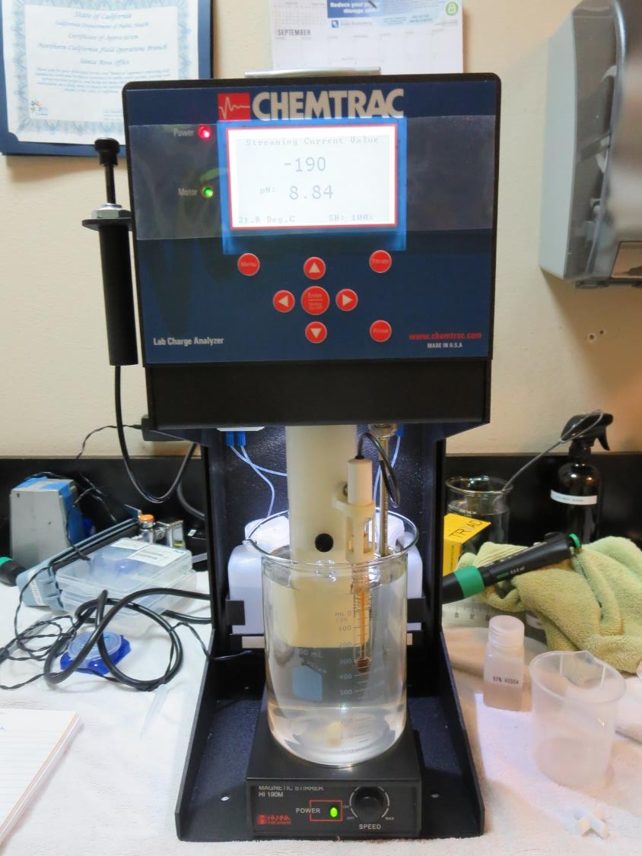
Laboratory Charge Analyzer
LCA: Used to determine coagulant demand of a source water entering the treatment plant.
Source pH: 8.86
LCA #1:
PAX – XL19: 54 mg/L as product
pH adjusted to 7.48 with acetic acid
LCA #2:
Advanced Coagulant: 103 mg/L
pH adjusted to 7.43 with acetic acid

Slide 7
Coagulant Information
Unless stated otherwise, all coagulant doses are reported as Product (100% strength).
Preparation of coagulant stock solutions are generally 1.0 and/or 0.1 percent strength using 100 and/or 200 mL volumetric flasks.
Finnpipette F2 variable volume pipette, capacity 100-1000 micro liters is used for stock solution preparation and coagulant aid jar test dosing.
Finnpipette F2 variable volume pipette, capacity 0.5-5 mL is used for primary coagulant jar test dosing.

Slide 8
Source Water pH and Alkalinity Changes Open Carbonate System (acid addition + coagulant)
Constituents | pH (measured) | Alkalinity as CaCO₃, mg/L
Source pH | 8.87 – 8.97 | 79.0
H₂SO₄ = 2 mg/L | 8.64 | 77.0
H₂SO₄ = 4 mg/L | 8.35 | 74.9
H₂SO₄ = 6 mg/L | 8.05 | 72.9
H₂SO₄ = 8 mg/L | 7.81 | 70.8
H₂SO₄ = 10 mg/L | 7.63 | 68.8
H₂SO₄ = 12 mg/L | 7.47 | 66.8
H₂SO₄ = 12 mg/L PAX-XL19 = 80 mg/L | 7.35 (calc.) | 57.3
H₂SO₄ = 12 mg/L, PAX-XL19 = 90 mg/L | 7.26 (calc.) | 56.1

Slide 9
Source Water pH and Alkalinity Changes Open Carbonate System (coagulant addition)
Constituents | pH (measured) | Alkalinity as CaCO₃, mg/L
Source pH | 8.87 – 8.97 | 79.0
PAX-XL19 = 10 mg/L | 8.73 | 77.8
PAX-XL19 = 20 mg/L | 8.61 | 76.6
PAX-XL19 = 30 mg/L | 8.48 | 75.5
PAX-XL19 = 40 mg/L | 8.35 | 74.3
PAX-XL19 = 50 mg/L | 8.22 | 73.1
PAX-XL19 = 60 mg/L | 8.11 | 71.9
PAX-XL19 = 70 mg/L | 8.00 | 70.7
PAX-XL19 = 80 mg/L | 7.93 (calc.) | 69.5
PAX-XL19 = 90 mg/L | 7.86 (calc.) | 68.4

Slide 10
CWS – North Garden, Jar Test 1 - 4 Results Flash Mix 200 RPM (30 sec); Floc Mix 30 RPM (5 min)
Jar# | PAX – XL19 mg/L | Filtrate NTU | Filtrate %UVT | Filtrate UVA/cm | %UVA Reduction | Settle NTU 25 min
J1 | 45 | 2.2 | 90.0 | 0.045 | 22.2 | 7.56
J2 | 50 | 1.34 | 89.5 | 0.048 | 17.2 | 6.55
J3 | 55 | 1.23 | 89.5 | 0.048 | 17.2 | 6.0
J4 | 60 | 2.26 | 91.6 | 0.037 | 36.2 | 1.37
Note: 20 mL of water was syringed after 5 minutes of settling for the
Filterability and UVT/UVA analysis.

Slide 11
CWS – North Garden, Jar Test 5 - 8 Results Flash Mix 200 RPM (30 sec); Floc Mix 30 RPM (10 min)
Jar# | H₂SO₄ mg/L | PAX – XL19 mg/L | Filtrate NTU | Filtrate %UVT | Filtrate UVA/cm | %UVA Reduction | Settle NTU 17 HR
J5 | 12 | 45 | 0.57 | 91.3 | 0.039 | 32.8 | 1.32
J6 | 12 | 50 | 0.42 | 91.9 | 0.036 | 37.9 | 1.10
J7 | 12 | 55 | 0.31 | 92.4 | 0.034 | 41.4 | 0.65
J8 | 12 | 60 | 0.16 | 92.9 | 0.031 | 46.6 | 0.27
Note: Due to no settling after 25 minutes, jars were allowed to settled
overnight (17 hours) to evaluate if flocs would settle after a significant time.
20 mL of water was syringed after 17 hours of settling for the
Filterability and UVT/UVA analysis.

Slide 12
CWS – North Garden, Jar Test 9 - 12 Results Flash Mix 200 RPM (30 sec); Floc Mix 30 RPM (5 min)
Jar# | H₂SO₄ mg/L | PAX – XL19 mg/L | Poly-amine mg/L | Filtrate NTU | Filtrate %UVT | Filtrate UVA/cm | %UVA Reduction | Settle NTU 25 min
J9 | 12 | 70 | 5 | - | - | - | - | 14.1
J10 | 12 | 70 | 0 | - | - |  | - | 5.24
J11 | 12 | 80 | 0 | - | - | - | - | 1.28
J12 | 12 | 90 | 0 | 0.13 | 93.8 | 0.027 | 53.4 | 0.34
Note: Due to very little settling after 5 minutes (Jars 9-11), filterability analysis
were not conducted. Jar 12 had fair settling after 5 minutes for
filterability/UVT/UVA analysis.

Slide 13
CWS – North Garden, Jar Test 13 - 16 Results Flash Mix 200 RPM (30 sec); Floc Mix 30 RPM (15 min)
Jar# | H₂SO₄ mg/L | PAX – XL19 mg/L | Filtrate NTU | Filtrate %UVT | Filtrate UVA/cm | %UVA Reduction | Settle NTU 25 min
J13 | 12 | 95 | - | - | - | - | 3.17
J14 | 12 | 100 | 0.69 | 92.9 | 0.031 | 46.6 | 2.66
J15 | 12 | 105 | 0.60 | 93.9 | 0.027 | 53.4 | 0.48
J16 | 12 | 110 | 0.14 | 94.0 | 0.026 | 55.2 | 0.26
Note: Due to very little settling after 5 minutes (Jar 13), filterability analysis
were not conducted. For Jars 14-16, 20 mL was drawn 5 minutes after the end
of the flocculation period for filterability and %UVT/UVA analysis.

Slide 14
CWS – North Garden, Jar Test 17 - 20 Results Flash Mix 200 RPM (30 sec); Floc Mix 30 RPM (5 min)
Jar# | H₂SO₄ mg/L | PAX – XL19 mg/L | Filtrate NTU | Filtrate %UVT | Filtrate UVA/cm | %UVA Reduction | Settle NTU 25 min
J17 | 12 | 90 | 0.11 | 93.8 | 0.027 | 53.4 | 0.28
J18 | 12 | 110 | 0.18 | 93.7 | 0.028 | 51.7 | 0.71
J19 | 12 | 115 | 0.16 | 93.6 | 0.028 | 51.7 | 0.49
J20 | 12 | 120 | 0.15 | 93.8 | 0.027 | 53.4 | 0.33
Note: 20 mL was drawn 10 minutes after the end
of the flocculation period for filterability and %UVT/UVA analysis.

Slide 15
CWS – North Garden, Jar Test 21 - 24 Results Flash Mix 200 RPM (30 sec); Floc Mix 30 RPM (5 min)
Jar# | H₂SO₄ mg/L | PAX – XL19 mg/L | Adv Coag. mg/L | Filtrate NTU | Filtrate %UVT | Filtrate UVA/cm | %UVA Reduction | Settle NTU 25 min
J21 | 12 | 90 | 0 | 0.22 | 93.4 | 0.029 | 50.0 | 0.92
J22 | 0 | 90 | 0 | 0.37 | 92.9 | 0.031 | 46.6 | 1.43
J23 | 12 | 0 | 200 | 0.27 | 94.0 | 0.026 | 55.2 | 1.24
J24 | 0 | 0 | 200 | 0.15 | 93.9 | 0.026 | 55.2 | 0.43
Note: 20 mL (filterability/%UVT/UVA analysis) was drawn 10 minutes after the end
of the flocculation period.

Slide 16
CWS – North Garden, Jar Test 25 - 28 Results Flash Mix 200 RPM (30 sec); Floc Mix 30 RPM (5 min)
Jar# | H₂SO₄ mg/L | PAX – XL19 mg/L | Filtrate NTU | Filtrate %UVT | Filtrate UVA/cm | %UVA Reduction | Settle NTU 25 min
J25 | 0 | 60 | - | - | - | - | 7.8
J26 | 0 | 70 | - | - | - | - | 4.3
J27 | 0 | 80 | 0.25 | 92.6 | 0.033 | 43.1 | 0.59
J28 | 0 | 90 | 0.34 | 92.8 | 0.032 | 44.8 | 1.3
Note: 20 mL (filterability/%UVT/UVA analysis) was drawn 15 minutes after the end
of the flocculation period.
Too much floc to filter (clogging) for jars 25-26.

Slide 17
CWS – North Garden, Jar Test 29 - 32 Results Flash Mix 200 RPM (30 sec); Floc Mix 30 RPM (5 min)
Jar# | NaOCl mg/L | PAX – XL19 mg/L | Filtrate NTU | Filtrate %UVT | Filtrate UVA/cm | %UVA Reduction | Settle NTU 25 min
J29 | 3 | 60 | - | - | - | - | 7.0
J30 | 3 | 70 | - | - | - | - | 5.6
J31 | 3 | 80 | 0.18 | 92.6 | 0.033 | 43.1 | 0.79
J32 | 3 | 90 | 0.16 | 92.8 | 0.032 | 44.8 | 0.40
Note: 20 mL (filterability analysis) was drawn 10 minutes after the end
of the flocculation period.
Too much floc to filter (clogging) for jars 29-30.

Slide 18
CWS – North Garden, Jar Test 33 - 36 Results Flash Mix 200 RPM (30 sec); Floc Mix 30 RPM (5 min)
Jar# | H₂SO₄ mg/L | NaOCl mg/L | PAX – XL19 mg/L | Filtrate NTU | Filtrate %UVT | Filtrate UVA/cm | %UVA Reduction | Settle NTU 25 min
J33 | 0 | 0 | 80 | 0.16 | 93.0 | 0.031 | 46.6 | 0.58
J34 | 12 | 0 | 80 | 0.13 | 93.4 | 0.029 | 50.0 | 0.35
J35 | 0 | 3 | 80 | 0.15 | 93.2 | 0.030 | 48.3 | 0.42
J36 | 12 | 3 | 80 | 0.15 | 93.7 | 0.028 | 51.7 | 13.6
Note: 20 mL (filterability/%UVT/UVA analysis) was drawn 10 minutes after the end
of the flocculation period.
By the end of 25 minutes of settling, floc floated up for Jar 36 which explains high
settled water turbidity.

Slide 19
CWS – North Garden, Jar Test 37 - 40 Results Flash Mix 200 RPM (30 sec); Floc Mix 30 RPM (5 min)
Jar# | H₂SO₄ mg/L | NaOCl mg/L | PAX – XL19 mg/L | Filtrate NTU | Filtrate %UVT | Filtrate UVA/cm | %UVA Reduction | Settle NTU 25 min
J37 | 0 | 0 | 90 | 0.16 | 93.3 | 0.030 | 48.3 | 0.43
J38 | 12 | 0 | 90 | 0.16 | 93.4 | 0.029 | 50.0 | 0.40
J39 | 0 | 3 | 90 | 0.16 | 93.3 | 0.030 | 48.3 | 0.48
J40 | 12 | 3 | 90 | 0.16 | 93.8 | 0.027 | 53.4 | 0.23
Note: 20 mL (filterability/%UVT/UVA analysis) was drawn 10 minutes after the end
of the flocculation period.

Slide 20
CWS – North Garden, Jar Test 41 - 44 Results Flash Mix 200 RPM (30 sec); Floc Mix 30 RPM (5 min)
Jar# | H₂SO₄ mg/L | PAX – XL19 mg/L | Filtrate NTU | Filtrate %UVT | Filtrate UVA/cm | %UVA Reduction | Settle NTU 25 min
J41 | 0 | 80 | 0.22 | 92.8 | 0.032 | 44.8 | 1.08
J42 | 12 | 80 | 0.19 | 93.4 | 0.029 | 50.0 | 0.51
J43 | 0 | 90 | 0.16 | 93.3 | 0.029 | 50.0 | 0.32
J44 | 12 | 90 | 0.11 | 93.8 | 0.027 | 53.4 | 0.23
Note: 20 mL (filterability/%UVT/UVA analysis) was drawn 10 minutes after the end
of the flocculation period.

Slide 21
Jars 1-4 Test Flash Mix 30 Sec (200 RPM) Floc Mix 5 min (30 RPM) Applied Coagulant PAX-XL-19

Slide 22
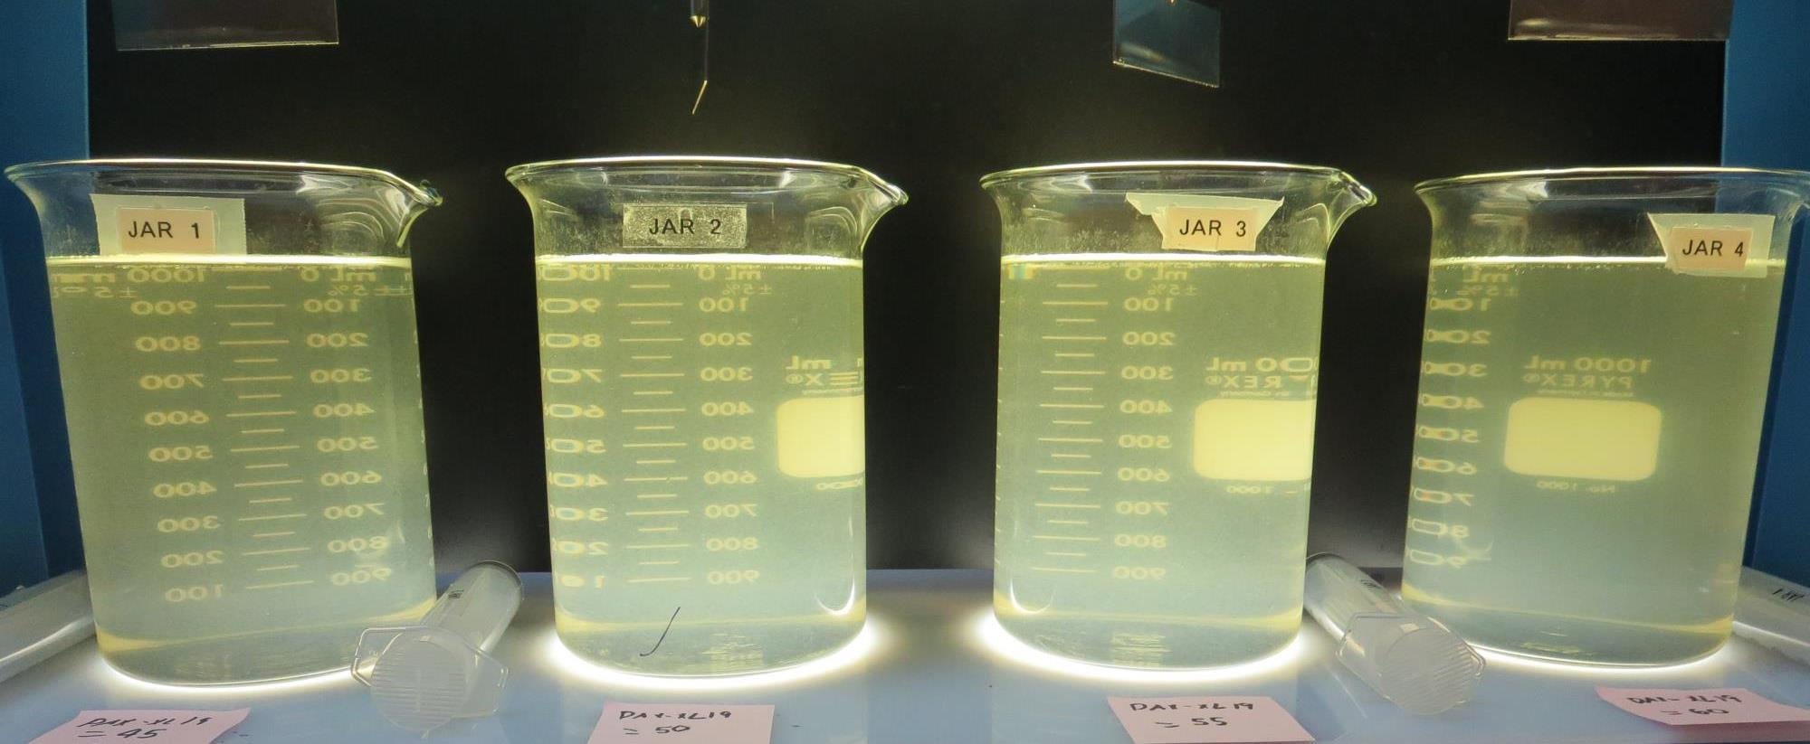
Jars 1-4: End of 5-minute flocculation (30 RPM) duration.
45 mg/L PAX-XL19
Filtrate 2.2 NTU
UVT: 90.0%
UVA: 0.045/cm
UVA Reduction 22.2%
Settled: 7.6 NTU
50 mg/L PAX-XL19
Filtrate 1.34 NTU
UVT: 89.5%
UVA: 0.048/cm
UVA Reduction 17.2%
Settled: 6.6 NTU
55 mg/L PAX-XL19
Filtrate 1.23 NTU
UVT: 89.5%
UVA: 0.048/cm
UVA Reduction 17.2%
Settled: 6.0 NTU
60 mg/L PAX-XL19
Filtrate 2.26 NTU
UVT: 91.6%
UVA: 0.036/cm
UVA Reduction 36.2%
Settled: 1.37 NTU

Slide 23
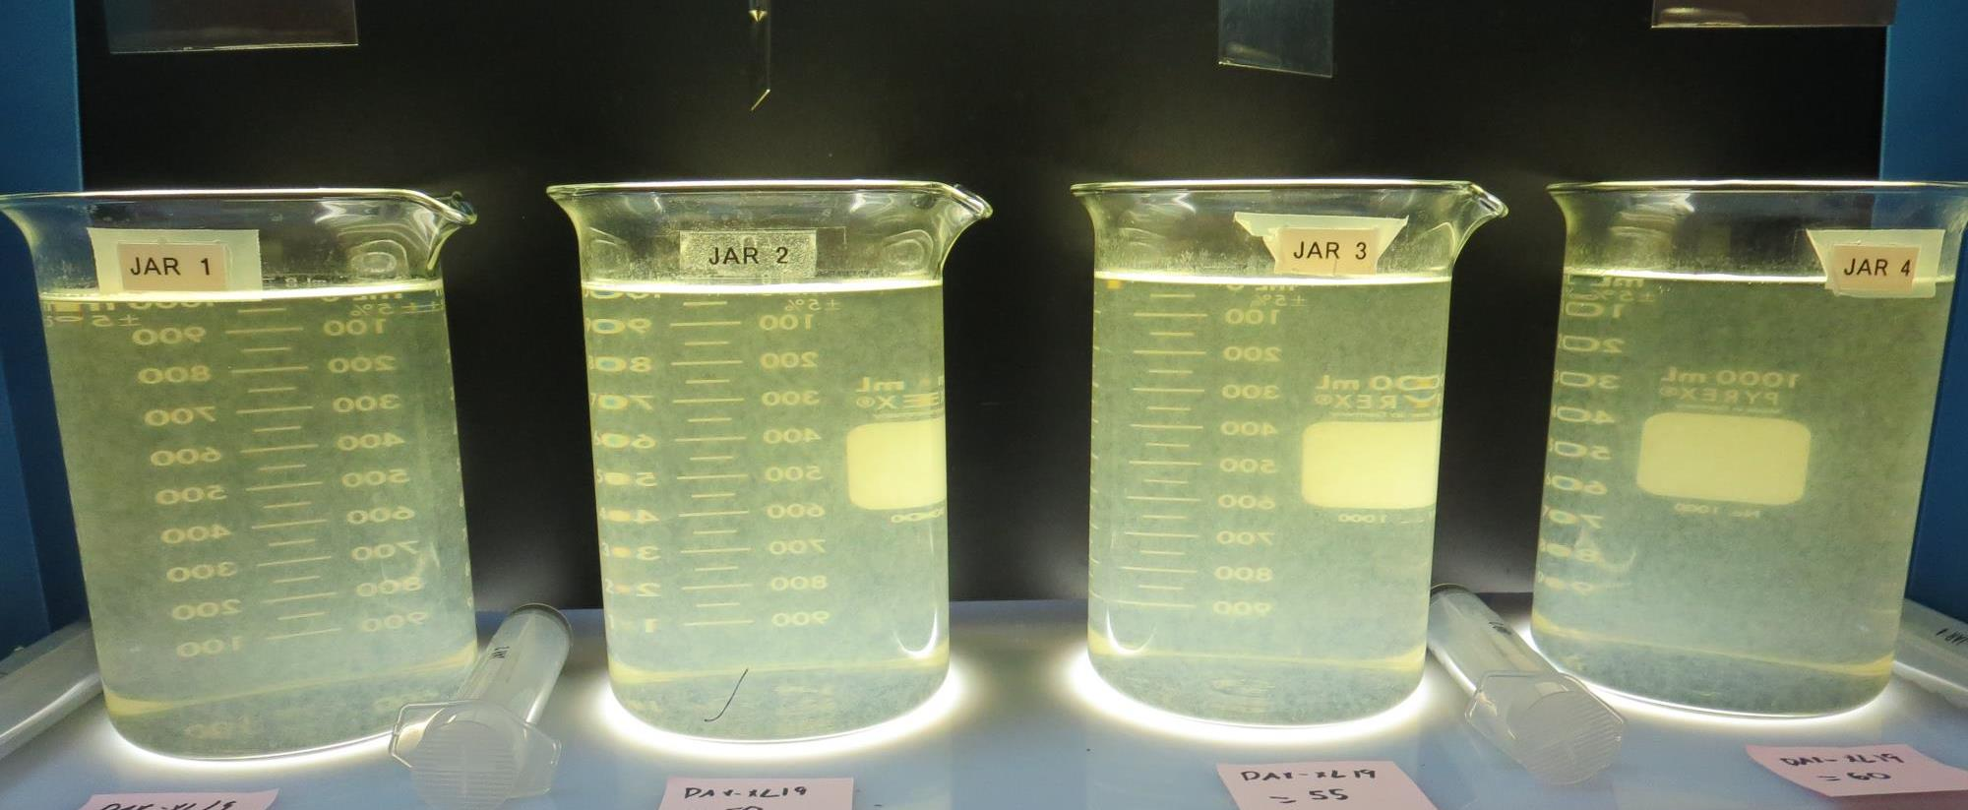
Jars 1-4: After 5 min of settling, 25 mL is syringed for filterability and %UVT/UVA.

Slide 24
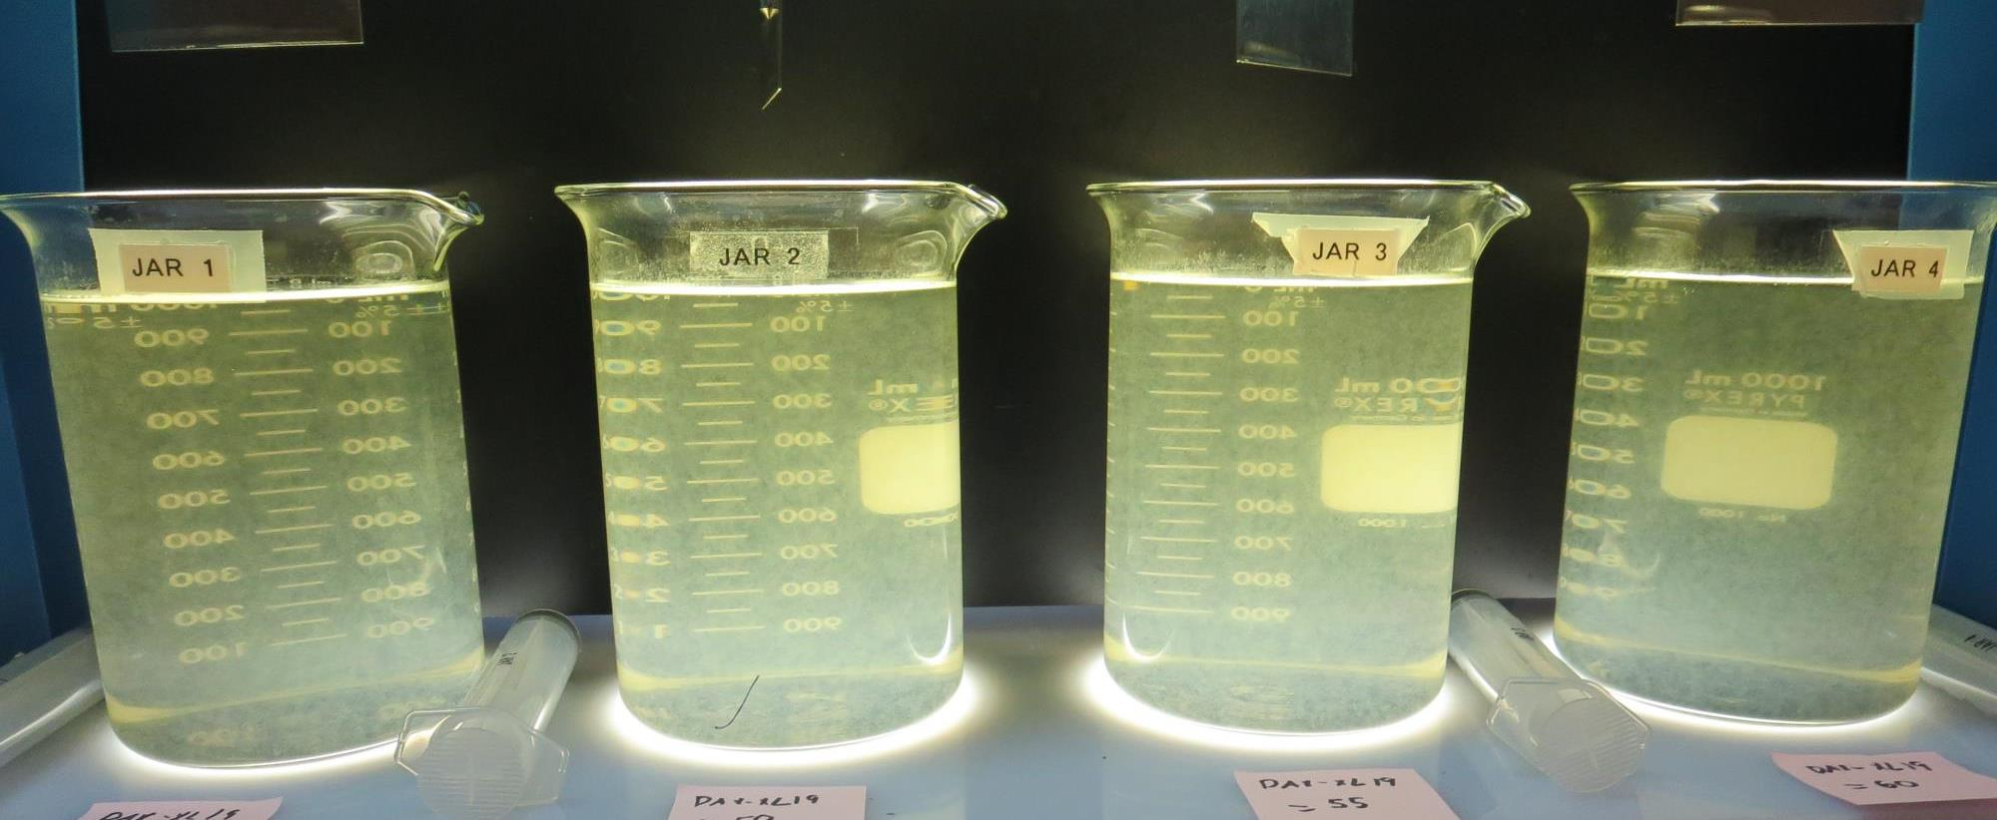
Jars 1-4: After 25-minutes of settling, settled water turbidity is taken.
45 mg/L PAX-XL19
Filtrate 2.2 NTU
UVT: 90.0%
UVA: 0.045/cm
UVA Reduction 22.2%
Settled: 7.6 NTU
50 mg/L PAX-XL19
Filtrate 1.34 NTU
UVT: 89.5%
UVA: 0.048/cm
UVA Reduction 17.2%
Settled: 6.6 NTU
55 mg/L PAX-XL19
Filtrate 1.23 NTU
UVT: 89.5%
UVA: 0.048/cm
UVA Reduction 17.2%
Settled: 6.0 NTU
60 mg/L PAX-XL19
Filtrate 2.26 NTU
UVT: 91.6%
UVA: 0.036/cm
UVA Reduction 36.2%
Settled: 1.37 NTU

Slide 25
Jars 5-8 Test Flash Mix 30 Sec (200 RPM) Floc Mix 5 min (30 RPM) Applied Acid (H₂SO₄) + Applied Coagulant PAX-XL-19

Slide 26
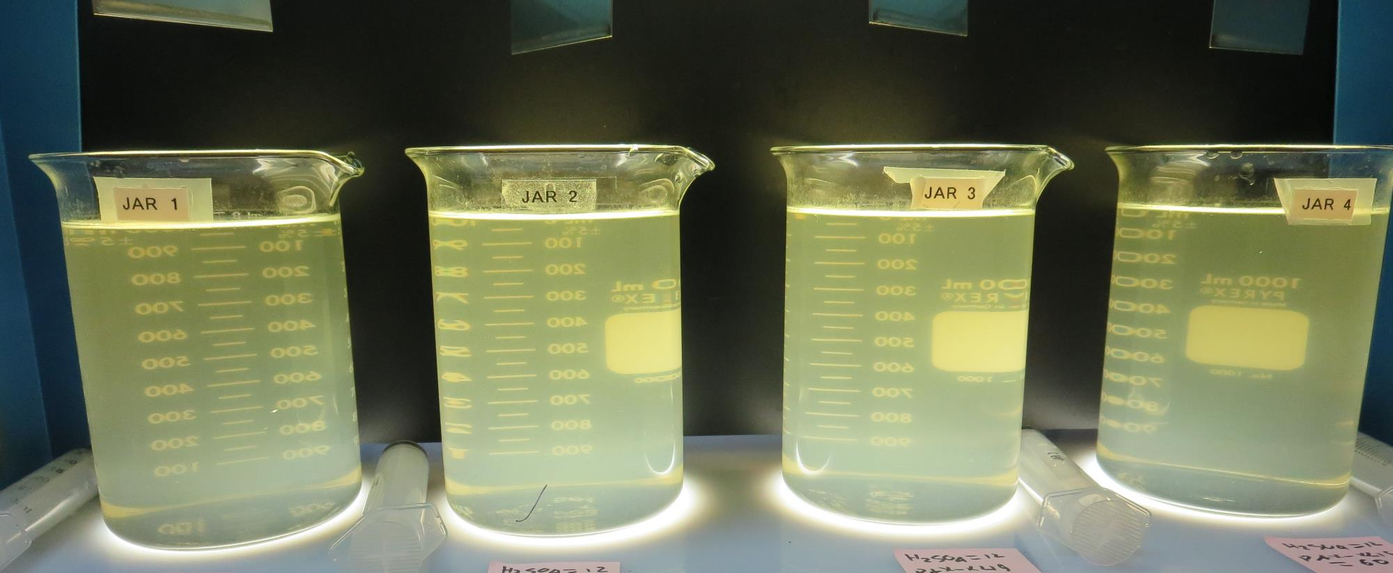
Jars 5-8: End of 5-minute flocculation (30 RPM) duration. Note: Sampling was taken 17 hours after settling.
12 mg/L H₂SO₄
45 mg/L PAX-XL19
Filtrate 0.57 NTU
UVT: 91.3%
UVA: 0.039/cm
UVA Reduction 32.8%
Settled: 1.32 NTU
12 mg/L H₂SO₄
50 mg/L PAX-XL19
Filtrate 0.42 NTU
UVT: 91.9%
UVA: 0.036/cm
UVA Reduction 37.9%
Settled: 1.10 NTU
12 mg/L H₂SO₄
55 mg/L PAX-XL19
Filtrate 0.31 NTU
UVT: 92.4%
UVA: 0.034/cm
UVA Reduction 41.4%
Settled: 0.65 NTU
12 mg/L H₂SO₄
60 mg/L PAX-XL19
Filtrate 0.16 NTU
UVT: 92.9%
UVA: 0.031/cm
UVA Reduction 46.6%
Settled: 0.27 NTU

Slide 27
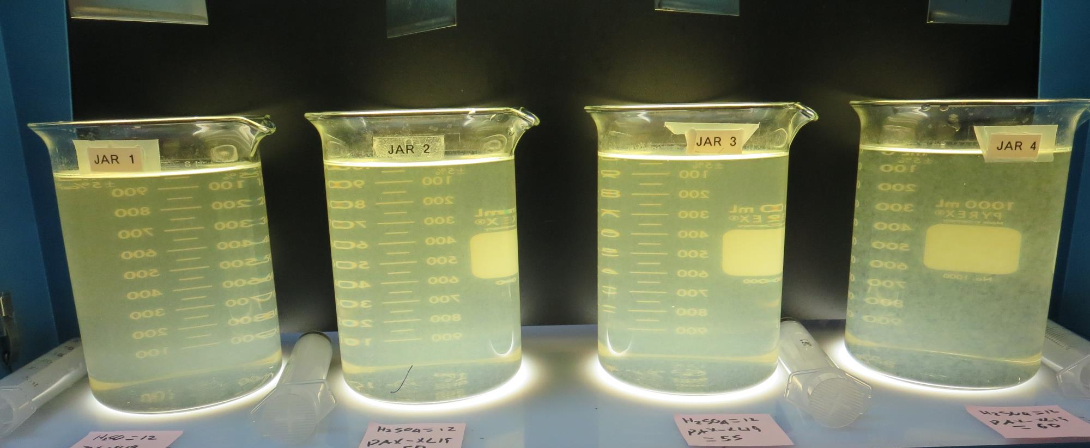
Jars 5-8: After 5 min of settling. No sampling was conducted at this point.

Slide 28
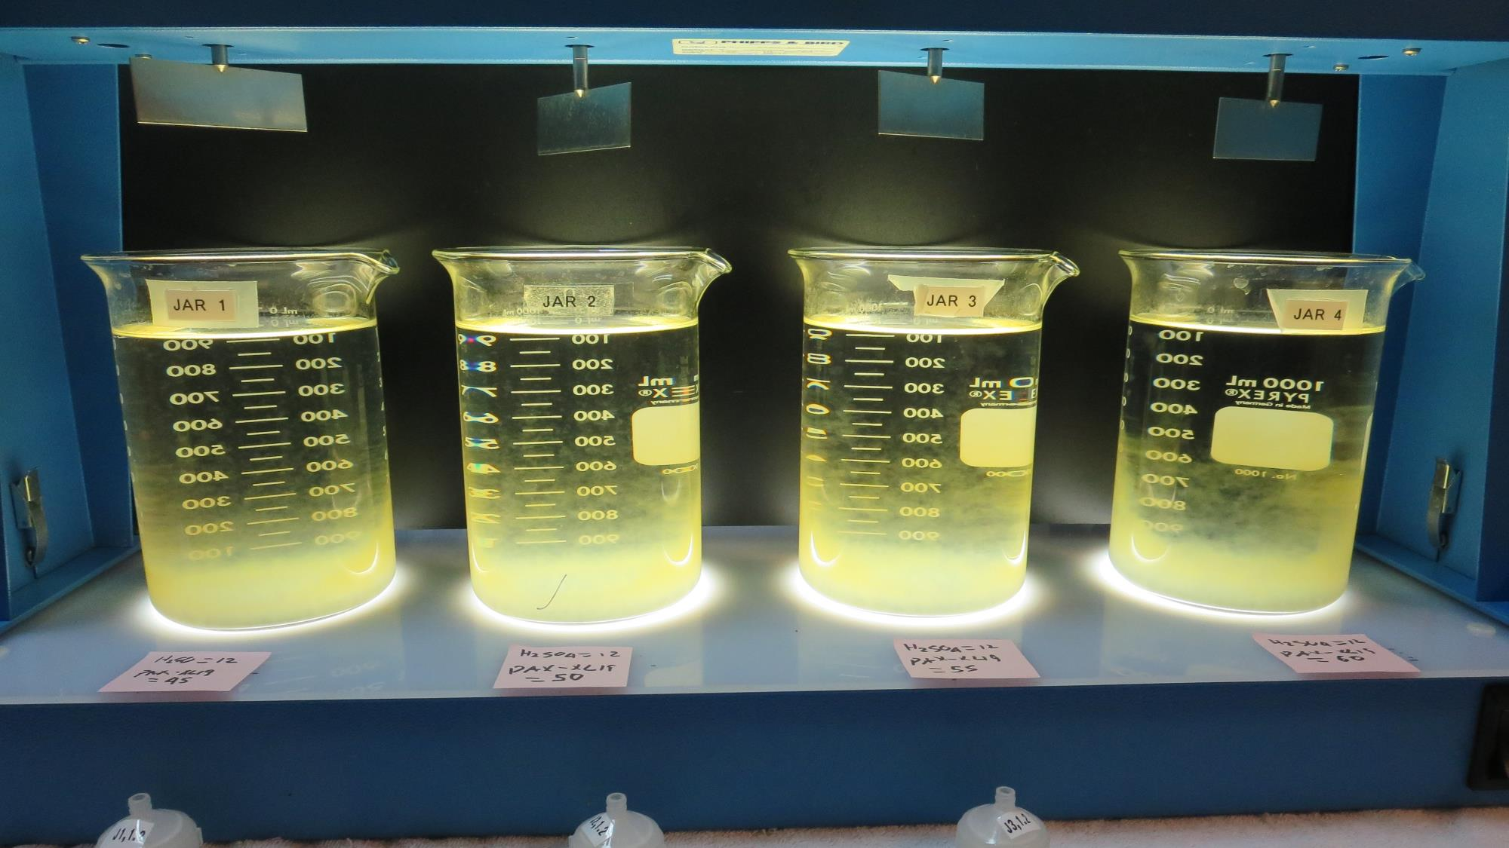
Jars 5-8: After 17 hours of settling: Filterability & settled water turbidity were taken.
12 mg/L H₂SO₄
45 mg/L PAX-XL19
Filtrate 0.57 NTU
UVT: 91.3%
UVA: 0.039/cm
UVA Reduction 32.8%
Settled: 1.32 NTU
12 mg/L H₂SO₄
50 mg/L PAX-XL19
Filtrate 0.42 NTU
UVT: 91.9%
UVA: 0.036/cm
UVA Reduction 37.9%
Settled: 1.10 NTU
12 mg/L H₂SO₄
55 mg/L PAX-XL19
Filtrate 0.31 NTU
UVT: 92.4%
UVA: 0.034/cm
UVA Reduction 41.4%
Settled: 0.65 NTU
12 mg/L H₂SO₄
60 mg/L PAX-XL19
Filtrate 0.16 NTU
UVT: 92.9%
UVA: 0.031/cm
UVA Reduction 46.6%
Settled: 0.27 NTU

Slide 29
Jars 9-12 Test Flash Mix 30 Sec (200 RPM) Floc Mix 5 min (30 RPM) Applied Acid (H₂SO₄) + Applied Coagulants PAX-XL-19 Polyamine

Slide 30
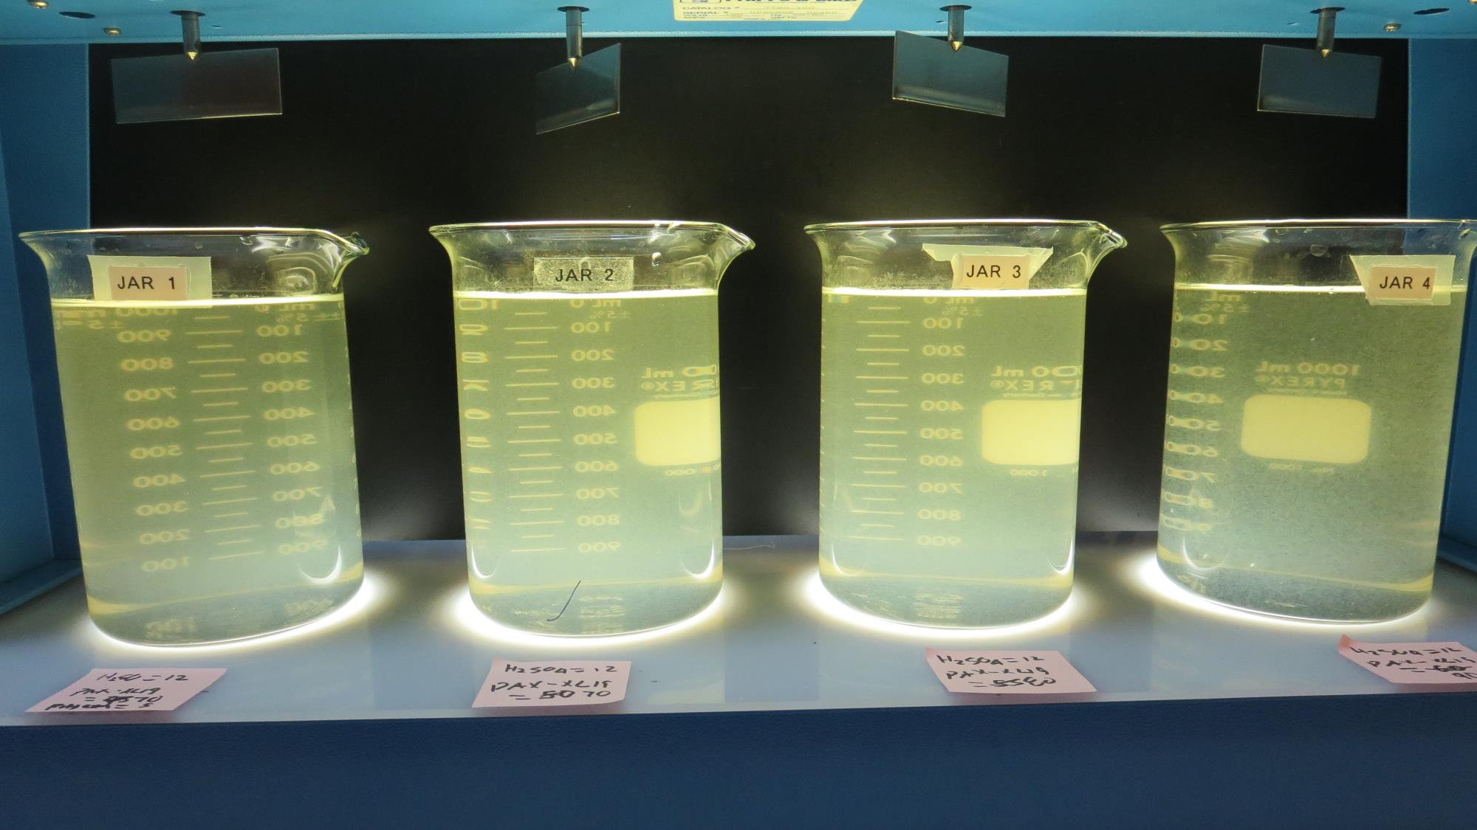
Jars 9-12: End of 5-minute flocculation (30 RPM) duration.
12 mg/L H₂SO₄
70 mg/L PAX-XL19
5 mg/L Polyamine
Filtrate - NTU
UVT: -%
UVA: -/cm
UVA Reduction -%
Settled: 14.1 NTU
12 mg/L H₂SO₄
70 mg/L PAX-XL19
Filtrate - NTU
UVT: -%
UVA: -/cm
UVA Reduction -%
Settled: 5.2 NTU
12 mg/L H₂SO₄
80 mg/L PAX-XL19
Filtrate - NTU
UVT: -%
UVA: -/cm
UVA Reduction -%
Settled: 1.28 NTU
12 mg/L H₂SO₄
90 mg/L PAX-XL19
Filtrate 0.13 NTU
UVT: 93.8%
UVA: 0.027/cm
UVA Reduction 53.4%
Settled: 0.34 NTU

Slide 31
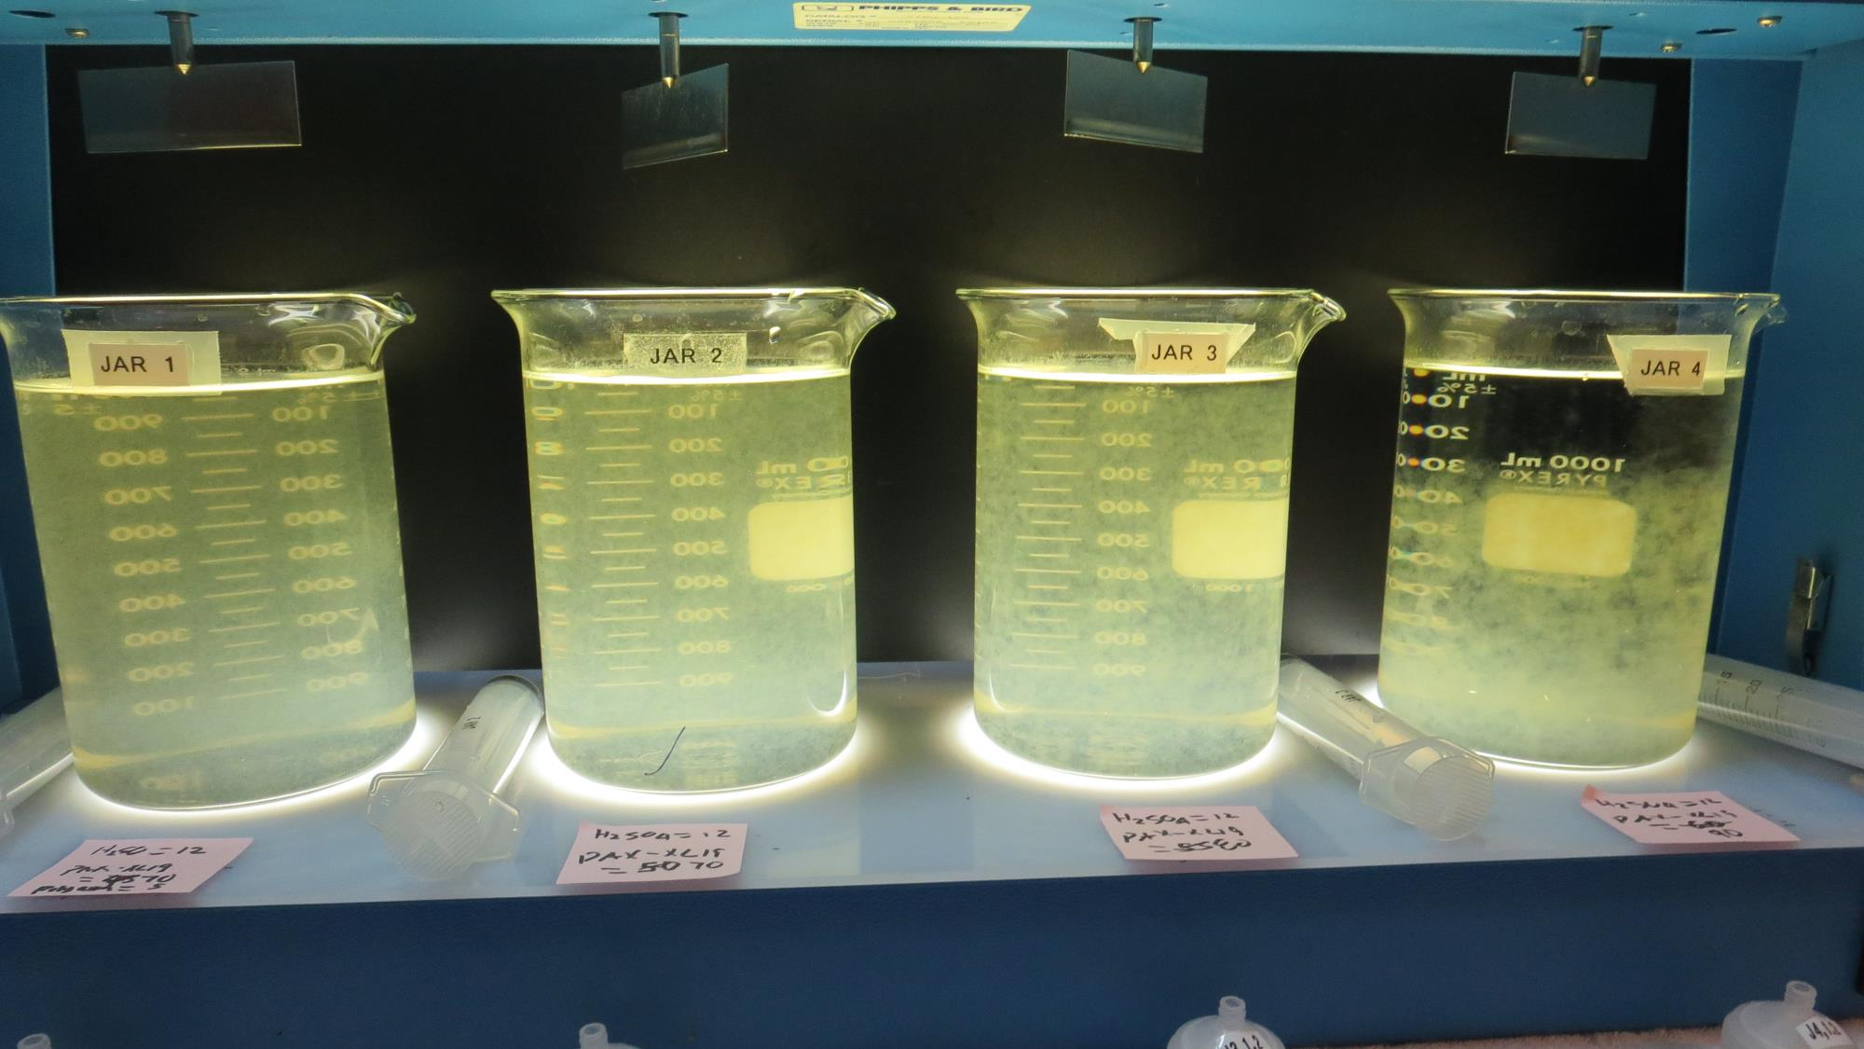
Jars 9-12: After 5 min of settling, 25 mL is syringed for filterability and %UVT/UVA.

Slide 32
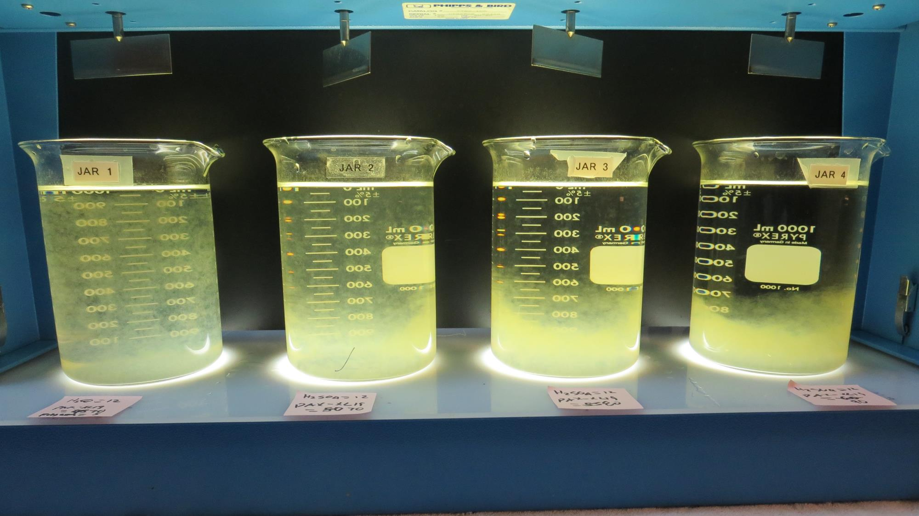
Jars 9-12: After 25-minutes of settling, settled water turbidity is taken.
12 mg/L H₂SO₄
70 mg/L PAX-XL19
5 mg/L Polyamine
Filtrate - NTU
UVT: -%
UVA: -/cm
UVA Reduction -%
Settled: 14.1 NTU
12 mg/L H₂SO₄
70 mg/L PAX-XL19
Filtrate - NTU
UVT: -%
UVA: -/cm
UVA Reduction -%
Settled: 5.2 NTU
12 mg/L H₂SO₄
80 mg/L PAX-XL19
Filtrate - NTU
UVT: -%
UVA: -/cm
UVA Reduction -%
Settled: 1.28 NTU
12 mg/L H₂SO₄
90 mg/L PAX-XL19
Filtrate 0.13 NTU
UVT: 93.8%
UVA: 0.027/cm
UVA Reduction 53.4%
Settled: 0.34 NTU

Slide 33
Jars 13-16 Test Flash Mix 30 Sec (200 RPM) Floc Mix 15 min (30 RPM) Applied Acid (H₂SO₄) + Applied Coagulant PAX-XL-19

Slide 34
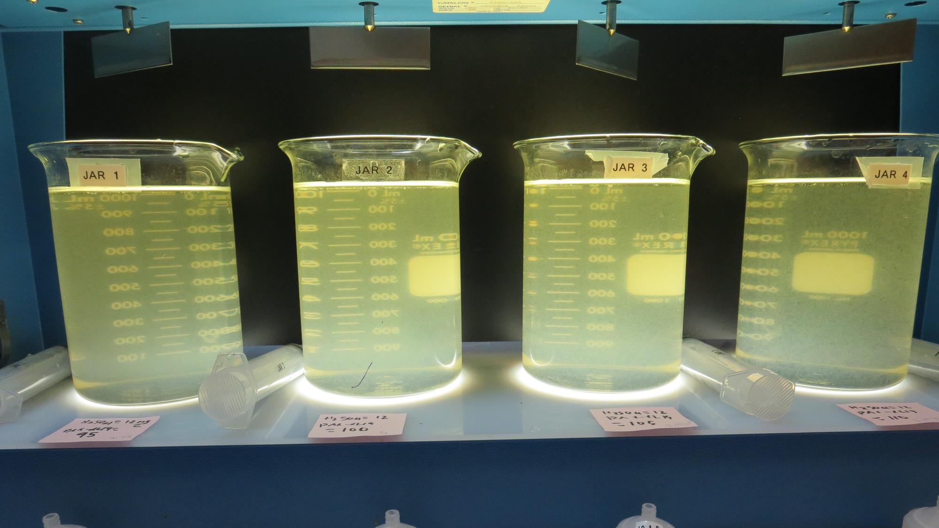
Jars 13-16: End of 15-minute flocculation (30 RPM) duration.
12 mg/L H₂SO₄
95 mg/L PAX-XL19
Filtrate - NTU
UVT: -%
UVA: -/cm
UVA Reduction -%
Settled: 3.2 NTU
12 mg/L H₂SO₄
100 mg/L PAX-XL19
Filtrate 0.69 NTU
UVT: 91.9%
UVA: 0.031/cm
UVA Reduction 46.6%
Settled: 2.7 NTU
12 mg/L H₂SO₄
105 mg/L PAX-XL19
Filtrate 0.60 NTU
UVT: 93.9%
UVA: 0.027/cm
UVA Reduction 53.4%
Settled: 0.48 NTU
12 mg/L H₂SO₄
110 mg/L PAX-XL19
Filtrate 0.14 NTU
UVT: 94.0%
UVA: 0.026/cm
UVA Reduction 55.2%
Settled: 0.26 NTU

Slide 35
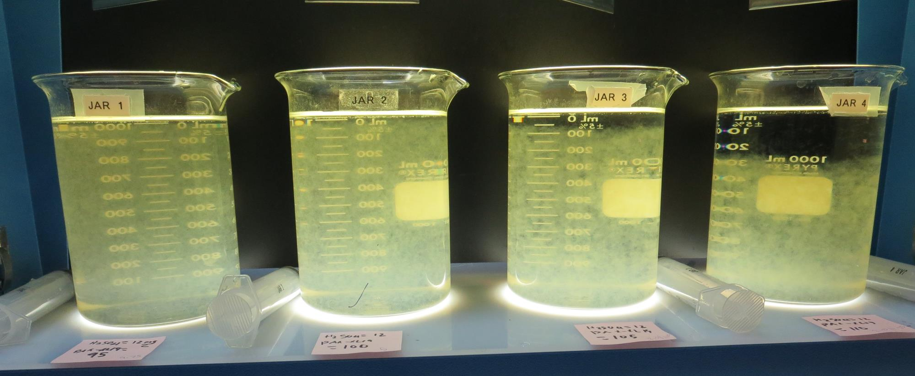
Jars 13-16: After 5 min of settling, 25 mL is syringed for filterability and %UVT/UVA.

Slide 36
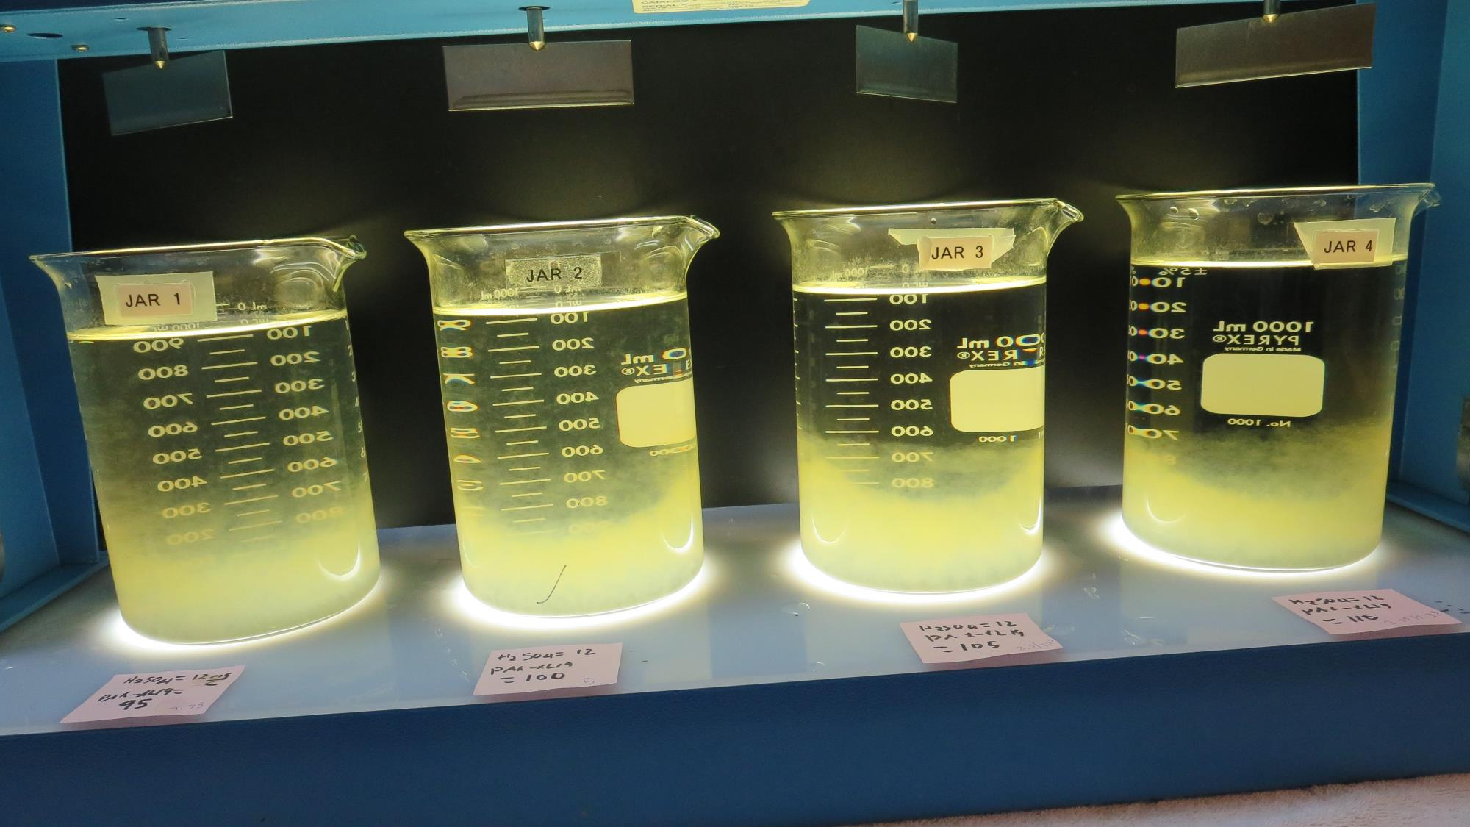
Jars 13-16: After 25-minutes of settling, settled water turbidity is taken.
12 mg/L H₂SO₄
95 mg/L PAX-XL19
Filtrate - NTU
UVT: -%
UVA: -/cm
UVA Reduction -%
Settled: 3.2 NTU
12 mg/L H₂SO₄
100 mg/L PAX-XL19
Filtrate 0.69 NTU
UVT: 91.9%
UVA: 0.031/cm
UVA Reduction 46.6%
Settled: 2.7 NTU
12 mg/L H₂SO₄
105 mg/L PAX-XL19
Filtrate 0.60 NTU
UVT: 93.9%
UVA: 0.027/cm
UVA Reduction 53.4%
Settled: 0.48 NTU
12 mg/L H₂SO₄
110 mg/L PAX-XL19
Filtrate 0.14 NTU
UVT: 94.0%
UVA: 0.026/cm
UVA Reduction 55.2%
Settled: 0.26 NTU

Slide 37
Jars 17-20 Test Flash Mix 30 Sec (200 RPM) Floc Mix 5 min (30 RPM) Applied Acid (H₂SO₄) + Applied Coagulant PAX-XL-19

Slide 38
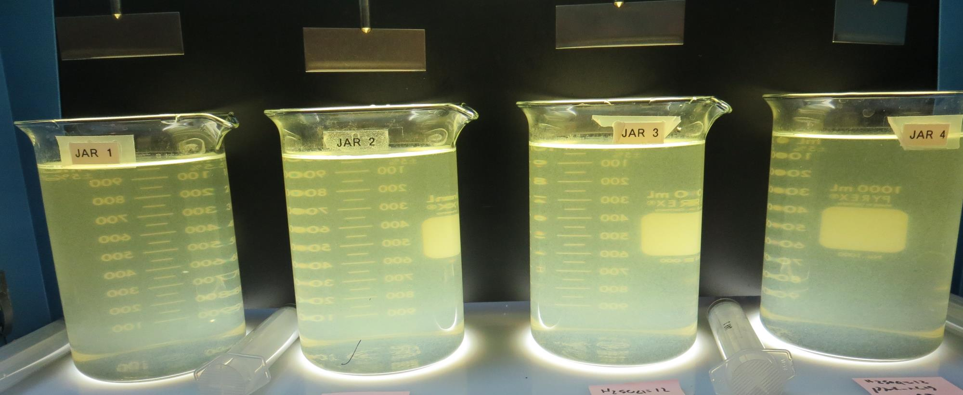
Jars 17-20: End of 5-minute flocculation (30 RPM) duration.
12 mg/L H₂SO₄
90 mg/L PAX-XL19
Filtrate 0.11 NTU
UVT: 93.8%
UVA: 0.027/cm
UVA Reduction 53.4%
Settled: 0.28 NTU
12 mg/L H₂SO₄
110 mg/L PAX-XL19
Filtrate 0.18 NTU
UVT: 93.7%
UVA: 0.028/cm
UVA Reduction 51.7%
Settled: 0.71 NTU
12 mg/L H₂SO₄
115 mg/L PAX-XL19
Filtrate 0.16 NTU
UVT: 93.6%
UVA: 0.028/cm
UVA Reduction 51.7%
Settled: 0.49 NTU
12 mg/L H₂SO₄
120 mg/L PAX-XL19
Filtrate 0.15 NTU
UVT: 93.8%
UVA: 0.027/cm
UVA Reduction 53.4%
Settled: 0.33 NTU

Slide 39
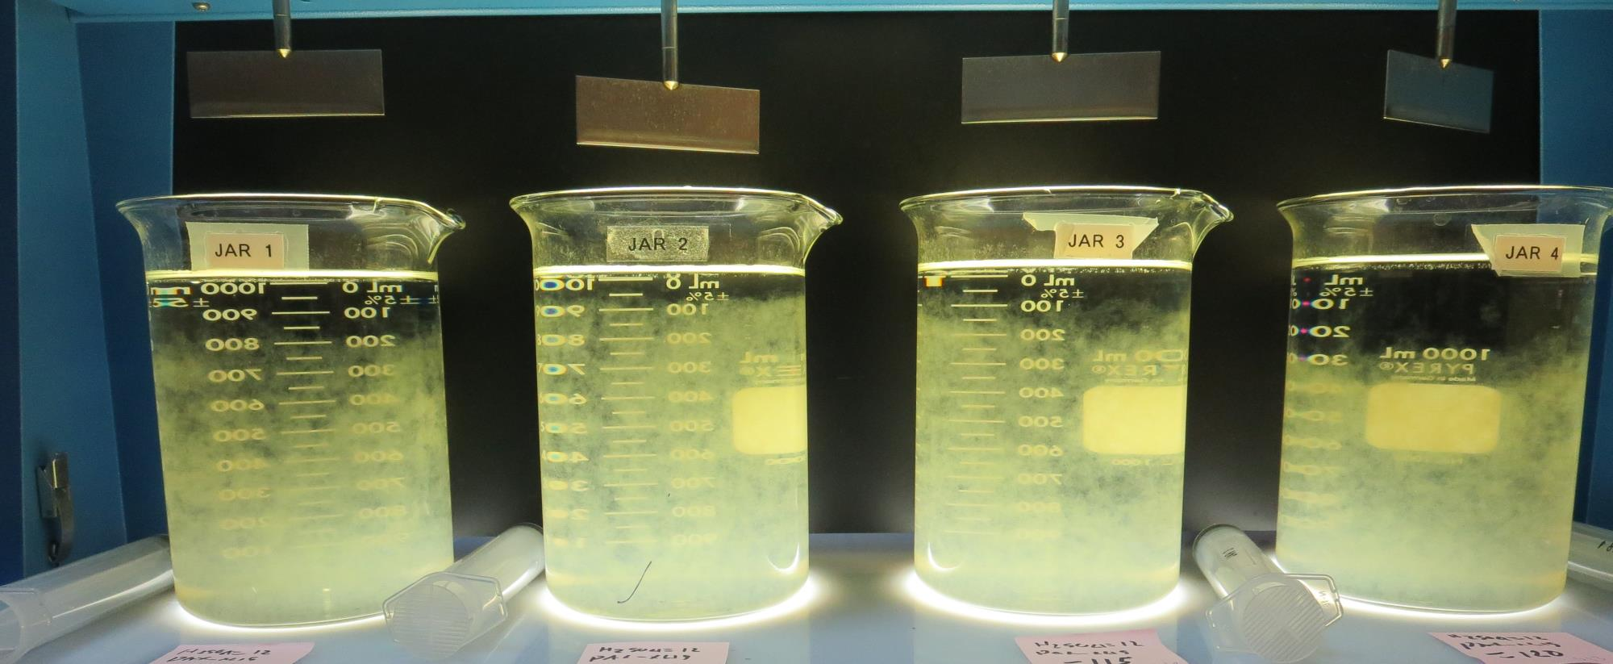
Jars 17-20: After 10 min of settling, 25 mL is syringed for filterability and %UVT/UVA.

Slide 40
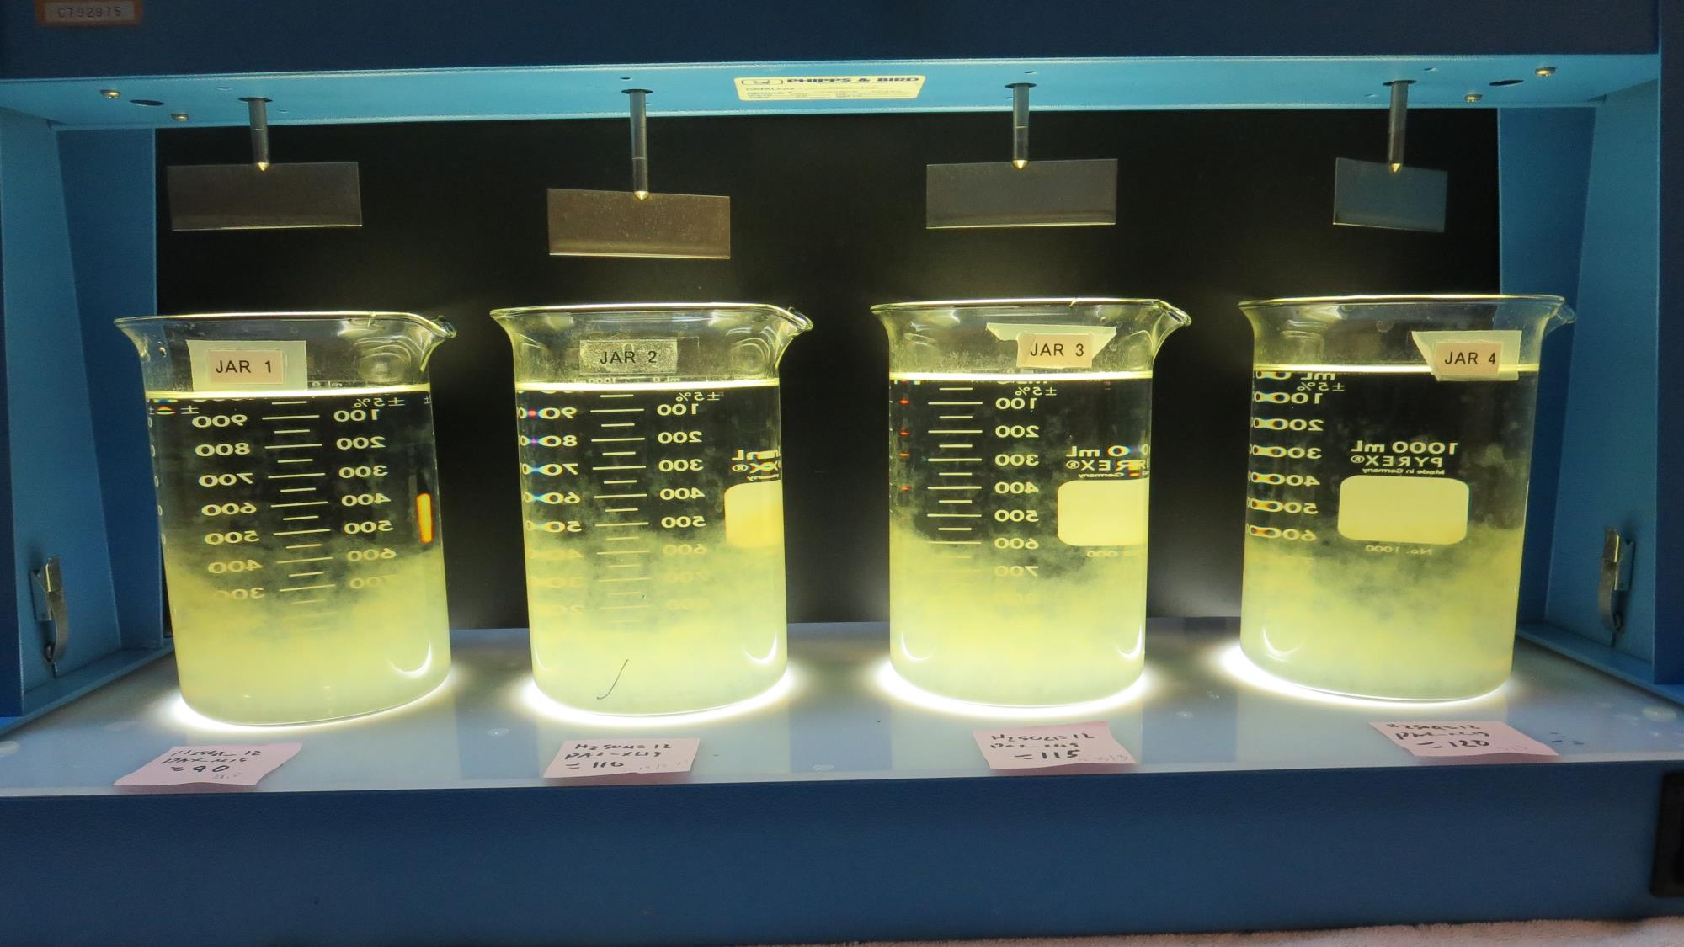
Jars 17-20: After 25-minutes of settling, settled water turbidity is taken.
12 mg/L H₂SO₄
90 mg/L PAX-XL19
Filtrate 0.11 NTU
UVT: 93.8%
UVA: 0.027/cm
UVA Reduction 53.4%
Settled: 0.28 NTU
12 mg/L H₂SO₄
110 mg/L PAX-XL19
Filtrate 0.18 NTU
UVT: 93.7%
UVA: 0.028/cm
UVA Reduction 51.7%
Settled: 0.71 NTU
12 mg/L H₂SO₄
115 mg/L PAX-XL19
Filtrate 0.16 NTU
UVT: 93.6%
UVA: 0.028/cm
UVA Reduction 51.7%
Settled: 0.49 NTU
12 mg/L H₂SO₄
120 mg/L PAX-XL19
Filtrate 0.15 NTU
UVT: 93.8%
UVA: 0.027/cm
UVA Reduction 53.4%
Settled: 0.33 NTU

Slide 41
Jars 21-24 Test Flash Mix 30 Sec (200 RPM) Floc Mix 5 min (30 RPM) Applied NaOCl + Applied Coagulants Advanced Coagulant PAX-XL-19

Slide 42
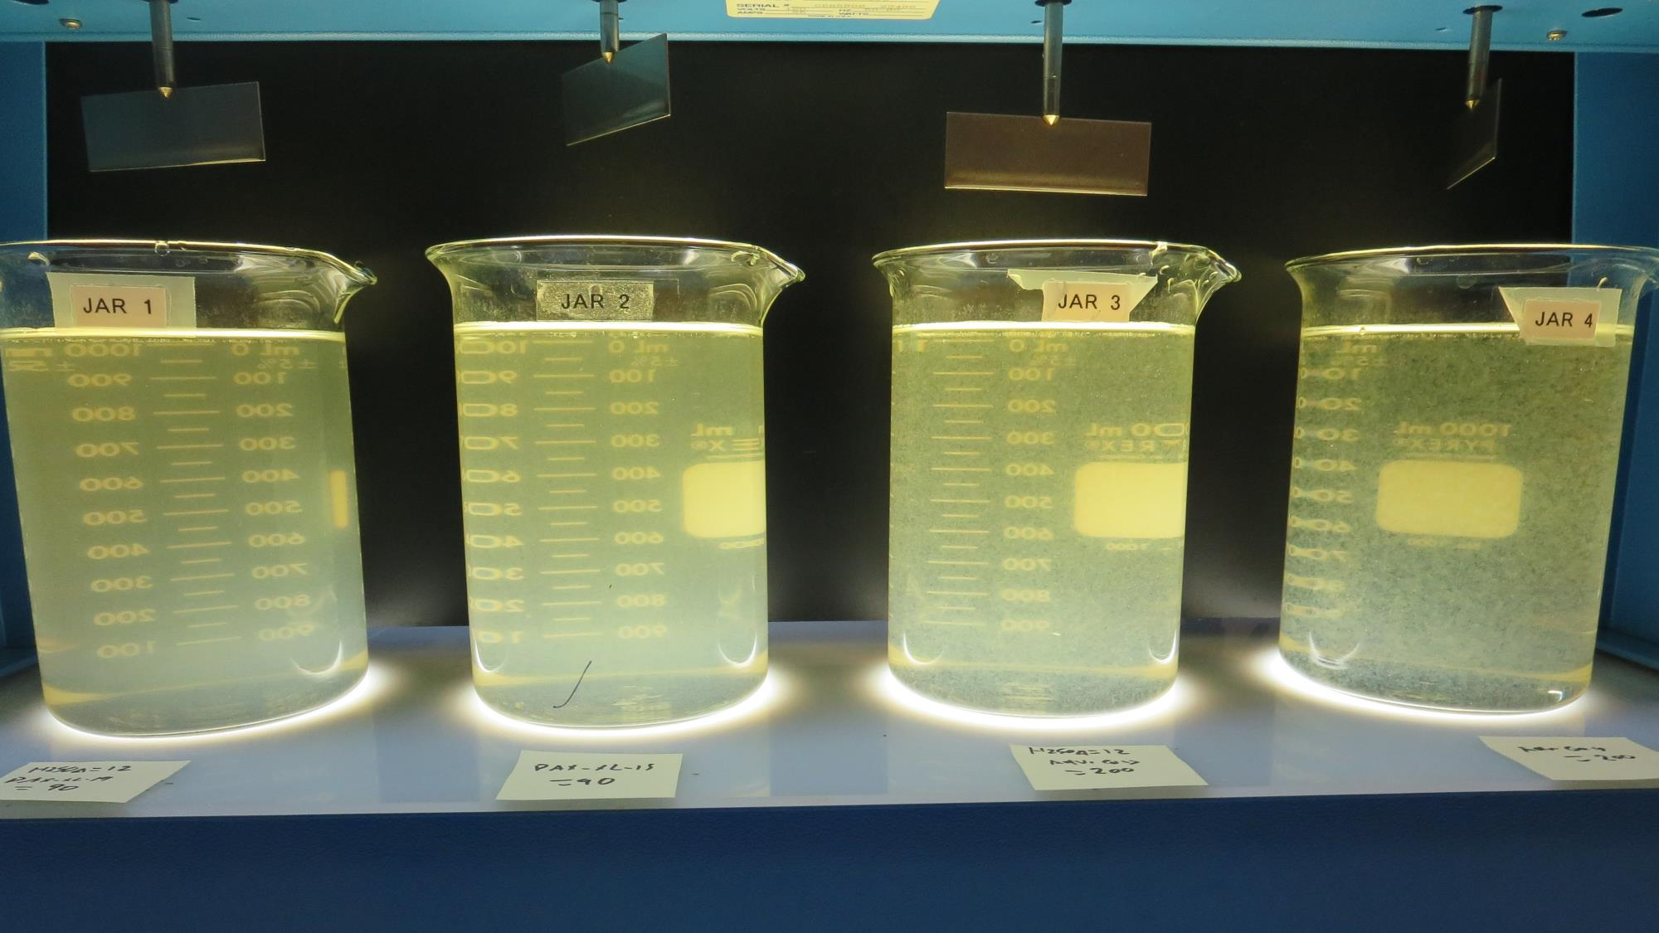
Jars 21-24: End of 5-minute flocculation (30 RPM) duration.
12 mg/L H₂SO₄
90 mg/L PAX-XL19
Filtrate 0.22 NTU
UVT: 93.4%
UVA: 0.029/cm
UVA Reduction 50.0%
Settled: 0.92 NTU
0 mg/L H₂SO₄
90 mg/L PAX-XL19
Filtrate 0.37 NTU
UVT: 92.9%
UVA: 0.031/cm
UVA Reduction 46.6%
Settled: 1.43 NTU
12 mg/L H₂SO₄
200 mg/L Adv Coag.
Filtrate 0.27 NTU
UVT: 94.0%
UVA: 0.026/cm
UVA Reduction 55.2%
Settled: 1.24 NTU
0 mg/L H₂SO₄
200 mg/L Adv Coag.
Filtrate 0.15 NTU
UVT: 93.9%
UVA: 0.026/cm
UVA Reduction 55.2%
Settled: 0.43 NTU

Slide 43
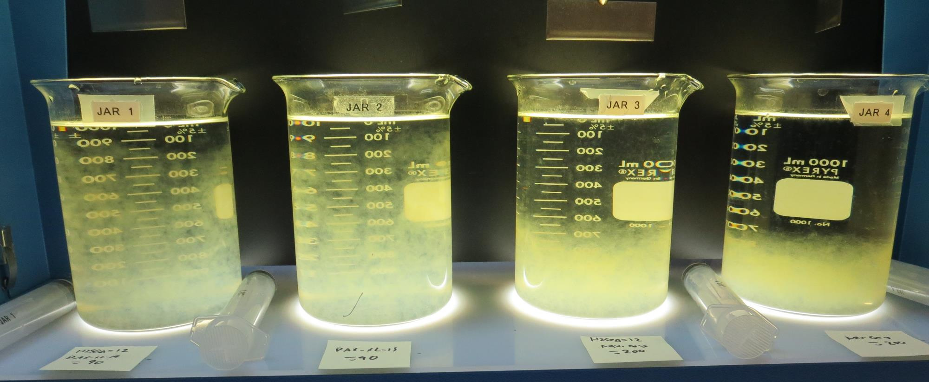
Jars 21-24: After 10 min of settling, 25 mL is syringed for filterability and %UVT/UVA.

Slide 44
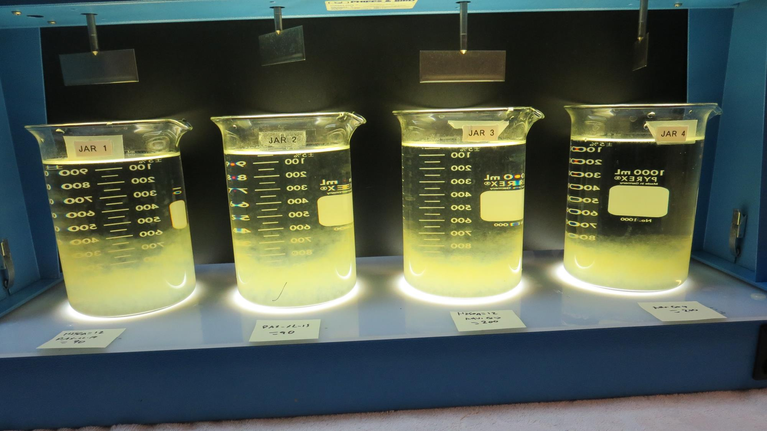
Jars 21-24: After 25-minutes of settling, settled water turbidity is taken.
12 mg/L H₂SO₄
90 mg/L PAX-XL19
Filtrate 0.22 NTU
UVT: 93.4%
UVA: 0.029/cm
UVA Reduction 50.0%
Settled: 0.92 NTU
0 mg/L H₂SO₄
90 mg/L PAX-XL19
Filtrate 0.37 NTU
UVT: 92.9%
UVA: 0.031/cm
UVA Reduction 46.6%
Settled: 1.43 NTU
12 mg/L H₂SO₄
200 mg/L Adv Coag.
Filtrate 0.27 NTU
UVT: 94.0%
UVA: 0.026/cm
UVA Reduction 55.2%
Settled: 1.24 NTU
0 mg/L H₂SO₄
200 mg/L Adv Coag.
Filtrate 0.15 NTU
UVT: 93.9%
UVA: 0.026/cm
UVA Reduction 55.2%
Settled: 0.43 NTU

Slide 45
Jars 25-28 Test Flash Mix 30 Sec (200 RPM) Floc Mix 5 min (30 RPM) Applied Coagulants PAX-XL-19

Slide 46
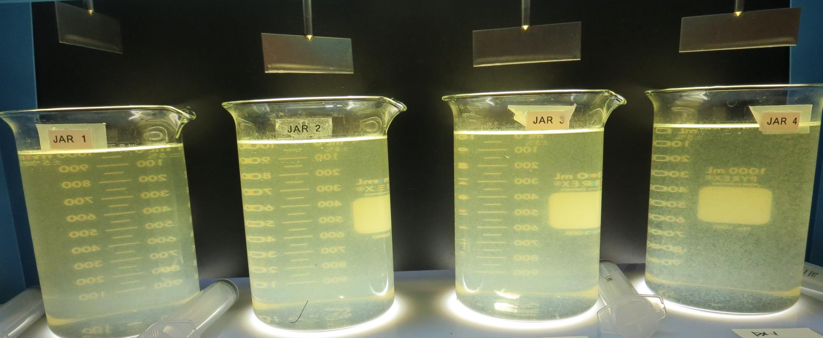
Jars 25-28: End of 5-minute flocculation (30 RPM) duration.
60 mg/L PAX-XL19
Filtrate - NTU
UVT: -%
UVA: -/cm
UVA Reduction -%
Settled: 7.8 NTU
70 mg/L PAX-XL19
Filtrate - NTU
UVT: -%
UVA: -/cm
UVA Reduction -%
Settled: 4.25 NTU
80 mg/L PAX-XL19
Filtrate 0.25 NTU
UVT: 92.6%
UVA: 0.033/cm
UVA Reduction 43.1%
Settled: 0.59 NTU
90 mg/L PAX-XL19
Filtrate 0.34 NTU
UVT: 92.8%
UVA: 0.032/cm
UVA Reduction 44.8%
Settled: 1.3 NTU

Slide 47
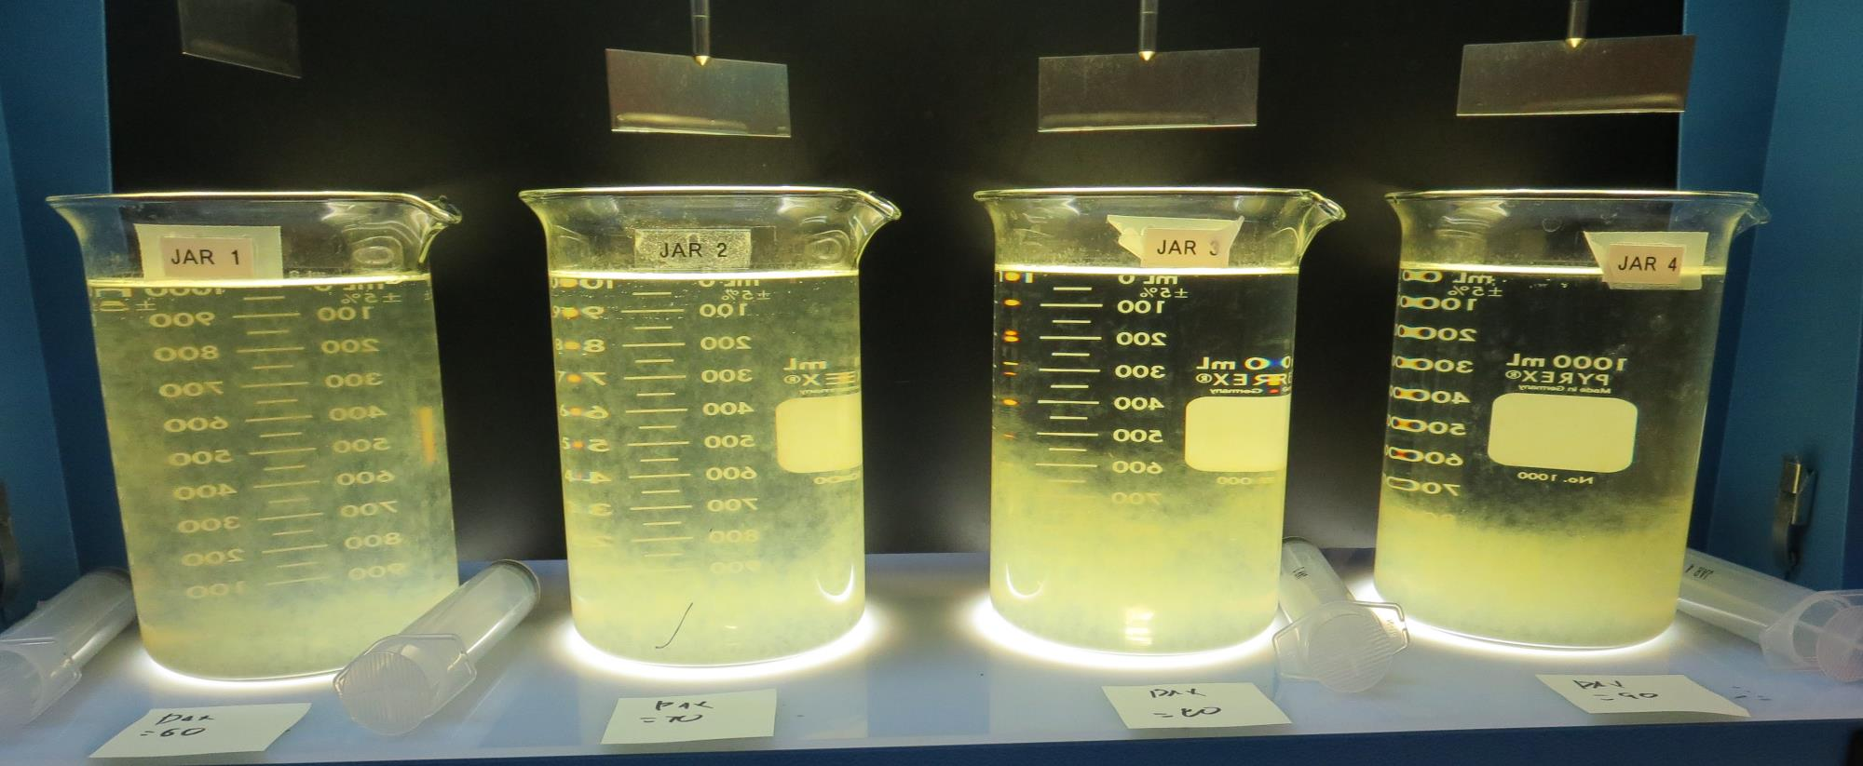
Jars 25-28: After 5 min of settling, 25 mL is syringed for filterability and %UVT/UVA.

Slide 48
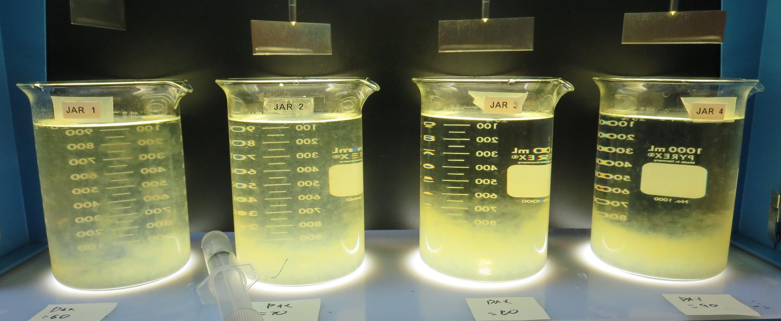
Jars 25-28: After 25-minutes of settling, settled water turbidity is taken.
60 mg/L PAX-XL19
Filtrate - NTU
UVT: -%
UVA: -/cm
UVA Reduction -%
Settled: 7.8 NTU
70 mg/L PAX-XL19
Filtrate - NTU
UVT: -%
UVA: -/cm
UVA Reduction -%
Settled: 4.25 NTU
80 mg/L PAX-XL19
Filtrate 0.25 NTU
UVT: 92.6%
UVA: 0.033/cm
UVA Reduction 43.1%
Settled: 0.59 NTU
90 mg/L PAX-XL19
Filtrate 0.34 NTU
UVT: 92.8%
UVA: 0.032/cm
UVA Reduction 44.8%
Settled: 1.3 NTU

Slide 49
Jars 29-32 Test Flash Mix 30 Sec (200 RPM) Floc Mix 5 min (30 RPM) Applied NaOCl + Applied Coagulants PAX-XL-19

Slide 50
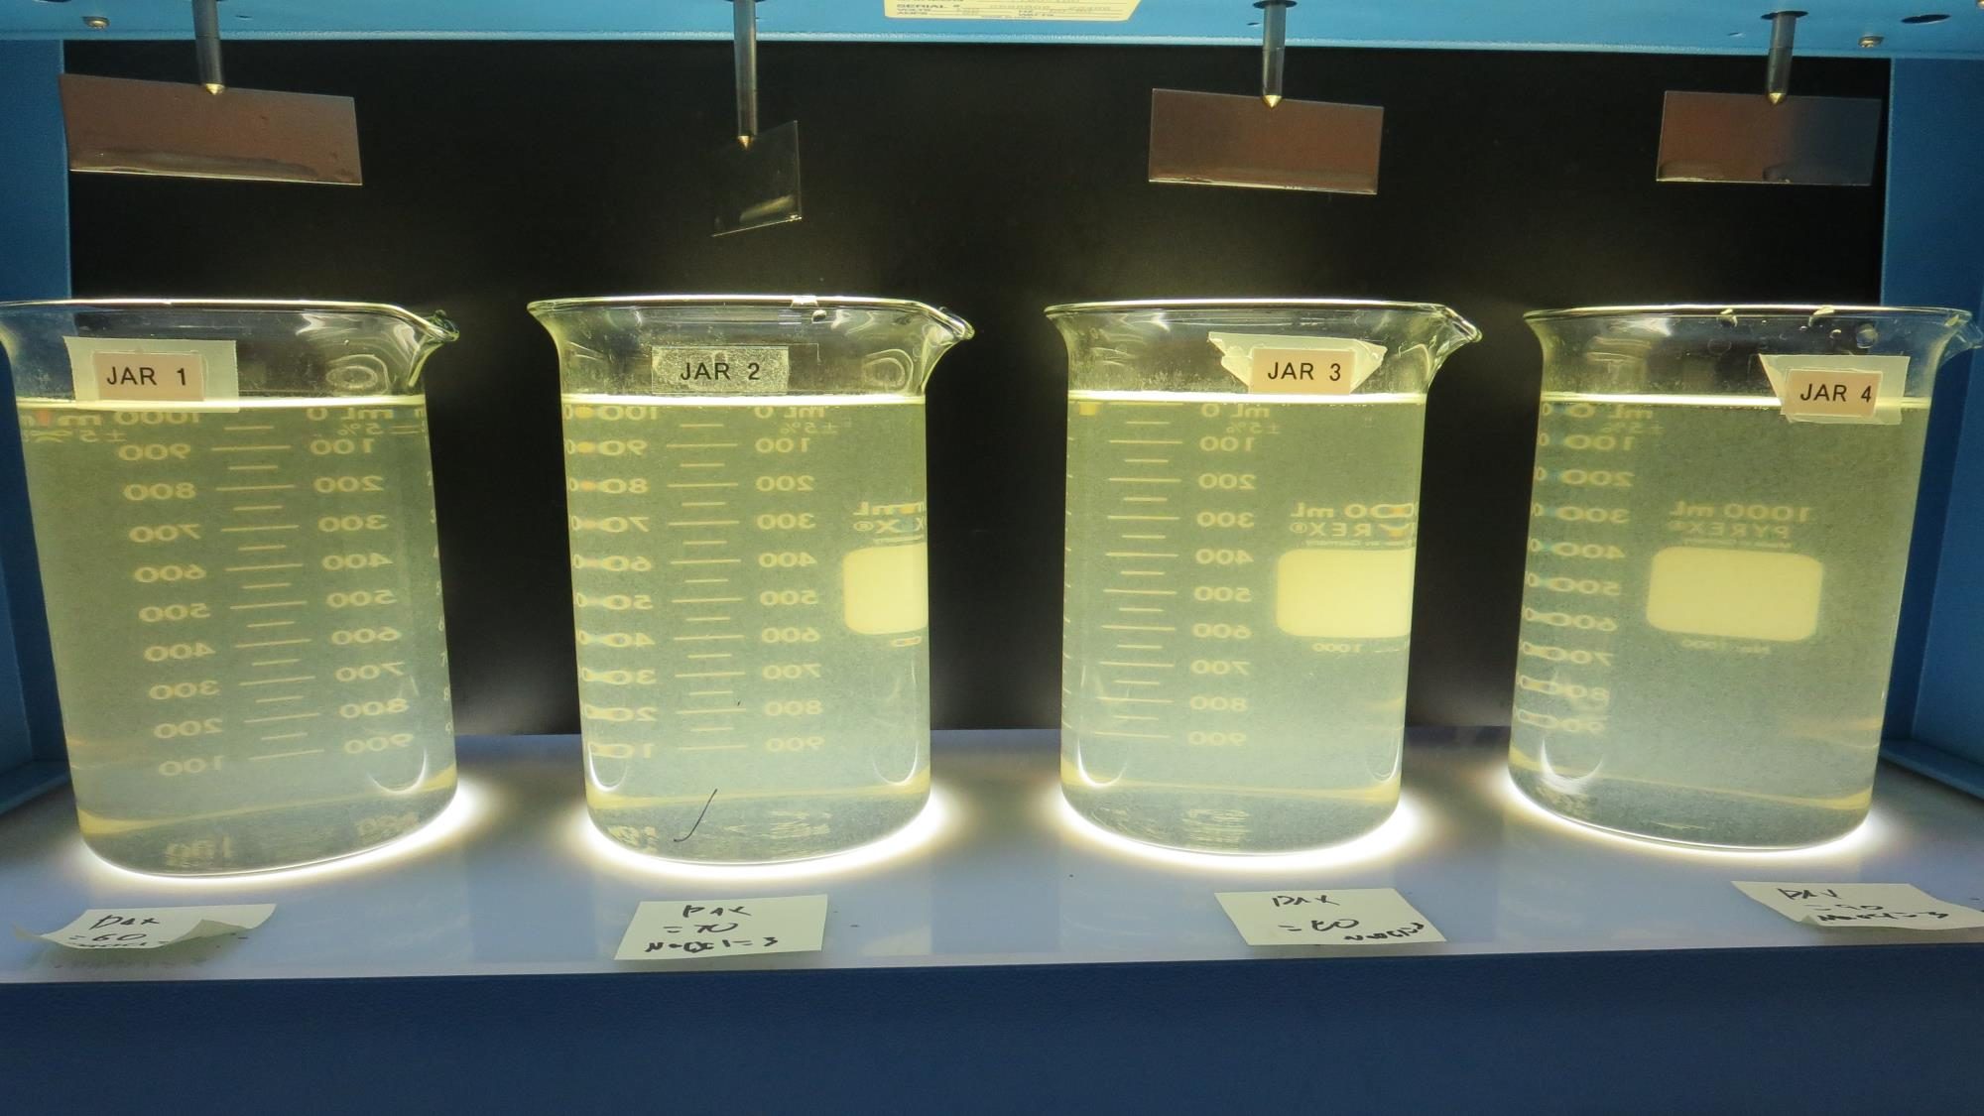
Jars 29-32: End of 5-minute flocculation (30 RPM) duration.
3 mg/L NaOCl
60 mg/L PAX-XL19
Filtrate - NTU
UVT: -%
UVA: -/cm
UVA Reduction -%
Settled: 7.0 NTU
3 mg/L NaOCl
60 mg/L PAX-XL19
Filtrate - NTU
UVT: -%
UVA: -/cm
UVA Reduction -%
Settled: 5.6 NTU
3 mg/L NaOCl
80 mg/L PAX-XL19
Filtrate 0.18 NTU
UVT: 92.6%
UVA: 0.033/cm
UVA Reduction 43.1%
Settled: 0.79 NTU
3 mg/L NaOCl
90 mg/L PAX-XL19
Filtrate 0.16 NTU
UVT: 92.8%
UVA: 0.033/cm
UVA Reduction 44.8%
Settled: 0.40 NTU

Slide 51
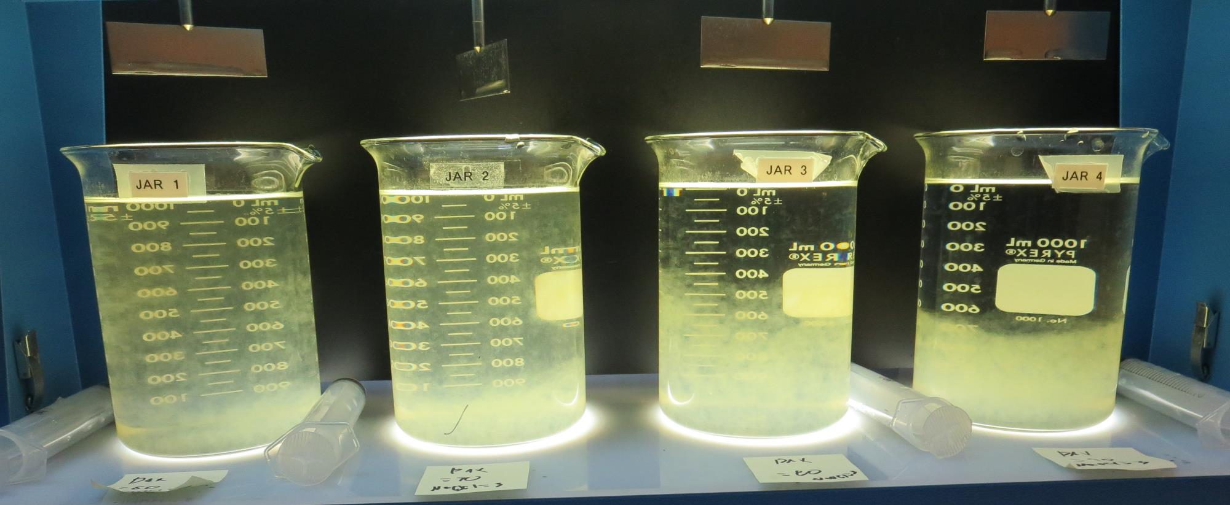
Jars 29-32: After 5 min of settling, 25 mL is syringed for filterability and %UVT/UVA.

Slide 52
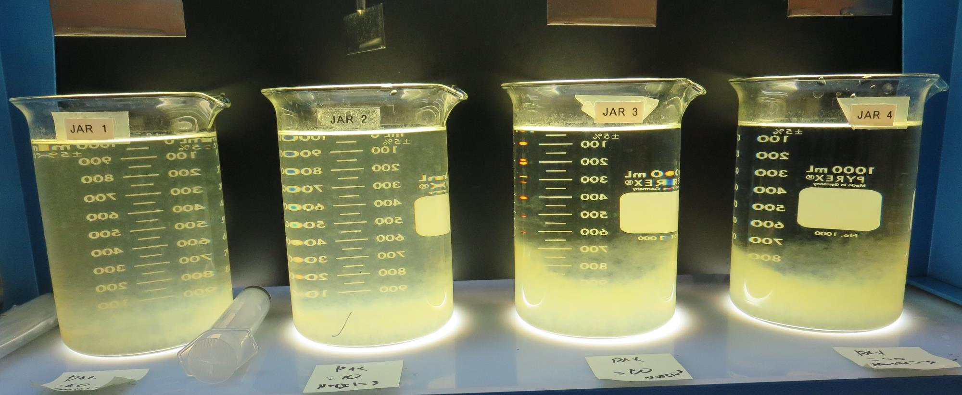
Jars 29-32: After 25-minutes of settling, settled water turbidity is taken.
3 mg/L NaOCl
60 mg/L PAX-XL19
Filtrate - NTU
UVT: -%
UVA: -/cm
UVA Reduction -%
Settled: 7.0 NTU
3 mg/L NaOCl
60 mg/L PAX-XL19
Filtrate - NTU
UVT: -%
UVA: -/cm
UVA Reduction -%
Settled: 5.6 NTU
3 mg/L NaOCl
80 mg/L PAX-XL19
Filtrate 0.18 NTU
UVT: 92.6%
UVA: 0.033/cm
UVA Reduction 43.1%
Settled: 0.79 NTU
3 mg/L NaOCl
90 mg/L PAX-XL19
Filtrate 0.16 NTU
UVT: 92.8%
UVA: 0.033/cm
UVA Reduction 44.8%
Settled: 0.40 NTU

Slide 53
Jars 33-36 Test Flash Mix 30 Sec (200 RPM) Floc Mix 5 min (30 RPM) Applied Acid (H₂SO₄) + Applied Coagulant PAX-XL-19

Slide 54
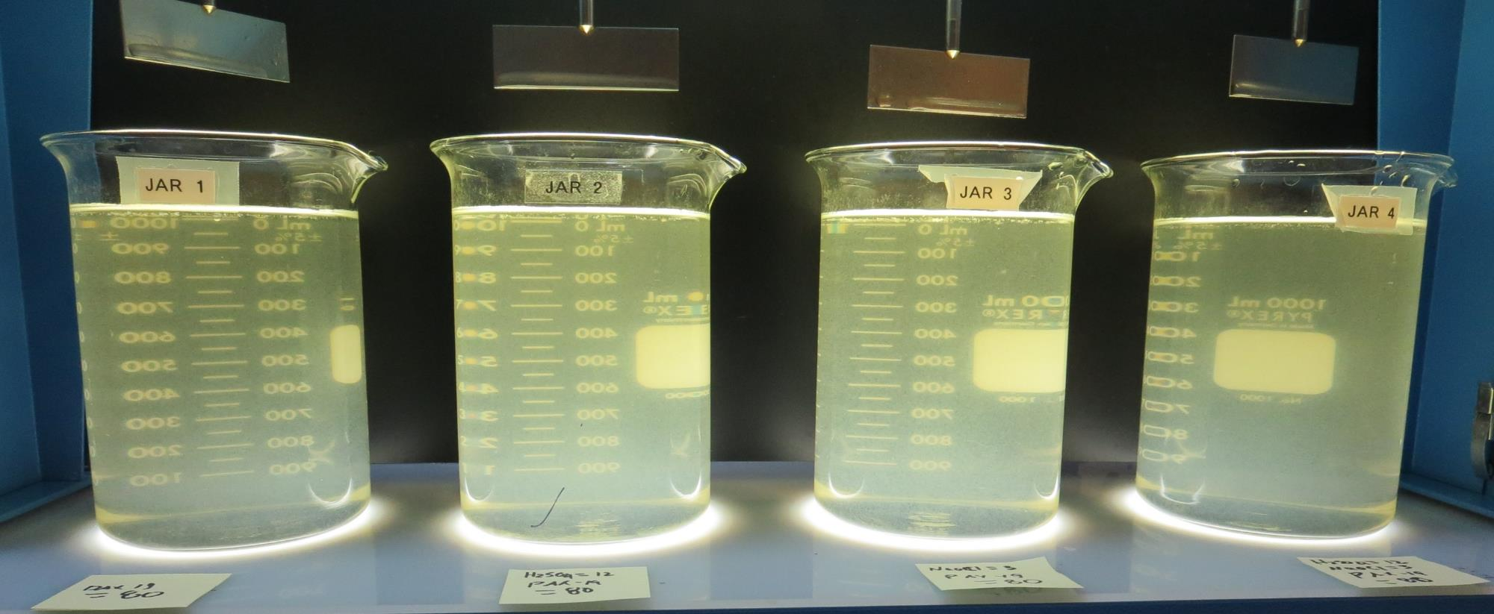
Jars 33-36: End of 5-minute flocculation (30 RPM) duration.
0 mg/L H₂SO₄
80 mg/L PAX-XL19
Filtrate 0.16 NTU
UVT: 93.0%
UVA: 0.031/cm
UVA Reduction 46.6%
Settled: 0.58 NTU
12 mg/L H₂SO₄
80 mg/L PAX-XL19
Filtrate 0.13 NTU
UVT: 93.4%
UVA: 0.029/cm
UVA Reduction 50.0%
Settled: 0.35 NTU
3 mg/L NaOCl
80 mg/L PAX-XL19
Filtrate 0.15 NTU
UVT: 93.2%
UVA: 0.030/cm
UVA Reduction 48.3%
Settled: 0.42 NTU
12 mg/L H₂SO₄
3 mg/L NaOCl
80 mg/L PAX-XL19
Filtrate 0.15 NTU
UVT: 93.7%
UVA: 0.028/cm
UVA Reduction 51.7%
Settled: 13.6 NTU

Slide 55
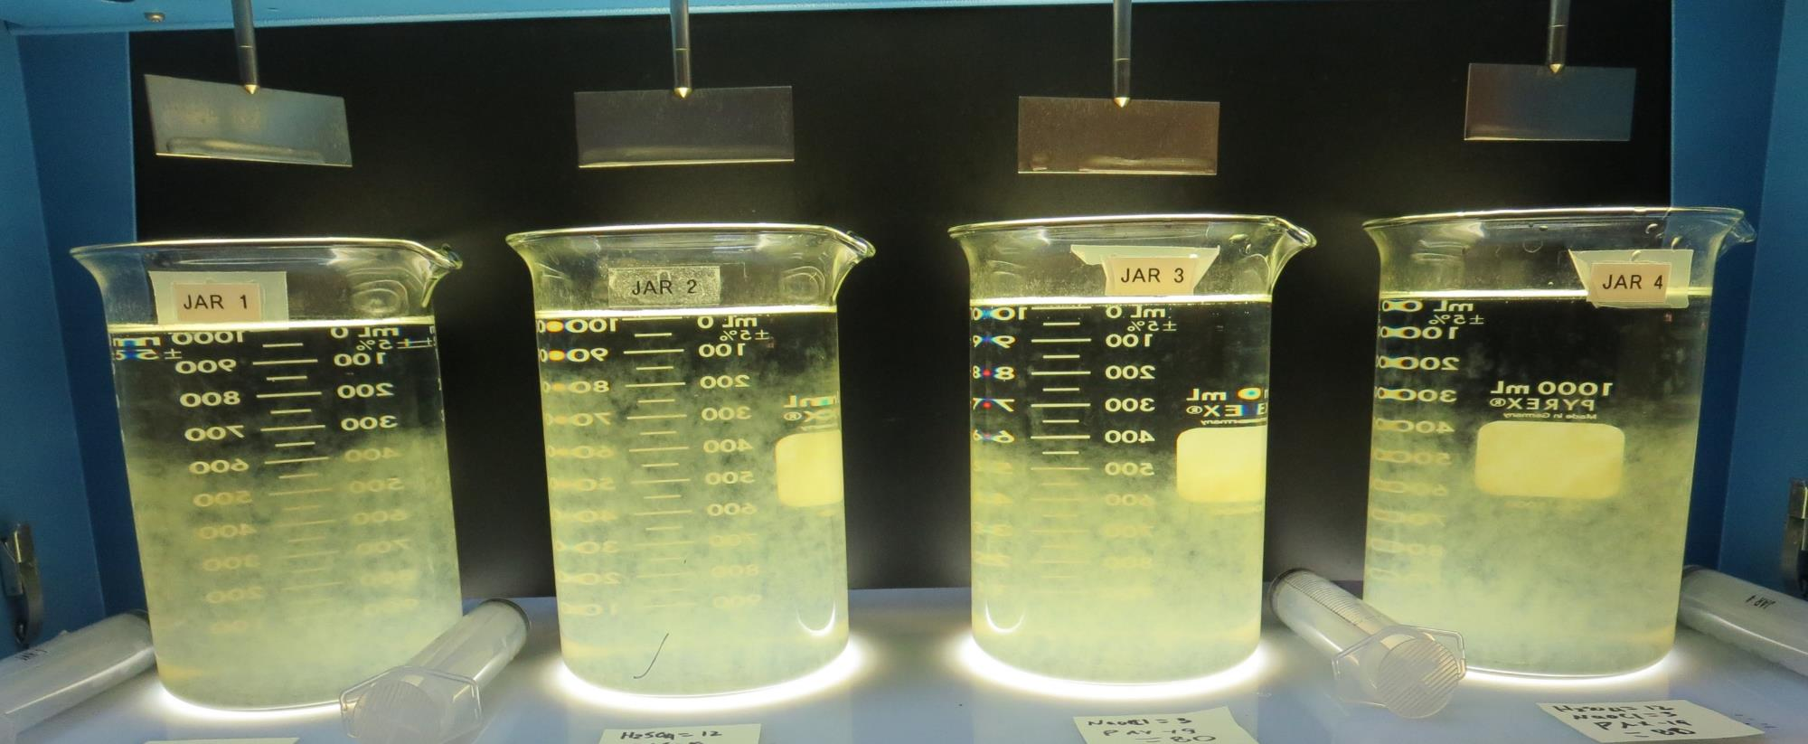
Jars 33-36: After 10 min of settling, 25 mL is syringed for filterability and %UVT/UVA.

Slide 56
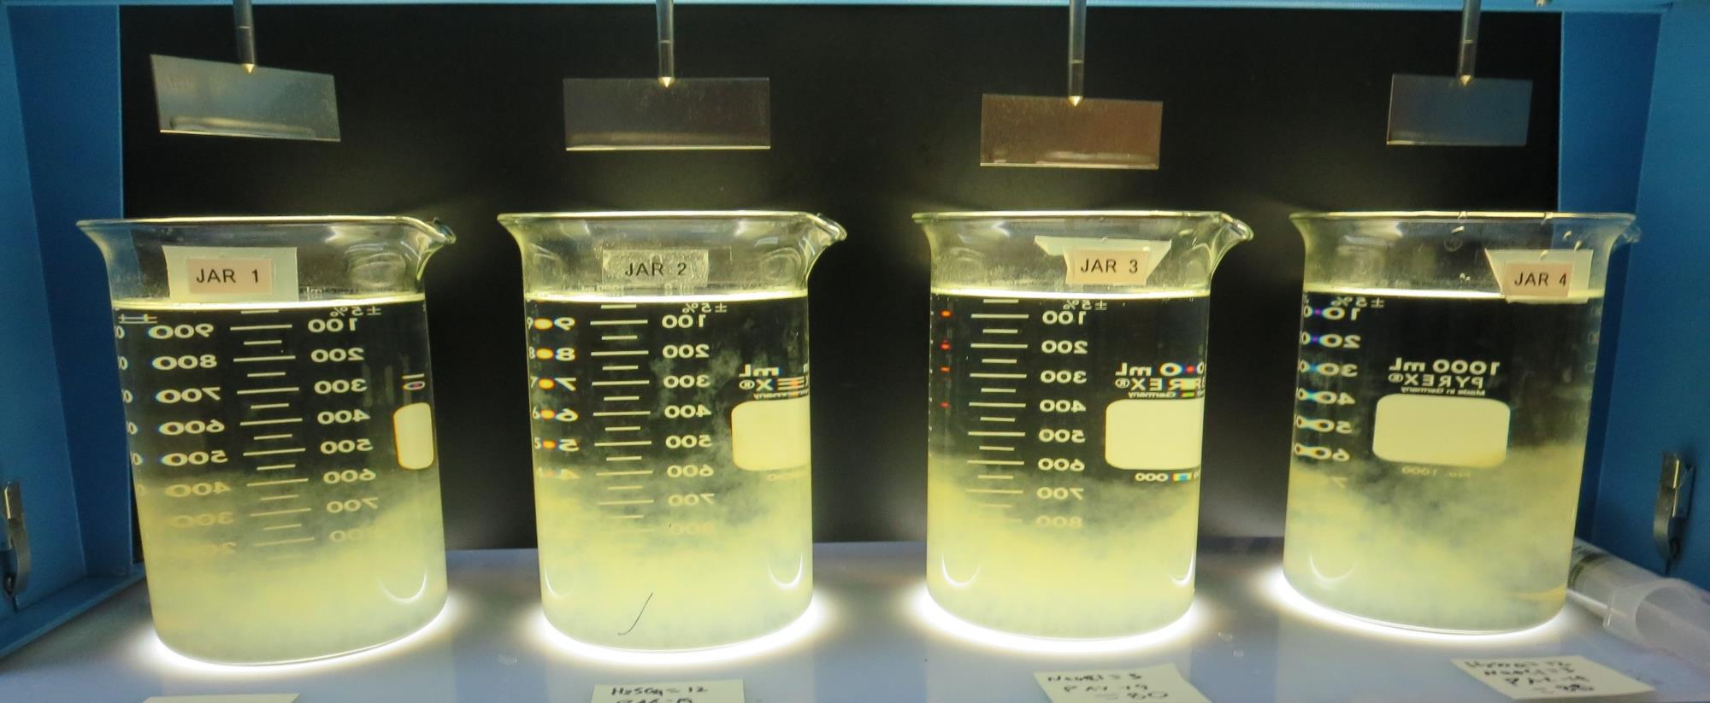
Jars 33-36: After 25-minutes of settling, settled water turbidity is taken.
0 mg/L H₂SO₄
80 mg/L PAX-XL19
Filtrate 0.16 NTU
UVT: 93.0%
UVA: 0.031/cm
UVA Reduction 46.6%
Settled: 0.58 NTU
12 mg/L H₂SO₄
80 mg/L PAX-XL19
Filtrate 0.13 NTU
UVT: 93.4%
UVA: 0.029/cm
UVA Reduction 50.0%
Settled: 0.35 NTU
3 mg/L NaOCl
80 mg/L PAX-XL19
Filtrate 0.15 NTU
UVT: 93.2%
UVA: 0.030/cm
UVA Reduction 48.3%
Settled: 0.42 NTU
12 mg/L H₂SO₄
3 mg/L NaOCl
80 mg/L PAX-XL19
Filtrate 0.15 NTU
UVT: 93.7%
UVA: 0.028/cm
UVA Reduction 51.7%
Settled: 13.6 NTU

Slide 57
Jars 37-40 Test Flash Mix 30 Sec (200 RPM) Floc Mix 5 min (30 RPM) Applied Acid (H₂SO₄) + Applied Coagulant PAX-XL-19

Slide 58
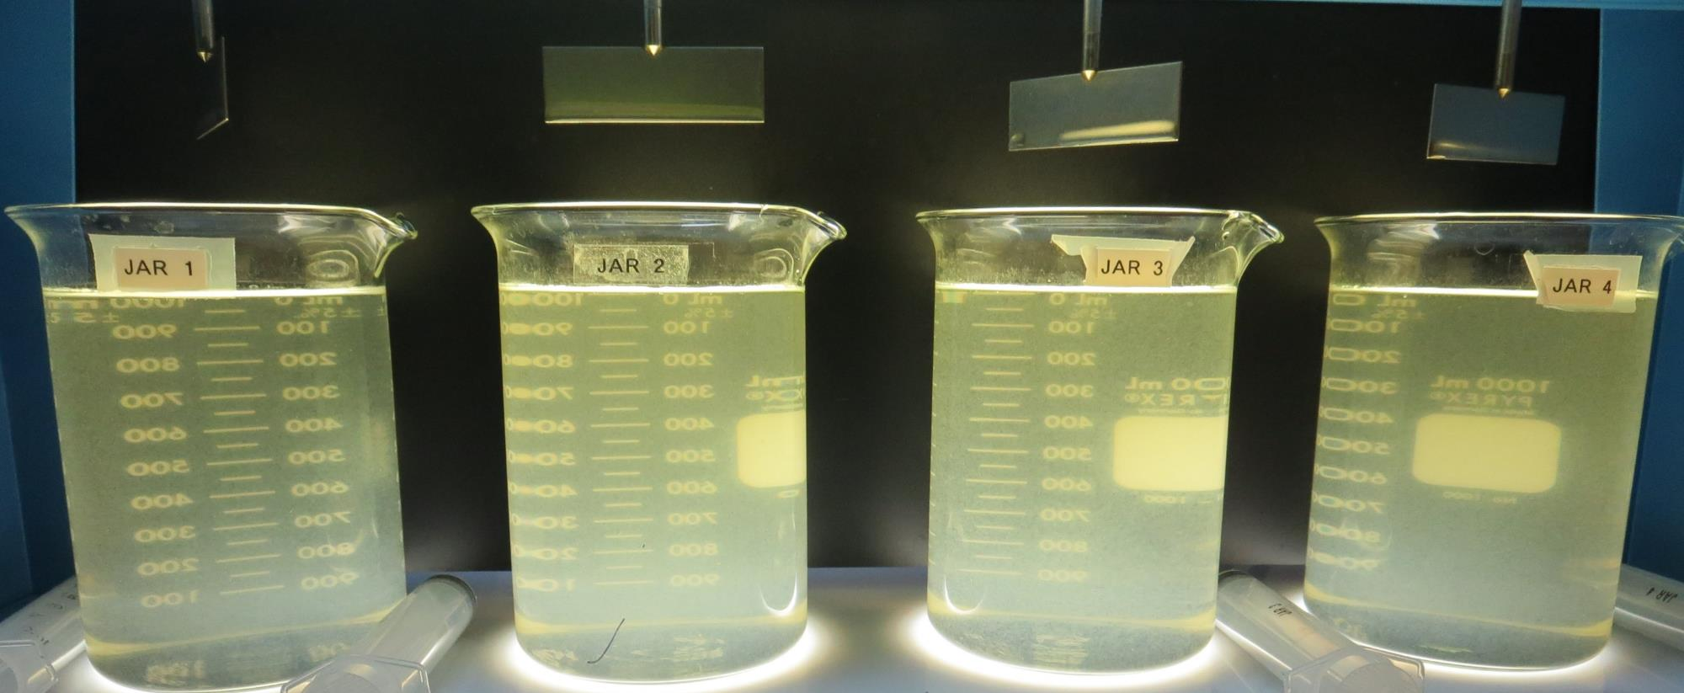
Jars 37-40: End of 5-minute flocculation (30 RPM) duration.
0 mg/L H₂SO₄
90 mg/L PAX-XL19
Filtrate 0.16 NTU
UVT: 93.3%
UVA: 0.030/cm
UVA Reduction 48.3%
Settled: 0.43 NTU
12 mg/L H₂SO₄
90 mg/L PAX-XL19
Filtrate 0.16 NTU
UVT: 93.4%
UVA: 0.029/cm
UVA Reduction 50.0%
Settled: 0.40 NTU
3 mg/L NaOCl
90 mg/L PAX-XL19
Filtrate 0.16 NTU
UVT: 93.2%
UVA: 0.030/cm
UVA Reduction 48.3%
Settled: 0.48 NTU
12 mg/L H₂SO₄
3 mg/L NaOCl
90 mg/L PAX-XL19
Filtrate 0.11 NTU
UVT: 93.8%
UVA: 0.027/cm
UVA Reduction 53.4%
Settled: 0.23 NTU

Slide 59
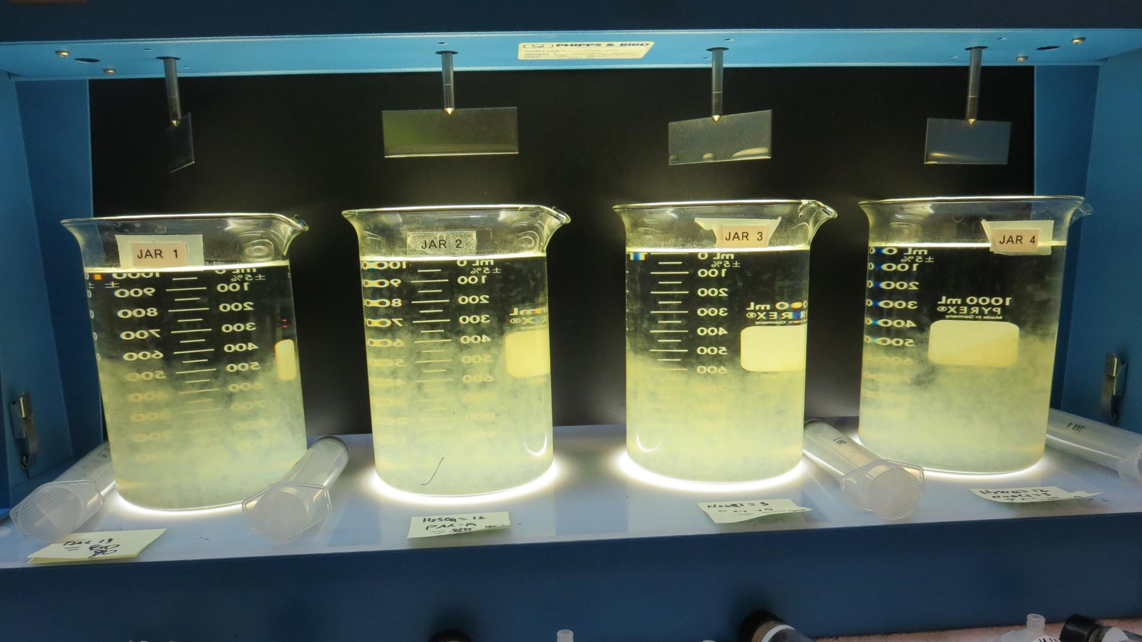
Jars 37-40: After 10 min of settling, 25 mL is syringed for filterability and %UVT/UVA.

Slide 60
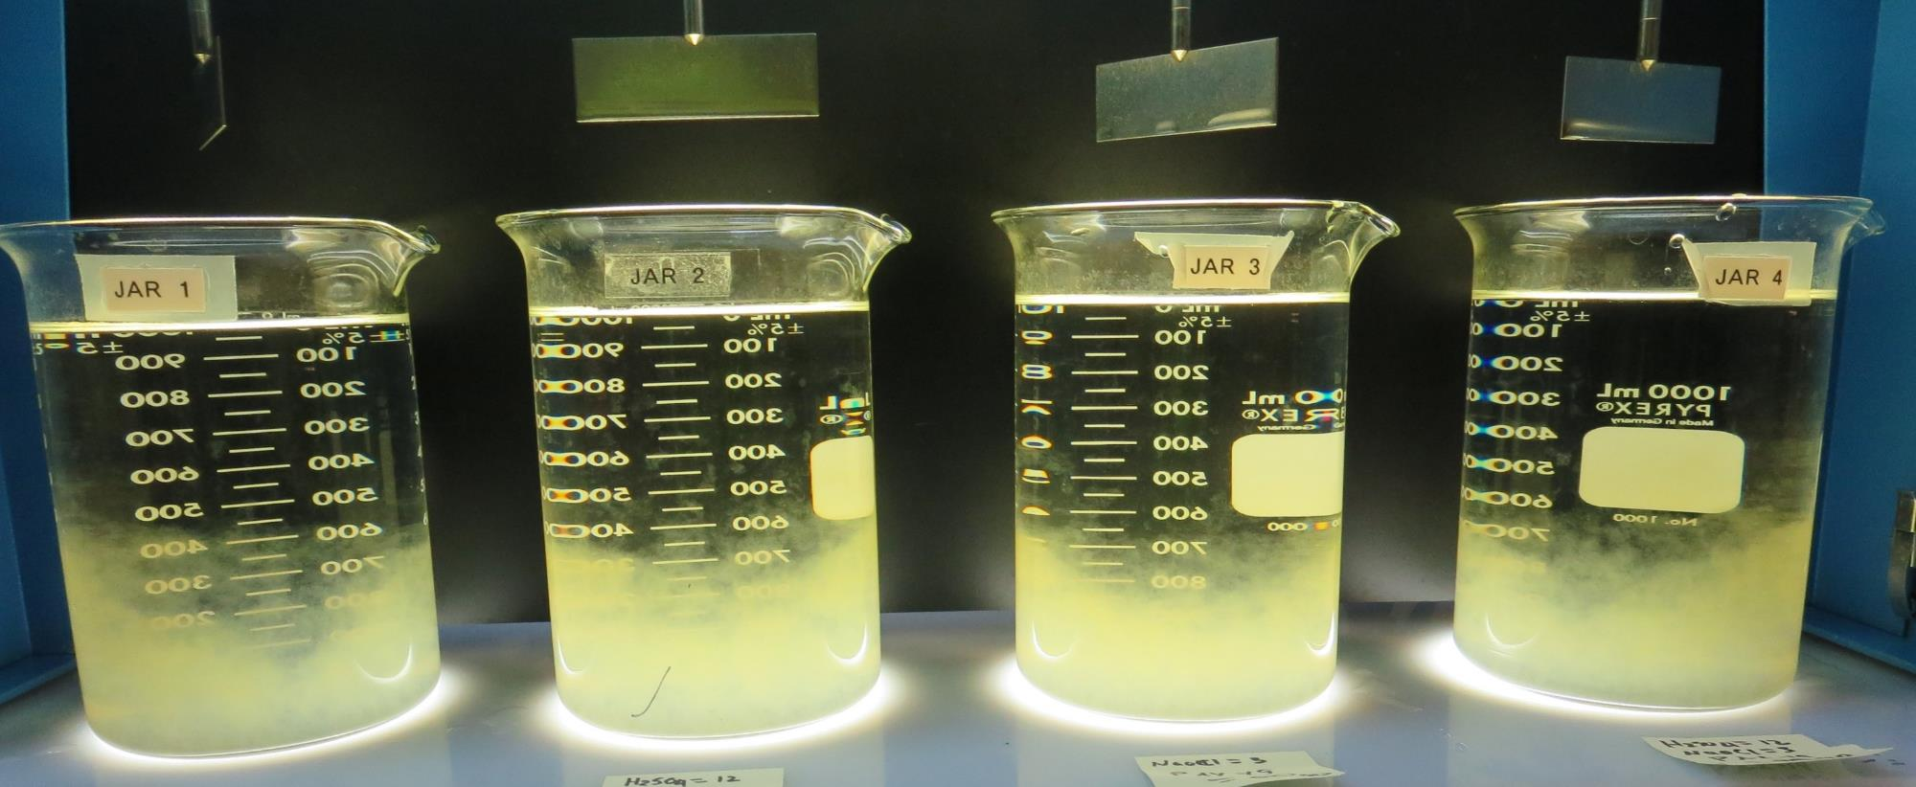
Jars 37-40: After 25-minutes of settling, settled water turbidity is taken.
0 mg/L H₂SO₄
90 mg/L PAX-XL19
Filtrate 0.16 NTU
UVT: 93.3%
UVA: 0.030/cm
UVA Reduction 48.3%
Settled: 0.43 NTU
12 mg/L H₂SO₄
90 mg/L PAX-XL19
Filtrate 0.16 NTU
UVT: 93.4%
UVA: 0.029/cm
UVA Reduction 50.0%
Settled: 0.40 NTU
3 mg/L NaOCl
90 mg/L PAX-XL19
Filtrate 0.16 NTU
UVT: 93.2%
UVA: 0.030/cm
UVA Reduction 48.3%
Settled: 0.48 NTU
12 mg/L H₂SO₄
3 mg/L NaOCl
90 mg/L PAX-XL19
Filtrate 0.11 NTU
UVT: 93.8%
UVA: 0.027/cm
UVA Reduction 53.4%
Settled: 0.23 NTU

Slide 61
Jars 41-44 Test Flash Mix 30 Sec (200 RPM) Floc Mix 5 min (30 RPM) Applied Acid (H₂SO₄) + Applied Coagulant PAX-XL-19

Slide 62
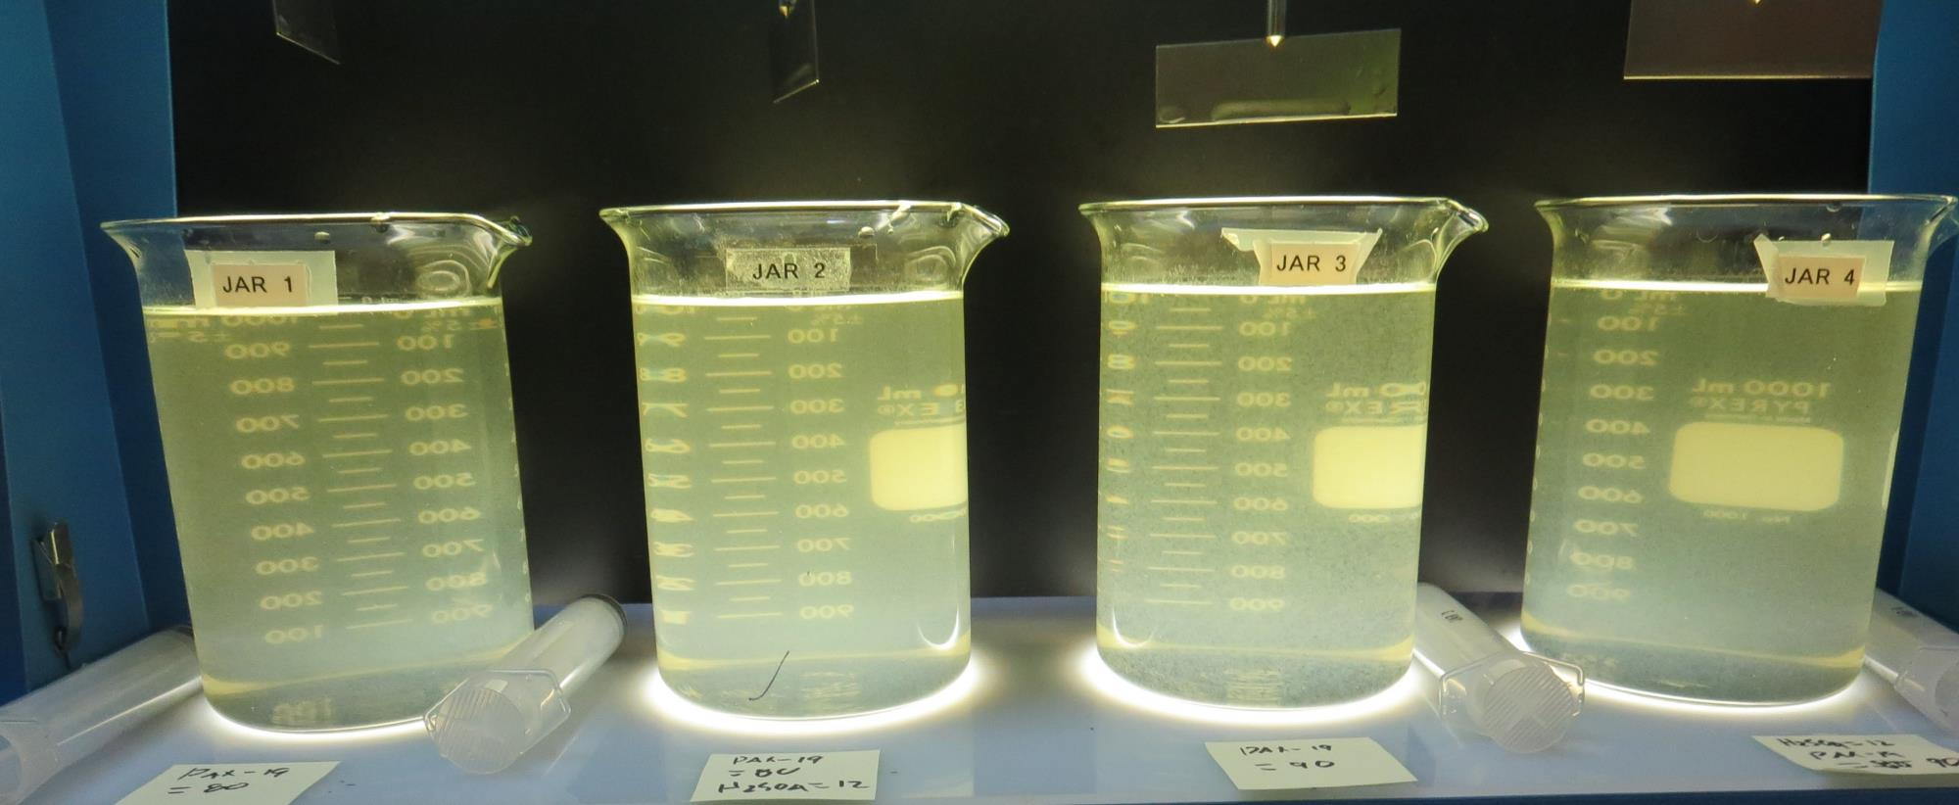
Jars 41-44: End of 5-minute flocculation (30 RPM) duration.
0 mg/L H₂SO₄
80 mg/L PAX-XL19
Filtrate 0.22 NTU
UVT: 92.8%
UVA: 0.032/cm
UVA Reduction 44.8%
Settled: 1.08 NTU
12 mg/L H₂SO₄
80 mg/L PAX-XL19
Filtrate 0.19 NTU
UVT: 93.4%
UVA: 0.029/cm
UVA Reduction 50.0%
Settled: 0.51 NTU
0 mg/L H₂SO₄
90 mg/L PAX-XL19
Filtrate 0.16 NTU
UVT: 93.3%
UVA: 0.029/cm
UVA Reduction 50.0%
Settled: 0.32 NTU
12 mg/L H₂SO₄
90 mg/L PAX-XL19
Filtrate 0.11 NTU
UVT: 93.8%
UVA: 0.027/cm
UVA Reduction 53.4%
Settled: 0.23 NTU

Slide 63
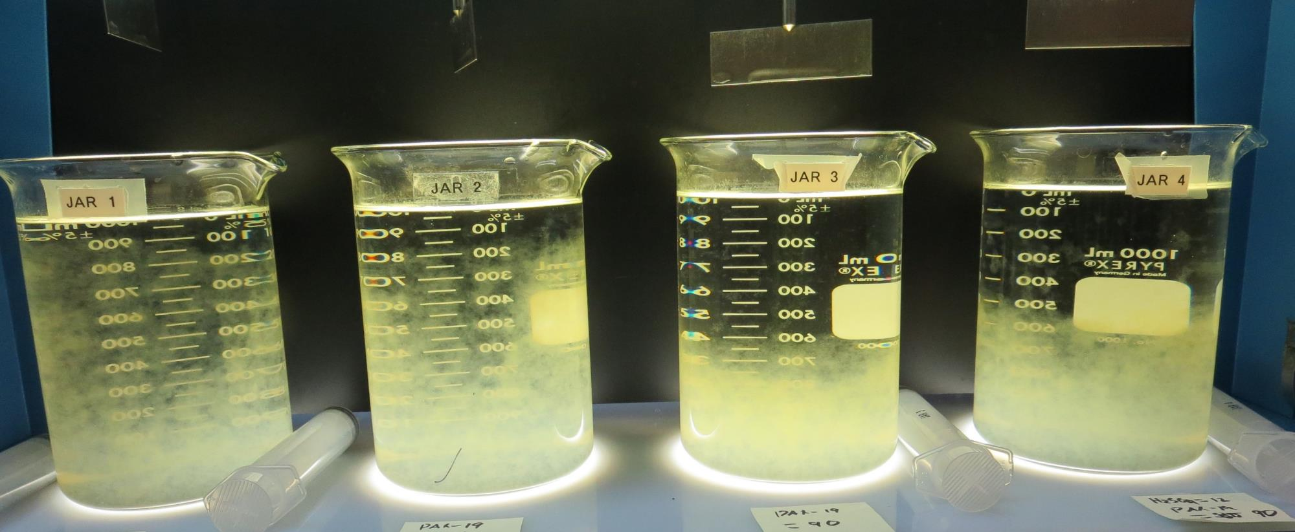
Jars 41-44: After 10 min of settling, 25 mL is syringed for filterability and %UVT/UVA.

Slide 64
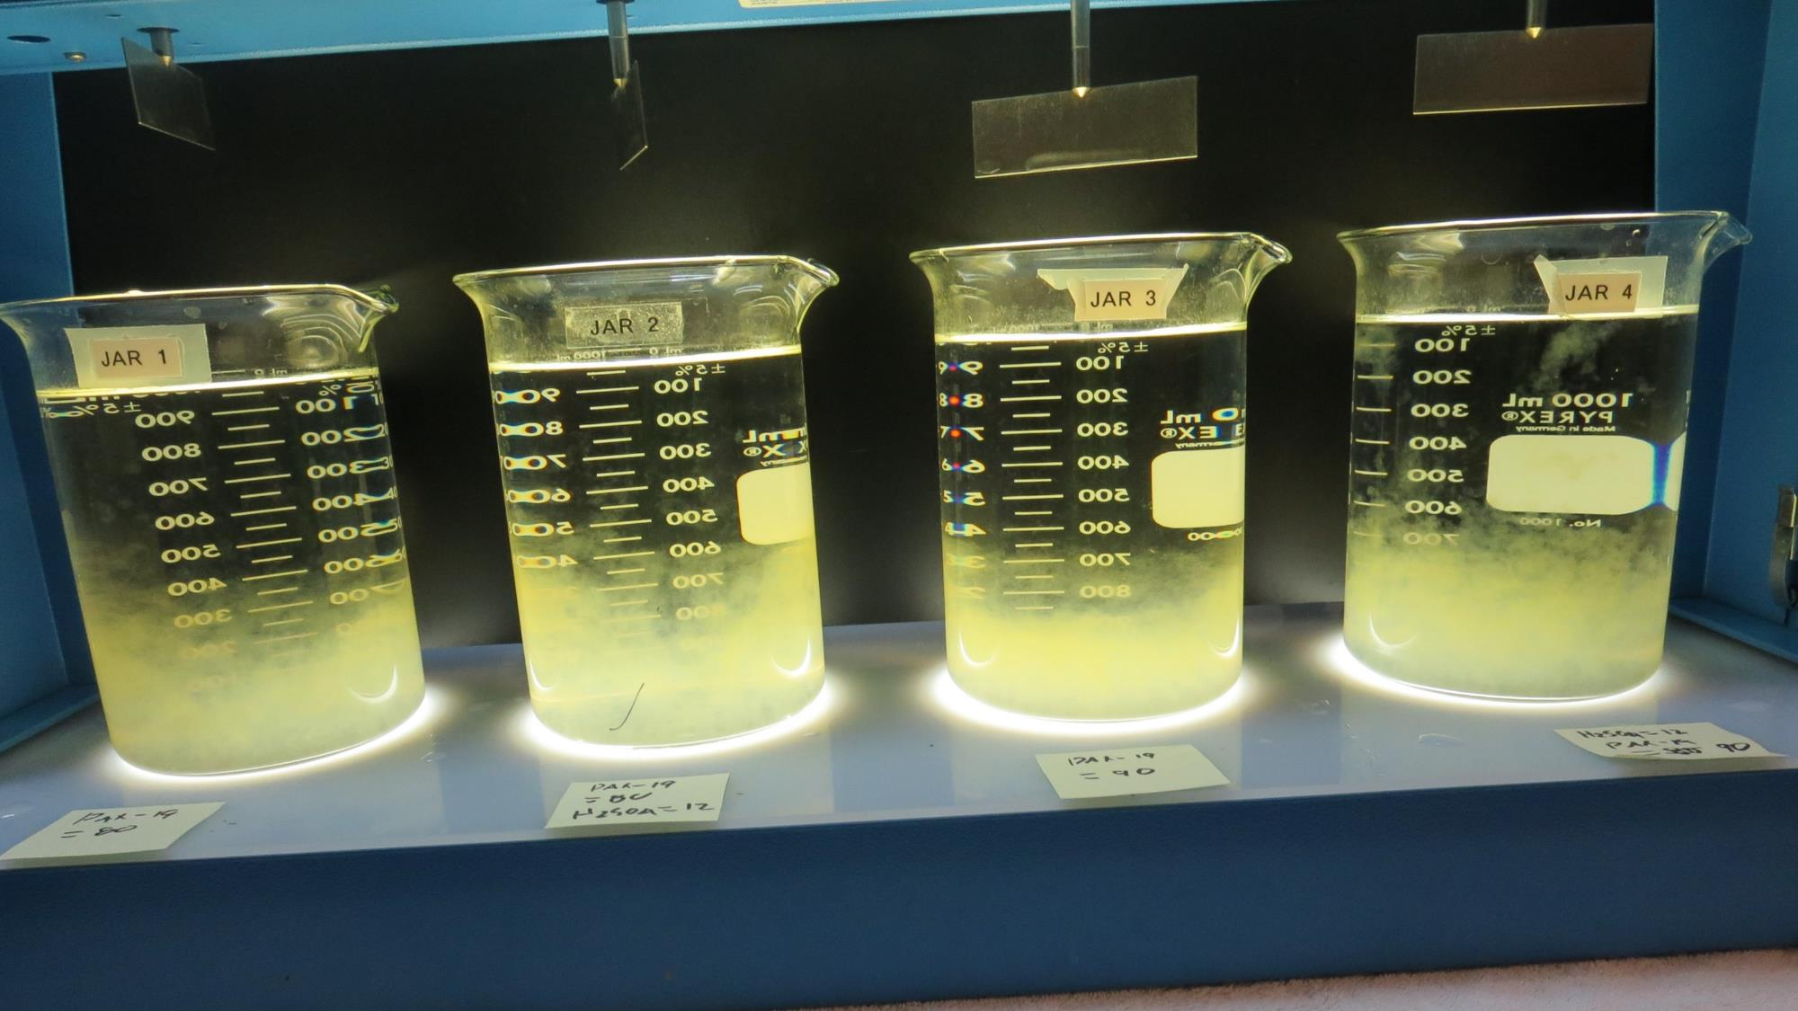
Jars 41-44: After 25-minutes of settling, settled water turbidity is taken.
0 mg/L H₂SO₄
80 mg/L PAX-XL19
Filtrate 0.22 NTU
UVT: 92.8%
UVA: 0.032/cm
UVA Reduction 44.8%
Settled: 1.08 NTU
12 mg/L H₂SO₄
80 mg/L PAX-XL19
Filtrate 0.19 NTU
UVT: 93.4%
UVA: 0.029/cm
UVA Reduction 50.0%
Settled: 0.51 NTU
0 mg/L H₂SO₄
90 mg/L PAX-XL19
Filtrate 0.16 NTU
UVT: 93.3%
UVA: 0.029/cm
UVA Reduction 50.0%
Settled: 0.32 NTU
12 mg/L H₂SO₄
90 mg/L PAX-XL19
Filtrate 0.11 NTU
UVT: 93.8%
UVA: 0.027/cm
UVA Reduction 53.4%
Settled: 0.23 NTU

Slide 65
Jar Testing for 1-Liter Jars: Procedures for Most Treatment Plants
Fill jars with source water prior to coagulant injection and set paddle speed at 30 rpm
Add chemicals (i.e., NaOCl, primary coagulant, coagulant aid) to each jar
Flash mix for 15-30 seconds (200 rpm)
Slow mix for 5 minutes (20-30 rpm)
Settled for 5 minutes. Syringe 25 mL from each jar taken 1-inch below surface (25 mL/12 sec rate)
Filtered through 1.2 um isopore membrane into cuvette drip rate, 15 mL/(50-90 sec)
Measure filtrate turbidity, chlorine residual and %UVT/UVA
Measure settled water turbidity after 25 minutes of total setting
Record all data

Slide 66
Jar Test Filterability Test Equipment
Turbidity Instrument
Syringe w/Luer-Lock Tip, 30 cc
(part#: 2225800, by Hach)
Swinnex Filter Holder, 25 mm (part#: SX0002500)
Isopore Membrane Filter, 1.2 um absolute
pore size,
Φ= 25 mm , thickness: 24 um,
hydrophilic polycarbonate membrane
(part #: RTTP02500)
Go to Sigma-Aldrich for laboratory supplies http://www.sigmaaldrich.com/united-states.html

Slide 67
Isopore Membrane Information
Categories | Information
trade name | Isopore
filter color | White
chemistry | Polycarbonate (PC)
water flow rate | Avg. 175 mL/min x cm² (typical results @ 10 psi)
media | Isopore®
wettability | Hydrophilic
porosity | 14.7%
pore size | 1.2 µm
bubble point at 23 °C | 1.0 bar, air with water
thickness | 24 µm
filter diameter (ø) | 25 mm
material size | polycarbonate, Hydrophilic, 1.2 µm, 25 mm, white, plain, 100

Slide 68
Isopore Membrane Background Information
The Isopore membrane is a polycarbonate, track-etched screen filter recommended for all analyses in which the sample is viewed on the surface of the membrane. The Isopore membrane is composed of polycarbonate film, which has a smooth, glass-like surface for clearer sample observation. The unique manufacturing process of the membrane ensures a precise pore diameter and a consistent pore size for accurate separation of samples by size. Matched-weight filters are not usually required because of low, constant tar and ash weights. Features & Benefits: Membrane structure retains particles on the surface, simplifying counting and analysis

Slide 69
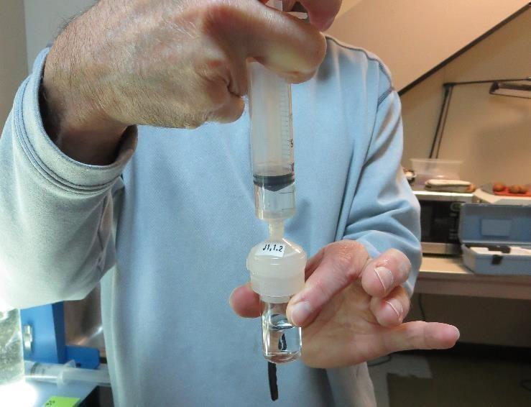
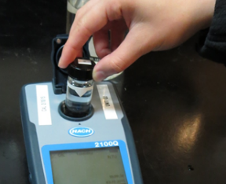
Jar Test - Filterability Test
Syringe ~ 25 mL from jar (after 5-minutes of settling)
Filter-to-waste 3-5 mL
Filter directly into clean cuvette
Measure turbidity
Note: Take several readings before recording final NTU results. Micro bubbles can adhere to glass causing false NTU readings. To remove bubbles, tilt cuvette up to 90 degrees.

Slide 70
Contact
Guy Schott, P.E.
State Water Resources Control Board
Division of Drinking Water
Santa Rosa, CA
Go to Stock Solution/Dose calculations/Jar Test Results for tools to download
www.waterboards.ca.gov/drinking_water/programs/districts/mendocino_district.html
Email: Guy Schott - Guy.Schott@waterboards.ca.gov
Office Number: 707-576-2732

