Slide 1
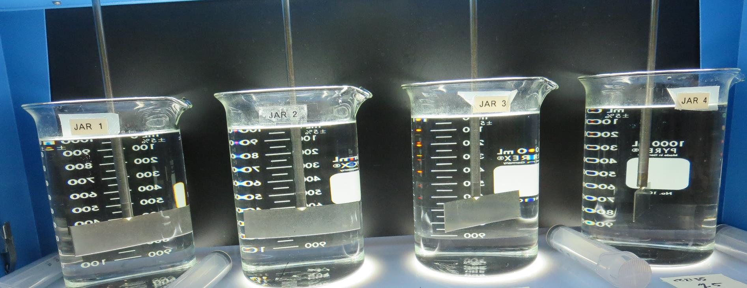
Orleans Mutual Water Company CA1200566, Humboldt County Inline Filtration Jar Test
by Guy Schott, P.E.
November 11, 2020

Slide 2
Orleans MWC, November 11, 2020 Source Water Characteristics
Source: Crawford Creek
pH: 8.0
Alkalinity: 61 mg/L as CaCO₃
Turbidity: 0.11 NTU
UVT: 97.9%
UVA: 0.008/cm
0.4 um Filtered
Turbidity: 0.08 NTU
UVT: 97.8%
UVA: 0.009/cm
Using the P200 UVT/UVA analyzer; calibrated with organic free water.

Slide 3
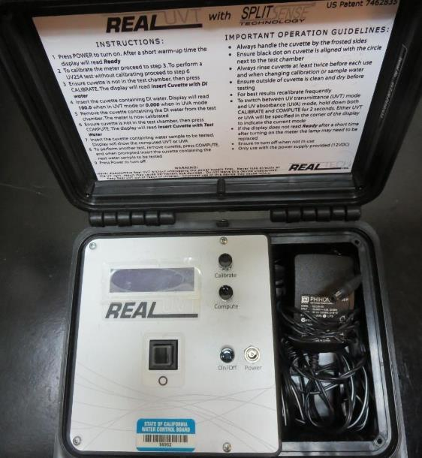
UVT/UVA, pathlength 10 mm
UV transmittance (UVT) is a measurement of the amount of ultraviolet light (commonly at 254 nm due to its germicidal effect) that passes through a water sample compared to the amount of light that passes through a pure water sample. The measurement is expressed as a percentage, % UVT.
%UVT = 10^{(-UVA)} x 100%
UV absorbance (UVA) is calculated as a relative measure of the amount of light absorbed by a water sample compared with the amount of light absorbed by a pure water sample.
UVA = -log(%UVT/100)

Slide 4
Applied Coagulants for Jar Testing
BWS, Inc.
Advanced Coagulant
AdvFloc-CTC-00011
Polyaluminum Chloride
12.55% Al₂O₃
64.9% Basicity
SG = 1.299
Max dose: 250 mg/L as product
Gregory F. Nieckarz, Ph.D.
Principal Consultant
SWS Consulting, LLC.
+1.541.953.5112
gregn.swsc@gmail.com
CalChem CC 2135
30-35% Aluminum Chlorohydrate
30-35% Water
35% polyamines (80% water, 20% active polyamines)
SG = 1.2-1.34
Max dose: 71 mg/L as product; equivalent to max dose 5 mg/L polyamines
Product dose 14.2 mgL = 1 mg/L polyamine

Slide 5
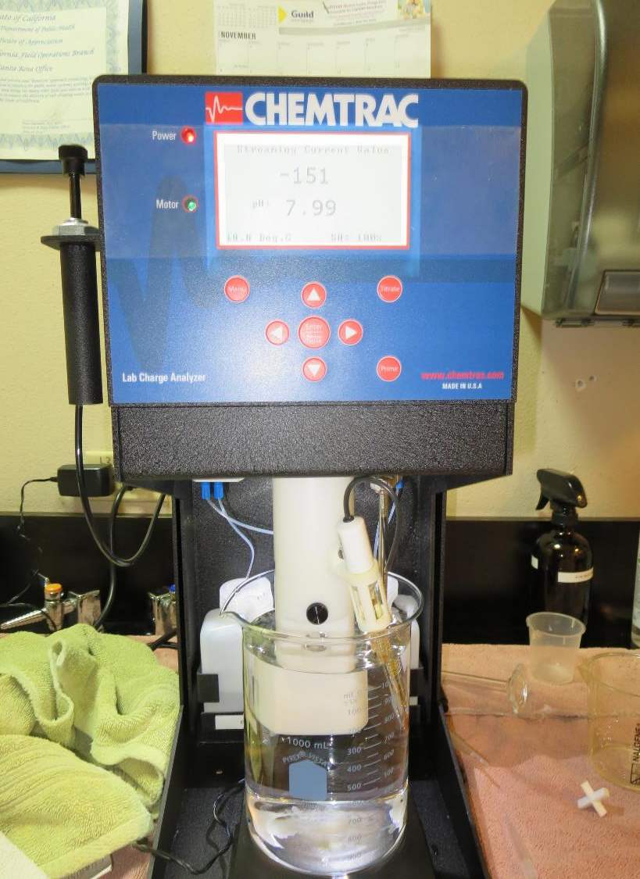
Laboratory Charge Analyzer
LCA: Used to determine coagulant demand of a source water entering the treatment plant.
pH adjusted to 7.5 with Acetic Acid
Source pH: 8.0
LCA #1:
CC 2135: 1.8 mg/L as product
LCA #2:
Adv Coagulant: 36 mg/L as product

Slide 6
Coagulant Information
Unless stated otherwise, all coagulant doses are reported as Product (100% strength).
Preparation of coagulant stock solutions are generally 1.0 or 0.1 percent strength using 100 and/or 200 mL volumetric flasks.
Finnpipette F2 variable volume pipette, capacity 100-1000 micro liters is used for stock solution preparation and coagulant aid jar test dosing.
Finnpipette F2 variable volume pipette, capacity 0.5-5 mL is used for primary coagulant jar test dosing.

Slide 7
Orleans MWC: Jar Test 1-8 Results Source: Crawford Creek
Jar # | 200 RPM Flash Mix Duration seconds | 10 RPM Floc Mix seconds | CC 2135 mg/L | Filtrate NTU | Filtrate %UVT | Filtrate UVA/cm | %UVA Reduction
J1 | 20 | 120 | 1.0 | 0.08 | 98.4 | 0.006 | 25.0
J2 | 20 | 120 | 1.5 | 0.14 | 98.0 | 0.008 | 0
J3 | 20 | 120 | 2.0 | 0.15 | 97.6 | 0.010 | 0
J4 | 20 | 120 | 2.5 | 0.15 | 97.6 | 0.010 | 0
J5 | 20 | 120 | 0.6 | 0.13 | 98.0 | 0.008 | 0
J6 | 20 | 120 | 0.8 | 0.09 | 98.3 | 0.007 | 12.5
J7 | 20 | 120 | 1.0 | 0.09 | 98.5 | 0.006 | 25.0
J8 | 20 | 120 | 1.2 | 0.14 | 98.1 | 0.008 | 0

Slide 8
Orleans MWC: Jar Test 9-16 Results Source: Crawford Creek
Jar # | 200 RPM Flash Mix Duration seconds | 10 RPM Floc Mix seconds | Adv Coag. mg/L | Filtrate NTU | Filtrate %UVT | Filtrate UVA/cm | %UVA Reduction
J9 | 20 | 120 | 20 | 0.12 | 98.9 | 0.004 | 50.0
J10 | 20 | 120 | 25 | 0.10 | 98.9 | 0.004 | 50.0
J11 | 20 | 120 | 30 | 0.11 | 98.9 | 0.004 | 50.0
J12 | 20 | 120 | 35 | 0.09 | 99.1 | 0.003 | 62.5
J13 | 20 | 120 | 10 | 0.08 | 98.9 | 0.004 | 50.0
J14 | 20 | 120 | 15 | 0.11 | 98.6 | 0.006 | 25.0
J15 | 20 | 120 | 35 | 0.07 | 99.2 | 0.003 | 62.5
J16 | 20 | 120 | 40 | 0.10 | 99.1 | 0.003 | 62.5

Slide 9
Orleans MWC: Jar Test 17-24 Results Source: Crawford Creek; Flash Mix 200 RPM (120 seconds)
Jar # | 10 RPM Floc Mix seconds | CC 2135 mg/L | Adv Coag. mg/L | Filtrate NTU | Filtrate %UVT | Filtrate UVA/cm | %UVA Reduction
J17 | 120 | 0 | 4 | 0.13 | 97.3 | 0.011 | 0
J18 | 120 | 0 | 6 | 0.12 | 97.5 | 0.011 | 0
J19 | 120 | 0 | 8 | 0.12 | 97.6 | 0.010 | 0
J20 | 120 | 0 | 10 | 0.13 | 97.4 | 0.011 | 0
J21 | 120 | 0 | 20 | 0.13 | 98.4 | 0.007 | 12.5
J22 | 120 | 0 | 25 | 0.09 | 98.3 | 0.007 | 12.5
J23 | 120 | 0 | 35 | 0.09 | 98.5 | 0.006 | 25.0
J24 | 120 | 1.0 | 0 | - | 98.0 | 0.008 | 0

Slide 10
Orleans MWC: Jar Test 25-28 Results Source: Crawford Creek
Jar # | 200 RPM Flash Mix Duration seconds | 10 RPM Floc Mix seconds | Adv Coag. mg/L | Filtrate NTU | Filtrate %UVT | Filtrate UVA/cm | %UVA Reduction
J25 | 20 | 0 | 25 | 0.08 | 98.6 | 0.006 | 25.0
J26 | 20 | 0 | 35 | 0.08 | 98.4 | 0.006 | 25.0
J27 | 20 | 120 | 35 | 0.08 | 98.5 | 0.006 | 25.0
J28 | 0 | 120 | 35 | 0.10 | 98.4 | 0.006 | 25.0

Slide 11
Orleans MWC: Jar Test 29-32 Results Source: Crawford Creek
Jar # | 200 RPM Flash Mix Duration seconds | 10 RPM Floc Mix seconds | CC 2135 mg/L | Filtrate NTU | Filtrate %UVT | Filtrate UVA/cm | %UVA Reduction
J25 | 20 | 0 | 0.8 | 0.11 | 98.0 | 0.008 | 0
J26 | 20 | 0 | 1.0 | 0.15 | 97.8 | 0.009 | 0
J27 | 20 | 120 | 1.0 | 0.15 | 97.8 | 0.009 | 0
J28 | 0 | 120 | 1.0 | 0.15 | 97.7 | 0.009 | 0

Slide 12
Jar Testing for 1-Liter Jars: Procedures for Most Treatment Plants
Fill jars with source water prior to coagulant injection and set paddle speed at 30 rpm
Add chemicals (i.e., NaOCl, primary coagulant, coagulant aid) to each jar
Flash mix for 15-30 seconds (200 rpm)
Slow mix for 5 minutes (20-30 rpm)
Settled for 5 minutes. Syringe 25 mL from each jar taken 1-inch below surface (25 mL/12 sec rate). For this study, 25 mL was taken at end of floc period.
Filtered through 1.2 um isopore membrane into cuvette drip rate, 15 mL/(50-90 sec)
Measure filtrate turbidity, chlorine residual and %UVT/UVA
Measure settled water turbidity after 25 minutes of total setting
Record all data

Slide 13
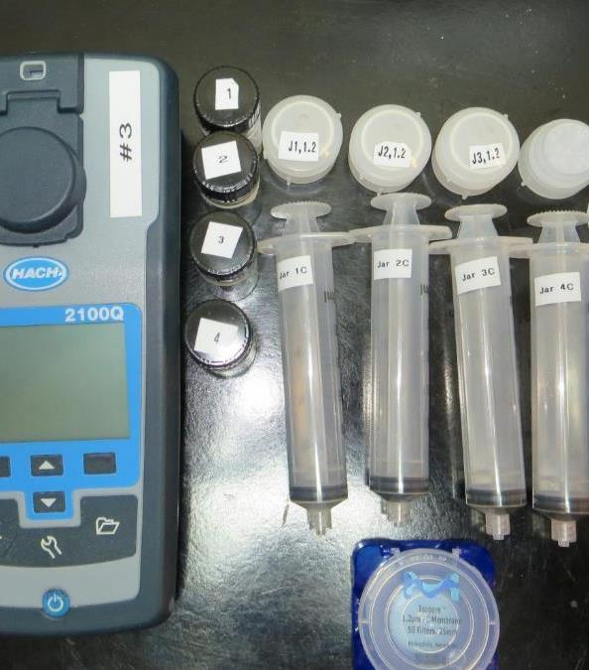
Jar Test Filterability Test Equipment
Turbidity Instrument
Syringe w/Luer-Lock Tip, 30 cc
(part#: 2225800, by Hach)
Swinnex Filter Holder, 25 mm (part#: SX0002500)
Isopore Membrane Filter, 1.2 um absolute
pore size,
Φ= 25 mm , thickness: 24 um,
hydrophilic polycarbonate membrane
(part #: RTTP02500)
Go to Sigma-Aldrich for laboratory supplies http://www.sigmaaldrich.com/united-states.html

Slide 14
Isopore Membrane Information
Categories | Information
trade name | Isopore
filter color | White
chemistry | Polycarbonate (PC)
water flow rate | Avg. 175 mL/min x cm² (typical results @ 10 psi)
media | Isopore®
wettability | Hydrophilic
porosity | 14.7%
pore size | 1.2 µm
bubble point at 23 °C | 1.0 bar, air with water
thickness | 24 µm
filter diameter (ø) | 25 mm
material size | polycarbonate, Hydrophilic, 1.2 µm, 25 mm, white, plain, 100

Slide 15
Isopore Membrane Background Information
The Isopore membrane is a polycarbonate, track-etched screen filter recommended for all analyses in which the sample is viewed on the surface of the membrane. The Isopore membrane is composed of polycarbonate film, which has a smooth, glass-like surface for clearer sample observation. The unique manufacturing process of the membrane ensures a precise pore diameter and a consistent pore size for accurate separation of samples by size. Matched-weight filters are not usually required because of low, constant tar and ash weights. Features & Benefits: Membrane structure retains particles on the surface, simplifying counting and analysis

Slide 16
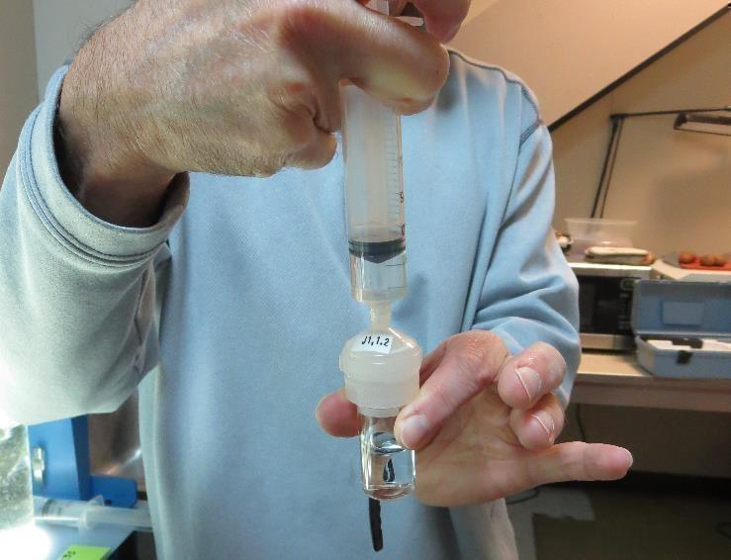
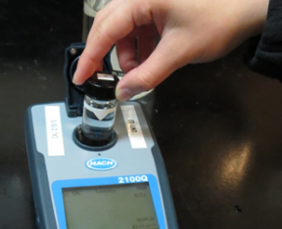
Jar Test - Filterability Test
Syringe ~ 25 mL from jar (after 5-minutes of settling)
Filter-to-waste 3-5 mL
Filter directly into clean cuvette
Measure turbidity
Note: Take several readings before recording final NTU results. Micro bubbles can adhere to glass causing false NTU readings. To remove bubbles, tilt cuvette up to 90 degrees.

Slide 17
Contact
Guy Schott, P.E.
State Water Resources Control Board
Division of Drinking Water
Santa Rosa, CA
Go to Stock Solution/Dose calculations/Jar Test Results for tools to download
www.waterboards.ca.gov/drinking_water/programs/districts/mendocino_district.html
Email: Guy Schott - Guy.Schott@waterboards.ca.gov
Office Number: 707-576-2732

